Slide 1
Geoscientific data analysis using UNIX and GMT
7/7: 3-D visualization and
other tools
Thorsten Becker
The University of Texas at Austin
April 2021

Slide 2
Visualization: 3-D
Licensed (expensive)
  Matlab
  IDL (not so good)
Free software with available source code:
  paraview: VTK based parallel tool
  GMT
  Octave: like matlab, sort of
  Python, matplotlib
I recommend paraview, python/matplotlib, and gnuplot
There is plenty of stuff around (don't write your own)

Slide 3
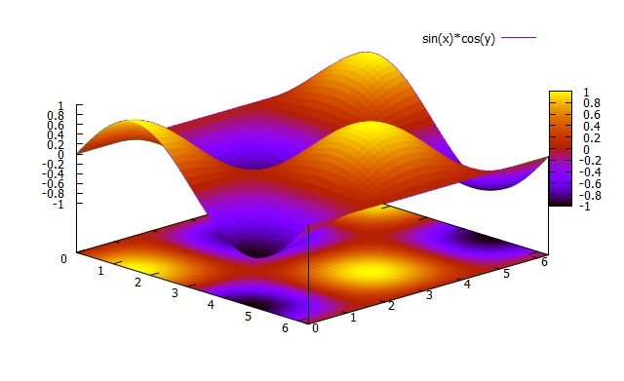
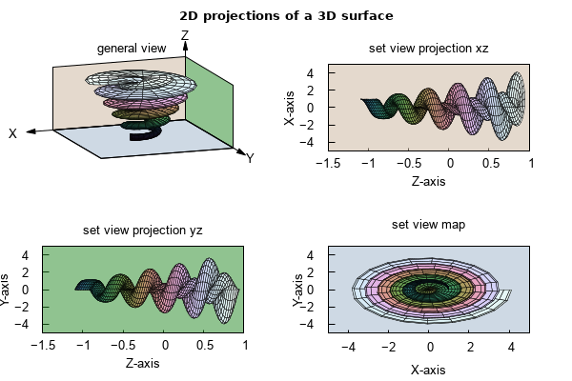
Gnuplot for 3-D

Slide 4
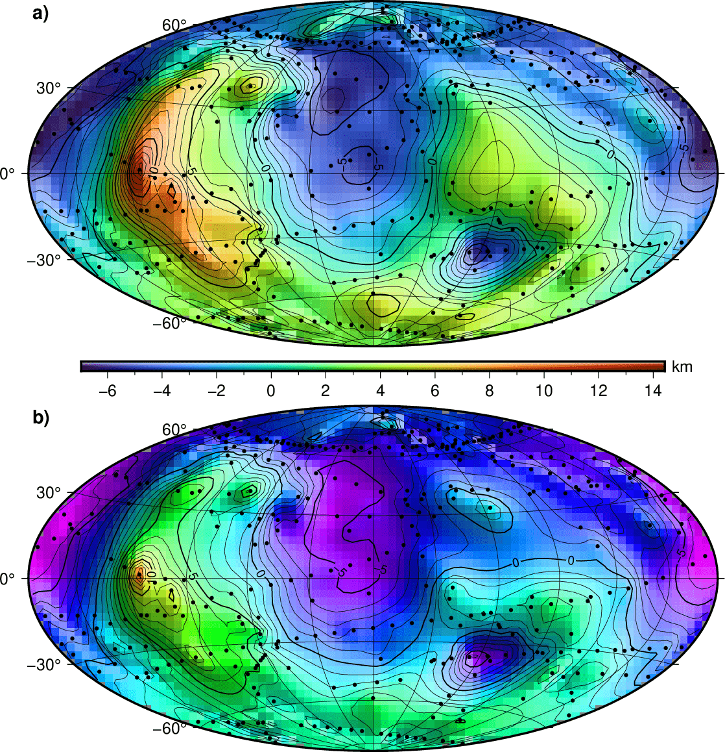
GMT for 3-D shading with gradient

Slide 5
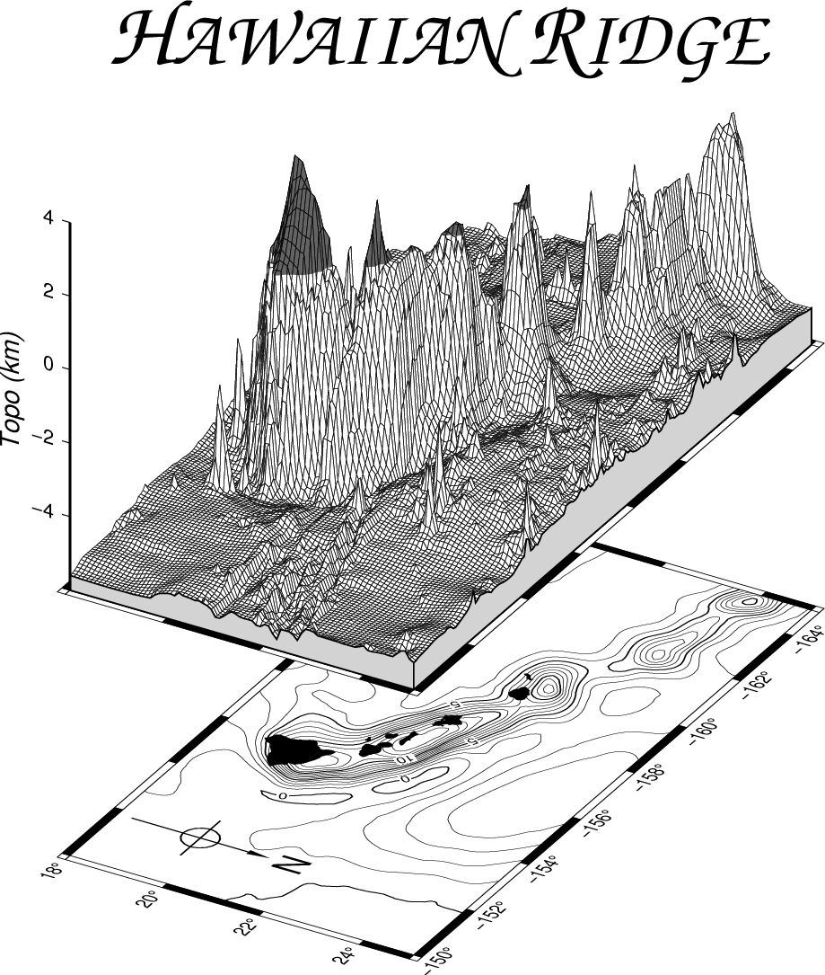
GMT for 3-D perspectives

Slide 6
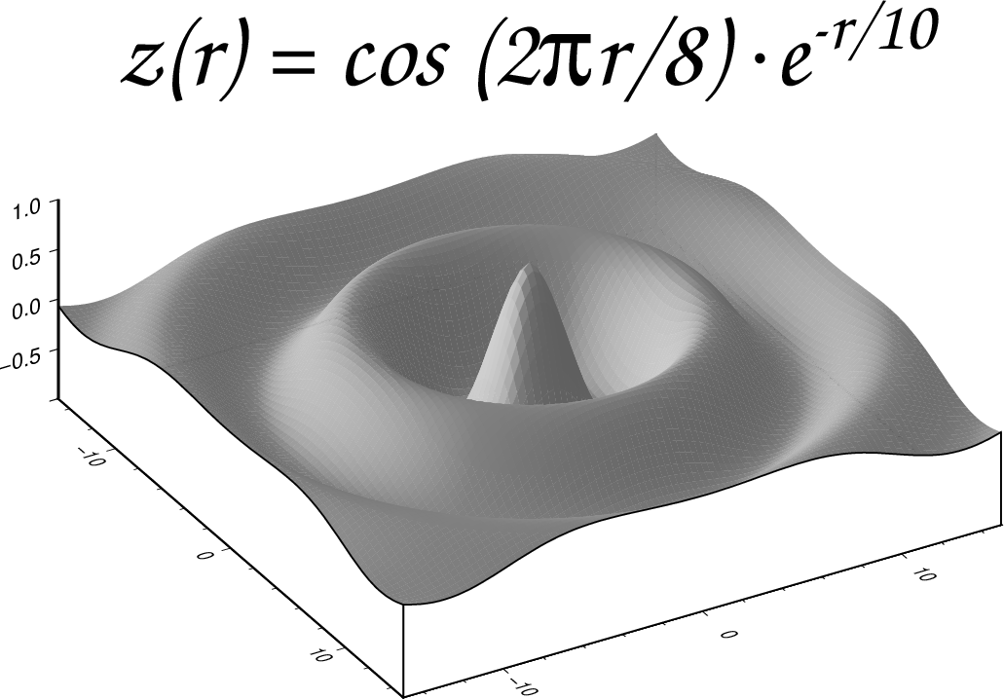
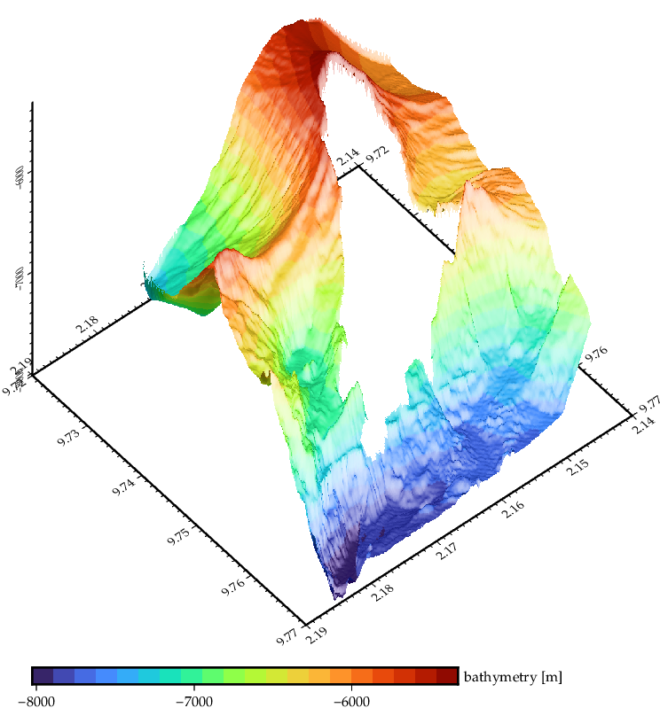
GMT for 3-D perspectives

Slide 7
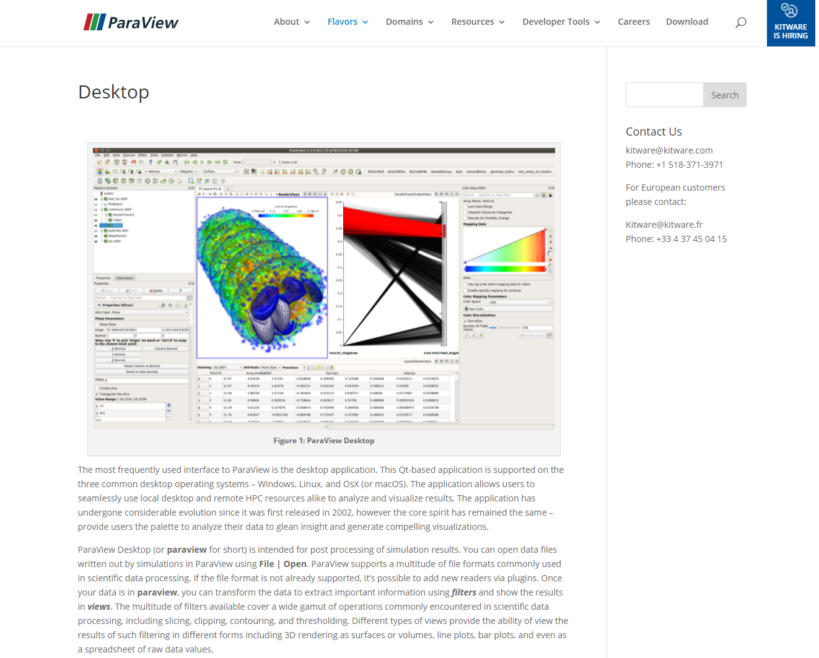

Slide 8
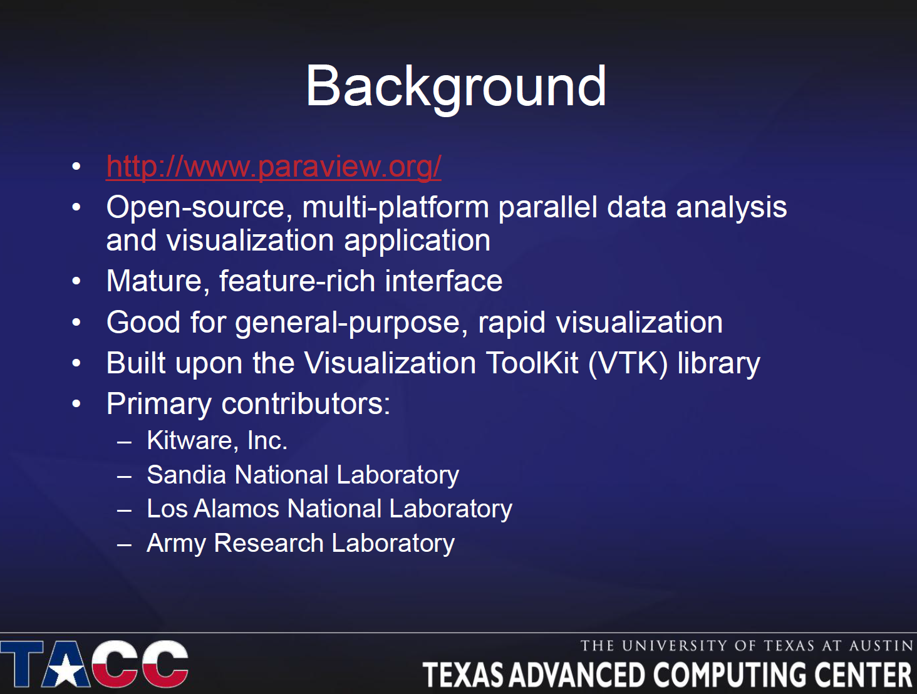

Slide 13
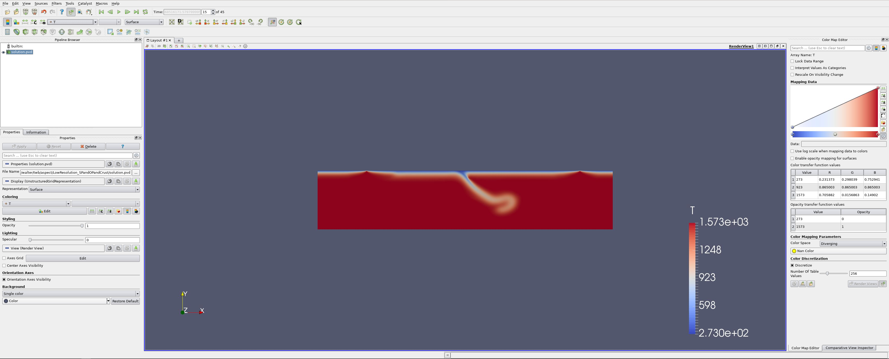
Paraview

Slide 14
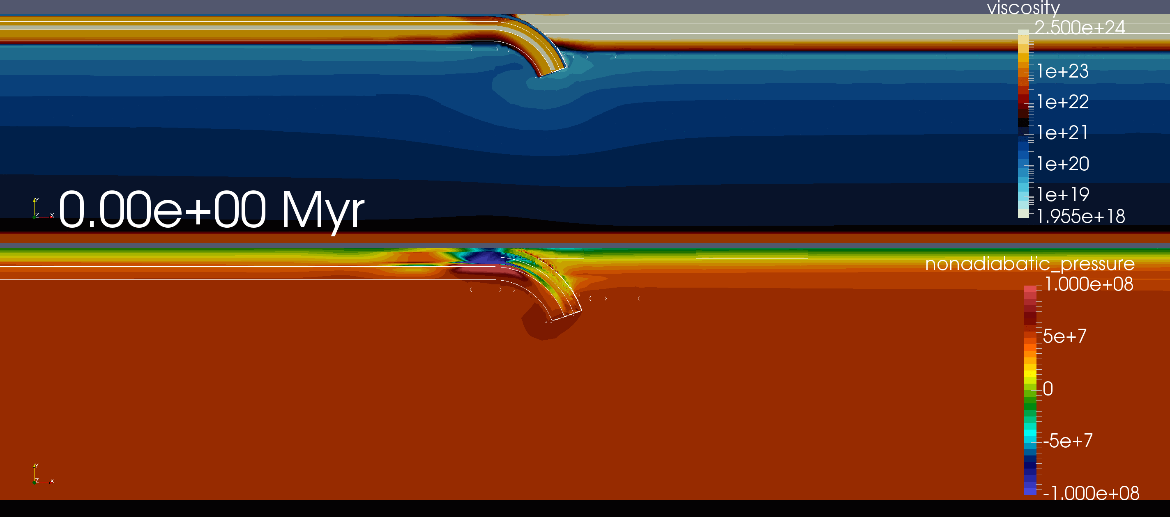
2D plots

Slide 15
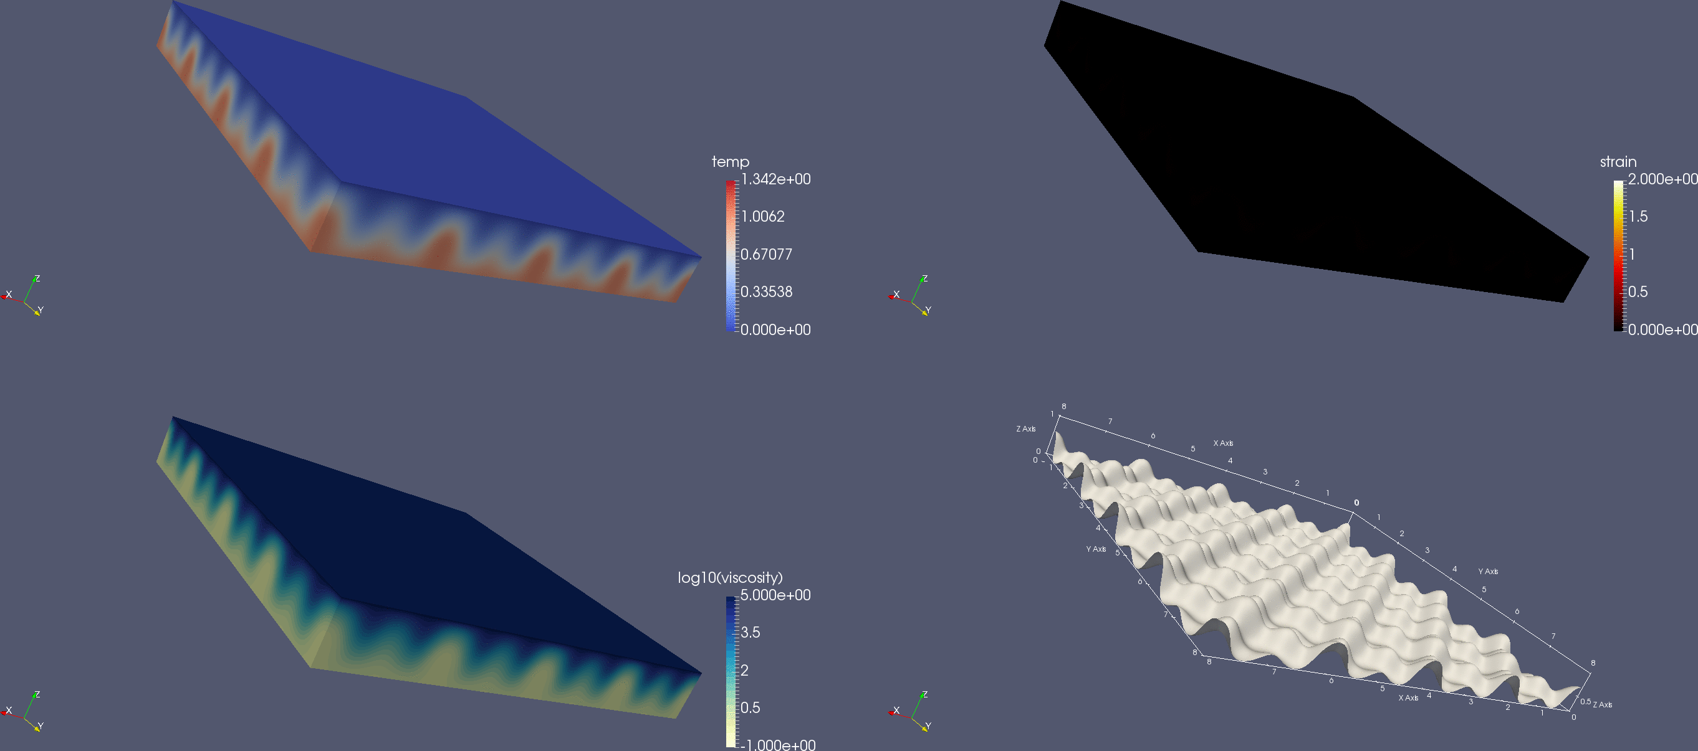
3D plots

Slide 16
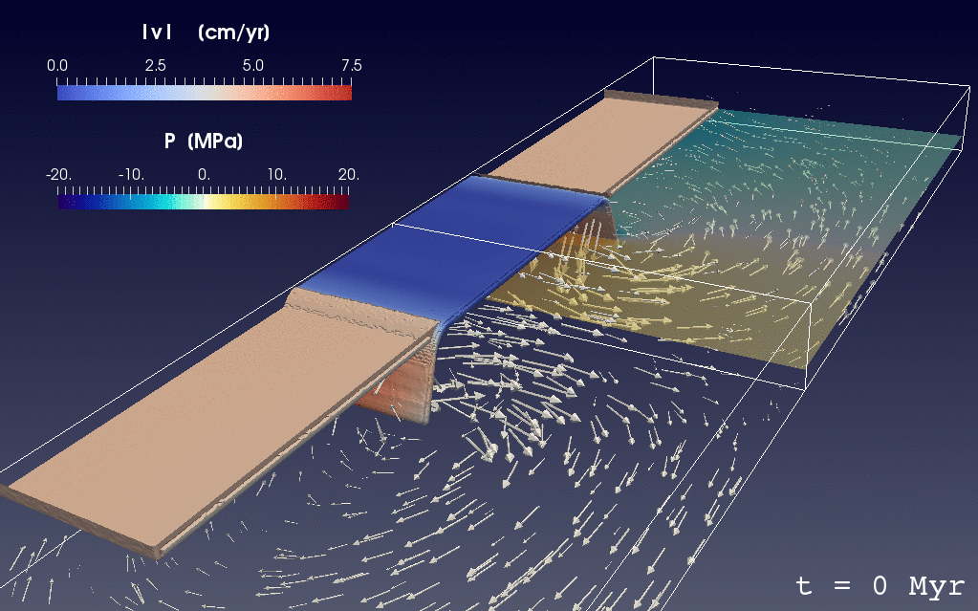
3D plots

Slide 17
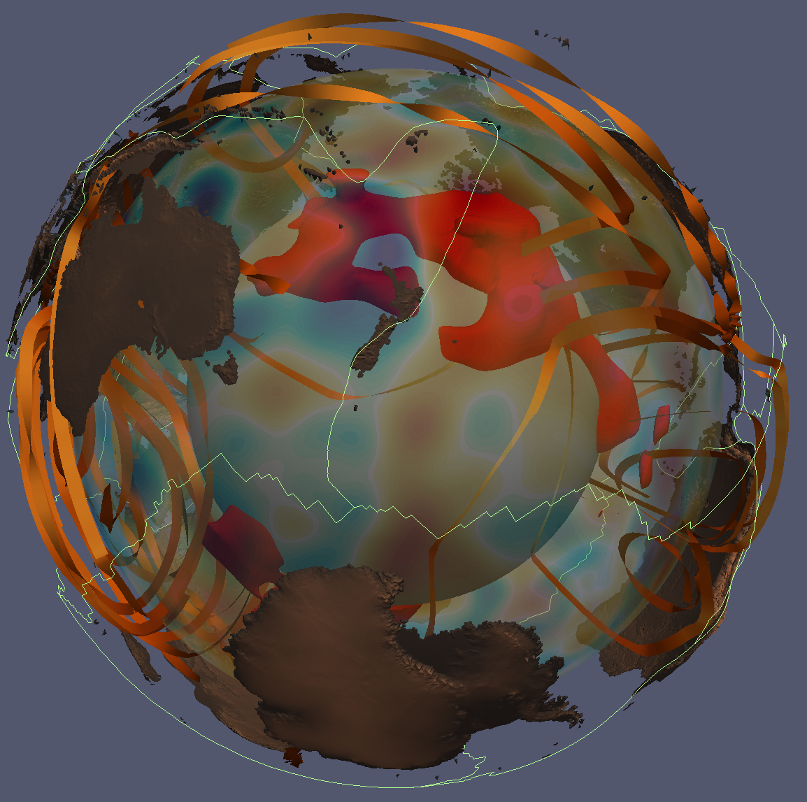
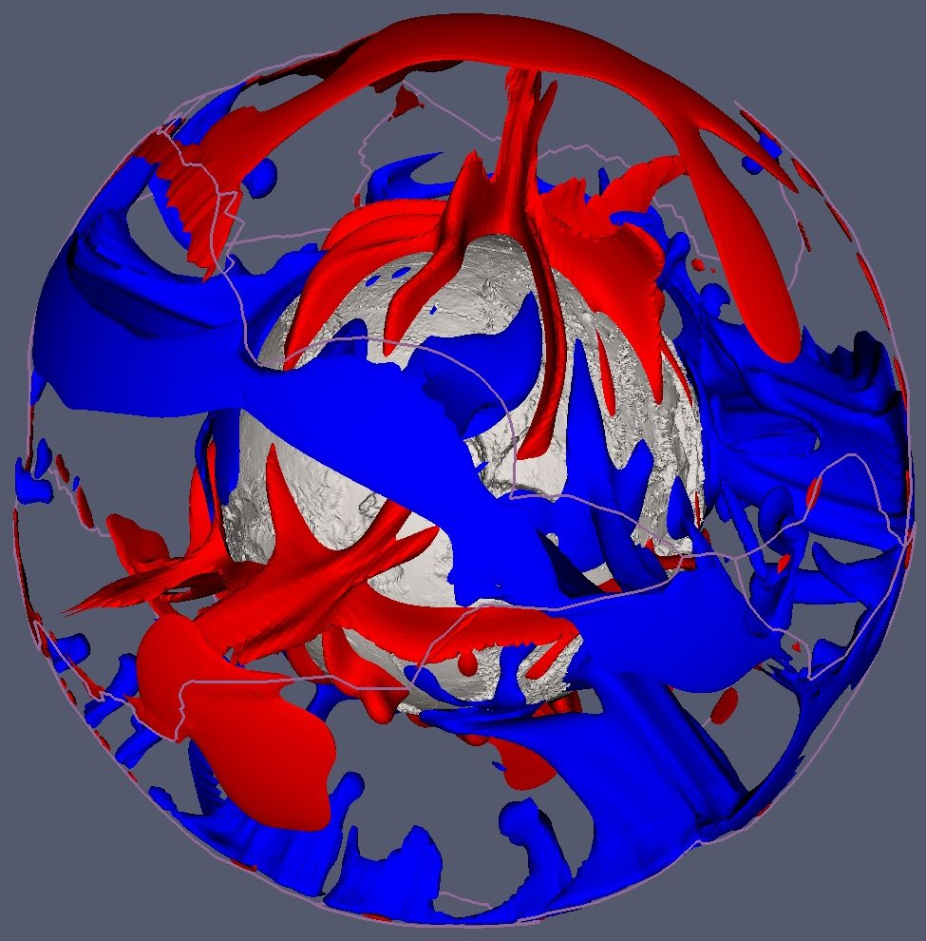

Slide 18
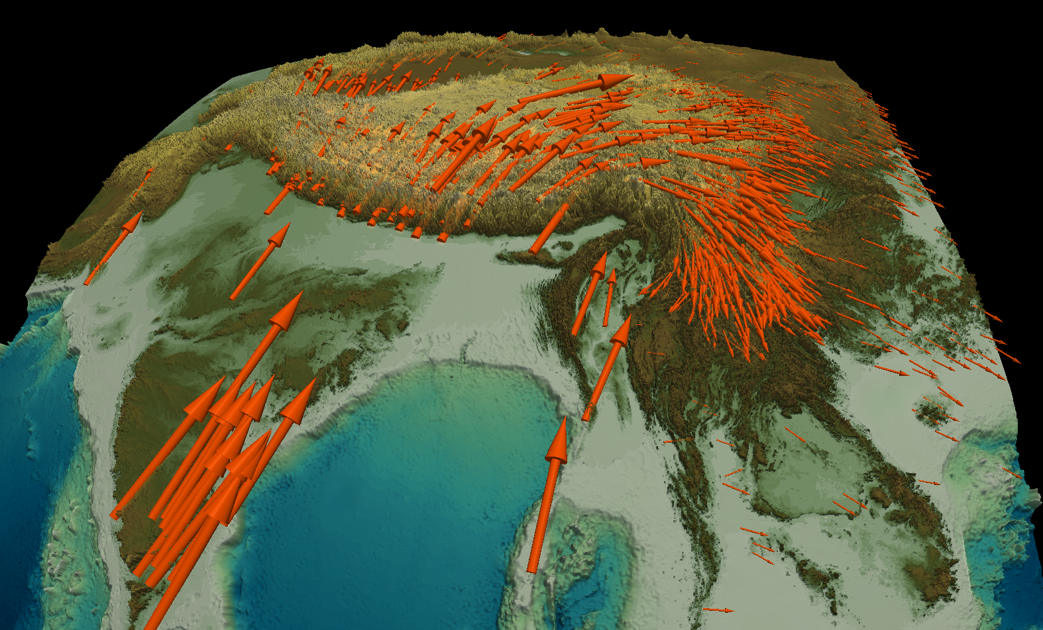

Slide 20
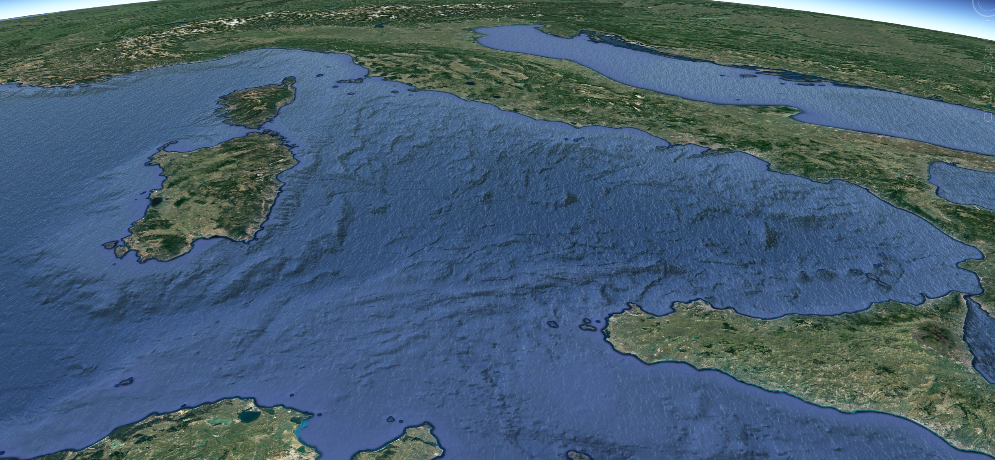

Slide 21
Paraview
I like it because
  It's free
  It's powerful
  It's quantitative
  It's scriptable (hey!)
  It's parallel
Can read a range of formats, including VTK
My web page/on Canvas:
  grd2vtk, grd2vtk_cart
  gmtpoly2vtk.awk, gmtcpt2paraview.awk

Slide 22
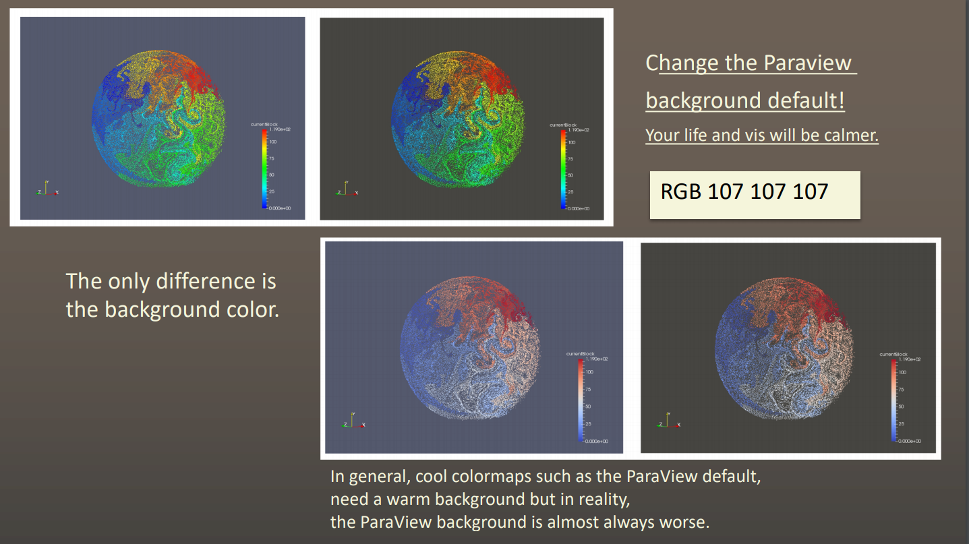

Paraview test drive

Slide 23
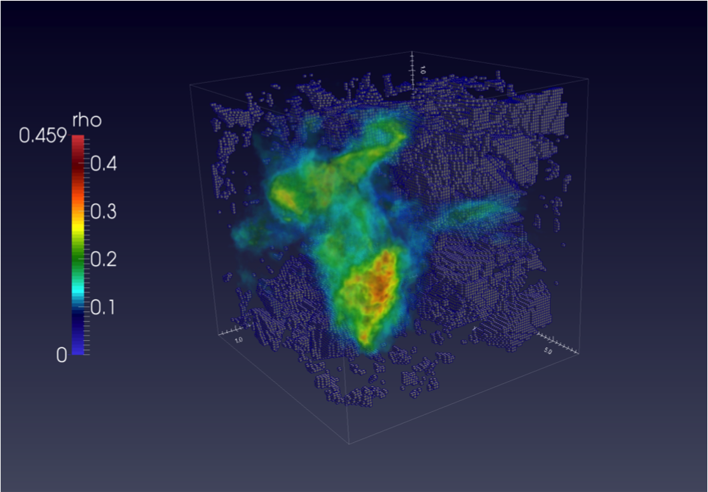
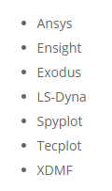
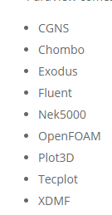
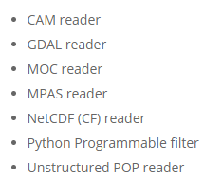
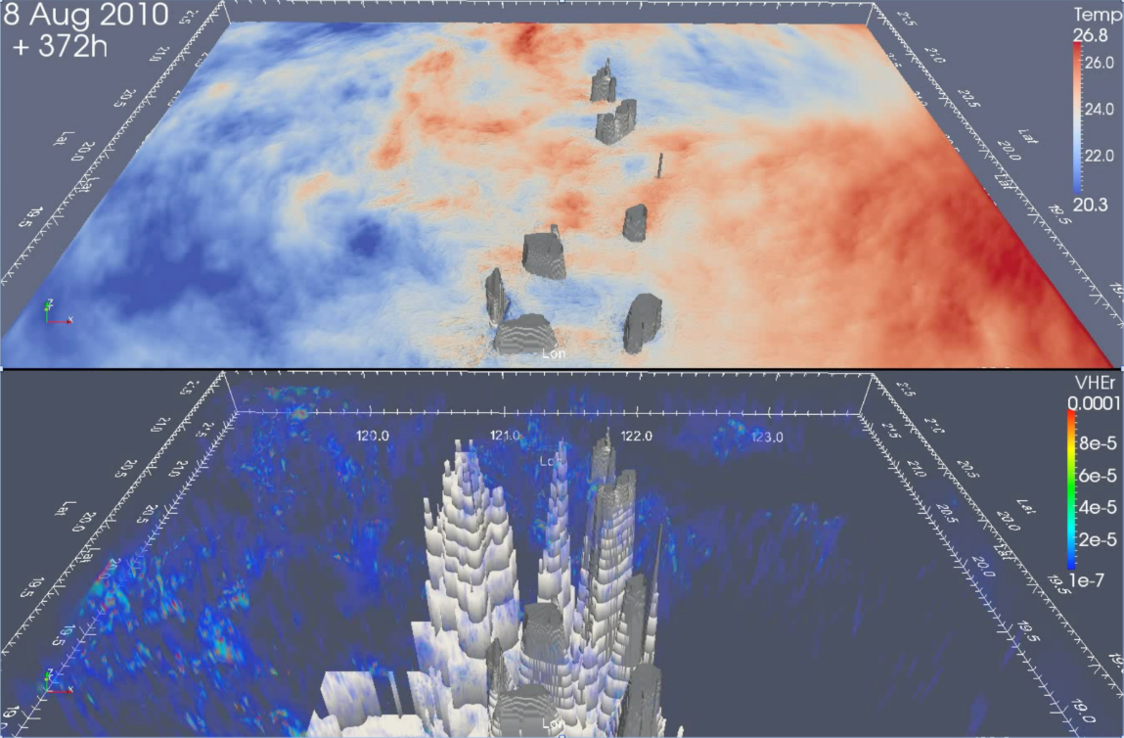
Data formats

Slide 24
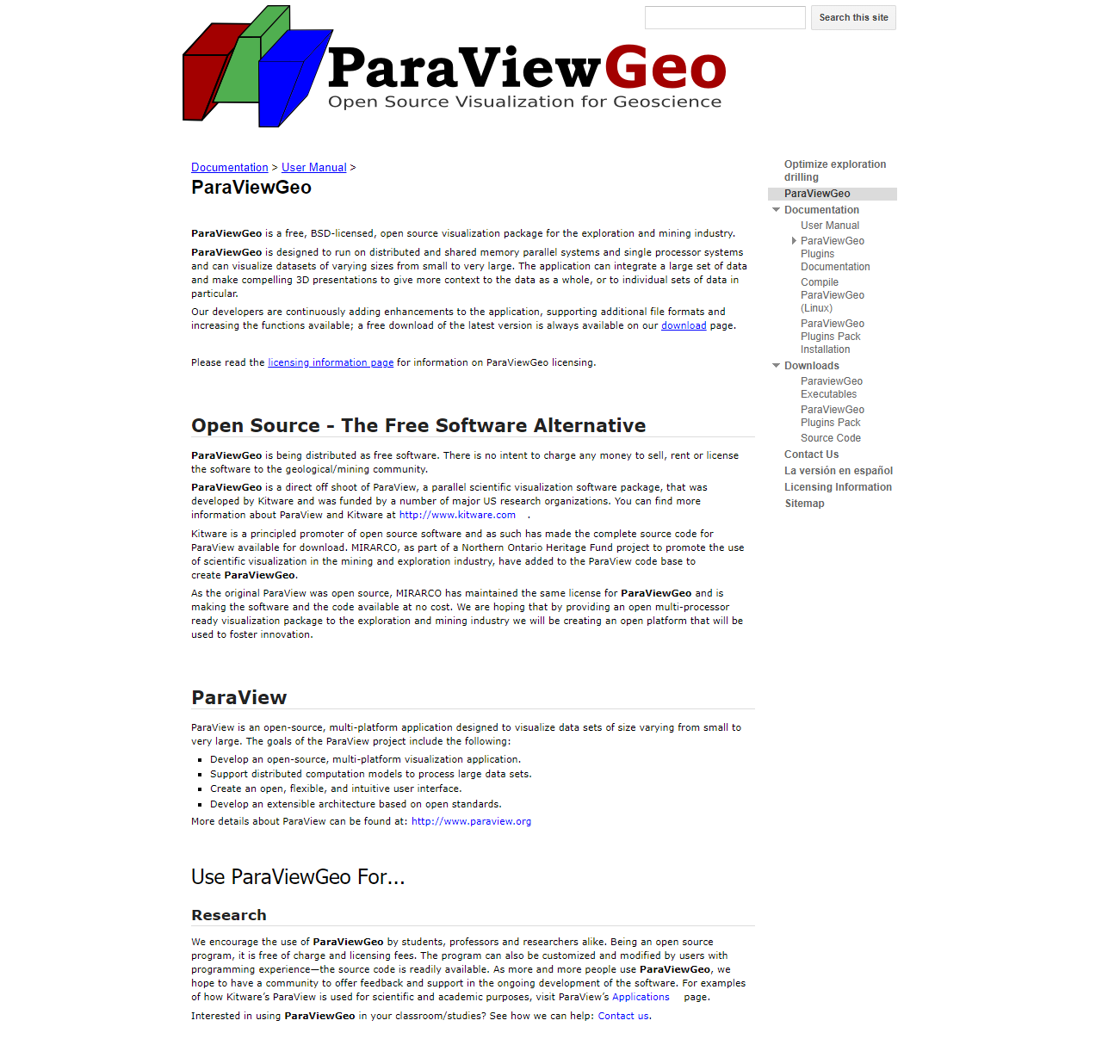

Slide 25
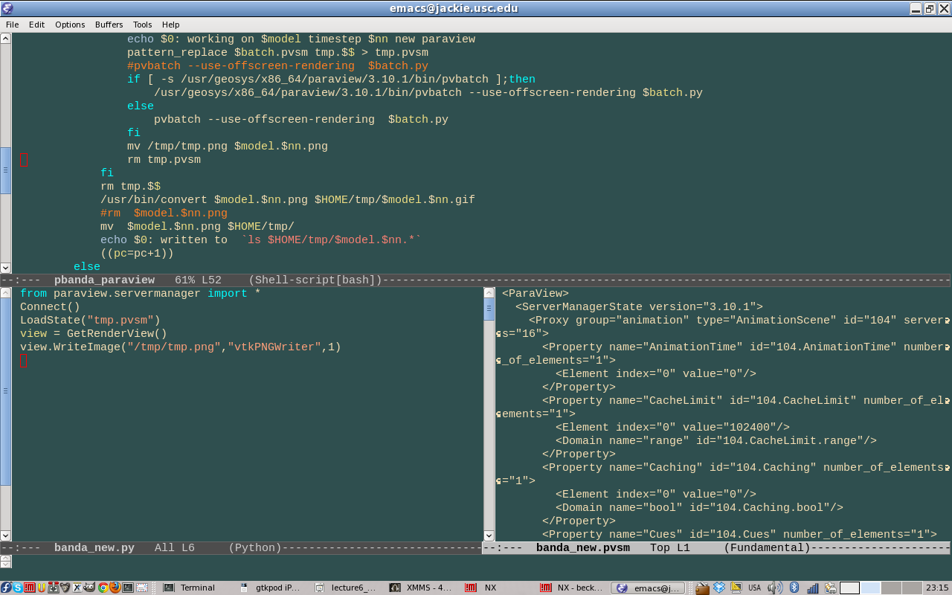
Paraview scripting

Slide 26
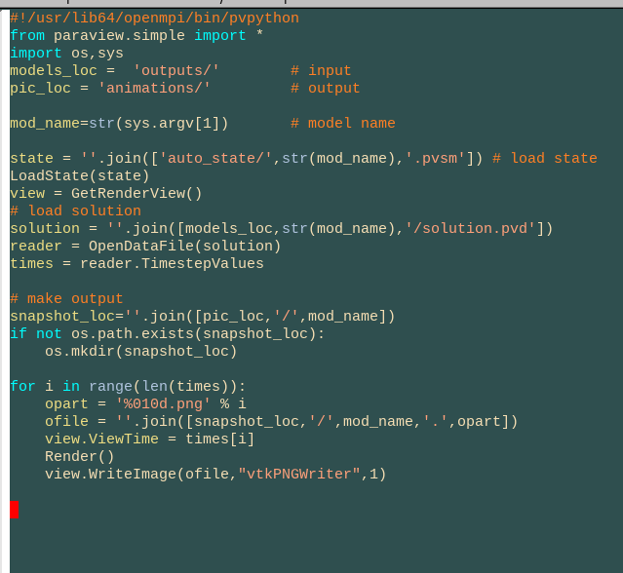
Paraview scripting

Slide 27
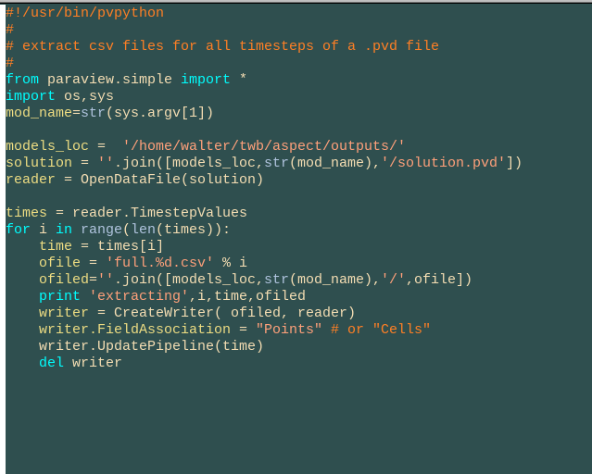
Paraview scripting

Slide 28
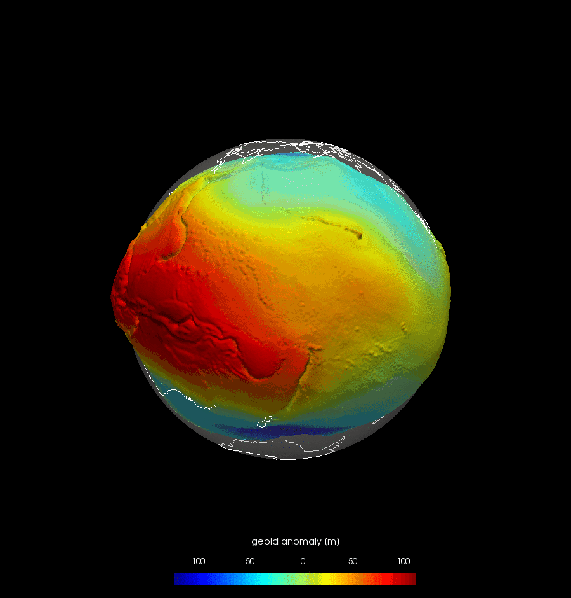

Slide 29
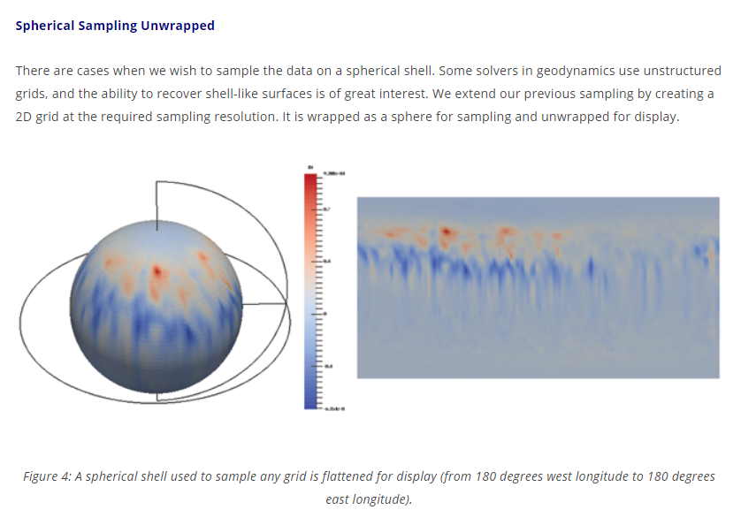
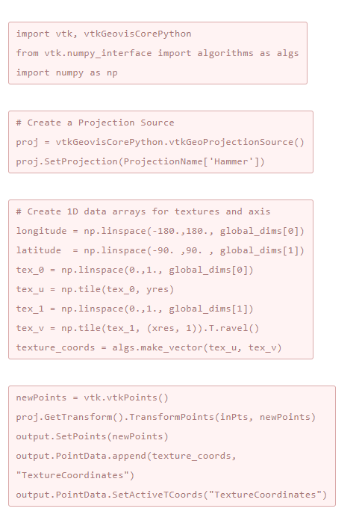
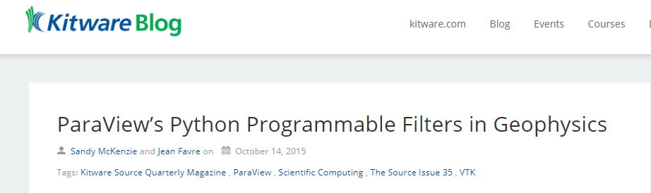

Slide 30
