Slide 1
Geoscientific data analysis using UNIX and GMT
6/8: GMT IV
x-y plots and fitting curves
Thorsten Becker
The University of Texas at Austin
April 2021

Slide 2
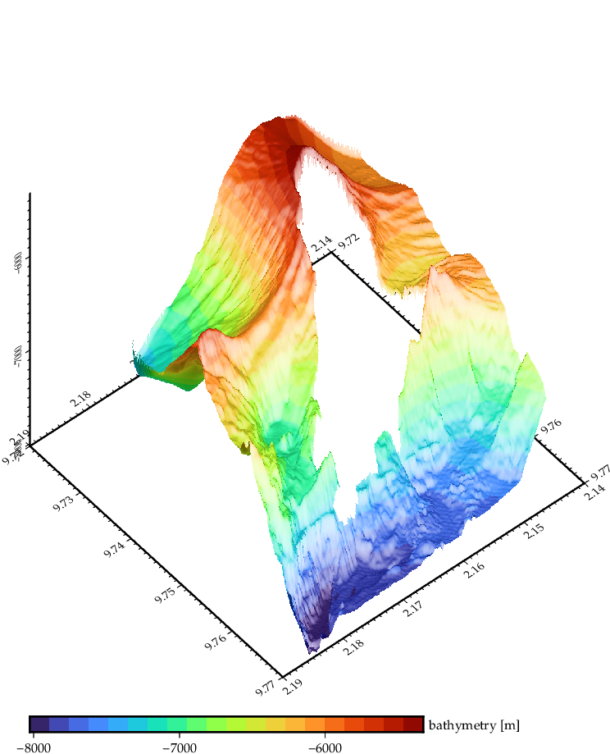

Slide 3

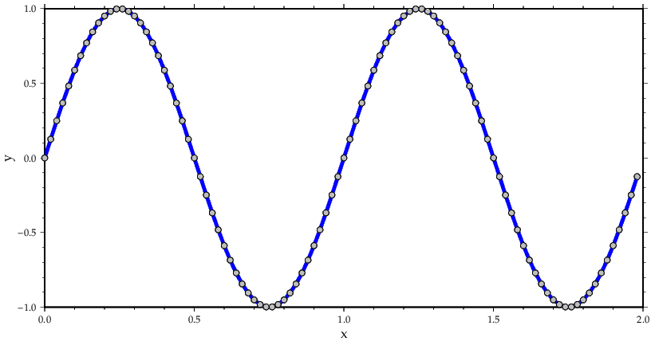

Slide 4
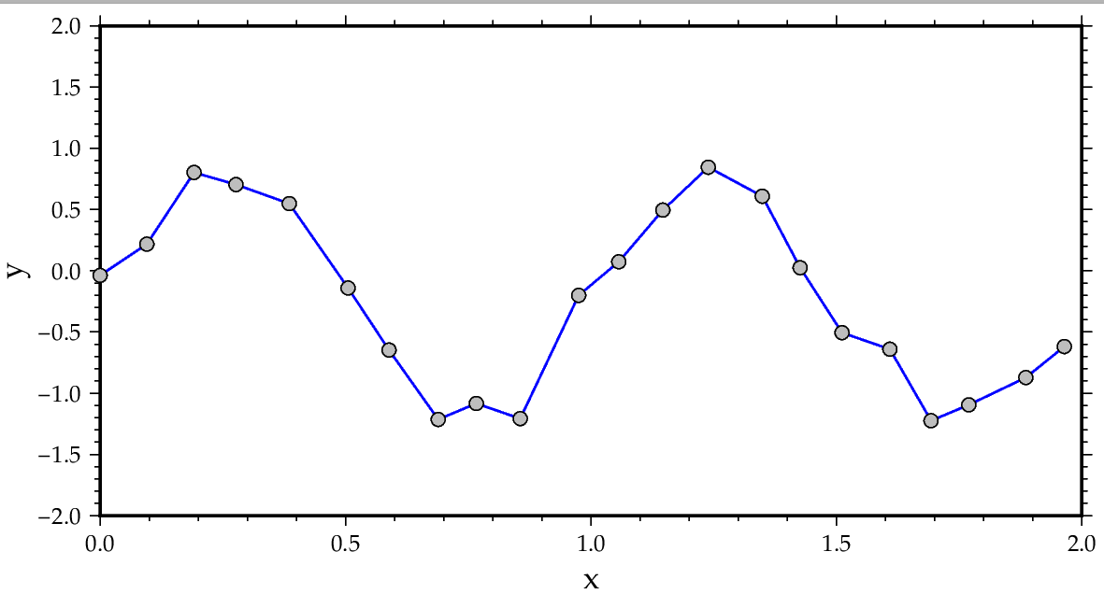
What to do with rough/irregularly spaced data?

Slide 5

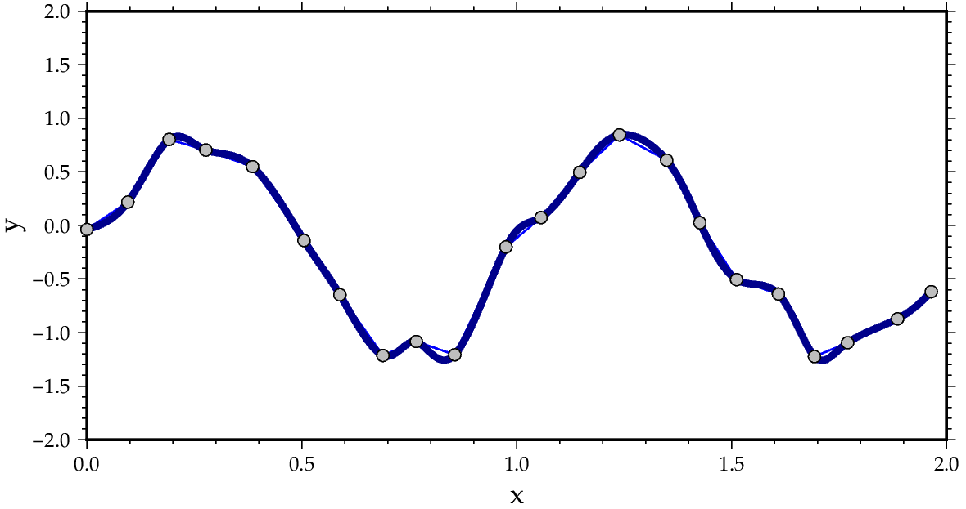
Use splines?

Slide 6
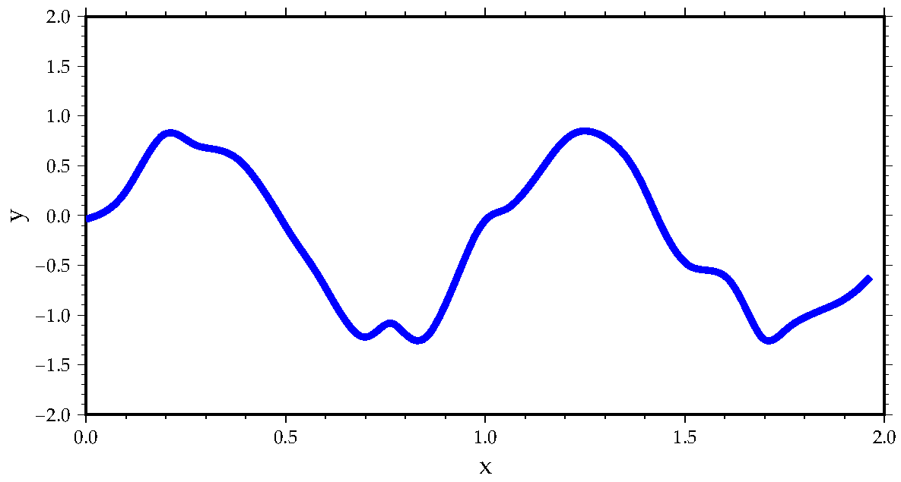
Note curve outside data range
-> use symbols and lines

Slide 7
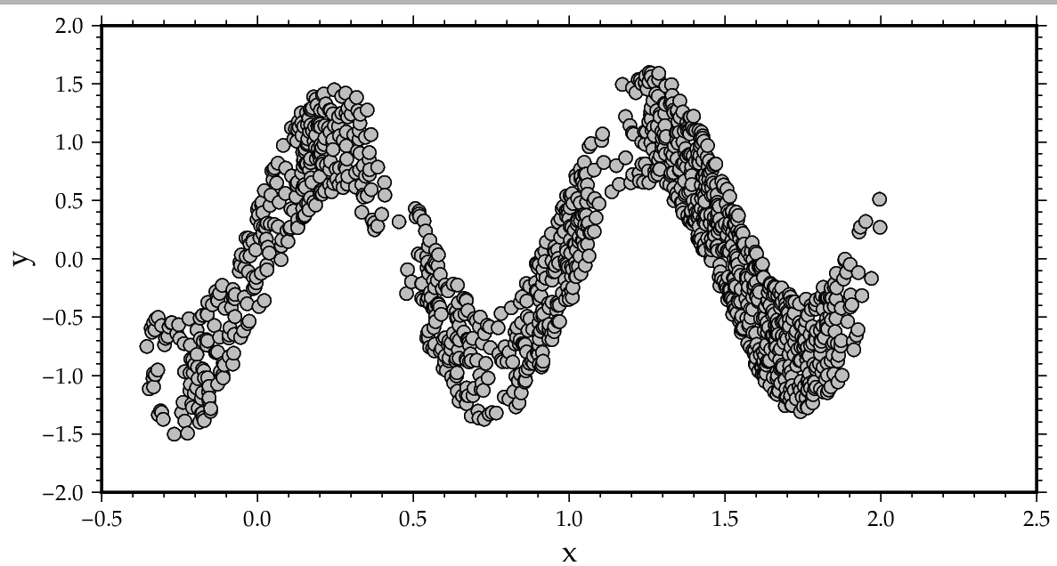
How to process noisy data

Slide 8

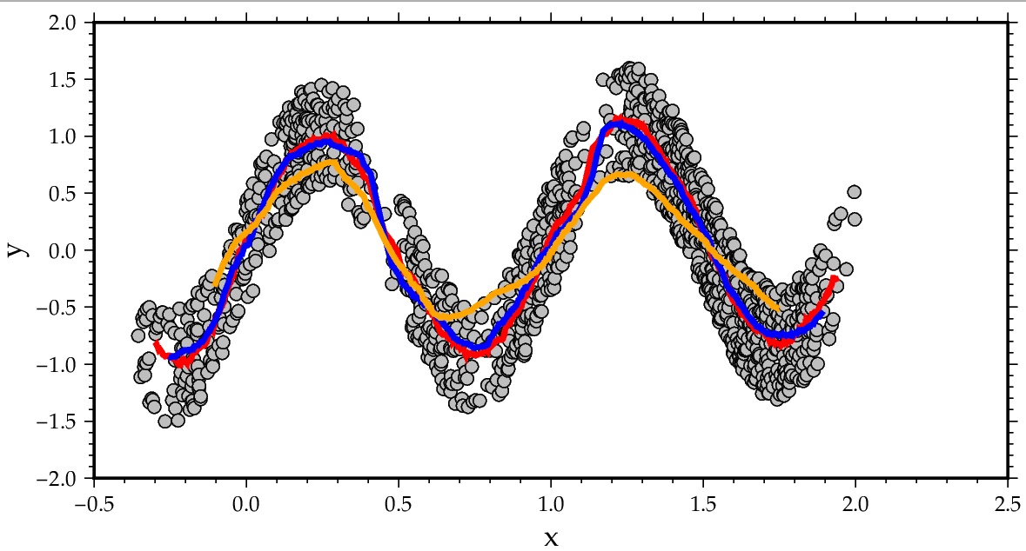
Box car filter

Slide 9
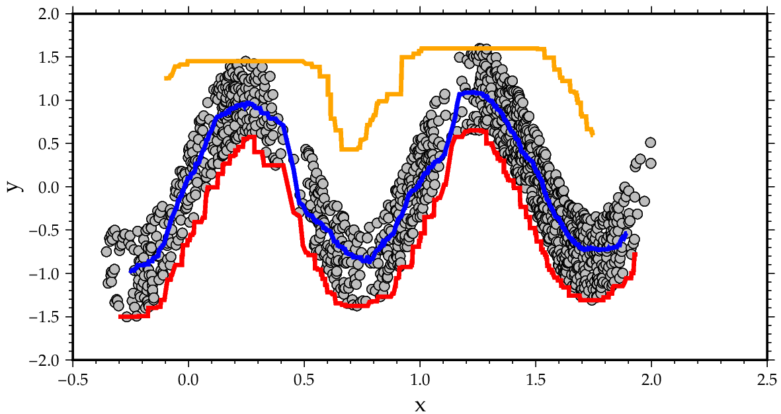
Min/Median/Max filter

Slide 10
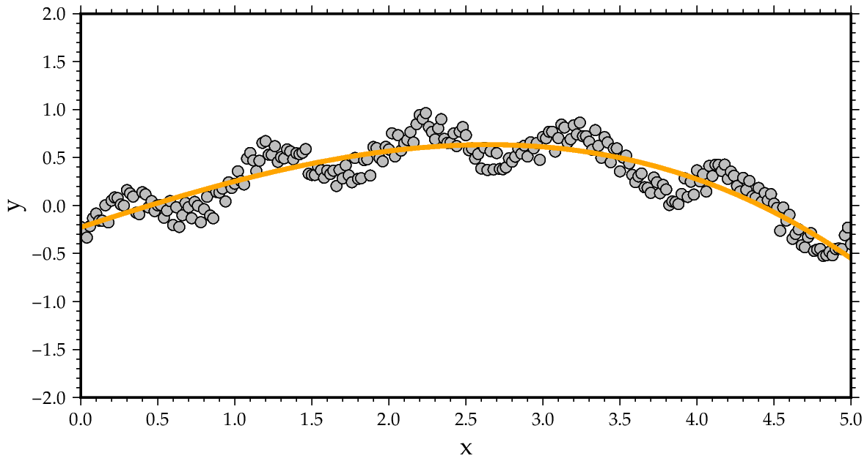
Fitting a polynomial

Slide 11

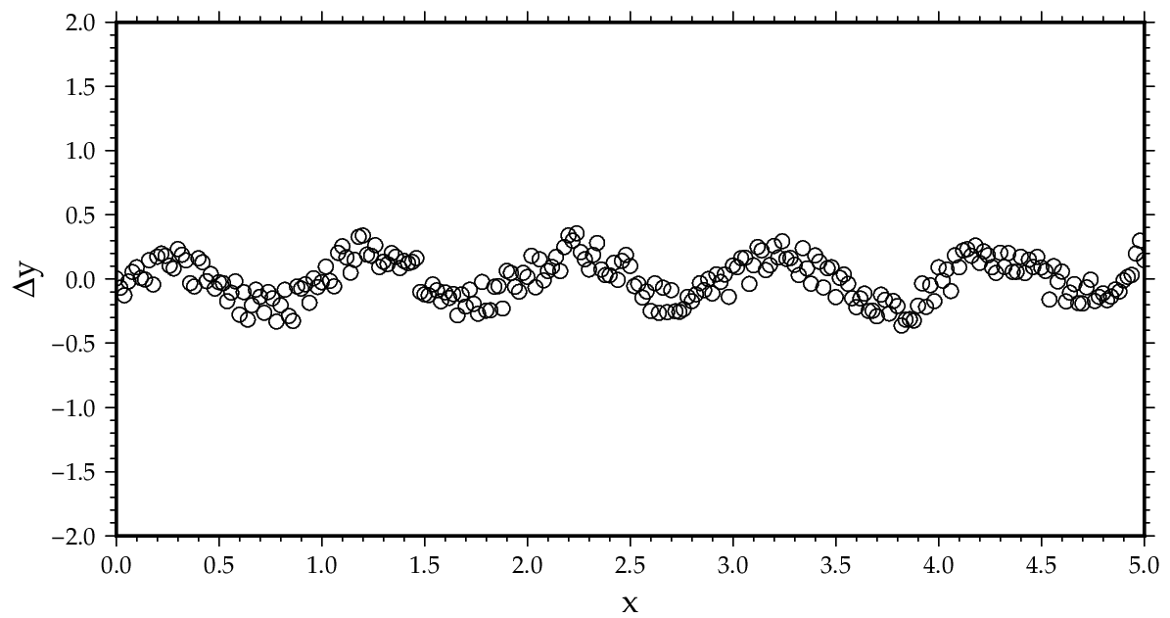
Fitting a polynomial – always plot the residual

Slide 12
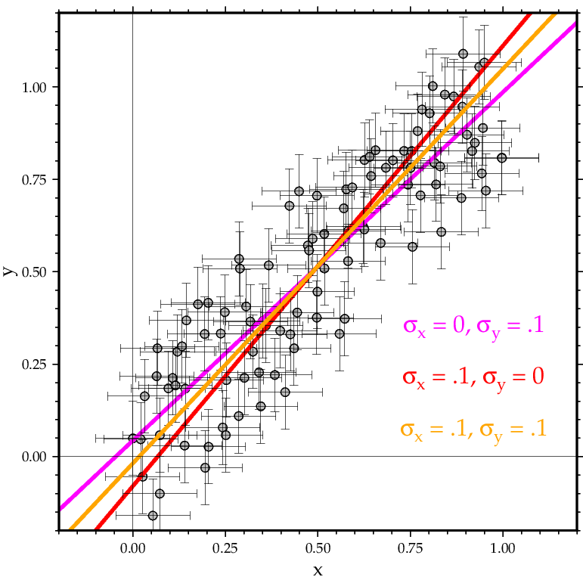
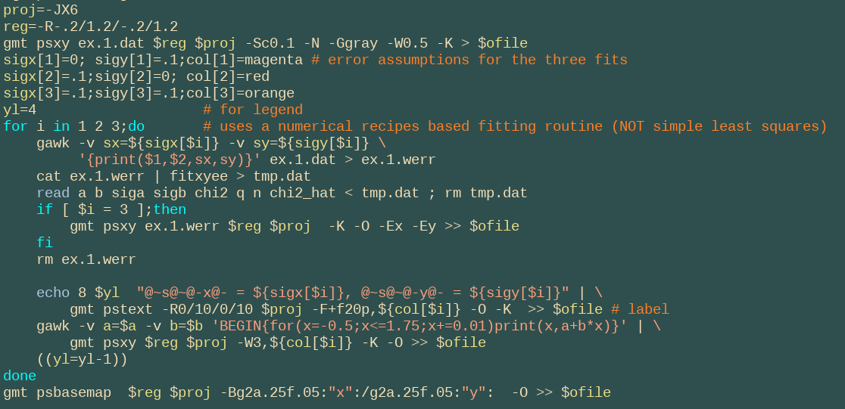
Fitting a line

Slide 13
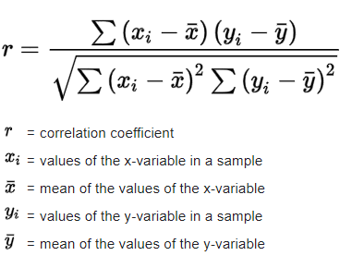
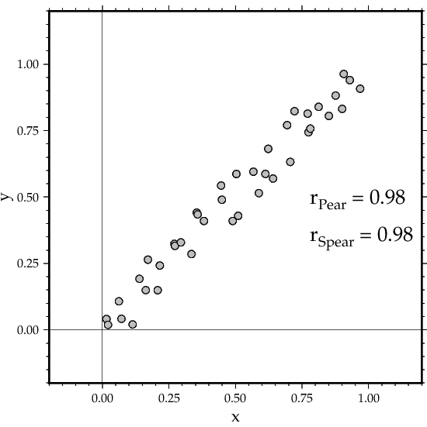



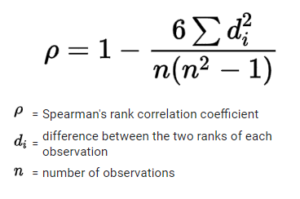

Correlation
Pearson (linear) correlation coefficient
Spearman rank correlation

Slide 14
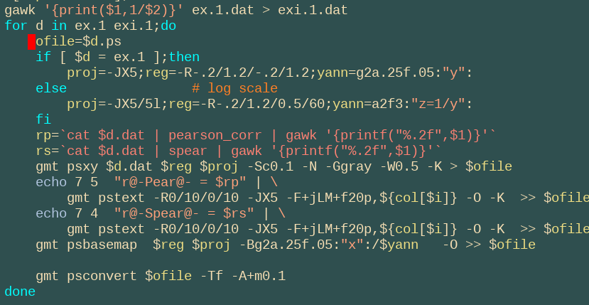
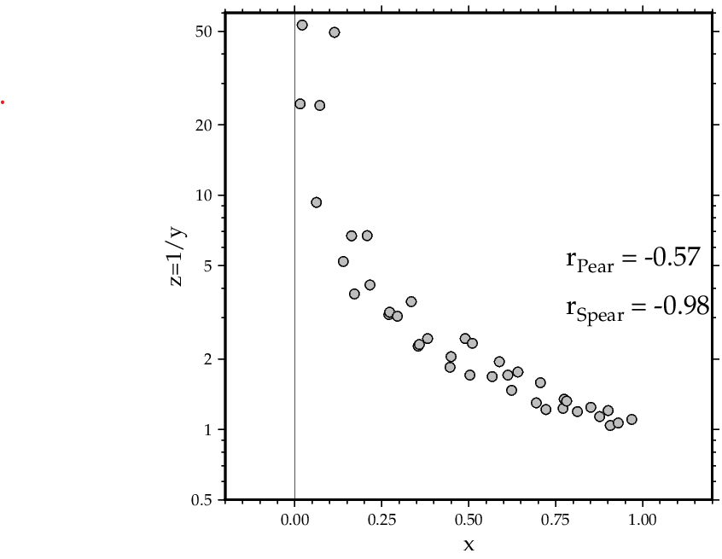
Correlation

Slide 15
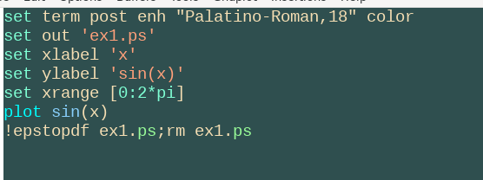
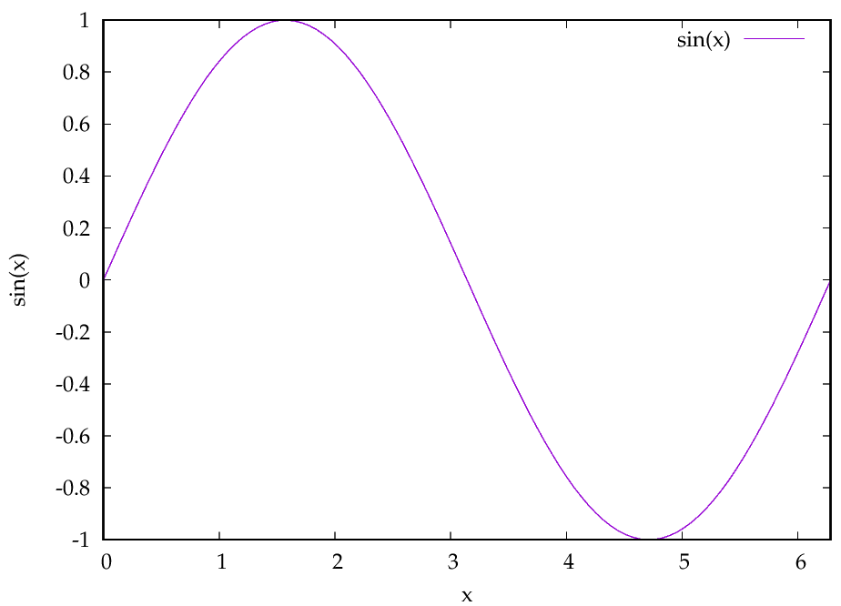
Gnuplot – plotting functions

Slide 16
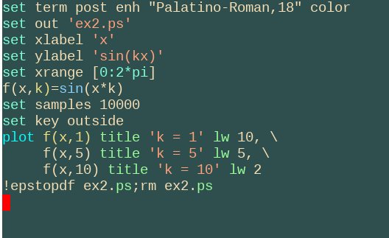
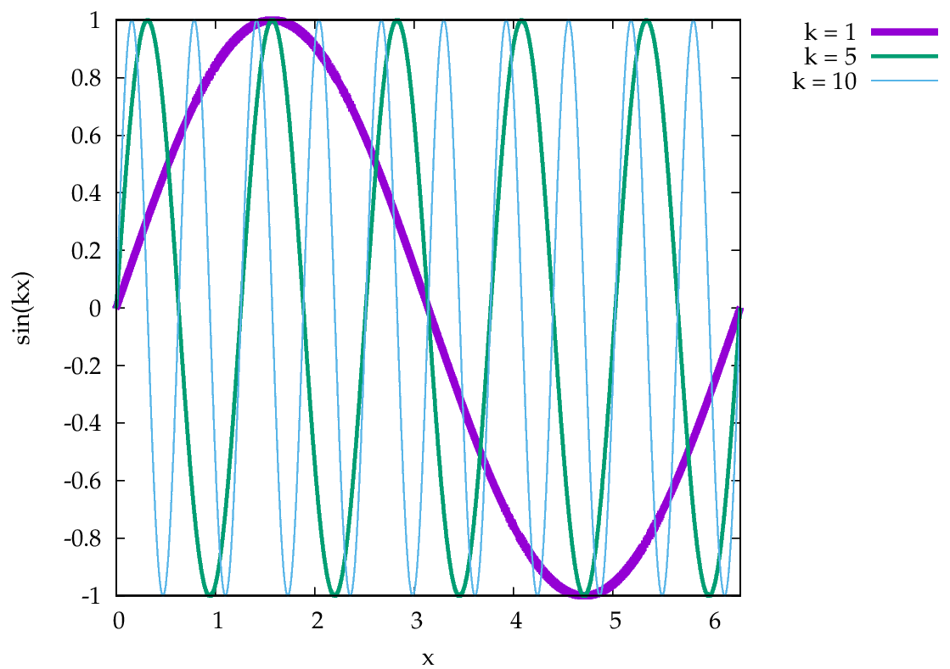
Gnuplot

Slide 17

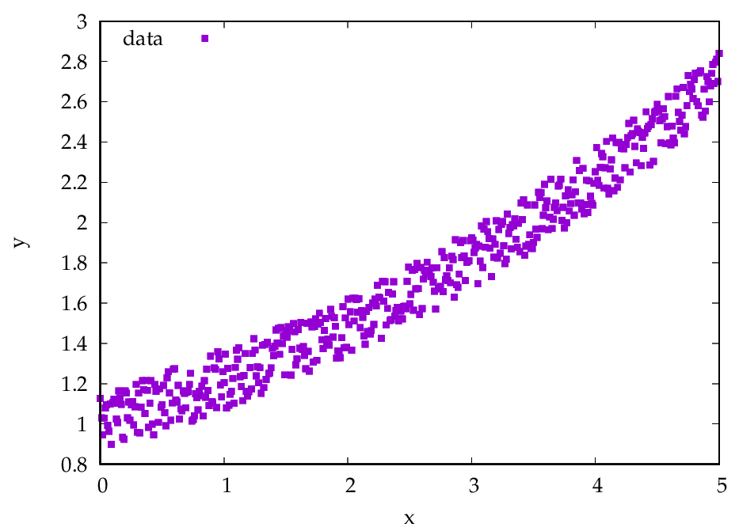
Gnuplot – plotting data

Slide 18

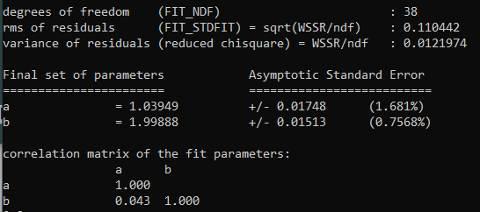
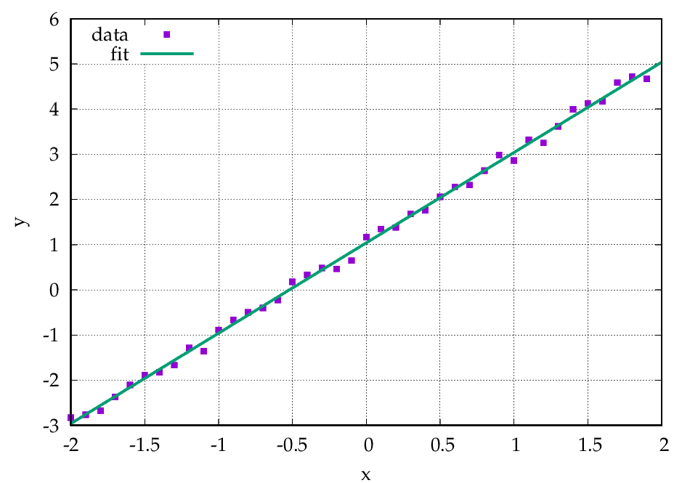
Gnuplot – fitting data

Slide 19

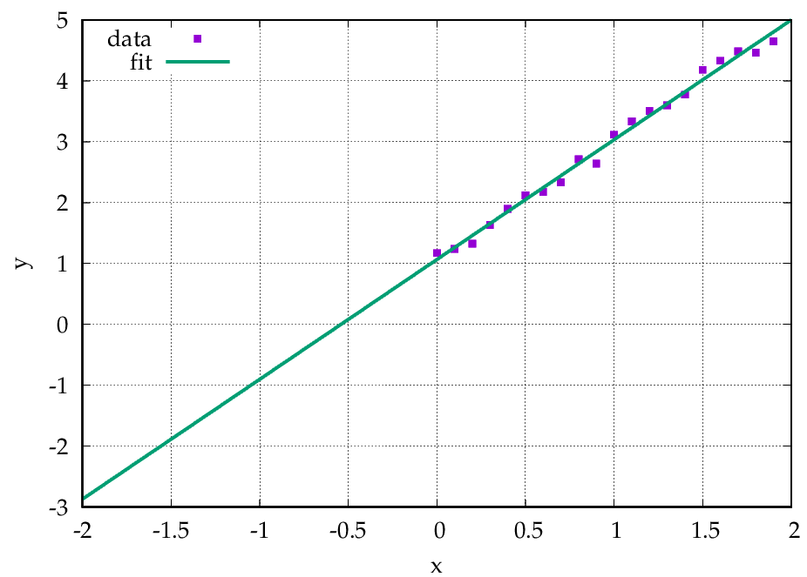
Gnuplot – fitting data

Slide 20

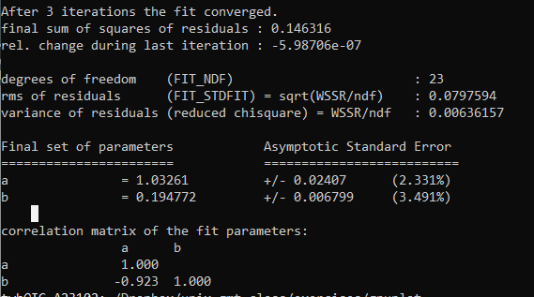
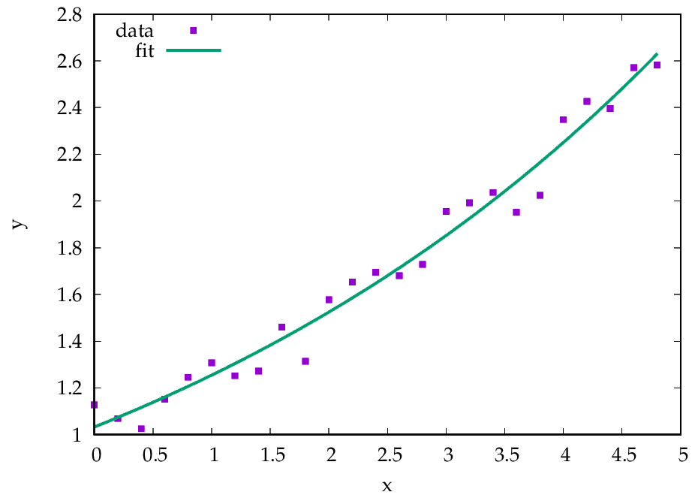

Slide 21

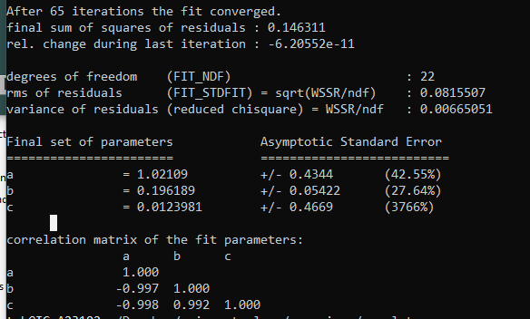


Slide 22
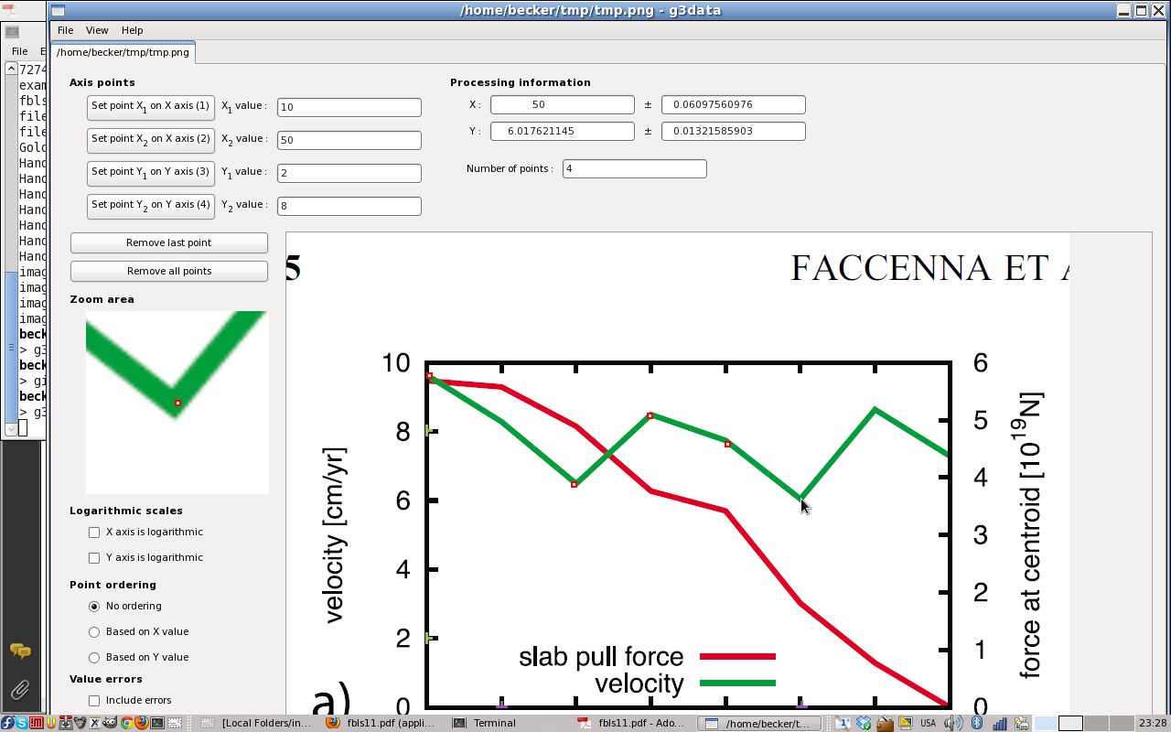
Tools: g3data

Slide 23
No class next Thursday
Friday is on Paraview 3-D visualization and other topics

