Slide 1
Geoscientific data analysis using UNIX and GMT
5/8: GMT III - gridding
Thorsten Becker
The University of Texas at Austin
April 2021

Slide 2
Contents
Gridding with GMT
Manipulating grids
Participant topics

Slide 3
Going from x-y-z data
(that can be irregularly distributed)
to regular, gridded (pixelated) representations

Slide 4
GMT default binary format
NetCDF grd
Single precision internal representation of floats, i.e. might lose precision of numerical data, particularly if not normalized
Some meta information accessible via grdinfo

Slide 5
Regularly binned binary (grd) vs. xyz (lon-lat-value)
xyz2grd
go from regularly space lon-lat-z or x-y-z data to a NetCDF grd
  Used -Rxmin/xmax/ymin/ymax and -Idx/dy to specify grid
  By default, will use NaN for missing values
  Can also use z only if ordering of data is specified
grd2xyz
go from grd to x-y-z or z
Other binary formats can usually be converted via x-y-z intermediate steps

Slide 6
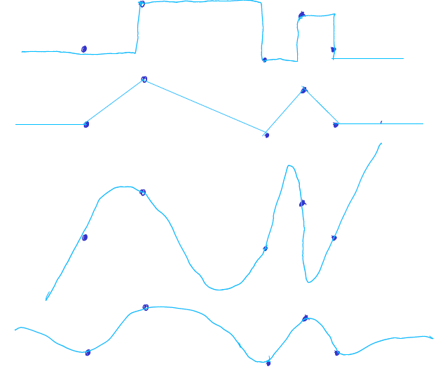
Interpolation
Really, a modeling problem

Slide 7
Gridding examples
examples/gmt/gridding/
interpolate_data
interpolate_data_nearneighor
interpolate_data_sphi
interpolate_data_surface
interpolate_data_triangulate

Slide 8
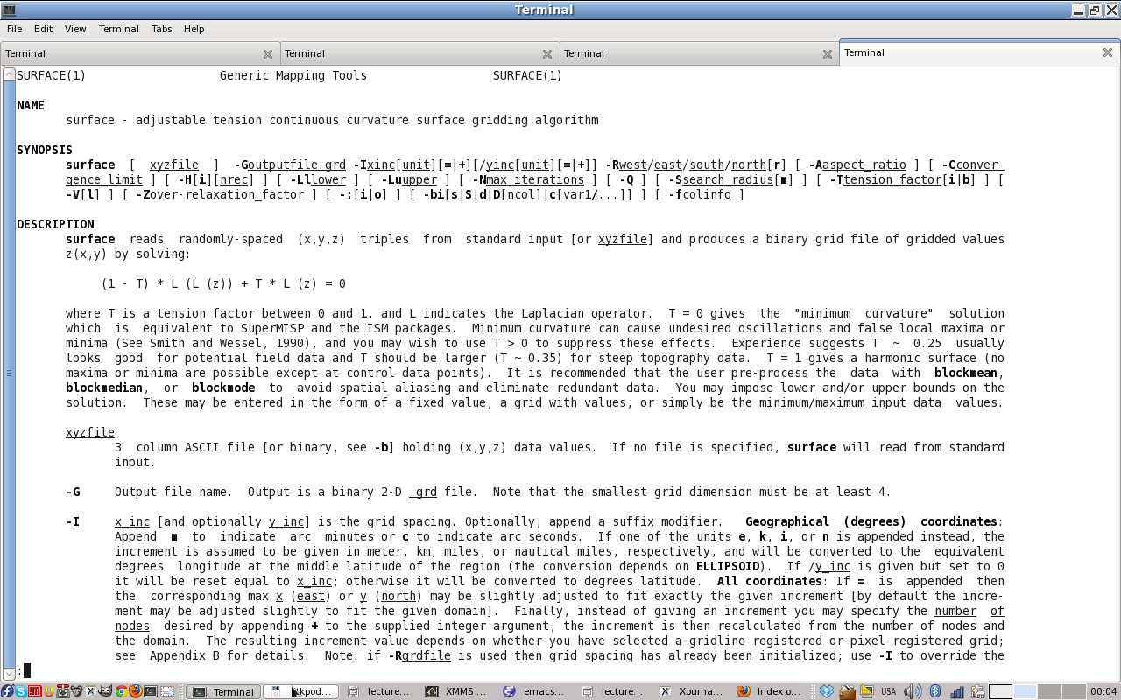
Surface interpolation
Splines in tension

Slide 9
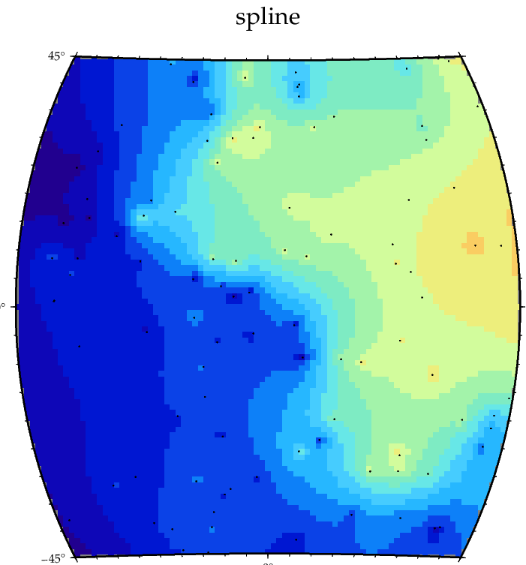
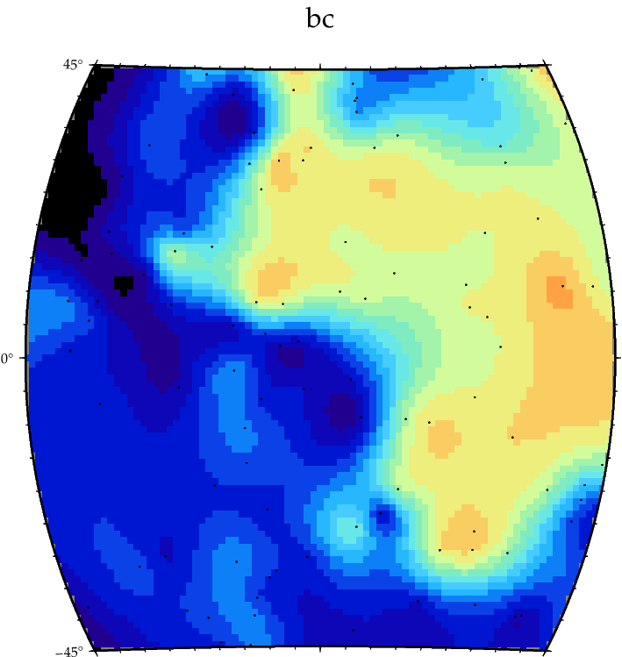
Surface spline interpolation
T = 1 tension (no extrema outside data)
T = 0 bicubic spline (smoothest)

Slide 10
GMT surface
Splines in tension
Dial between
  T = 0 (default) smoothest solution
  T = 1 no local extrema outside data solution
-A sets the aspect ratio for the grid, e.g. depending on mid latitude of the region (but this is not accurate for large, spherical coordinate grids!)
-Lld -Lud will limit the solution to be within range of data

Slide 11
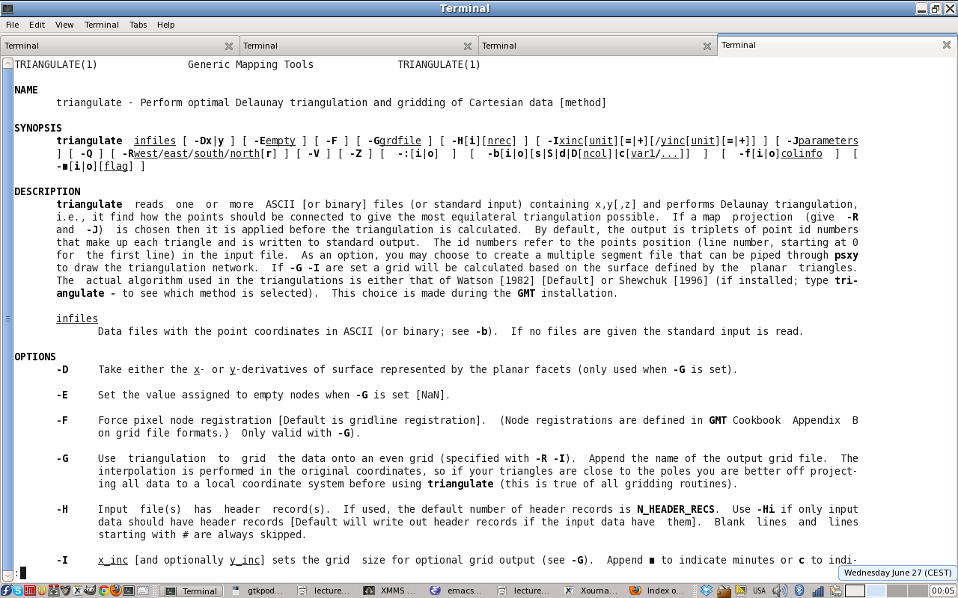
Triangulate
Linear interpolation in Delaunay triangulation

Slide 12
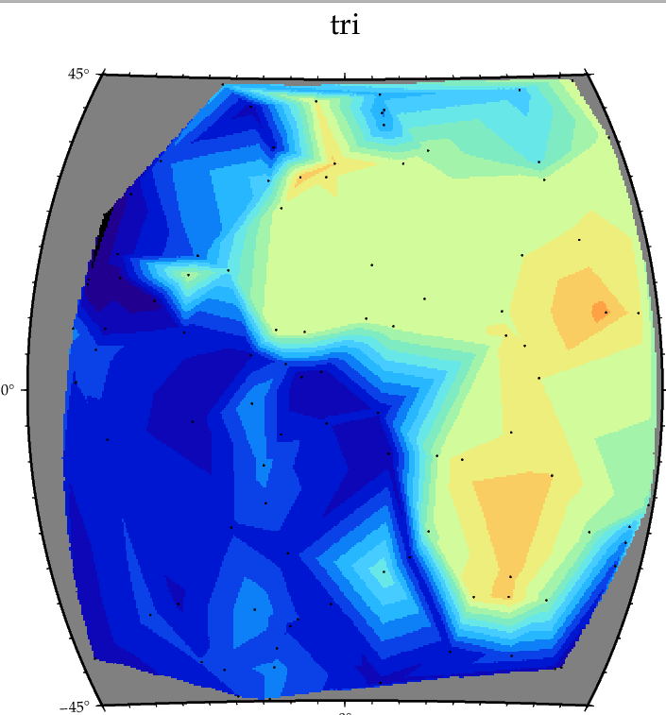
Triangulate

Slide 13
GMT triangulate
Assuming Cartesian coordinates, perform Delaunay triangulation
Interpolate linearly using triangles, i.e. derivatives of interpolated scalar within are constant
This distinction is important if we want to take derivate of the field, e.g. for geodetic data (see gpsgridder)

Slide 14
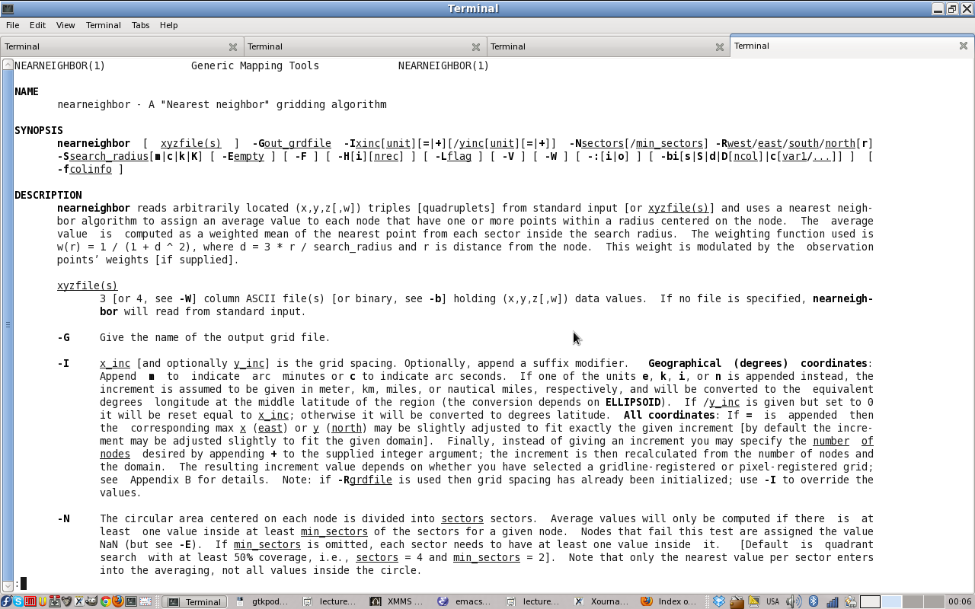
Nearneighbor
Local information, weighted by distance

Slide 15
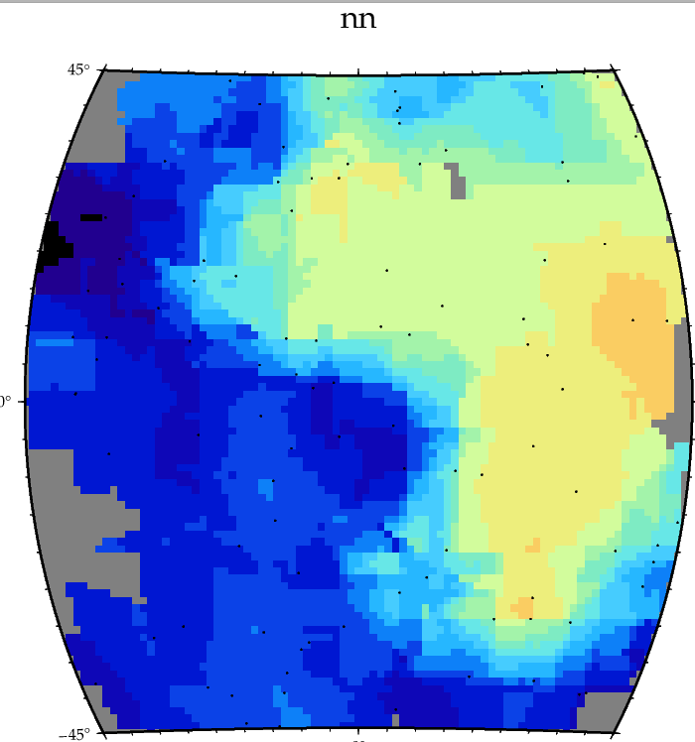
Nearneighbor

Slide 16
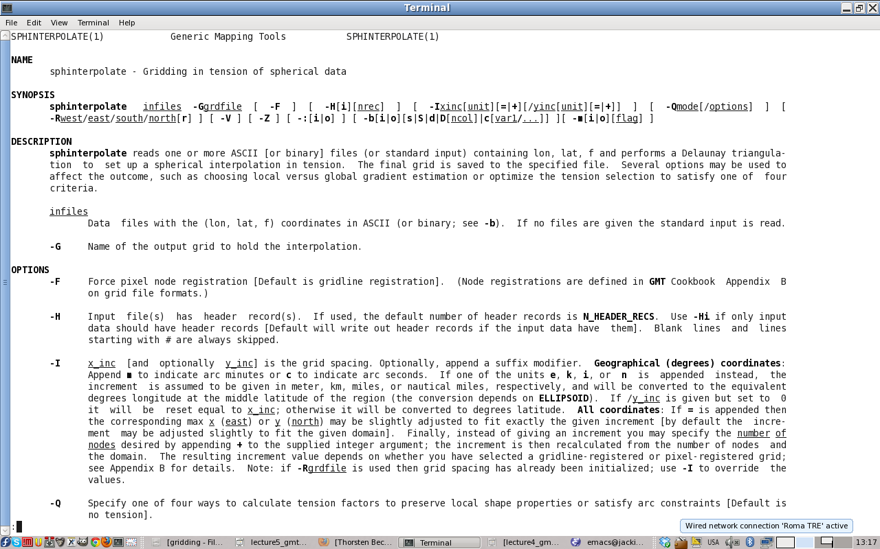
sphinterpolate
A true spherical combination of surface and triangulate

Slide 17
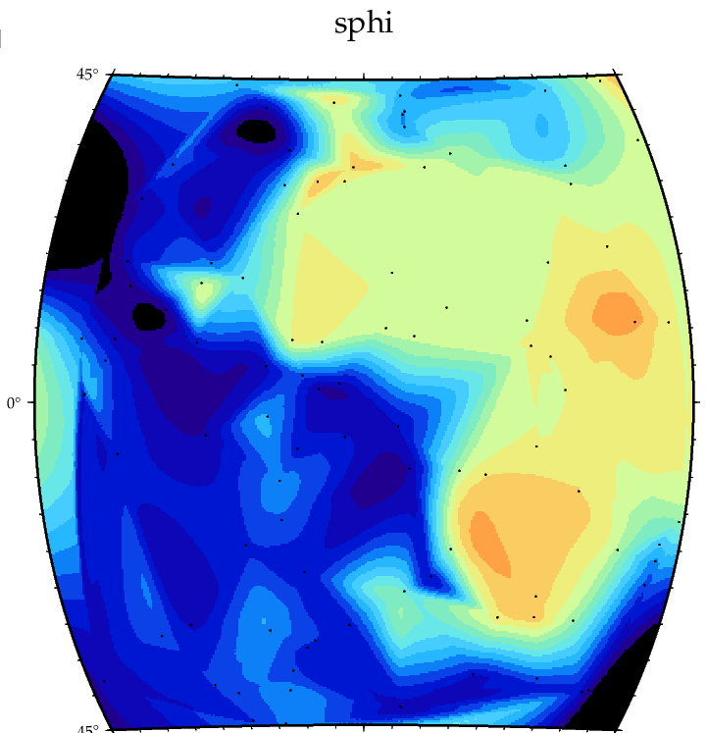
sphinterpolate

Slide 18
Not all GMT tools are spherical coordinate based
surface works well enough for regional data (remember to adjust -A), and (away from poles) will not do too poorly globally, broadly speaking
For true spherical, should/can use sphinterpolate

Slide 19
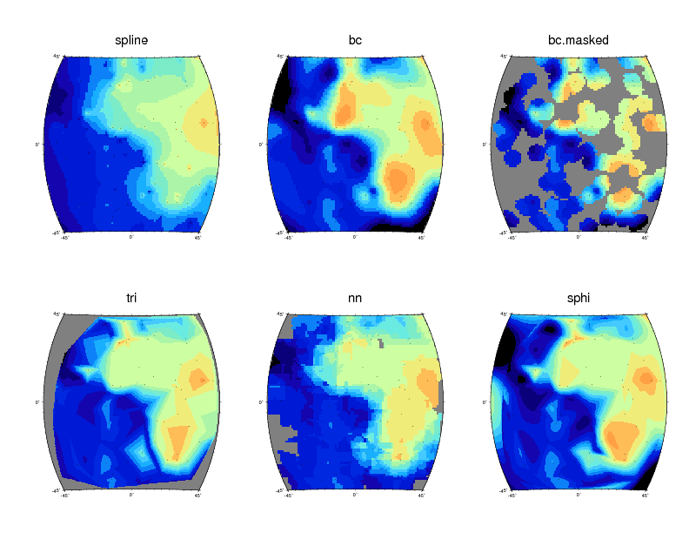
Comparison of methods, N=100

Slide 20
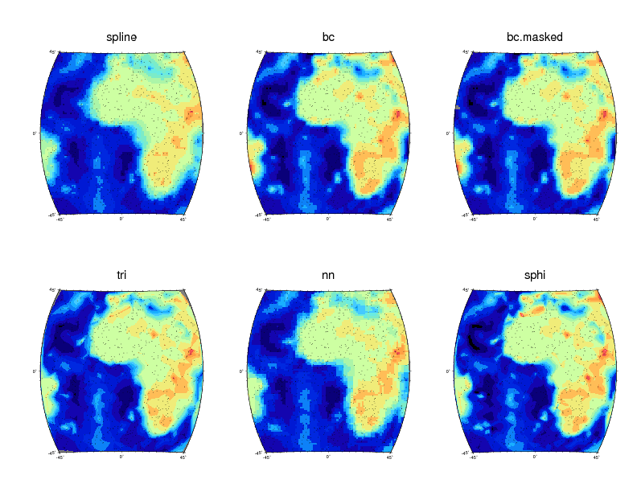
Comparison of methods, N=1000

Slide 21
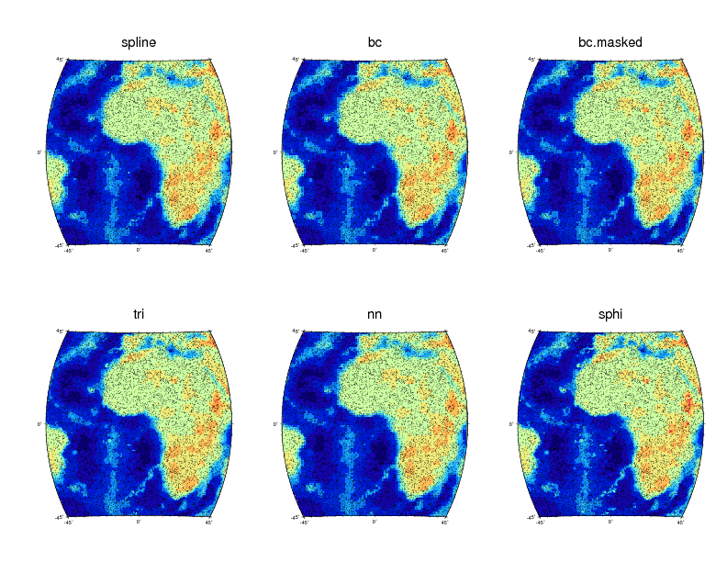
Comparison of methods, N=10000

Slide 22
Interpolation
There is no right answer, only trade-offs
  Optimally smooth vs. no local extrema
  No prior assumptions about data vs. imposing a priori constraints
There are other tools (such a kriging) which can be used for interpolation, but GMT tools will be a good start, broadly speaking
Always make sure you know (by plotting) your actual data distribution before interpolation
Mask out uncertain regions (grdmask, grdlandmask)

Slide 23
Once we have a grd
grdtrack : interpolate existing grd to lon/lat
  -Ql: linear interpolation
  -Qb: B-spline
  -Qc: bicubic
  -Qn: nearest-neighbor
grdsample: to refine grid sampling (only for plotting)
  Don't use to coarsen

Slide 24
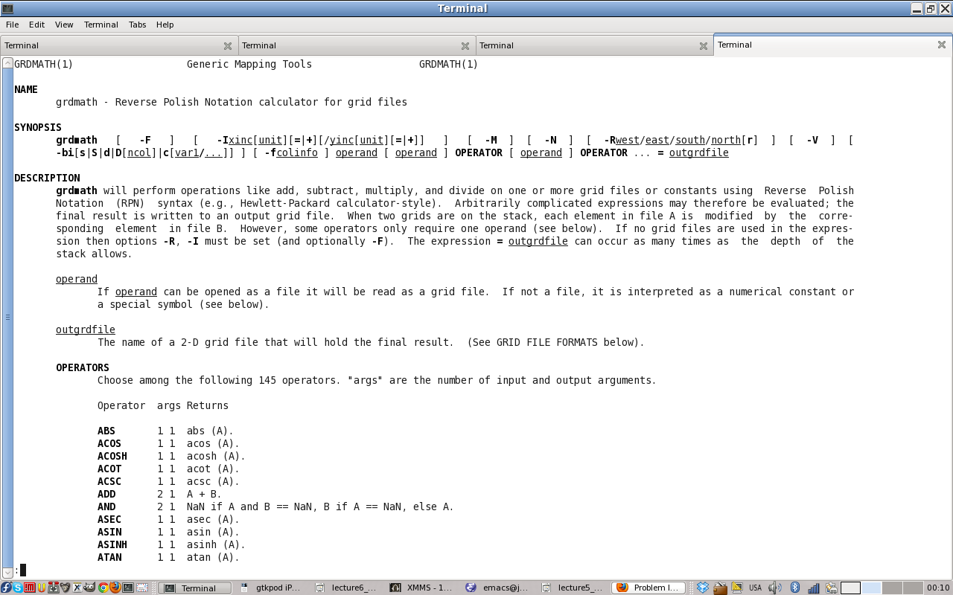
Operating on grids
grdmath

Slide 25
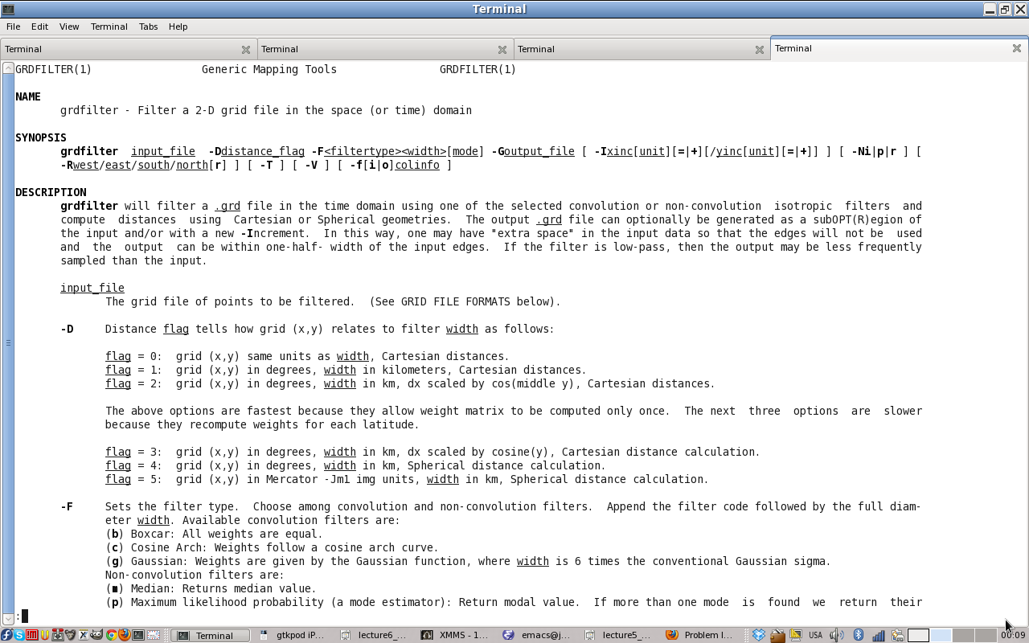
Operating on grids
grdfilter Filtering of data, e.g. convolution with Gaussian to smooth

Slide 26
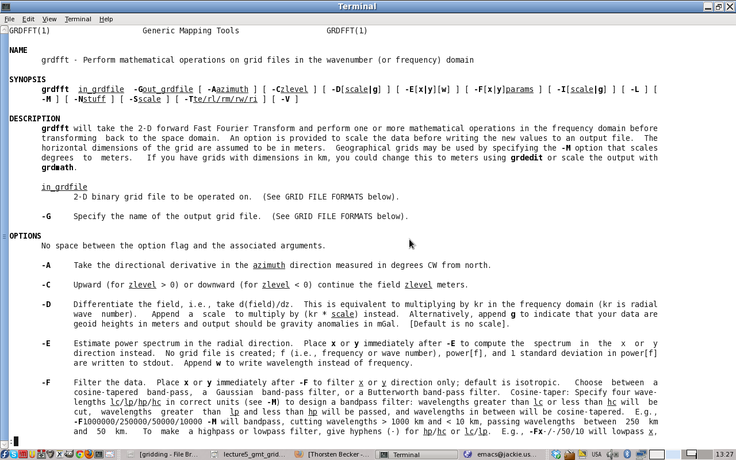
Operating on grids
grdfft Fourier transform, e.g. to compute spatial power spectra

Slide 27
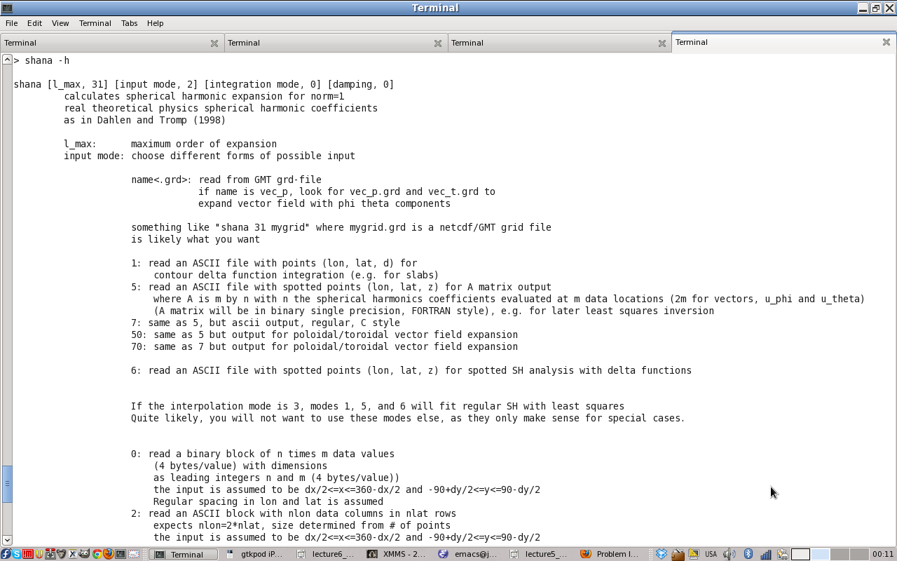
Operating on grids
shana/shsyn Spherical harmonics analysis for global grids

Slide 28

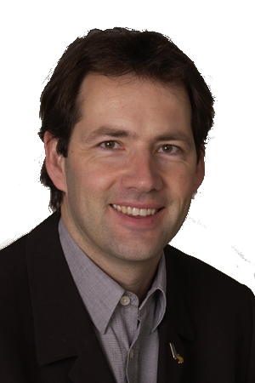
iGMT
Interactive mapping of
geoscientific datasets
Written by Thorsten Becker and Alexander Braun
UNIX based, TclTk script graphical user interfact for GMT
Access to several Earth science datasets
Produces GMT/bash scripts
(development discontinued, in favor of python based SEATREE)
http://geodynamics.usc.edu/~becker/igmt/

Slide 29
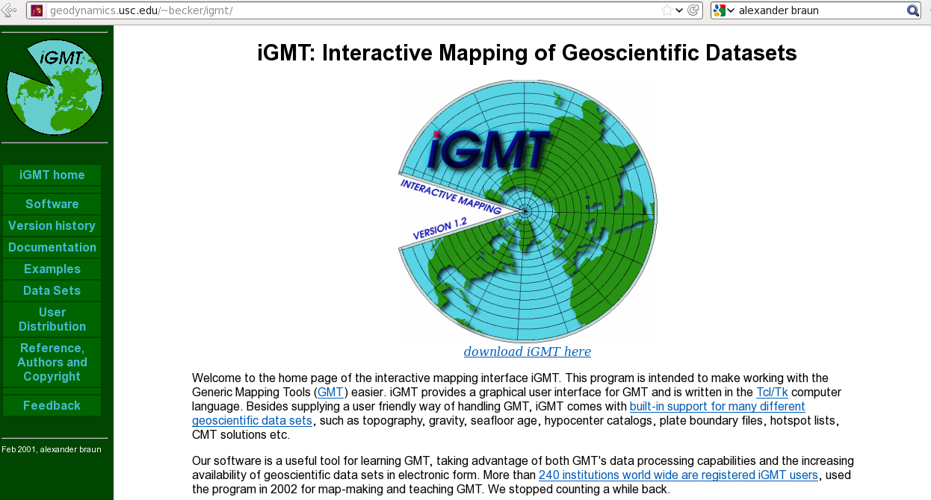
Installed on USC Geodynamics Earth Science Computing Environment

Slide 30
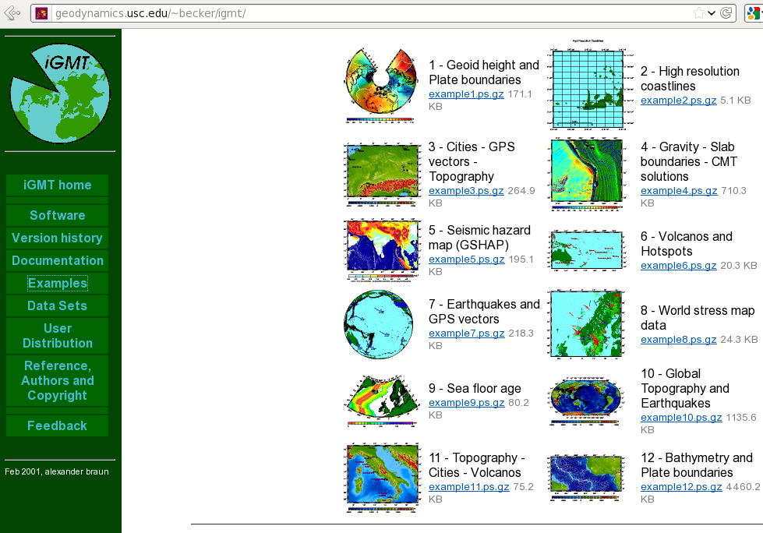
iGMT produced maps

Slide 31
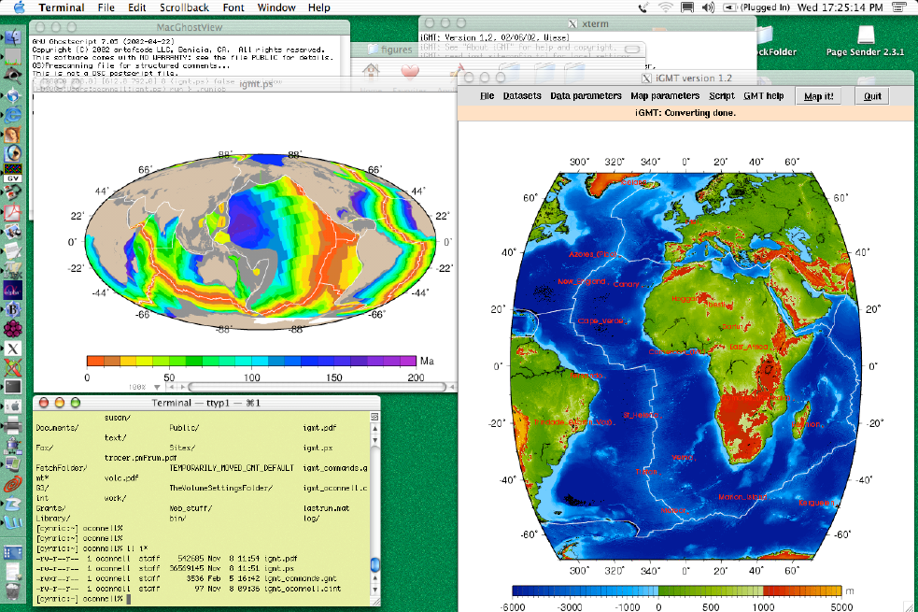
iGMT on desktop

Slide 32
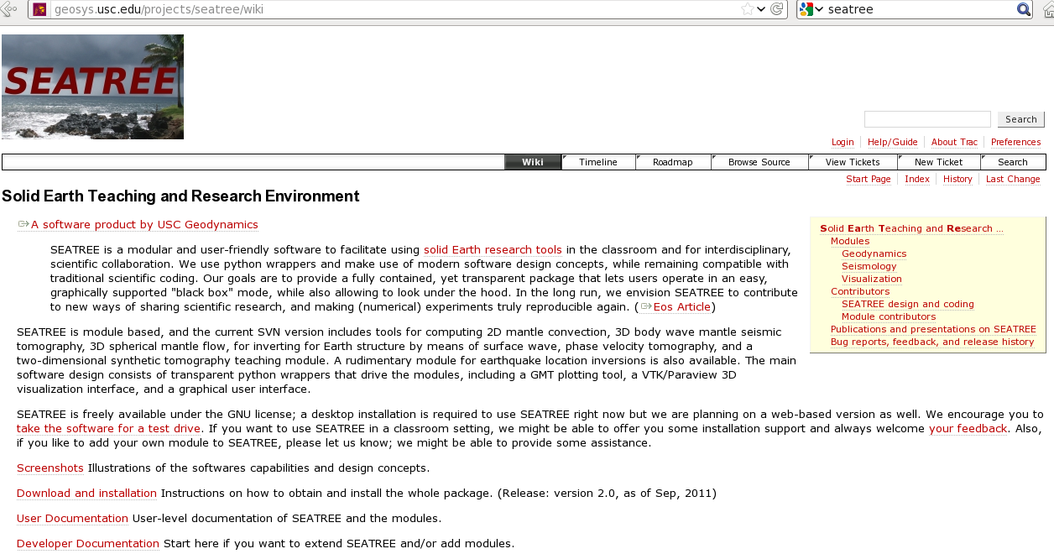
Solid Earth Research and Teaching Environment (SEATREE)

Slide 33
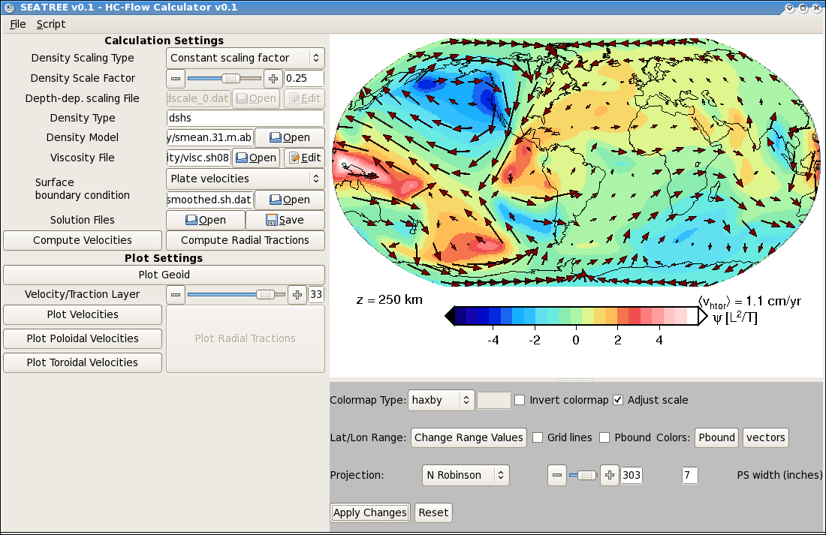
Python interface for GMT plots
(Only very rudimentary implementation; there are previous attempts on python-GMT, and
a proper interface is in the works.)

Slide 34
Making movies with GMT
Write a script that loop through parameters
Convert PS to GIF
Use gifsicle or similar to make a GIF movie

Slide 35
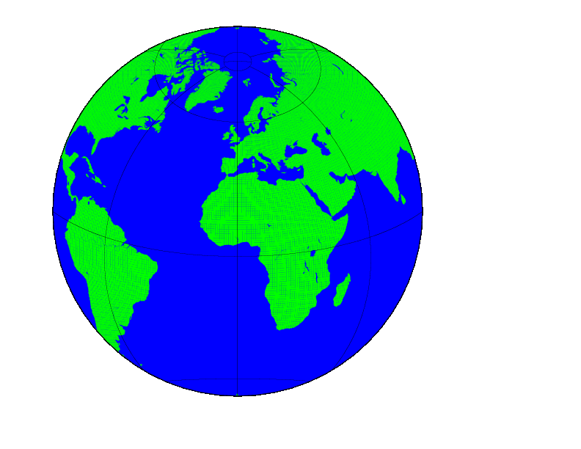
Making movies with GMT

Slide 36
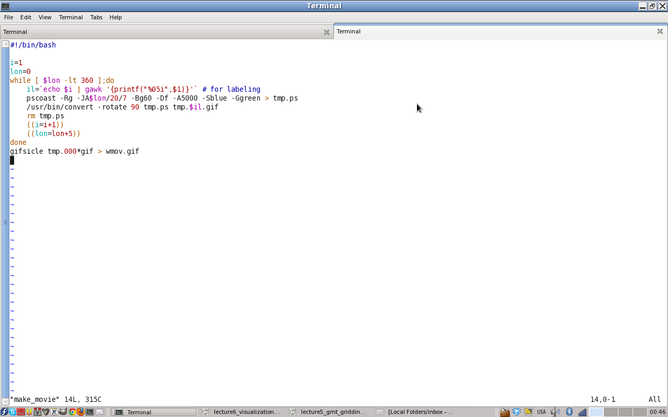
Making movies with GMT

