Slide 1
Earthquake Physics
UT GEO 302P – Spring 2021
Part III (Earthquakes) – Lecture #3, March 11, 2021
Prof. Thorsten Becker
Reading: Ch. 3

Slide 2

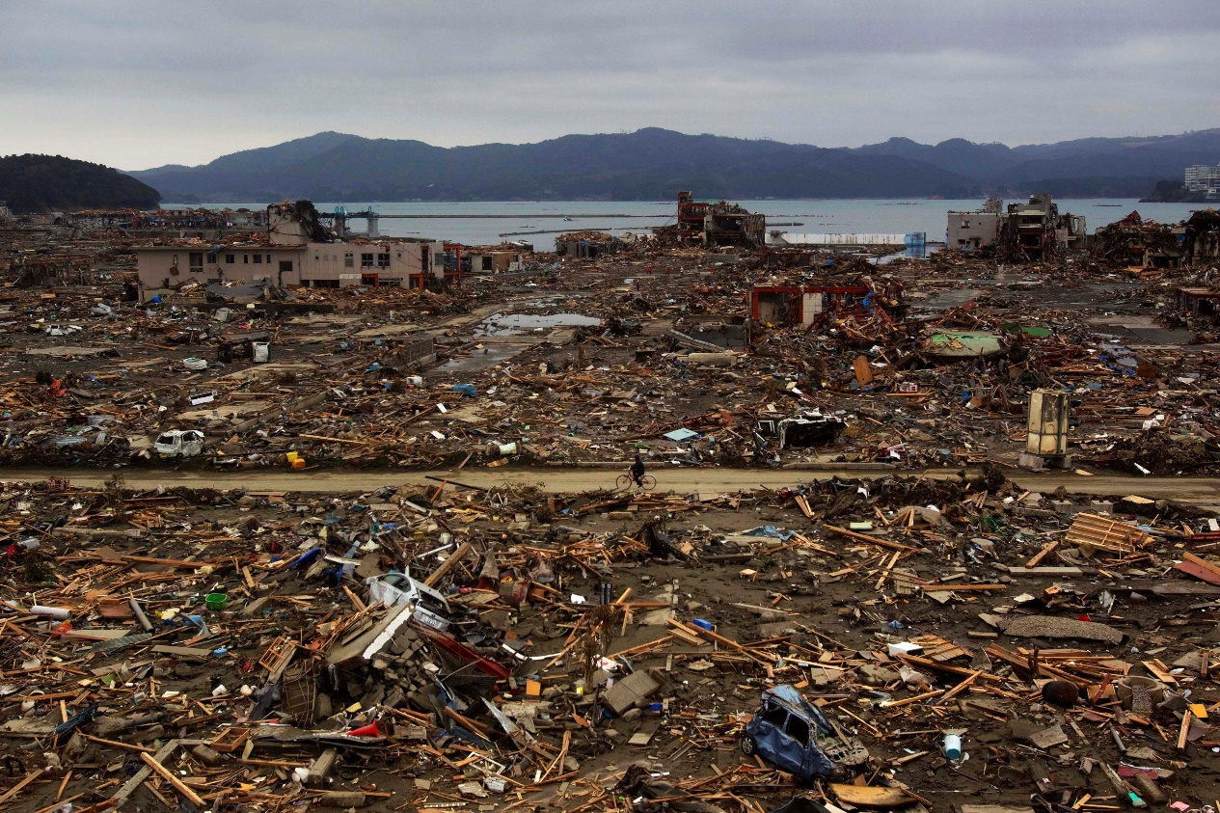
Magnitude 9.1 NEAR THE EAST COAST OF HONSHU, JAPAN
Friday, March 11, 2011 at 05:46:24 UTC
Ten years ago, on March 11, 2011, a devastating magnitude 9.1 earthquake occurred 130 km (80 miles) east of Sendai, Honshu, Japan and 373 km (231 miles) northeast of Tokyo, Japan at a depth of 24.4 km (15 miles).
In this March 15, 2011 photo, a survivor of the earthquake and tsunami rides his bicycle through the leveled city of Minamisanriku, in northeastern Japan, four days after the tsunami.
(AP Photo/David Guttenfelder)
Notes:
https://earthquake.usgs.gov/earthquakes/eventpage/official20110311054624120_30/executive

Slide 3
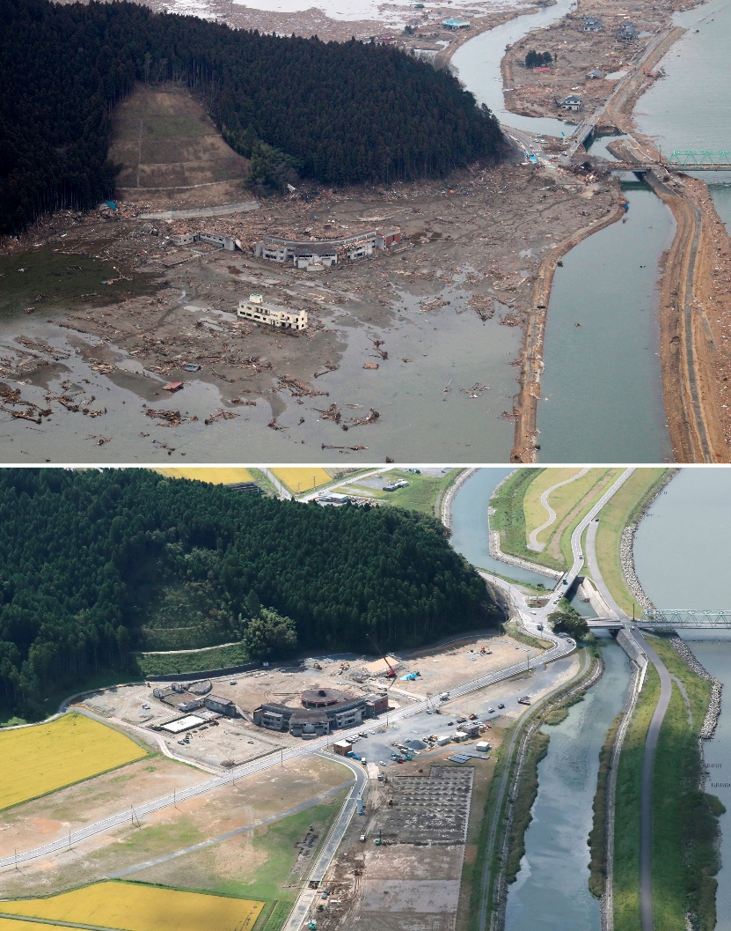
Magnitude 9.1 NEAR THE EAST COAST OF HONSHU, JAPAN
Friday, March 11, 2011 at 05:46:24 UTC
This M 9.1 earthquake and the tsunami that followed caused 15,899 deaths and 6,157 injuries, with 2,529 still missing. 130,927 people were displaced from their homes. 332,395 buildings, 2,126 roads, 56 bridges and 26 railways were destroyed or damaged. The vast majority of fatalities and damage was due to the tsunami and were concentrated on the Pacific coast of northern Honshu.
Electricity, gas and water supplies, telecommunications, and railway service were disrupted. The tsunami disabled the power supply and cooling of three Fukushima Daiichi reactors, causing a nuclear accident. The region experienced liquefaction, landslides, and a dam failure.
An aerial combination photo shows Okawa Elementary School after the tsunami hit (top, March 15, 2011) and (bottom, September 28, 2020) in Ishinomaki, Miyagi Prefecture. Seventy-eight students and ten teachers of the elementary school were killed in the tsunami.

Slide 4
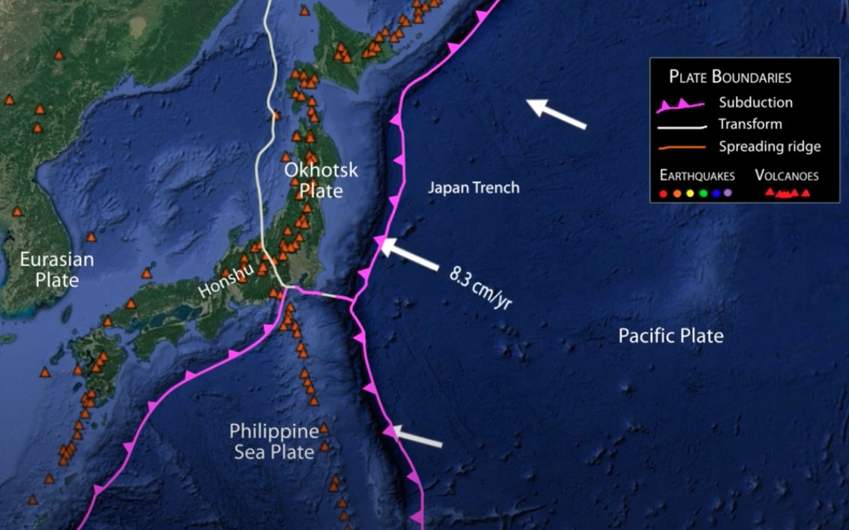
Magnitude 9.1 NEAR THE EAST COAST OF HONSHU, JAPAN
Friday, March 11, 2011 at 05:46:24 UTC
In Northern Honshu, the Pacific Plate subducts beneath the Okhotsk Plate at a rate of 8.3 cm/year. The epicenter of the magnitude 9.1 earthquake is shown by the red star.
Notes:
Relevant Animation:
Japan's Earthquakes & Tectonic Setting
https://www.iris.edu/hq/inclass/animation/546
YouTube: https://youtu.be/5BHnf1wGD9w

Slide 5
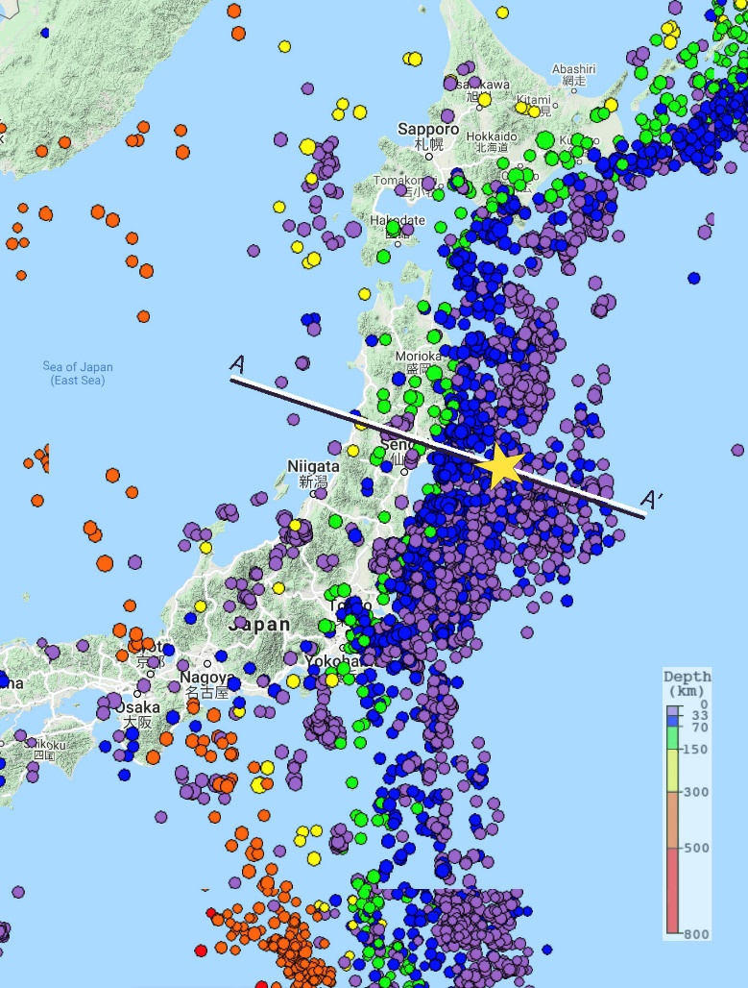
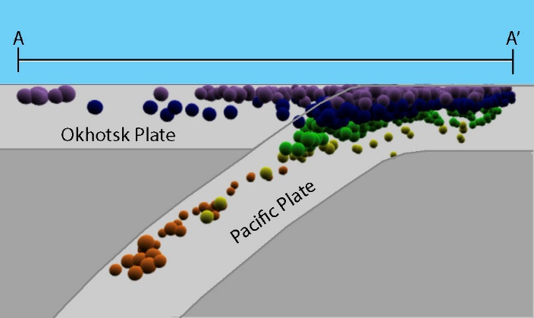
Magnitude 9.1 NEAR THE EAST COAST OF HONSHU, JAPAN
Friday, March 11, 2011 at 05:46:24 UTC
The map on the right shows historic earthquake activity > M 5 near the epicenter (star) from 1990 to present.
As shown on the cross section, earthquakes are shallow (purple) at the Japan Trench and increase in depth towards the west as the Pacific Plate dives deeper beneath Japan.
Seismicity Cross Section showing the megathrust plate boundary dipping beneath northern Honshu.
Images created with the IRIS Earthquake Browser
Notes:
Explore the Seismicity:
IRIS Earthquake Browser: http://ds.iris.edu/ieb/

Slide 6
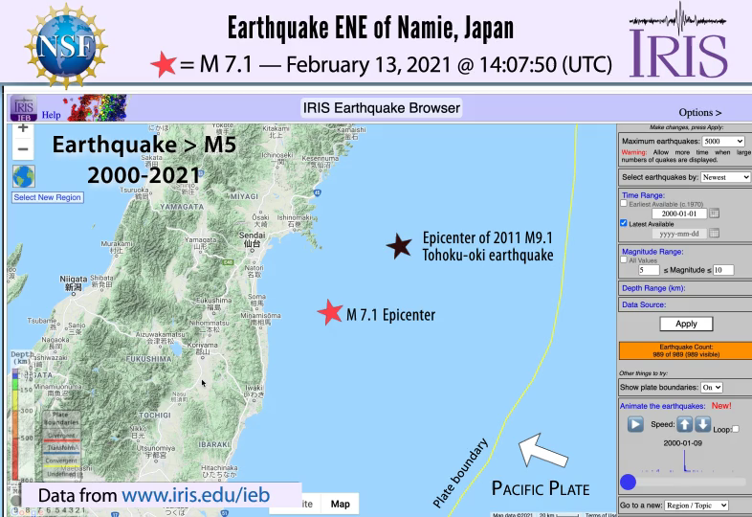
Magnitude 9.1 NEAR THE EAST COAST OF HONSHU, JAPAN
Friday, March 11, 2011 at 05:46:24 UTC
Animating 21 years of regional seismicity greater than magnitude 5. The red star highlights a recent 2021 aftershock, the black star highlights the M 9.1 2011 earthquake.
This earthquake was preceded by a series of large foreshocks over the prior two days, beginning on March 9th with an M 7.2 event approximately 40 km from the M 9.1.
In the 10 years that followed, aftershocks have continued and now number in the thousands.
Animation created with the IRIS Earthquake Browser
Notes:
Explore the Seismicity:
IRIS Earthquake Browser: http://ds.iris.edu/ieb/

Slide 7
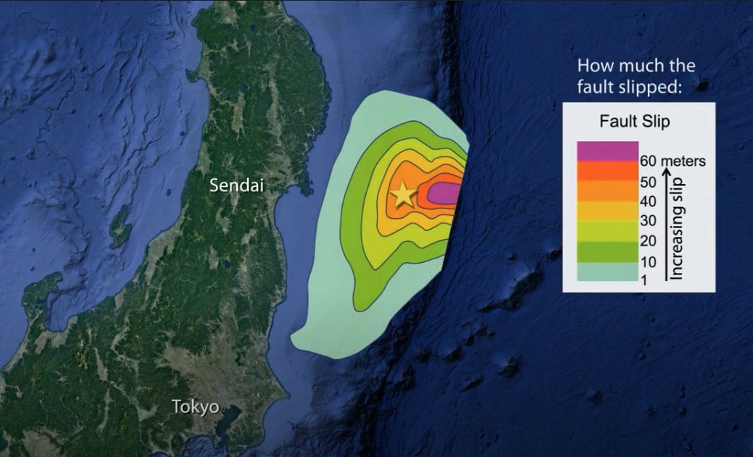
Magnitude 9.1 NEAR THE EAST COAST OF HONSHU, JAPAN
Friday, March 11, 2011 at 05:46:24 UTC
Rupture area for March 11, 2011
Magnitude 9.0
Tohoku-oki Earthquake
Rupture area for March 11, 2011
Magnitude 9.1
Tohoku-oki Earthquake
The M 9.1 Tohoku-oki earthquake ruptured a 500-km-long by 200-km-wide area of the Pacific – Okhotsk megathrust plate boundary. Fault slip reached over 60 meters near the Japan Trench. This great earthquake, the largest in Japan’s history, and the resulting tsunami took almost 20,000 lives and caused approximately $200 billion in damage (2011 dollars).

Slide 8
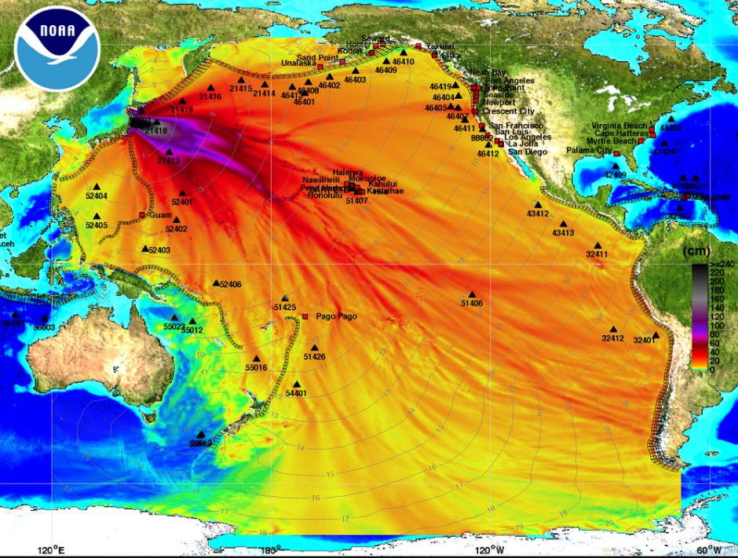
Magnitude 9.1 NEAR THE EAST COAST OF HONSHU, JAPAN
Friday, March 11, 2011 at 05:46:24 UTC
A Pacific wide tsunami warning was issued following this earthquake. The contour lines on this map show tsunami travel time in hours and the colors indicate wave height in centimeters.
The tsunami killed over 17,000 people, all but two of whom were in Japan.
One person was killed and several houses were destroyed at Indonesia, Indonesia by the tsunami (wave height 2 m).
One person was killed south of Crescent City, California (wave height 2.5 m). Several houses, boats and docks were destroyed or damaged.
In the open ocean, tsunami waves can travel at speeds up to 800 km per hour (500 miles per hour), as fast as a jet plane.

Slide 9
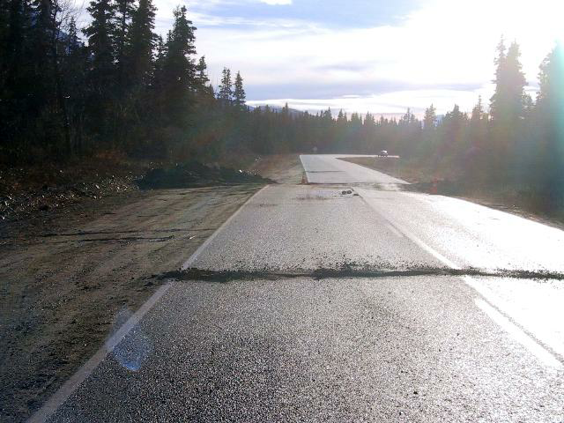
Earthquakes: sudden motion on faults

Slide 10
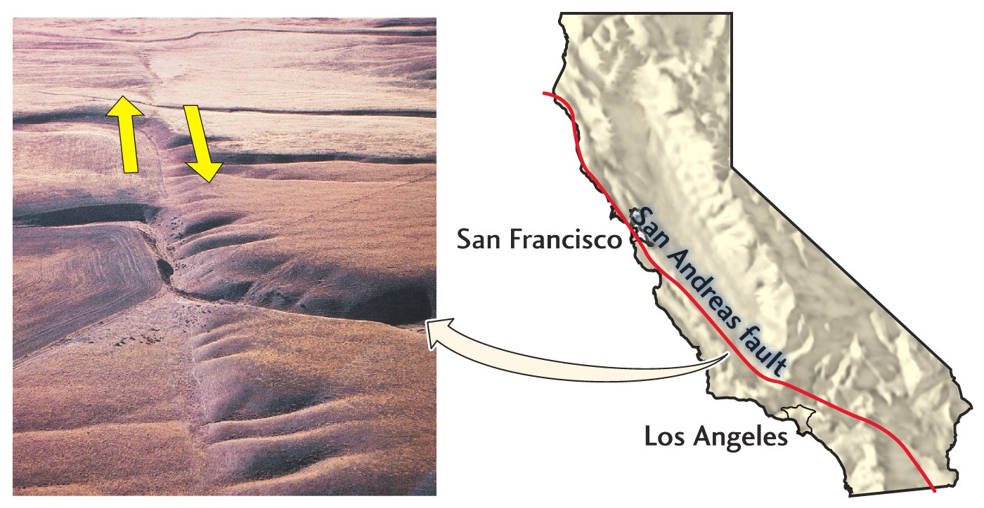
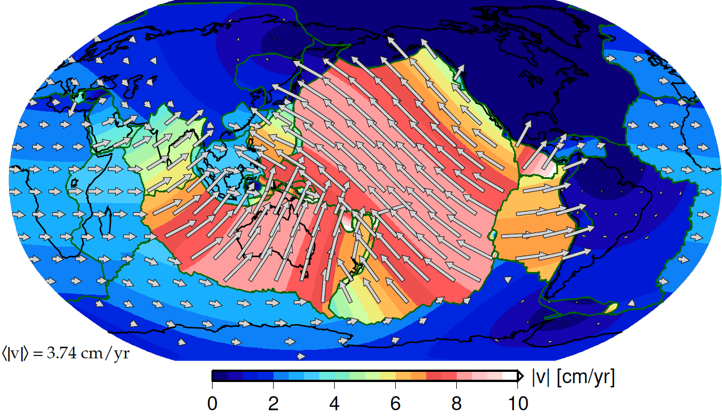
What controls when earthquakes happen at plate boundaries?

Slide 11
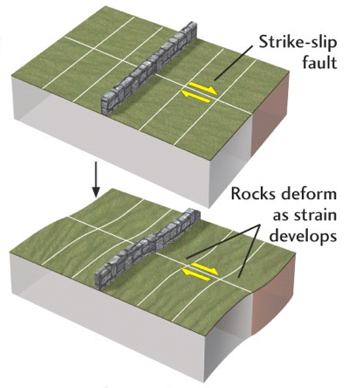

Slide 12
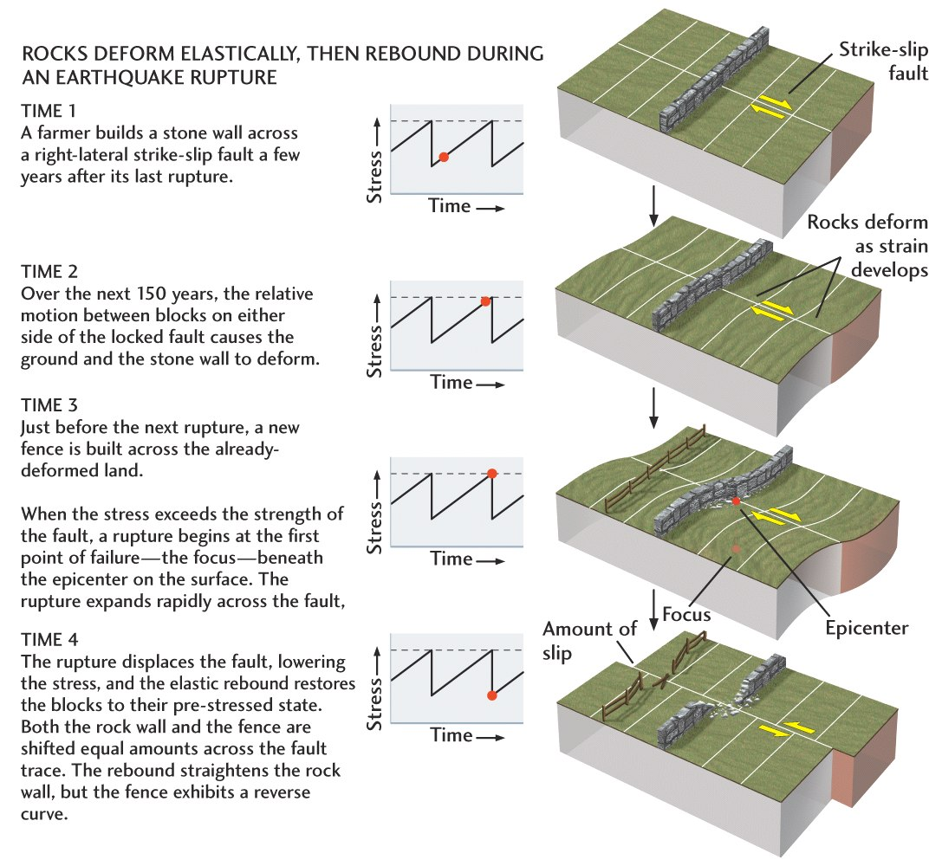

Slide 14
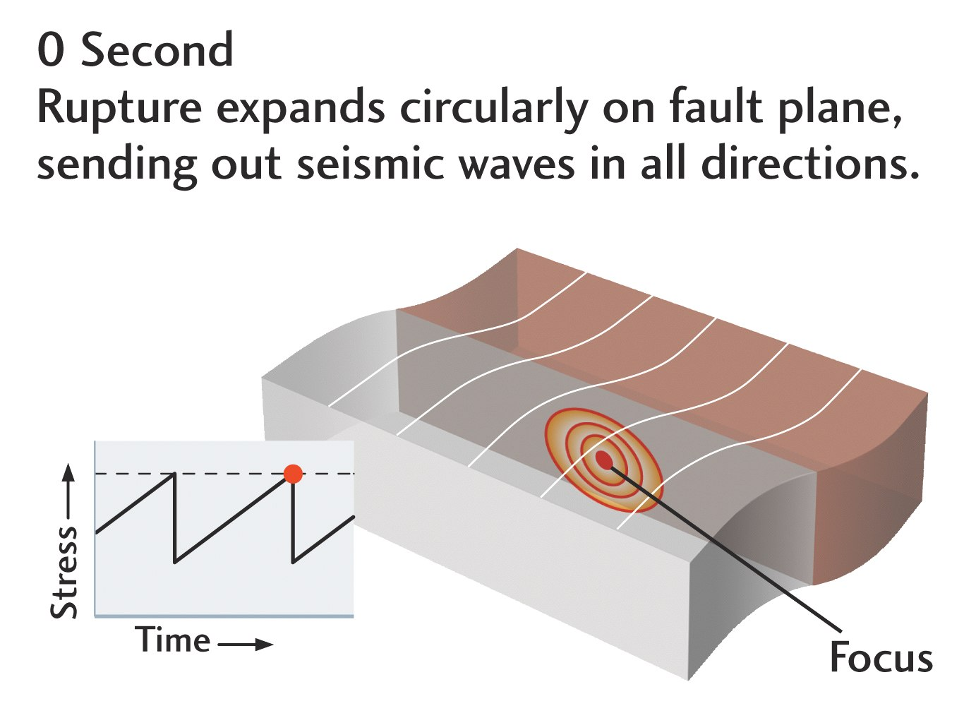
Earthquake rupture starts when failure strength exceeded

Slide 15
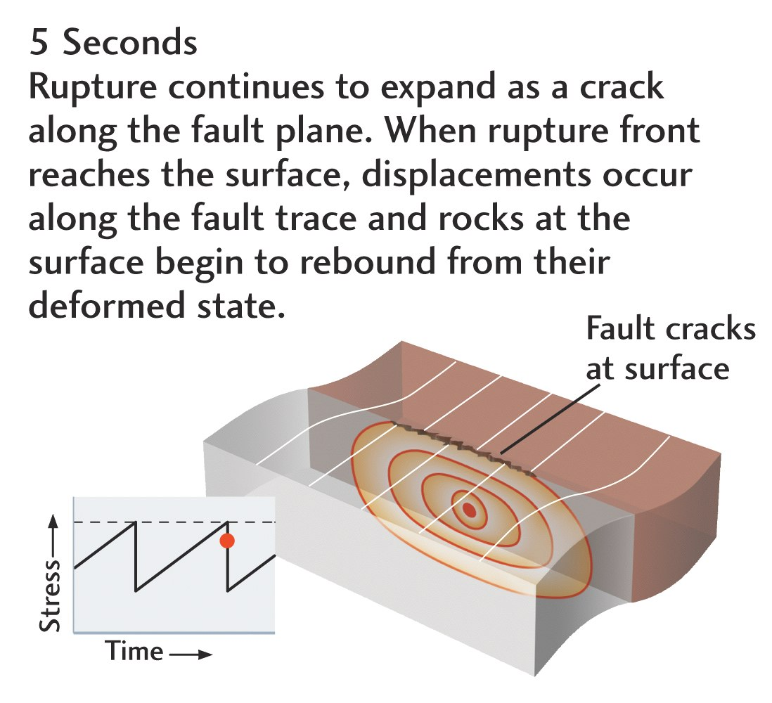
Rupture propagation

Slide 16
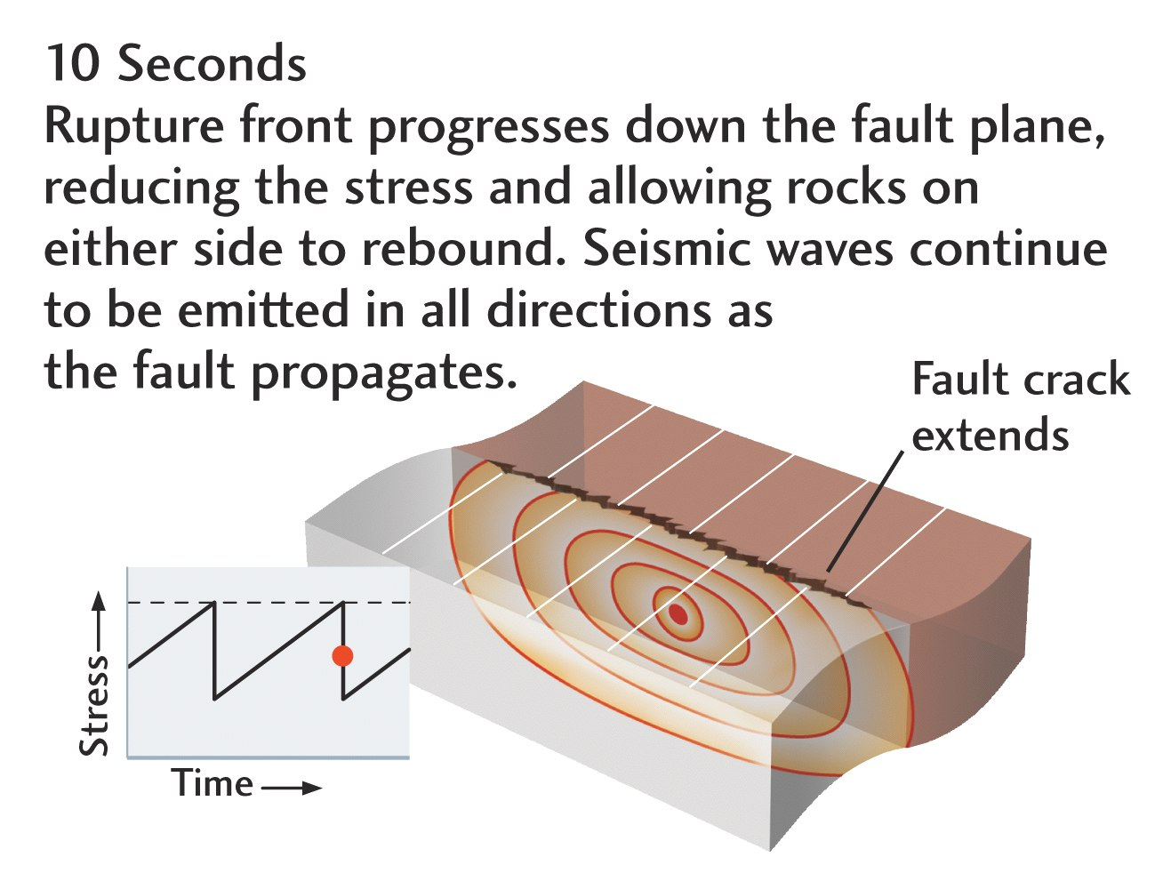
Rupture propagation

Slide 17
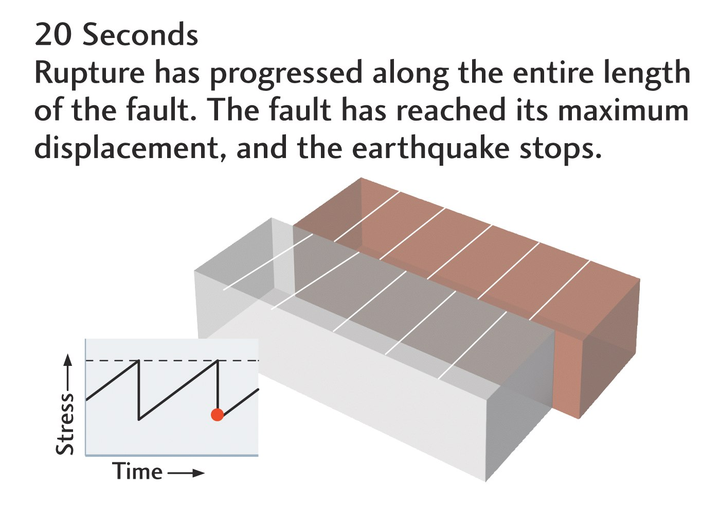
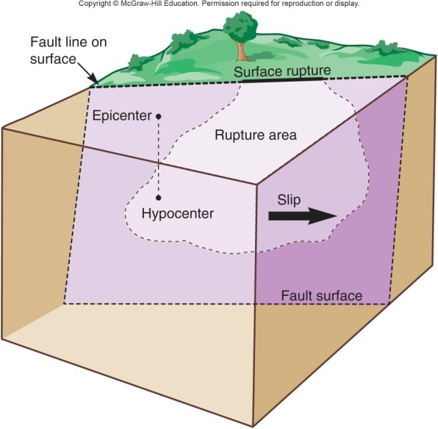
Rupture arrest

Slide 18
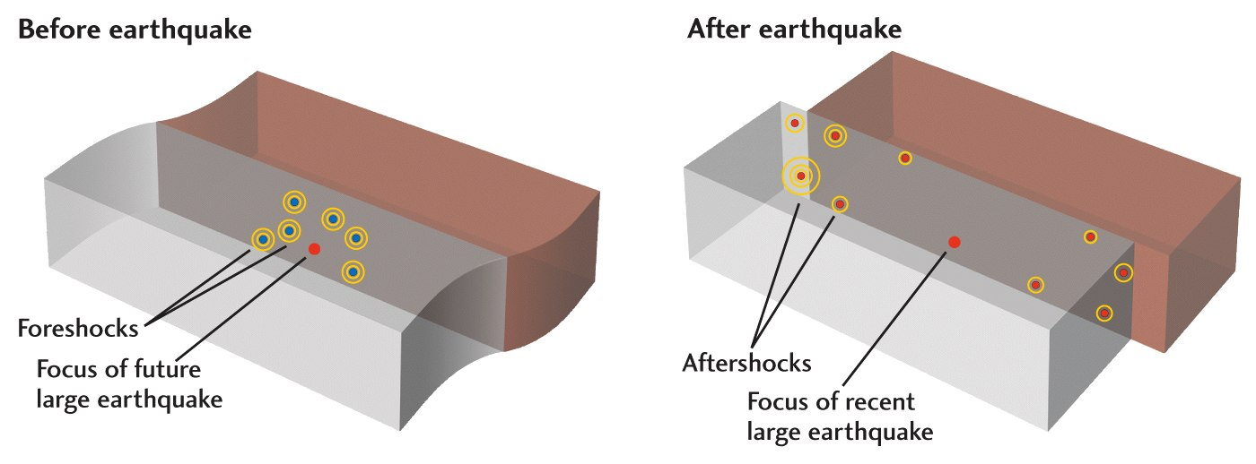
Foreshocks
Smaller earthquakes occur near the focus of the major earthquake (usually detected (and defined) in retrospect!)

Slide 19
Aftershocks
Occur on and around the edge of the rupture area (often define the latter)

Slide 20
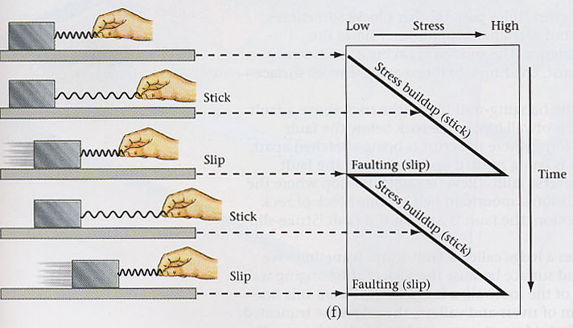
Reid’s (1910) elastic rebound theory
Stick-slip earthquake cycle

Slide 21
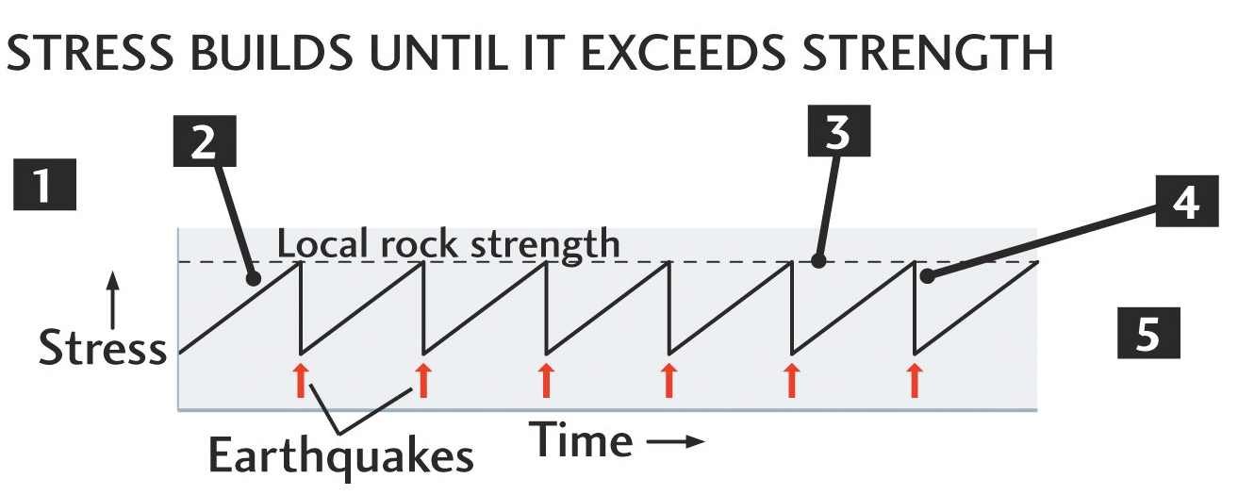
Why might this be too simplified?
(making it hard to predict earthquakes)

Slide 22
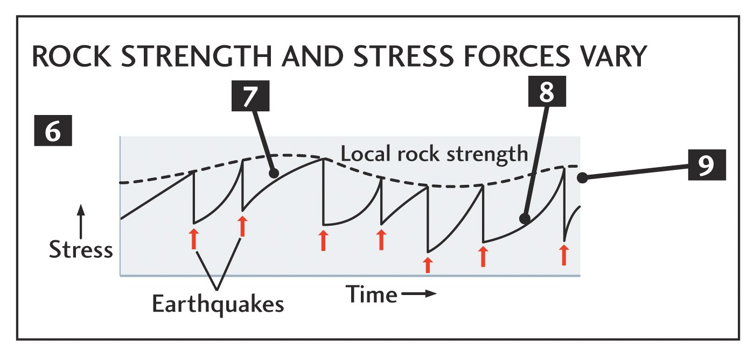
Complications

Slide 23
Seismicity (seismic activity)
Spatio-temporal clustering
  large event cycle/occurrence
    foreshocks (sometimes)
    aftershocks (almost always)
  earthquake interactions (triggering)
background seismicity
anthropogenic, climatic, tidal triggering

Slide 24
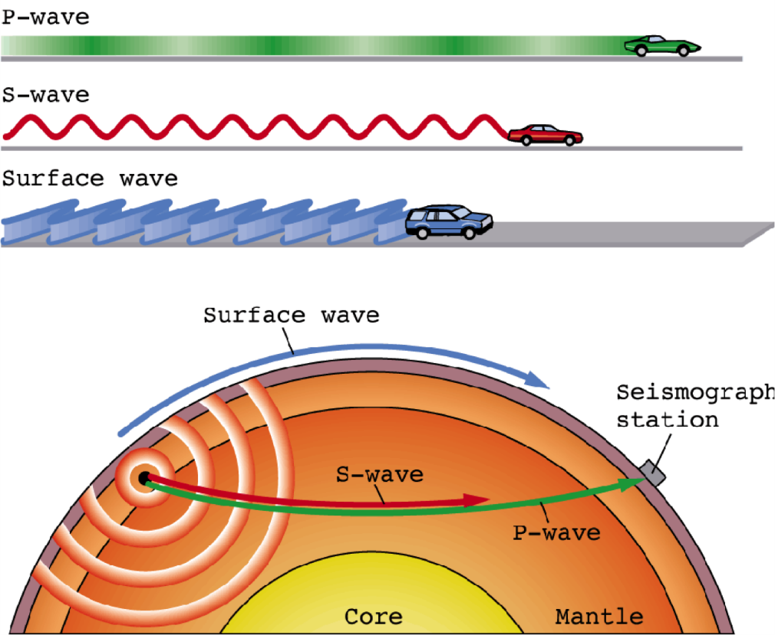
Earthquake source seismology
Quantify where, when, and how (big)?
different waves move at different speeds
their wavefronts separate further the longer the wave moves

Slide 25
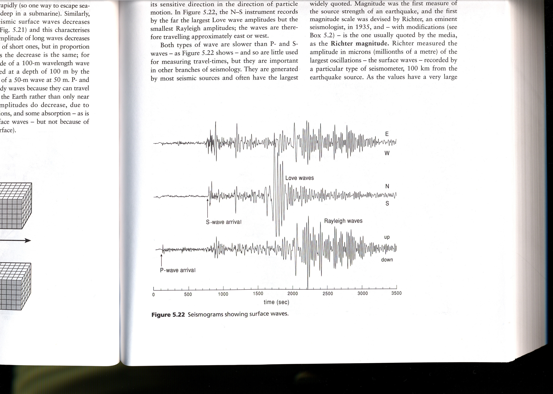
Delay between
P and S arrival
depends on distance

Slide 26
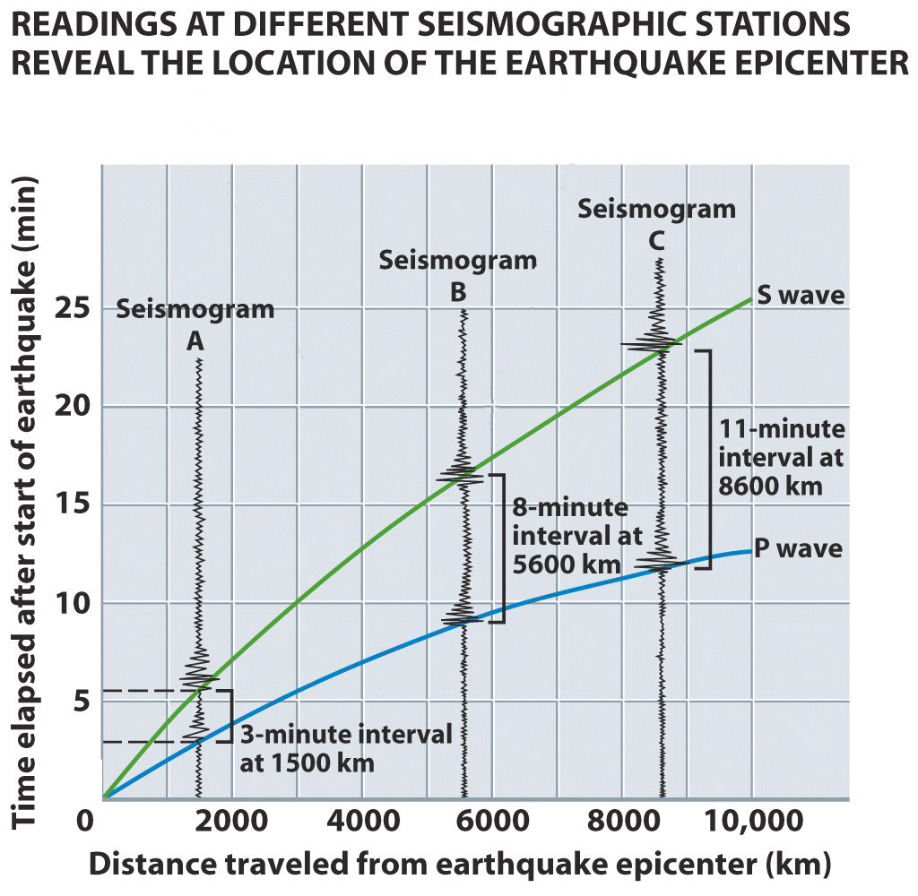
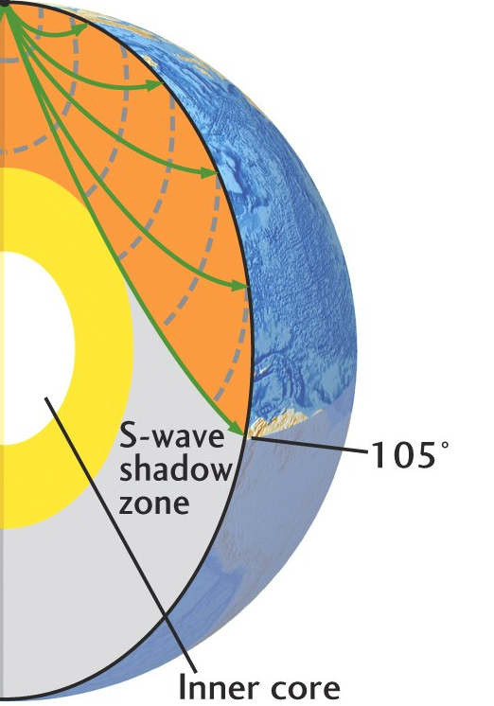
Obtain distance between earthquake and several stations from travel time curves

Slide 27
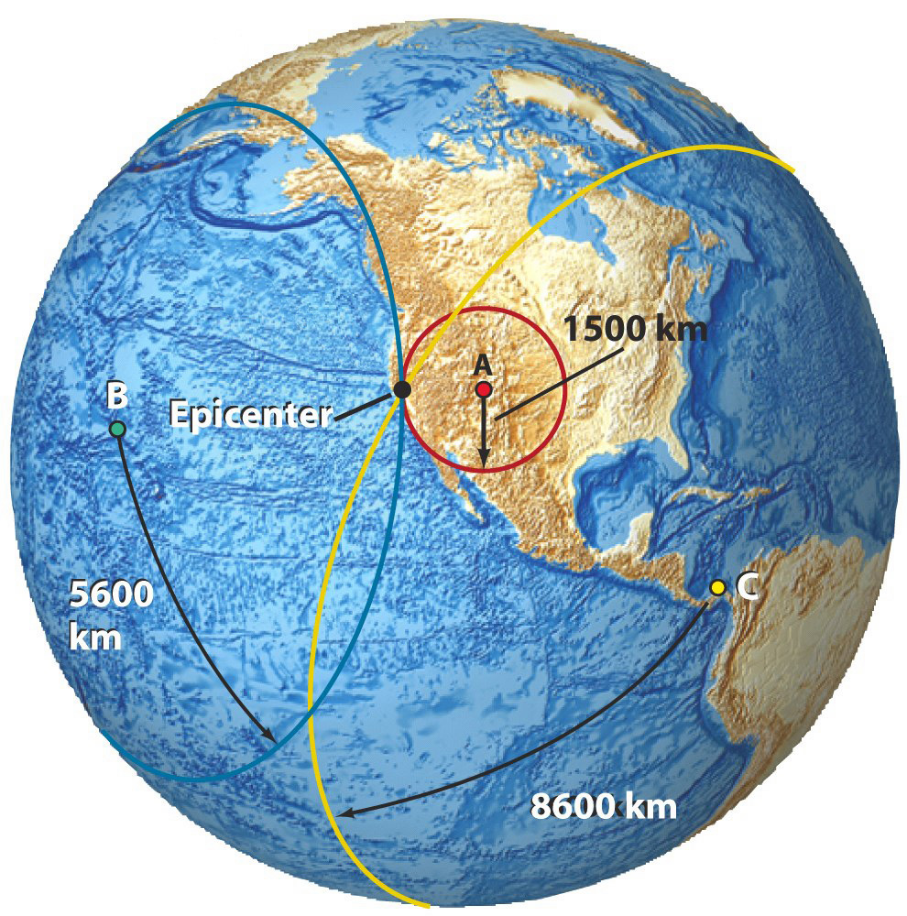
Locating an earthquake
epicenter: map location
hypocenter (or focus): actual location, allowing for depth

Slide 28
How might we quantify earthquake size?

Slide 29
Earthquake size measure I: seismic moment M₀
M₀ = slip × rupture area × shear modulus
based on rupture physics, scales with energy
slip, or offset
elastic constant
(spring stiffness,
rock property)

Slide 30
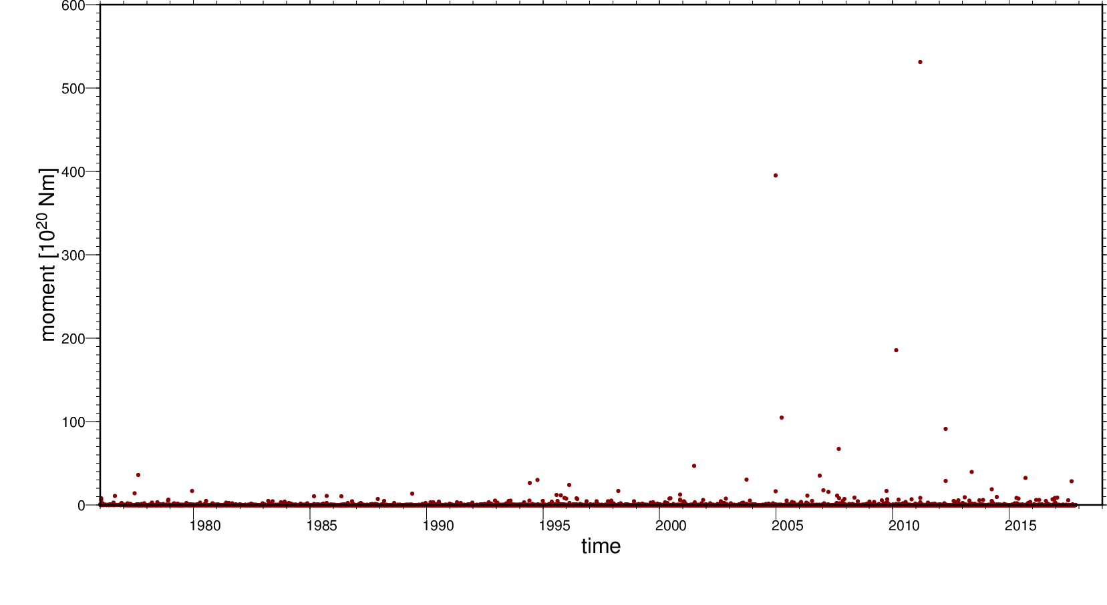
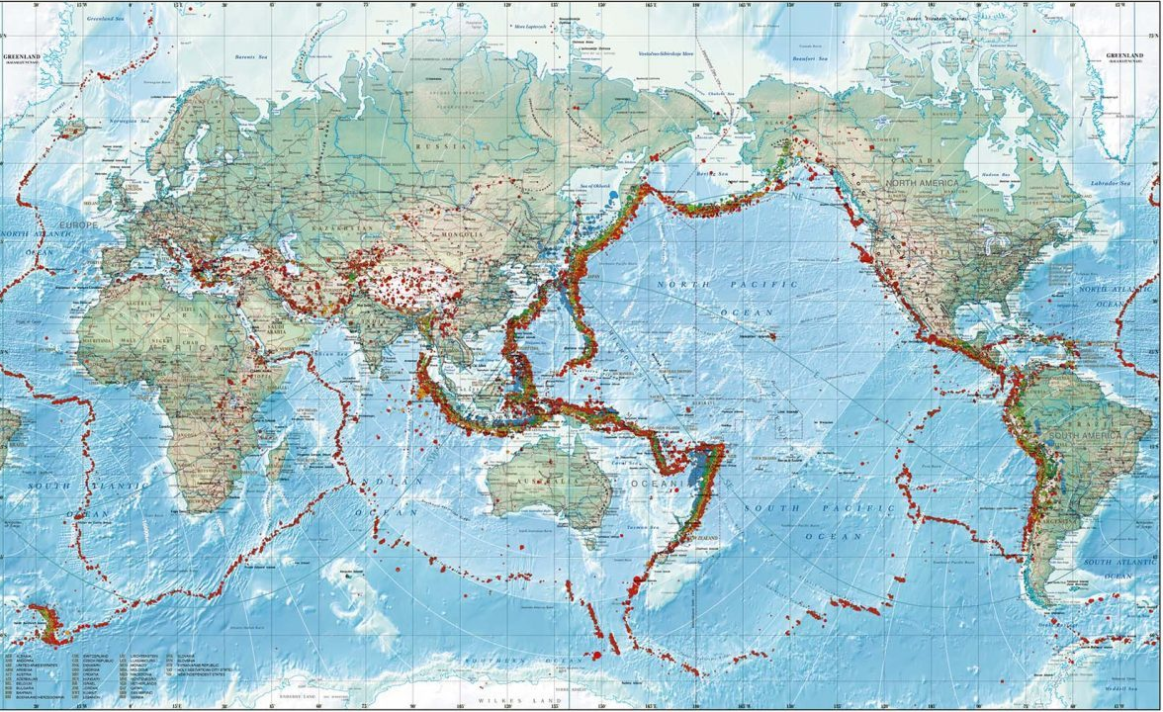
Moment catalog
global earthquake catalog

Slide 31
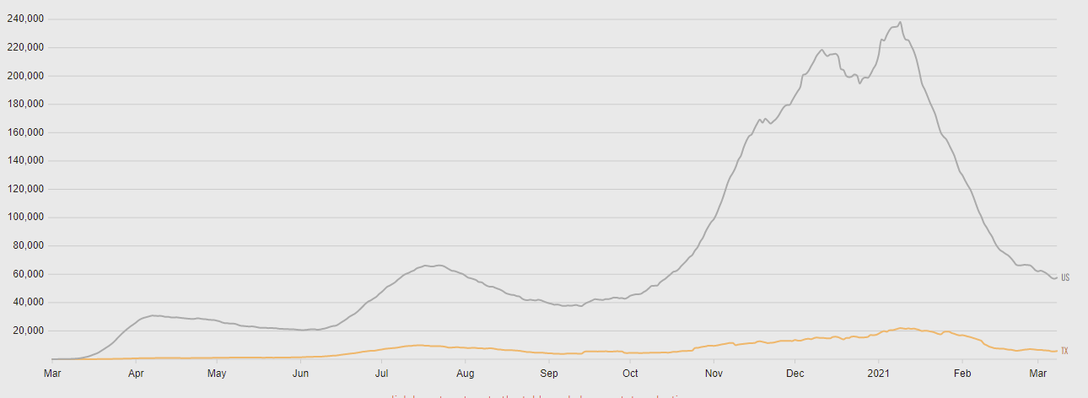
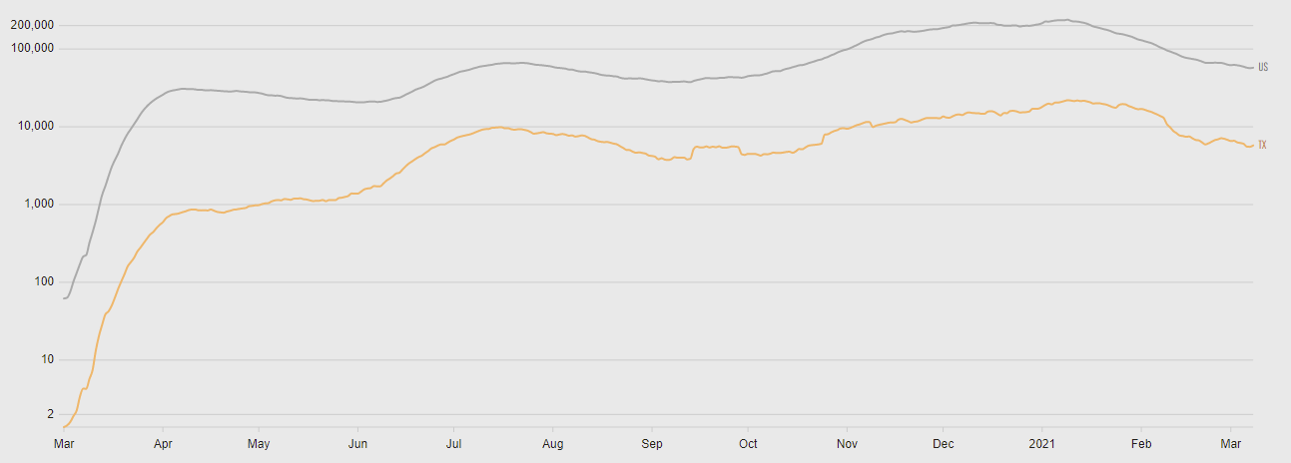
Daily new COVID cases
Linear scale on y axis
Logarithmic scale on y axis

Slide 32
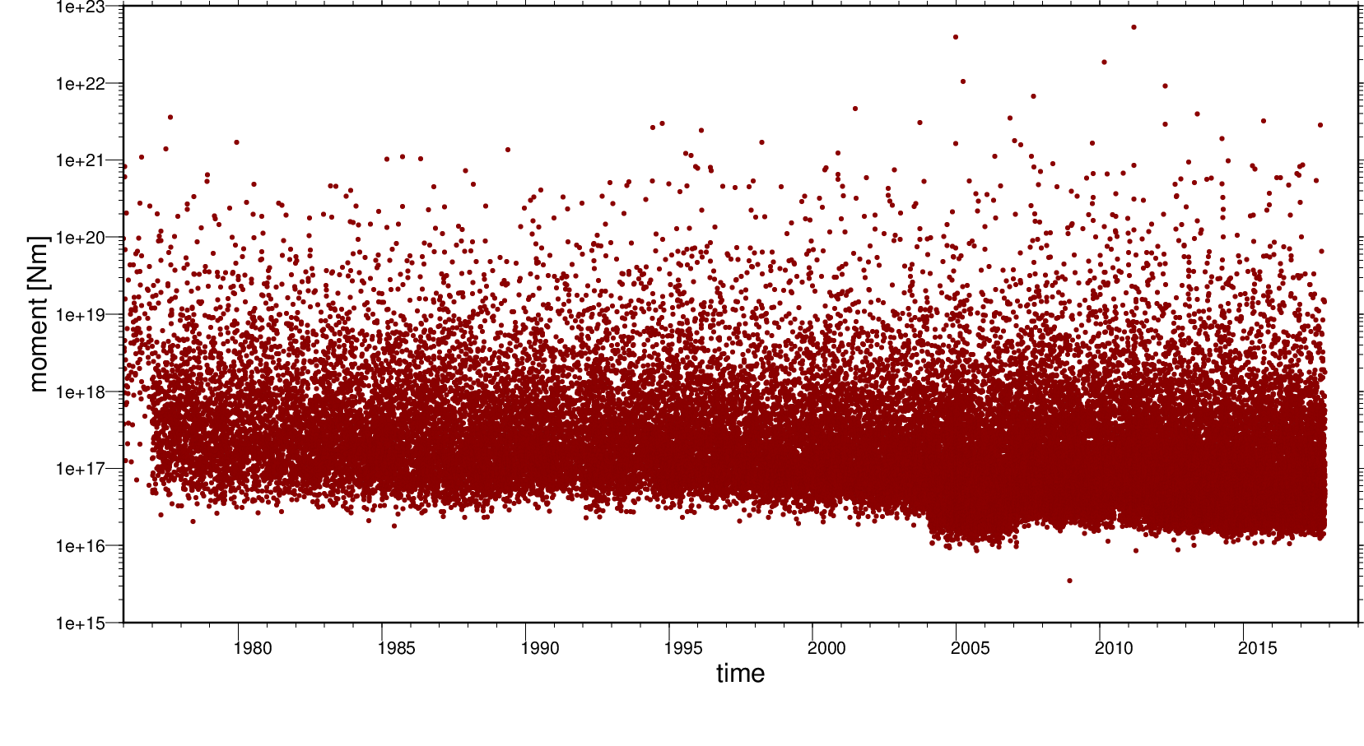
logarithmic scale for large variations in size

Slide 33
Earthquake size measure II:
(Richter) magnitude M
measure the amplitude A of seismic wave shaking at a certain period at a reference seismograph
take the logarithm of A and correct for distance
  M = log₁₀(A) + distance correction
Earthquakes less than M ~ 2 are generally not felt
Largest measured earthquake: M ~ 9.5 (Chile, 1960)

Slide 34
Moment (M₀) and magnitude (M)
Moment magnitude M based on M₀
M = 2/3 log₁₀(M₀) – 9.1 or
M₀ = 10^{3/2 (M + 9.1)}
Increase of 1 magnitude unit ~ 30 times more moment or energy release

Slide 35
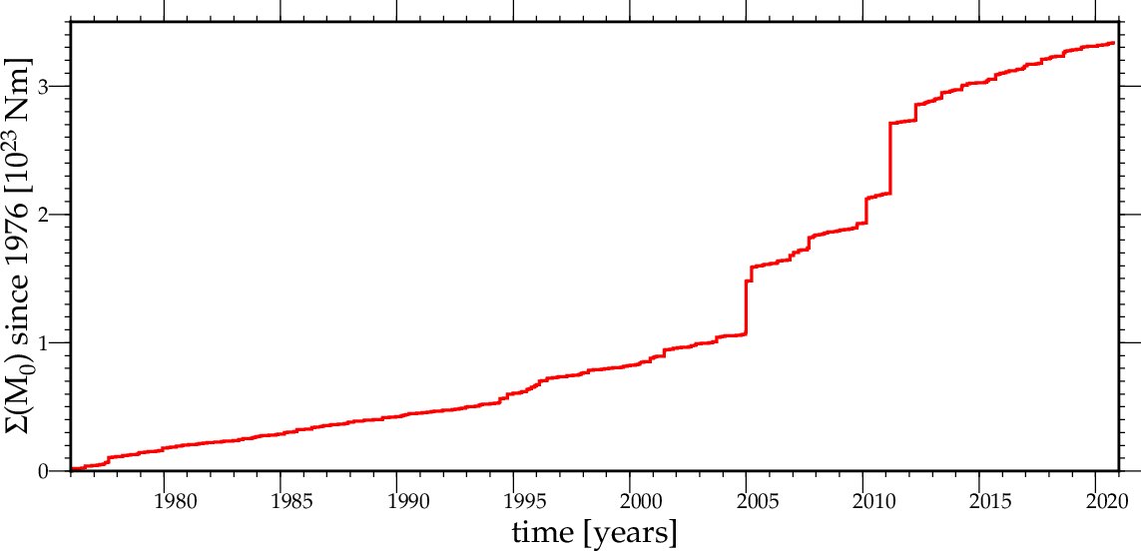
Summed global earthquake moment release

Slide 36
All earthquakes since 2011 M9 Tohoku-oki ~ same moment release

Slide 37
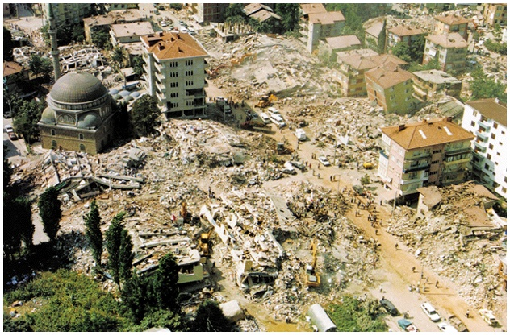
Earthquake size measure III: shaking intensity MI

Slide 38
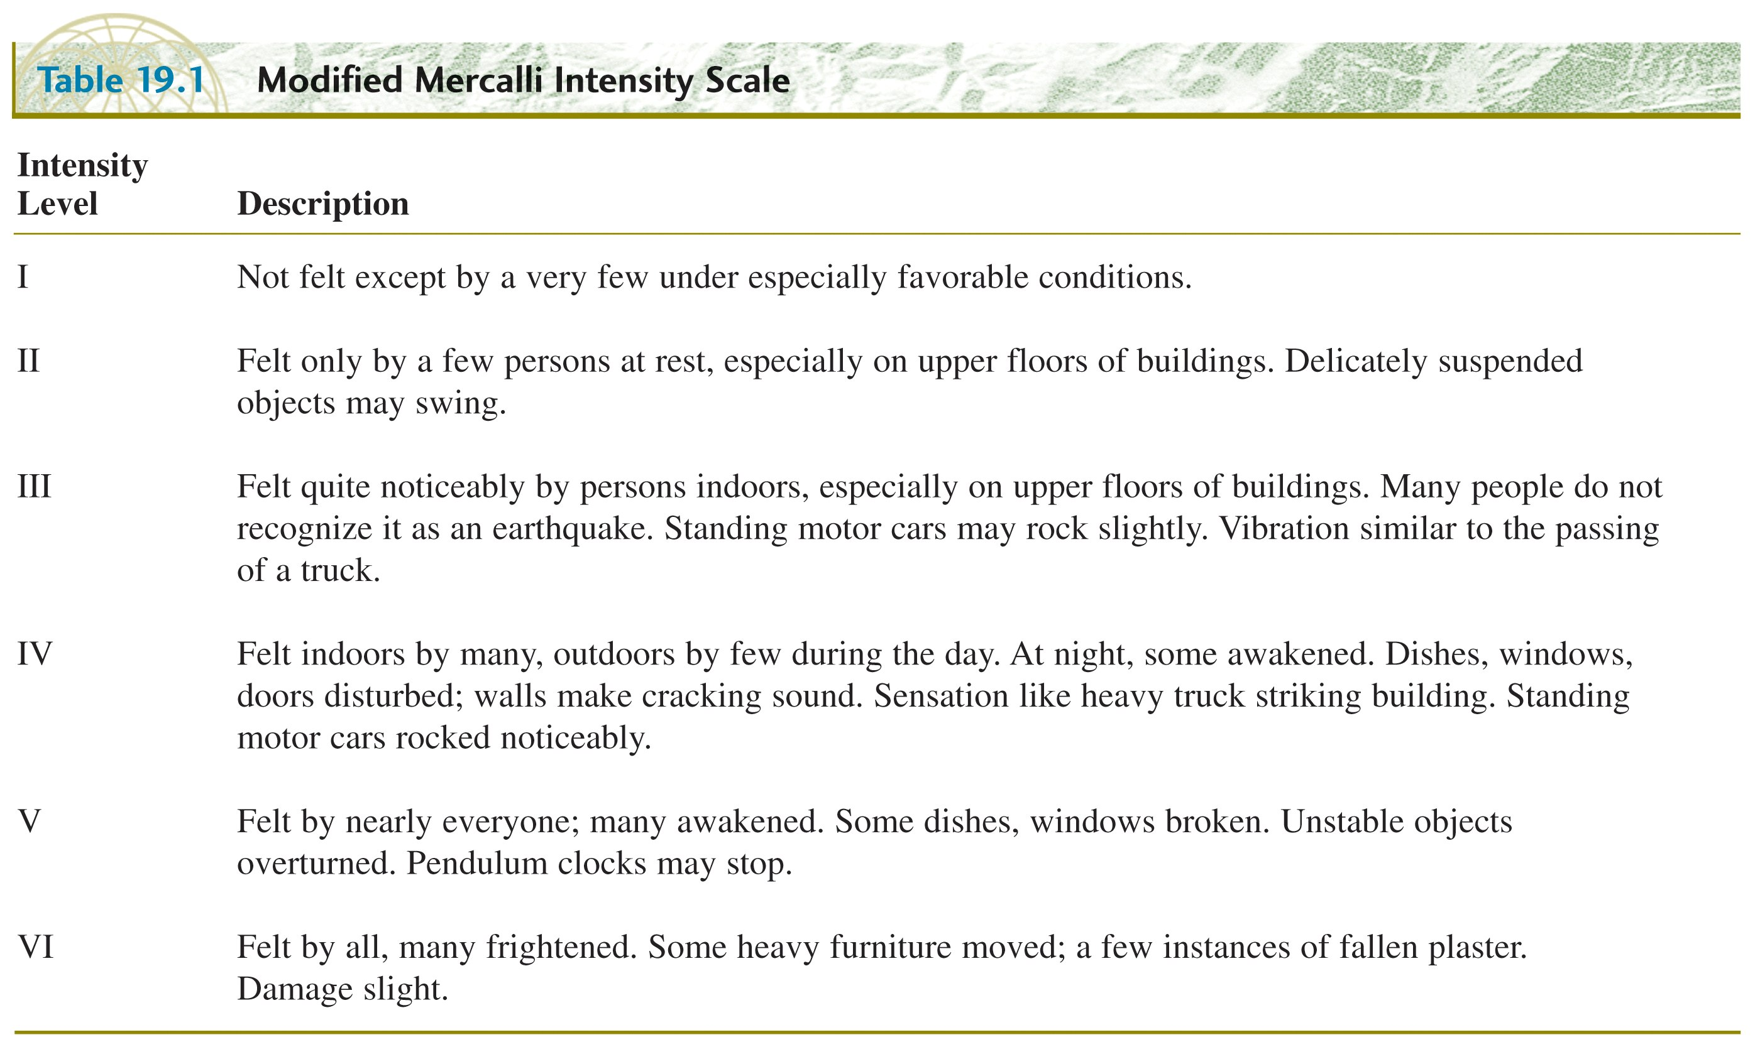
Earthquake size measure III: Modified Mercalli Intensity

Slide 39
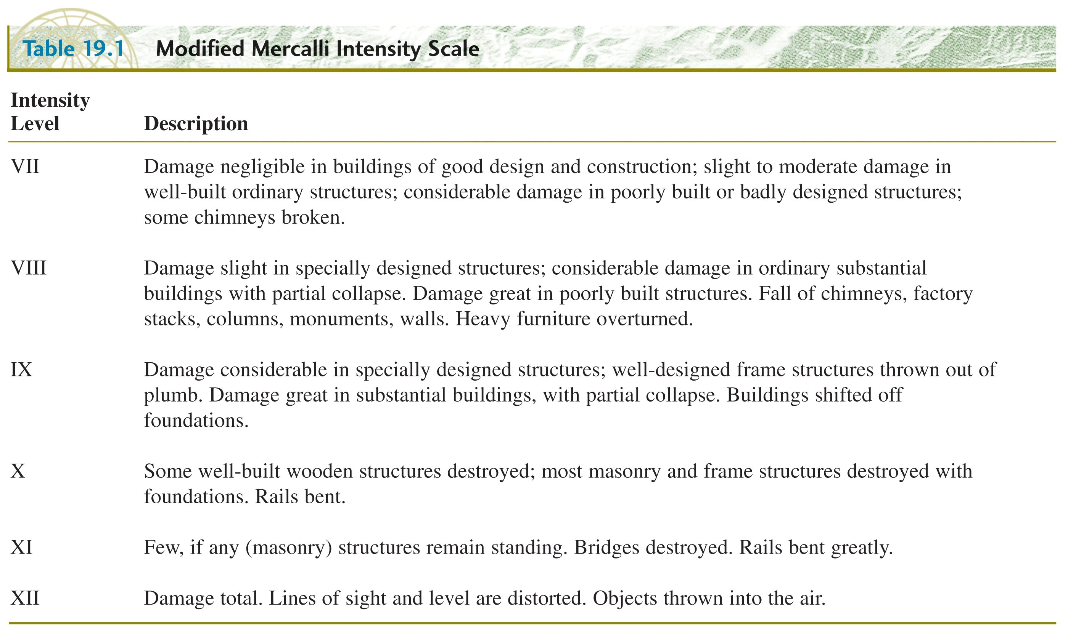
Earthquake size measure III: Modified Mercalli Intensity

Slide 40
Earthquake size metrics
Moment M₀
Based on physical quantities relating to the source, proportional to energy
Magnitude M
Based on the amplitude of ground motion recorded on a seismograph
Intensity I, or MI
Based on extent of damage and human perception (Modified Mercalli scale), equivalent to ground shaking (measured in fractions of gravitational acceleration, g)

Slide 41
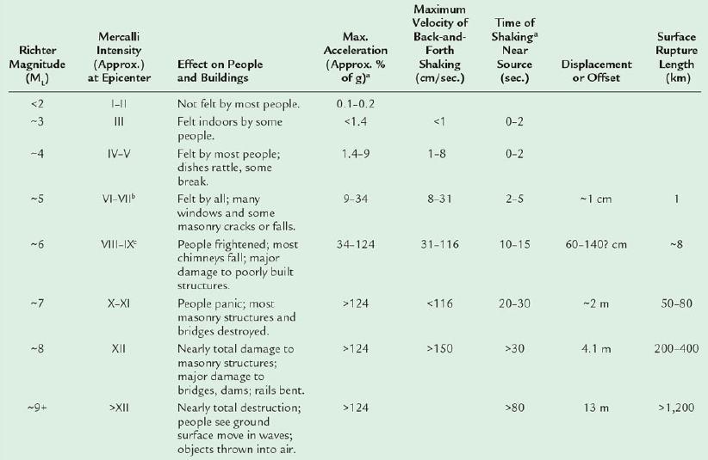
Relationship between size metrics

Slide 42
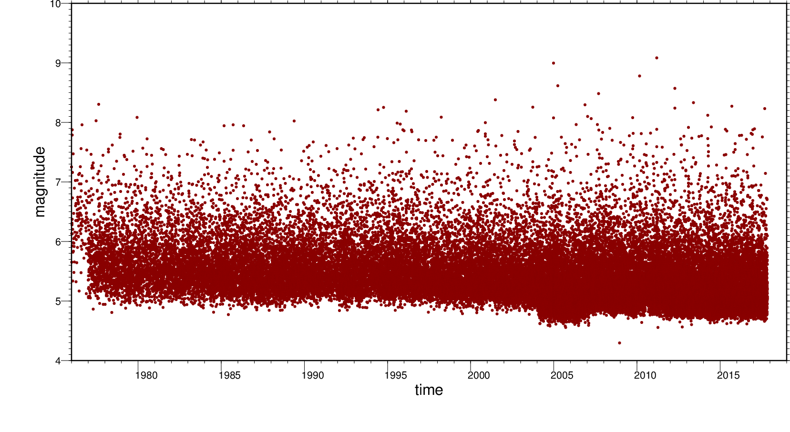
magnitude time distribution

Slide 43
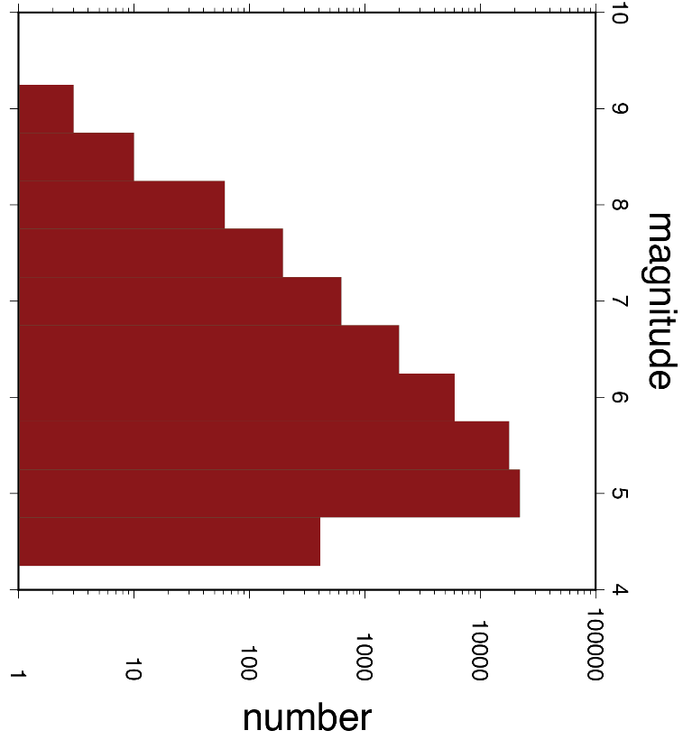
frequency-magnitude distribution

Slide 44
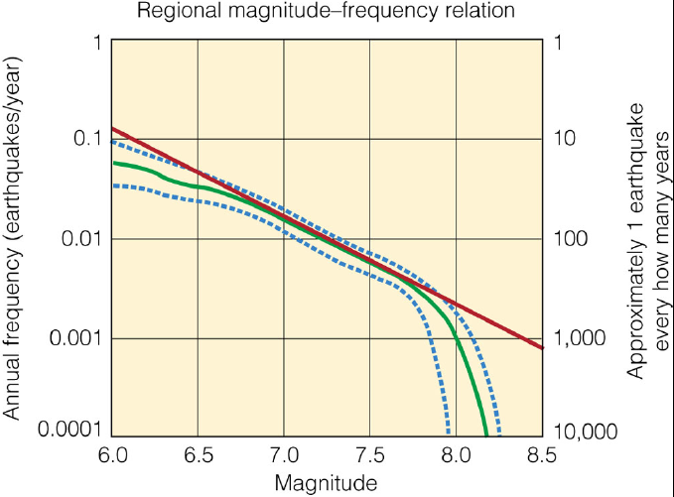
Gutenberg-Richter relationship

Slide 45
Additional material

Slide 47
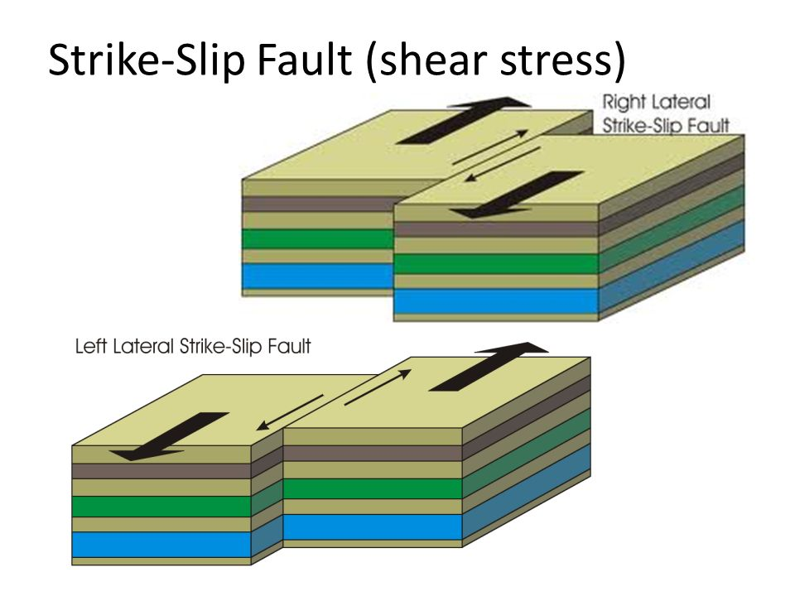
Types of faults: Strike – slip (responds to shear stress)

Slide 48
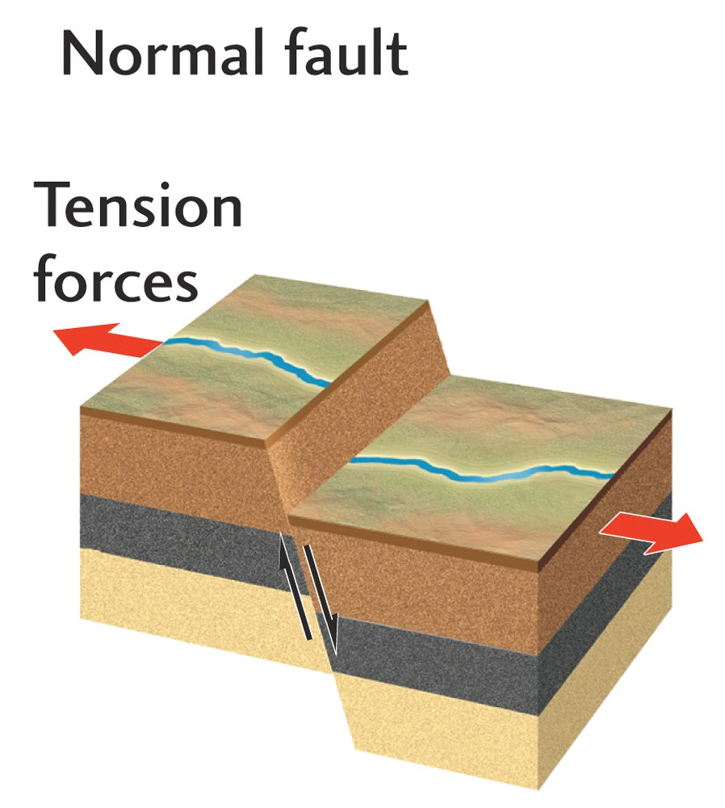

Slide 49
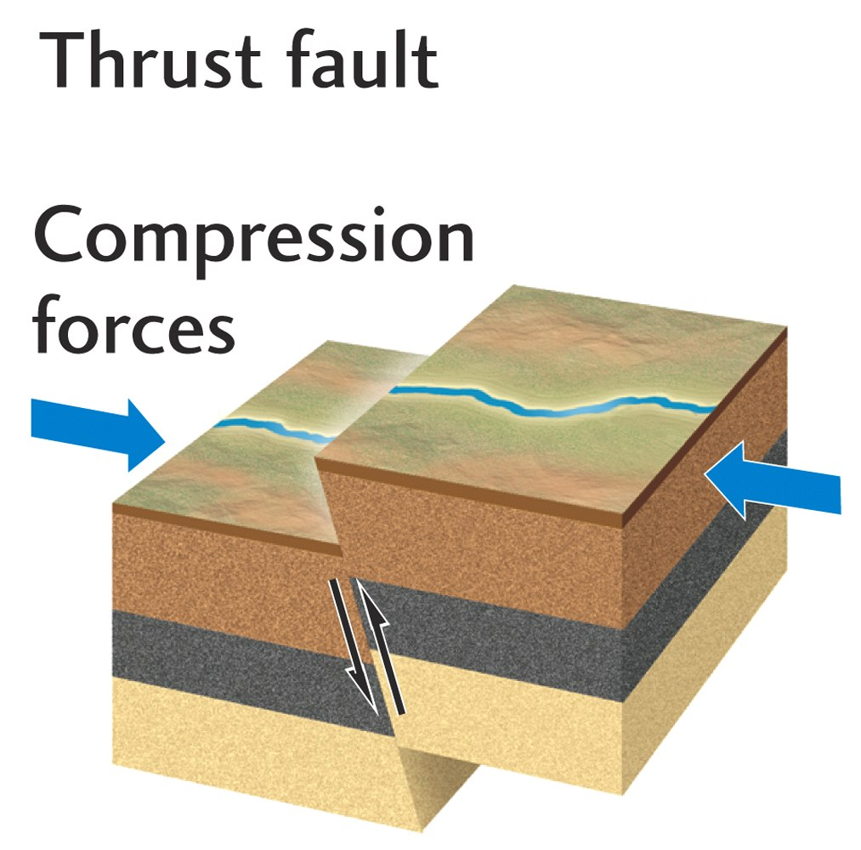

Slide 50
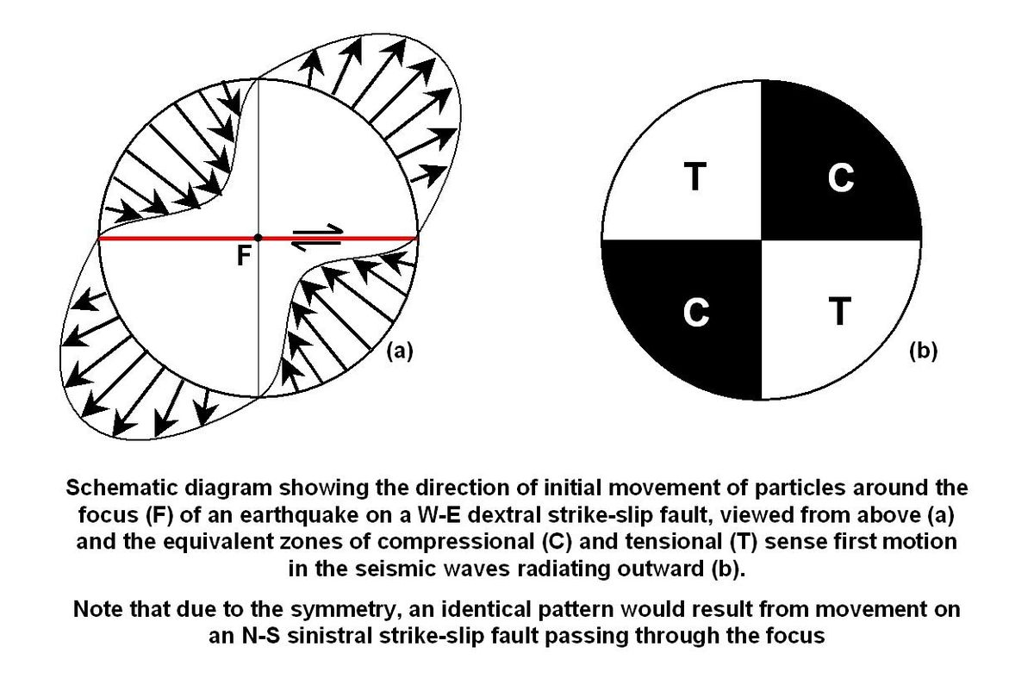
rupture on the fault leads to a characteristic seismic wave radiation pattern
P waves are compressional or extensional in different quadrants

Slide 51
This right lateral strike-slip has a radiation pattern (a) that looks like (b) in simplified map view when Compressional and Tensional quadrants are colored

Slide 52
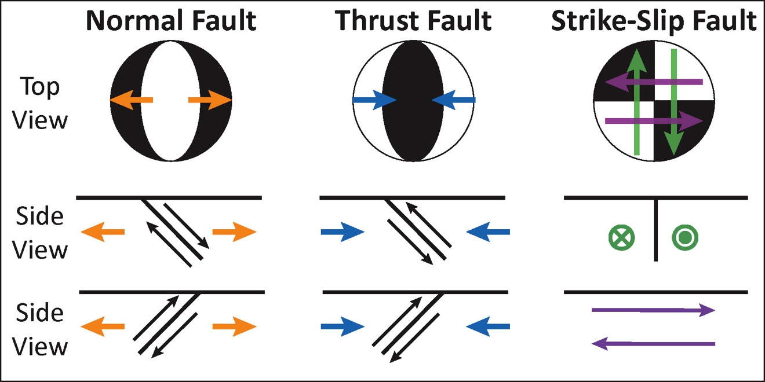
Focal mechanisms

Slide 53
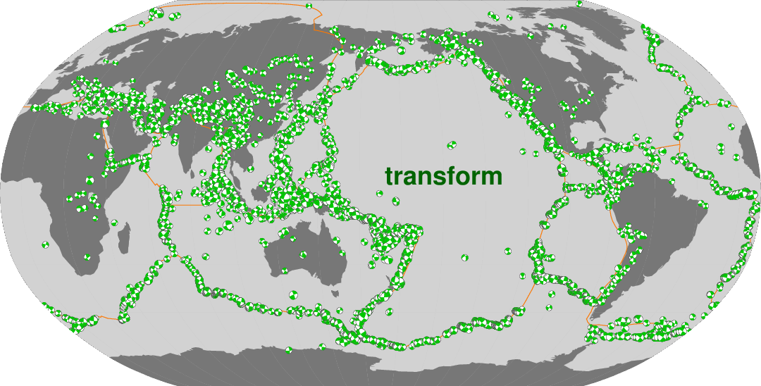
Shallow strike-slip earthquakes

Slide 54
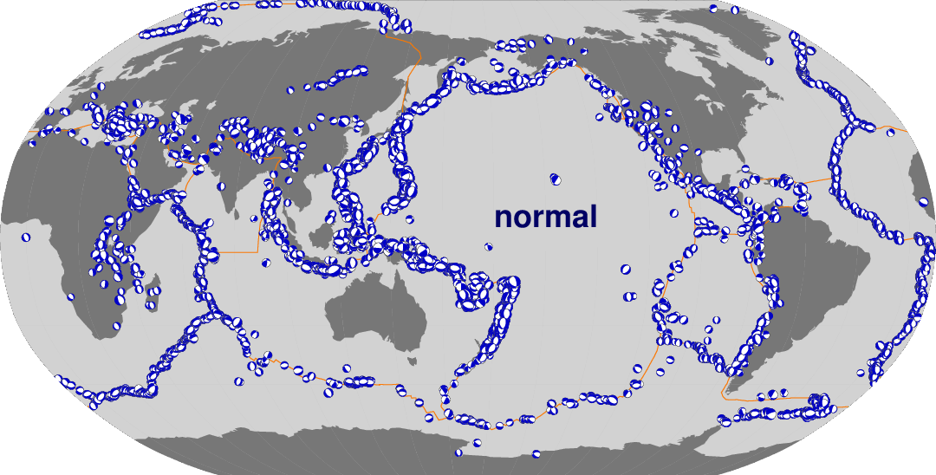
Shallow extensional earthquakes

Slide 55
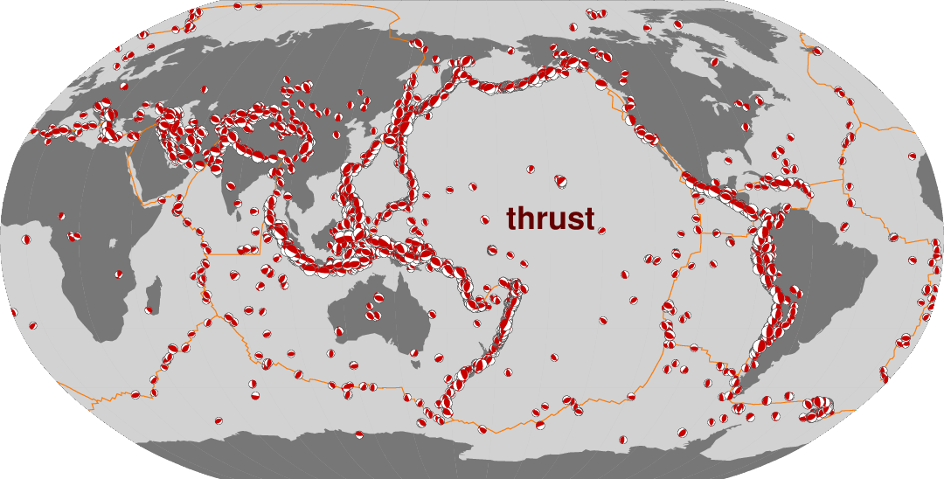
Shallow compressional earthquakes

Slide 56
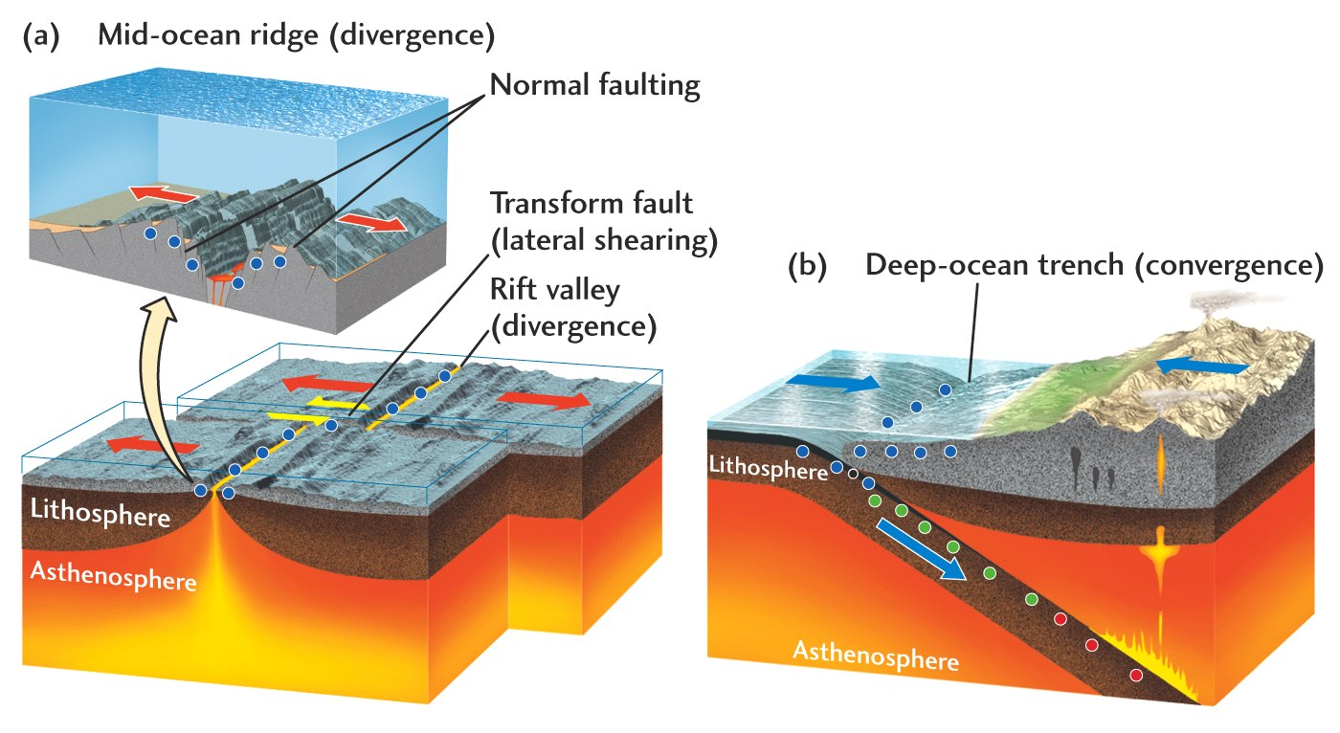
Plate boundary type ~controls type of earthquake
Thrust faulting

