Slide 1
Plate Tectonics
UT GEO 302P – Spring 2021
Part II (Earthquakes) – Lecture #1, March 4, 2021
Thorsten Becker
Reading: Ch. 2

Slide 2
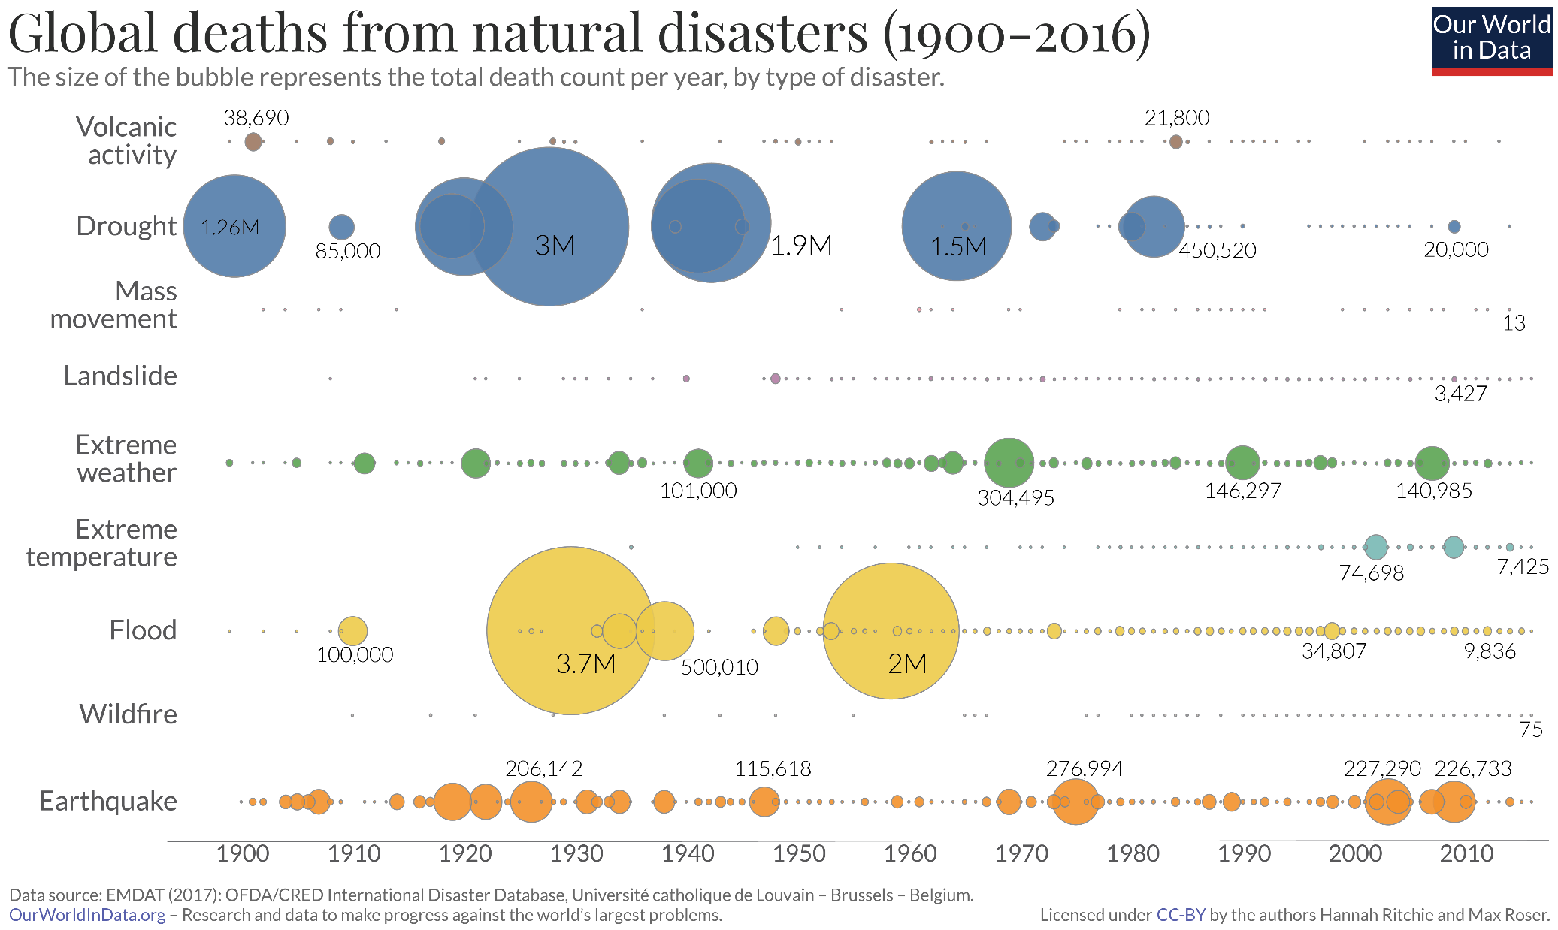

Slide 3
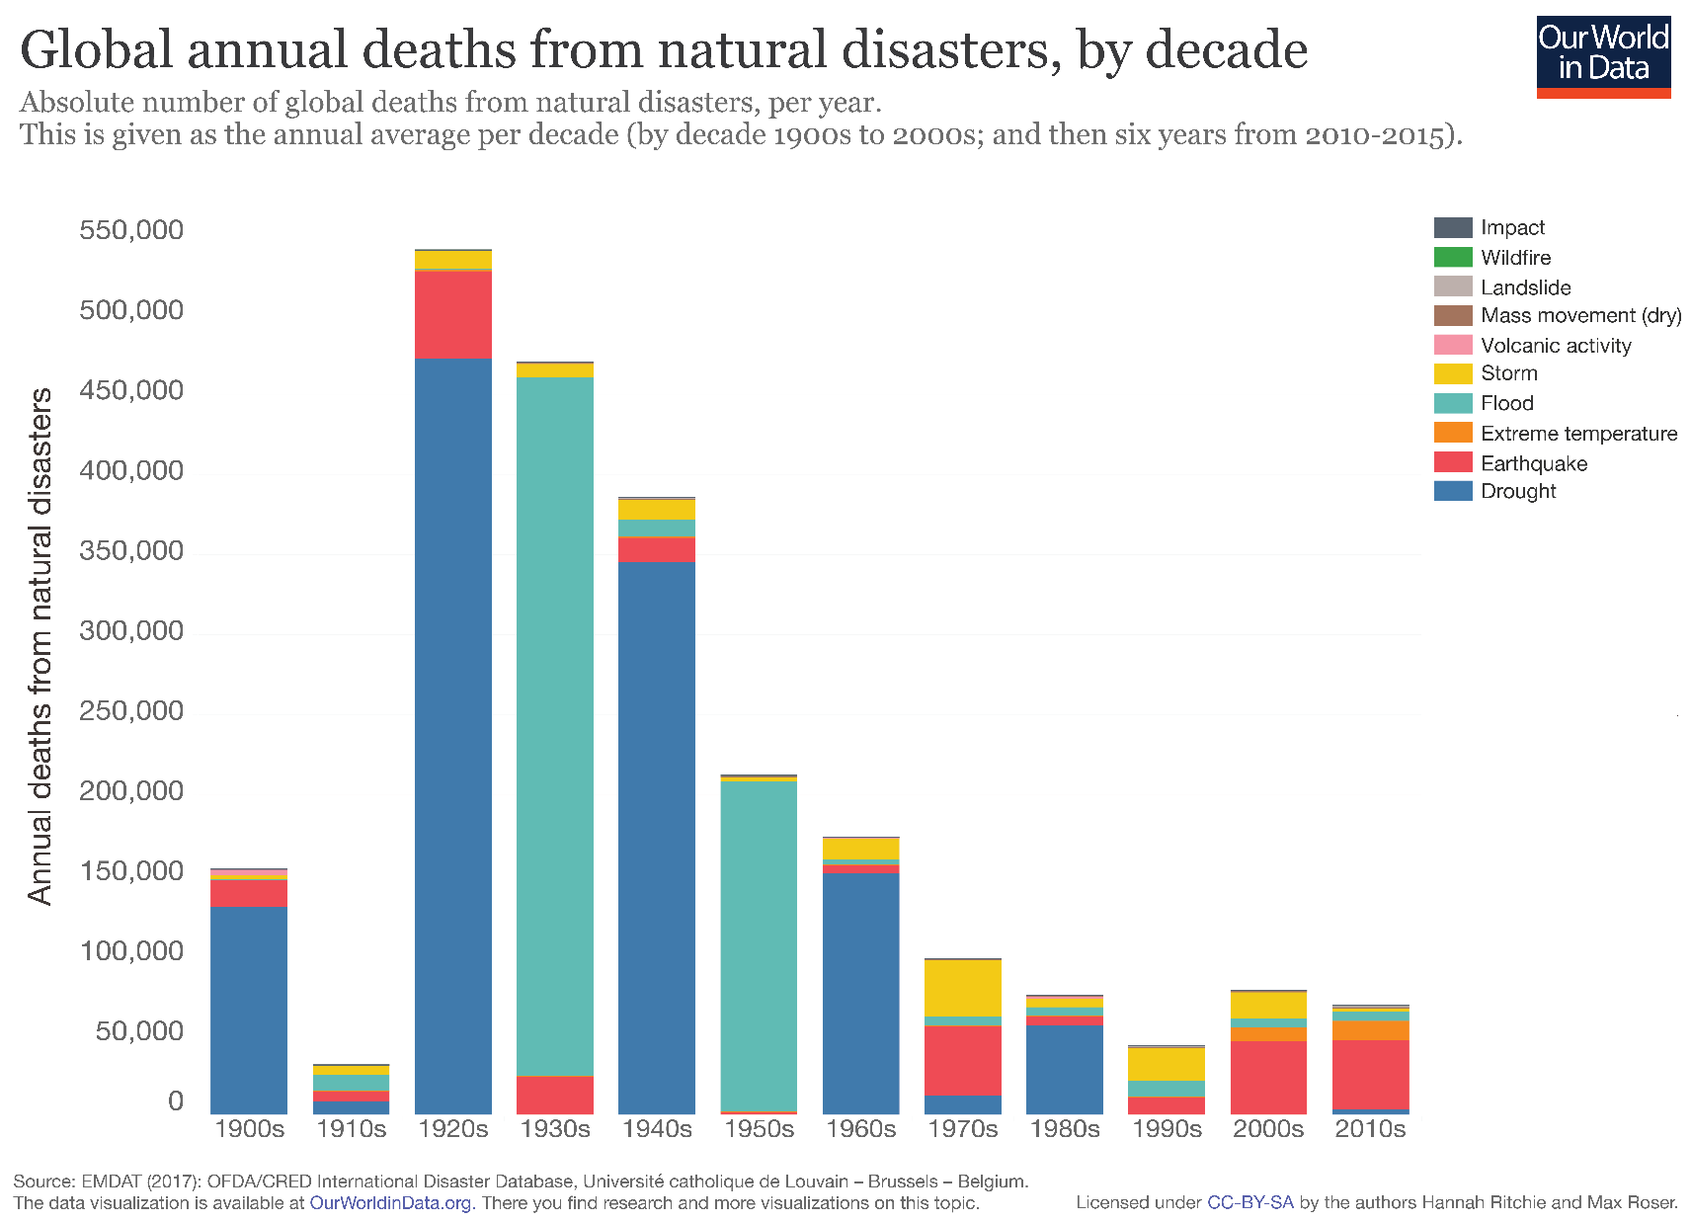

Slide 4
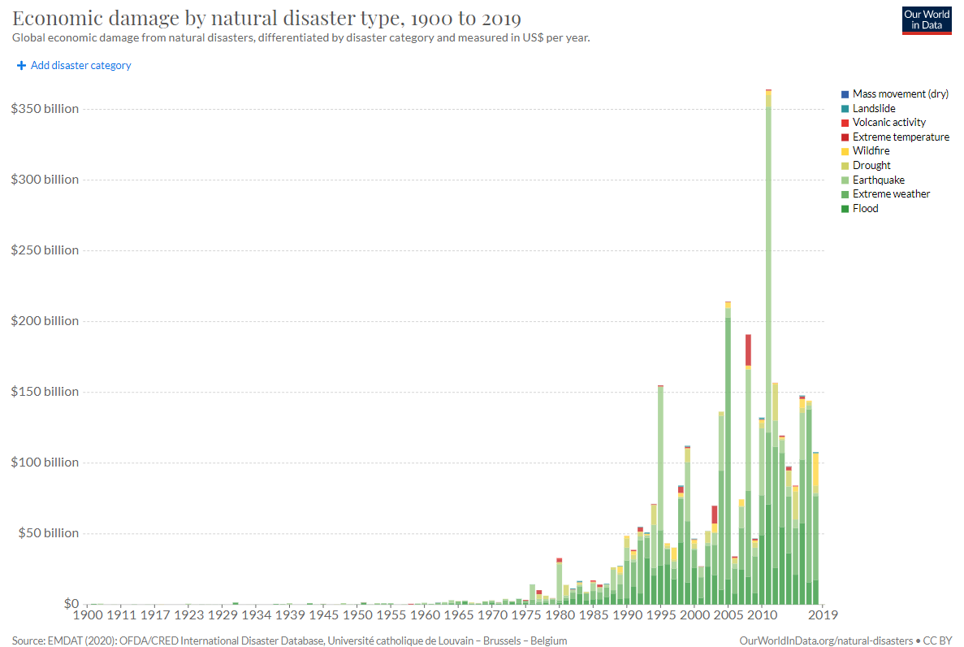

Slide 5
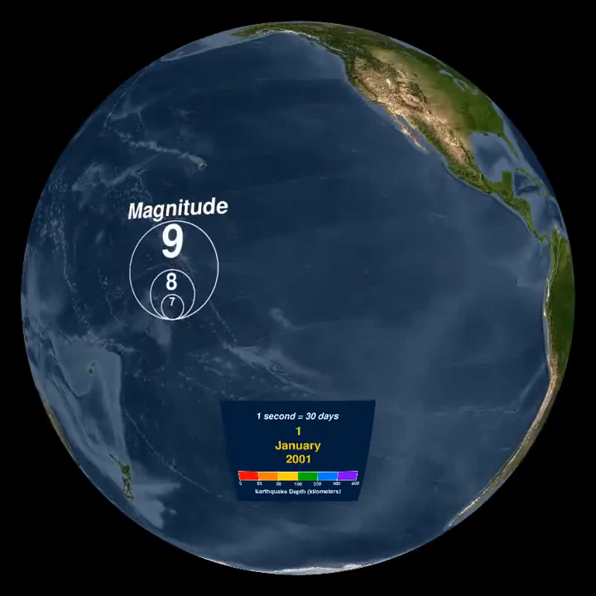
GISGroupofKosovo

Slide 6
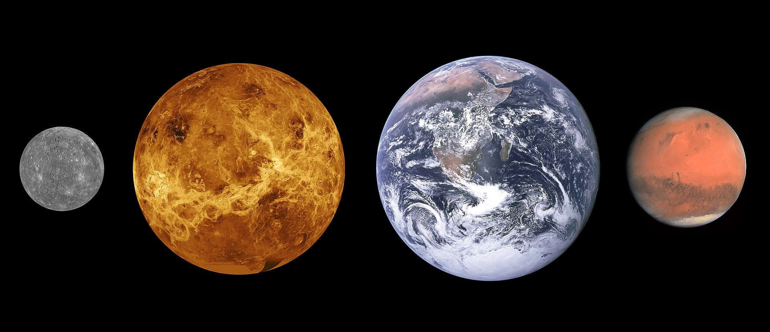

Slide 7
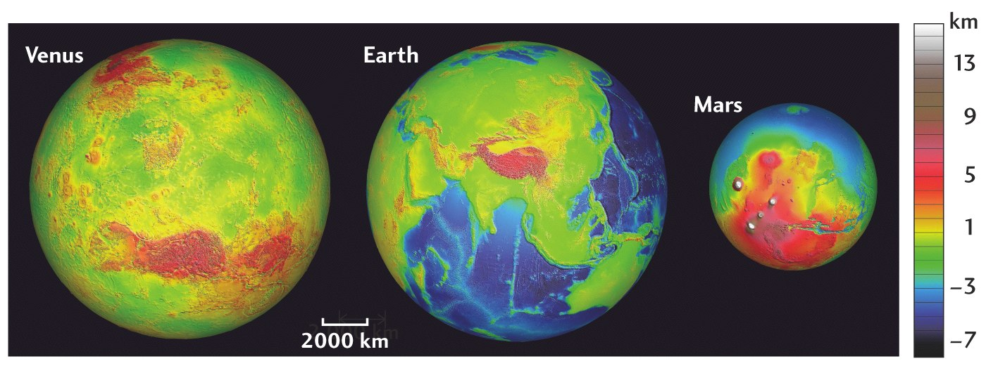

Slide 8
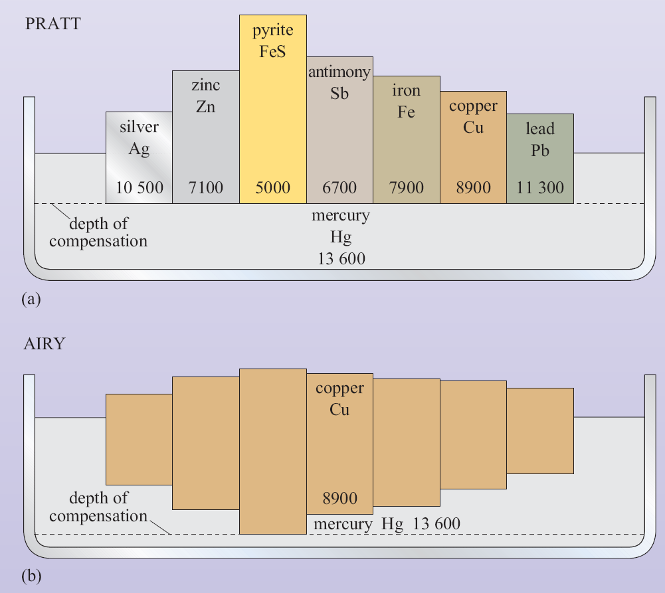
Isostasy
balance pressure at compensation depth (Archimedes principle)
add up weight (density times thickness of block)
(density = mass/volume)
Two ways to do it:
  Variable density (Pratt)
  Variable thickness (Airy)
Numbers are density of material in kg/m³
(these are metal analog examples, rock density ~3000 kg/m³)

Slide 9
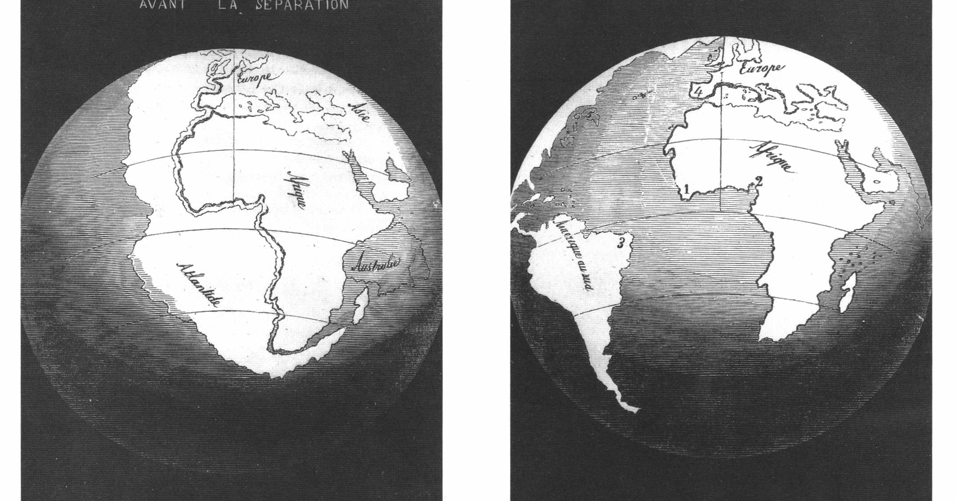
Isostasy does not account for…motion?
Since the 16th century it was noticed that the eastern margins of the Americas looked very much like the western margins of Europe/Africa. Could they have once been joined?
1858 maps of
Snider-Pelligrini

Slide 10
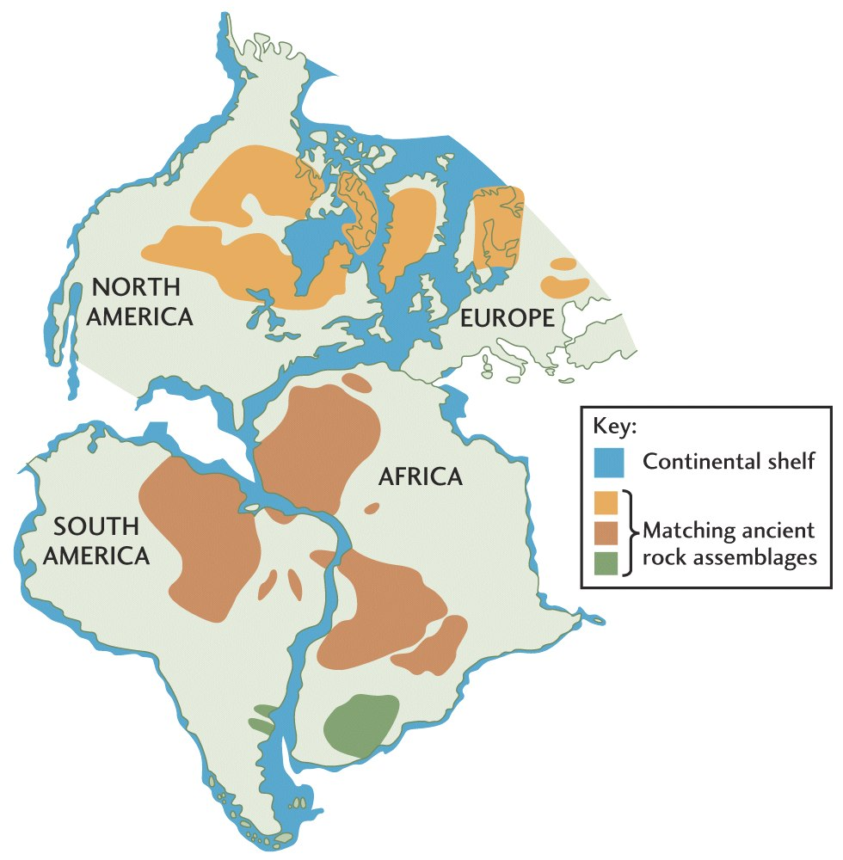
Rocks types

Slide 11
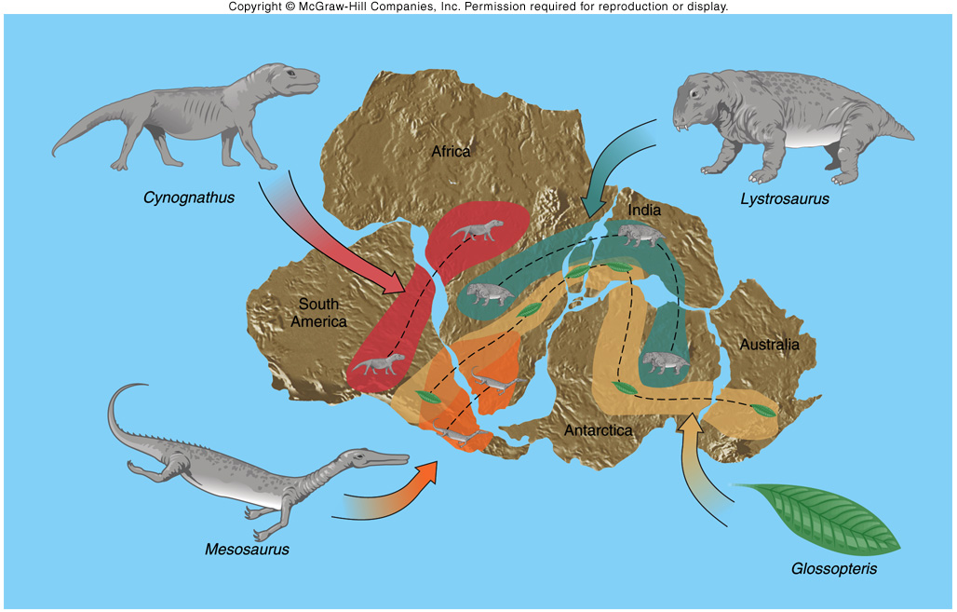
Fossils
Early Triassic
(220 Ma)‏
Permian-Pennsylvanian
(270 Ma)‏
Permian (250 Ma)

Slide 12
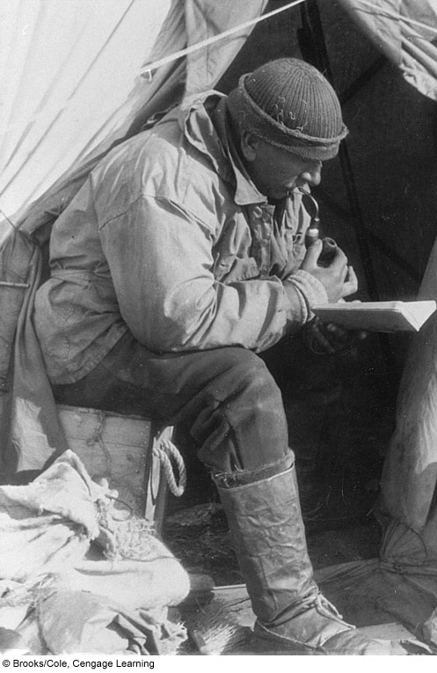
Alfred Wegener’s synthesis in 1912
Continental drift

Slide 13
250 Ma

Slide 14
Wegener’s Synthesis of Continental Drift
In 1912, Alfred Wegener proposed that several continents now separated by major ocean basins had been much closer together about 250 million years ago and had been part of a single super- continent called Pangaea
This also means that 250 million years ago there was one super-ocean – Panthalassa

Slide 15
Problems with continental drift
Very nice evidence, but: No reasonable, geological way to do it!
The theory envisioned the continents sliding over the mantle, yet geophysical data indicated crustal rocks would shatter if pushed.
Result : Continental Drift was not generally accepted

Slide 16
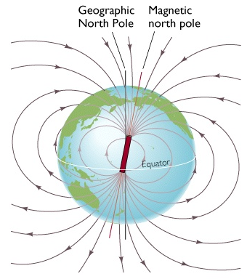
New discoveries based on magnetic field measurements

Slide 17
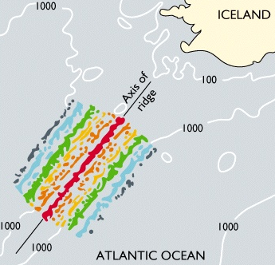
Ocean floor magnetic field anomalies

Slide 18
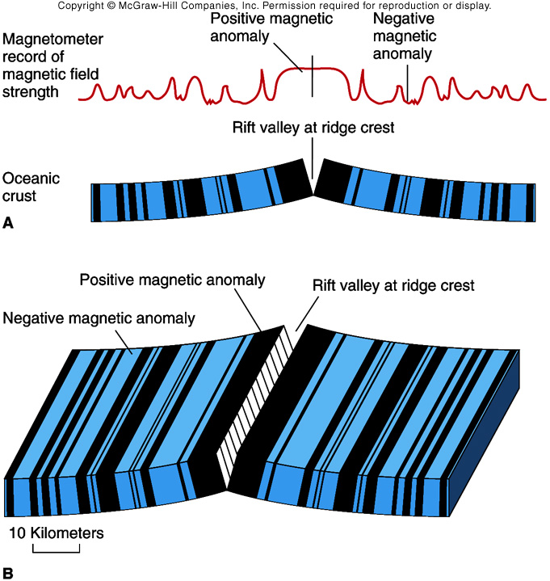
Magnetic anomalies symmetric across mid ocean ridge

Slide 19
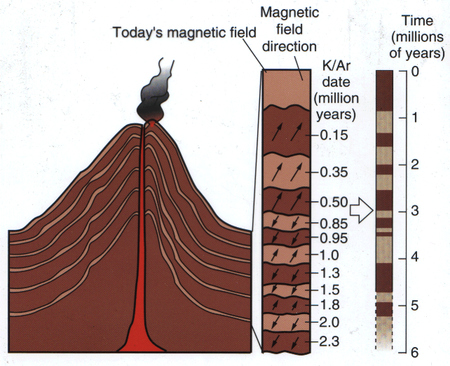
Consider Paleomagnetism
When magma erupts and solidifies into a rock, magnetic minerals in the rock orient with the ambient magnetic field
Vice versa, heating a rock above the Curie temperature, magnetization is lost
Frozen magnetization show periods of time when N is S and S is N (field reversals)

Slide 20
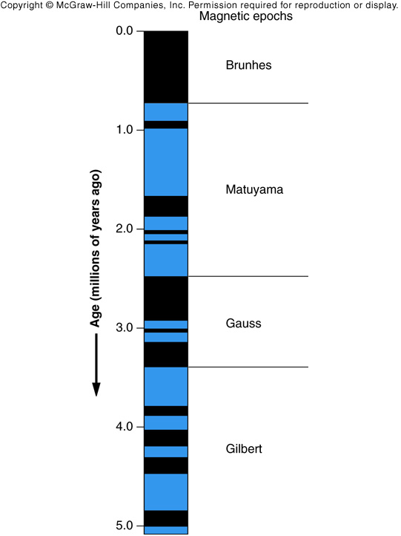
Paleomagnetic field reversal timescale from global lava flows

Slide 21
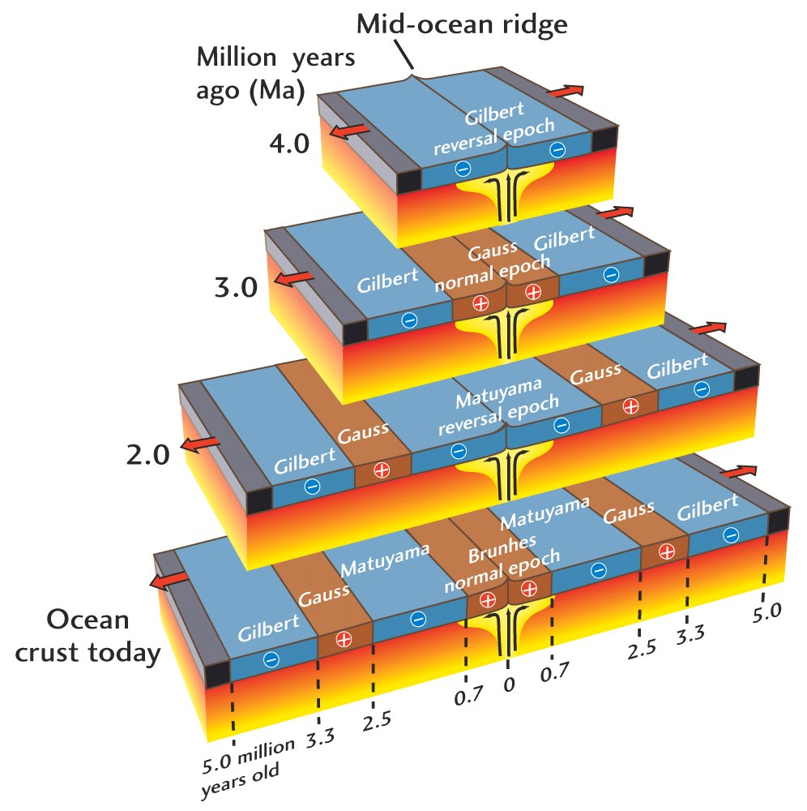
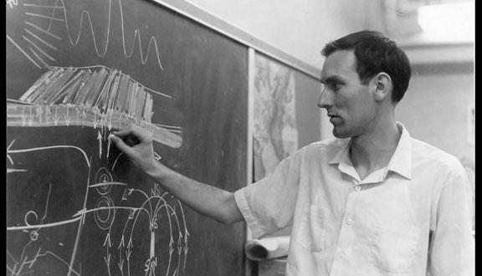
Theory of seafloor spreading
(Vine, Mathews, Morley, 1963)

Slide 22
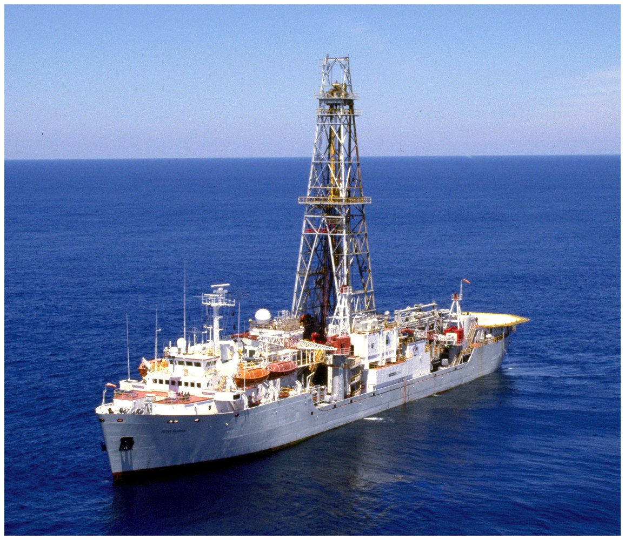
Theory of seafloor spreading confirmed by drilling

Slide 23
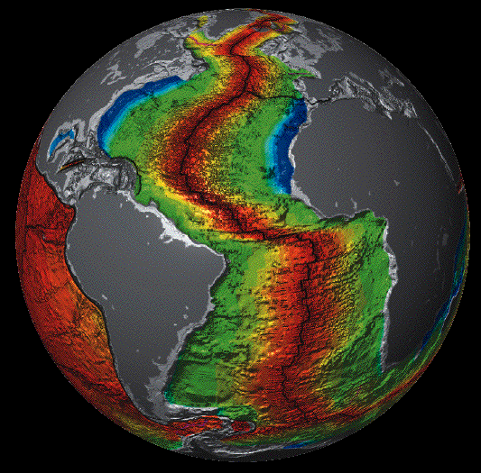
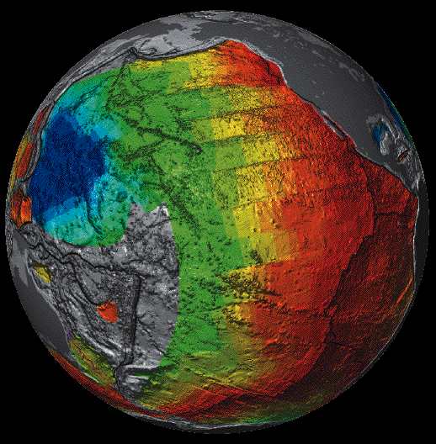

Seafloor age and spreading

Slide 24

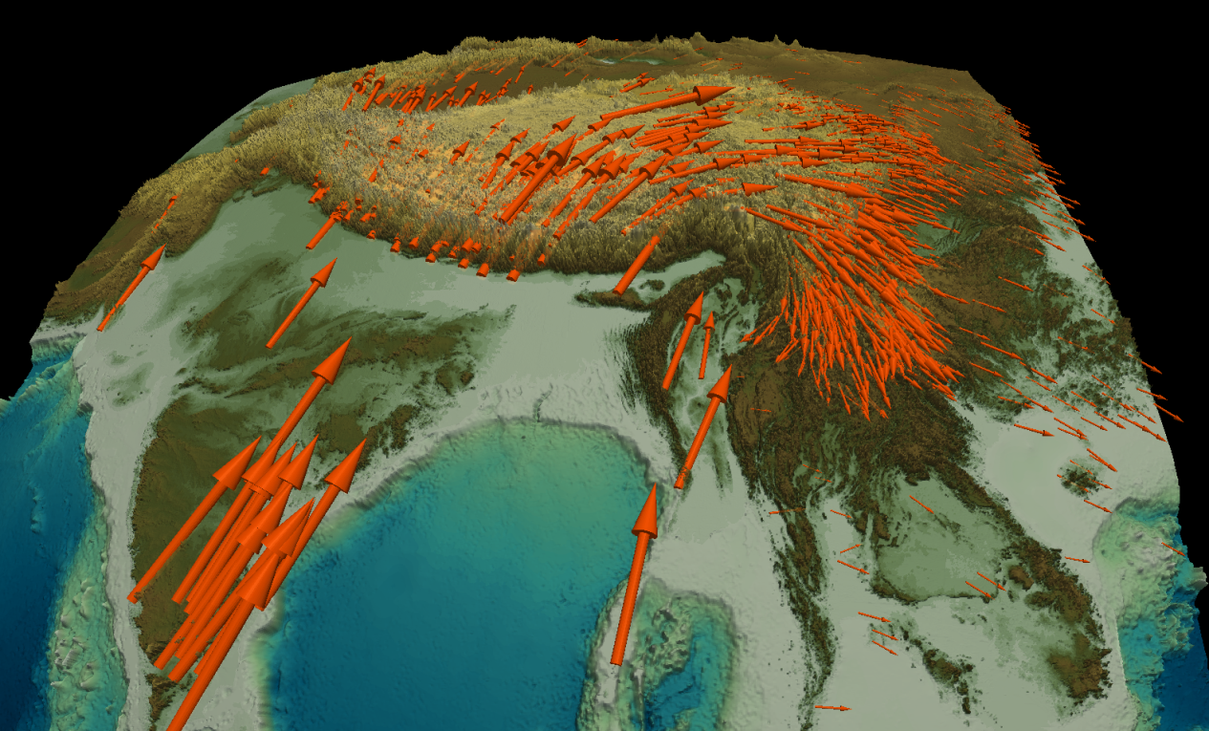
Present-day velocities: GPS
The Global Positioning System (GPS) uses signals from a constellation of satellites to allow receivers to determine position accurately (velocities to ~1 mm/yr)
Velocity with respect to Eurasia, max ~ 4 cm/yr

Slide 25
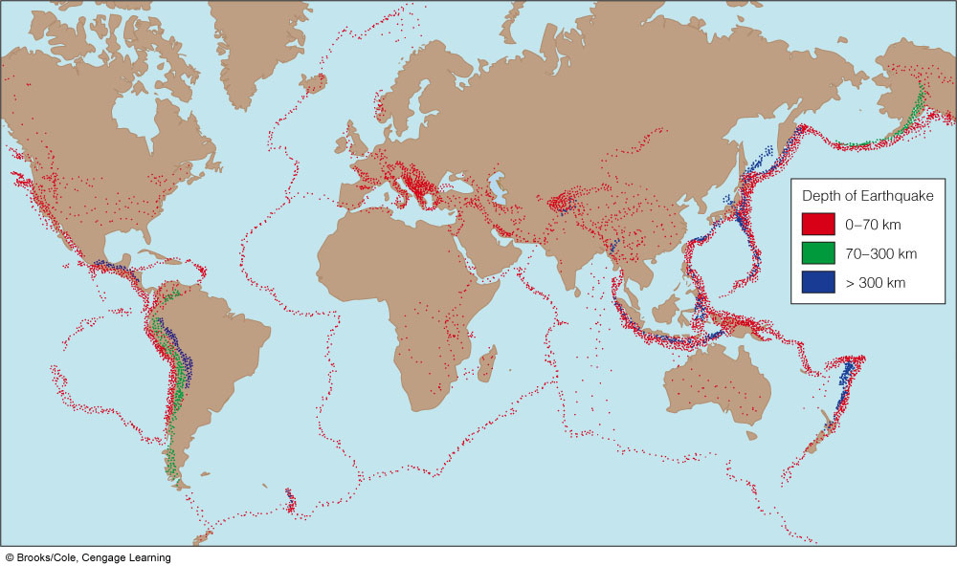
Does the whole surface deform?
Global earthquake catalogs

Slide 26
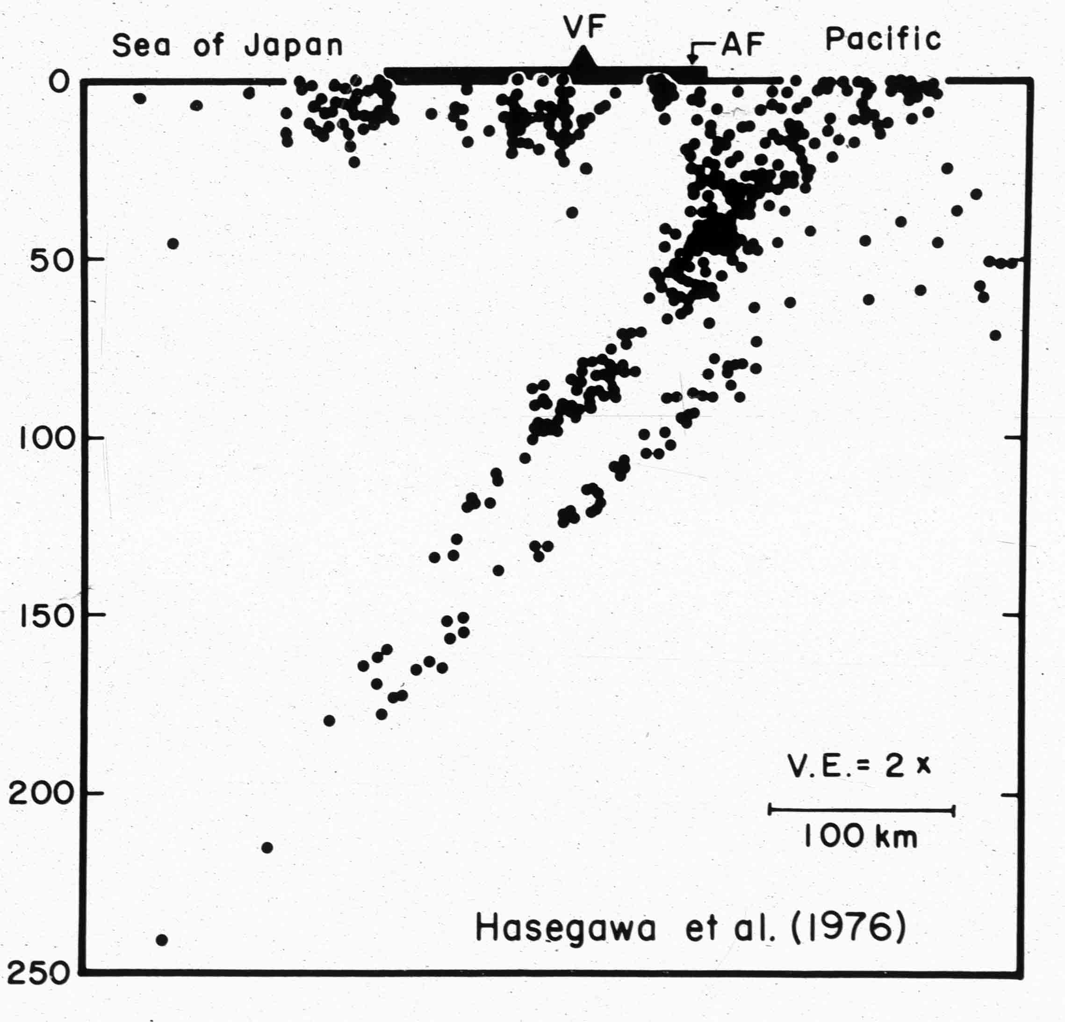
Wadati-
Benioff zones

Slide 27
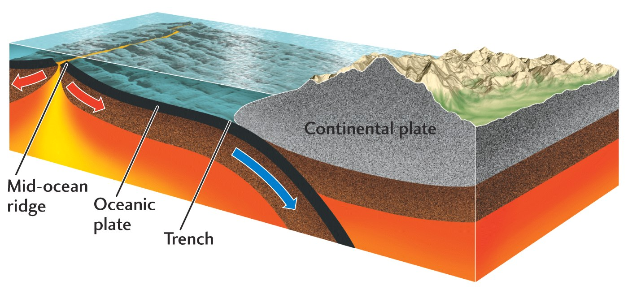
Surface divided into moving plates!

Slide 28
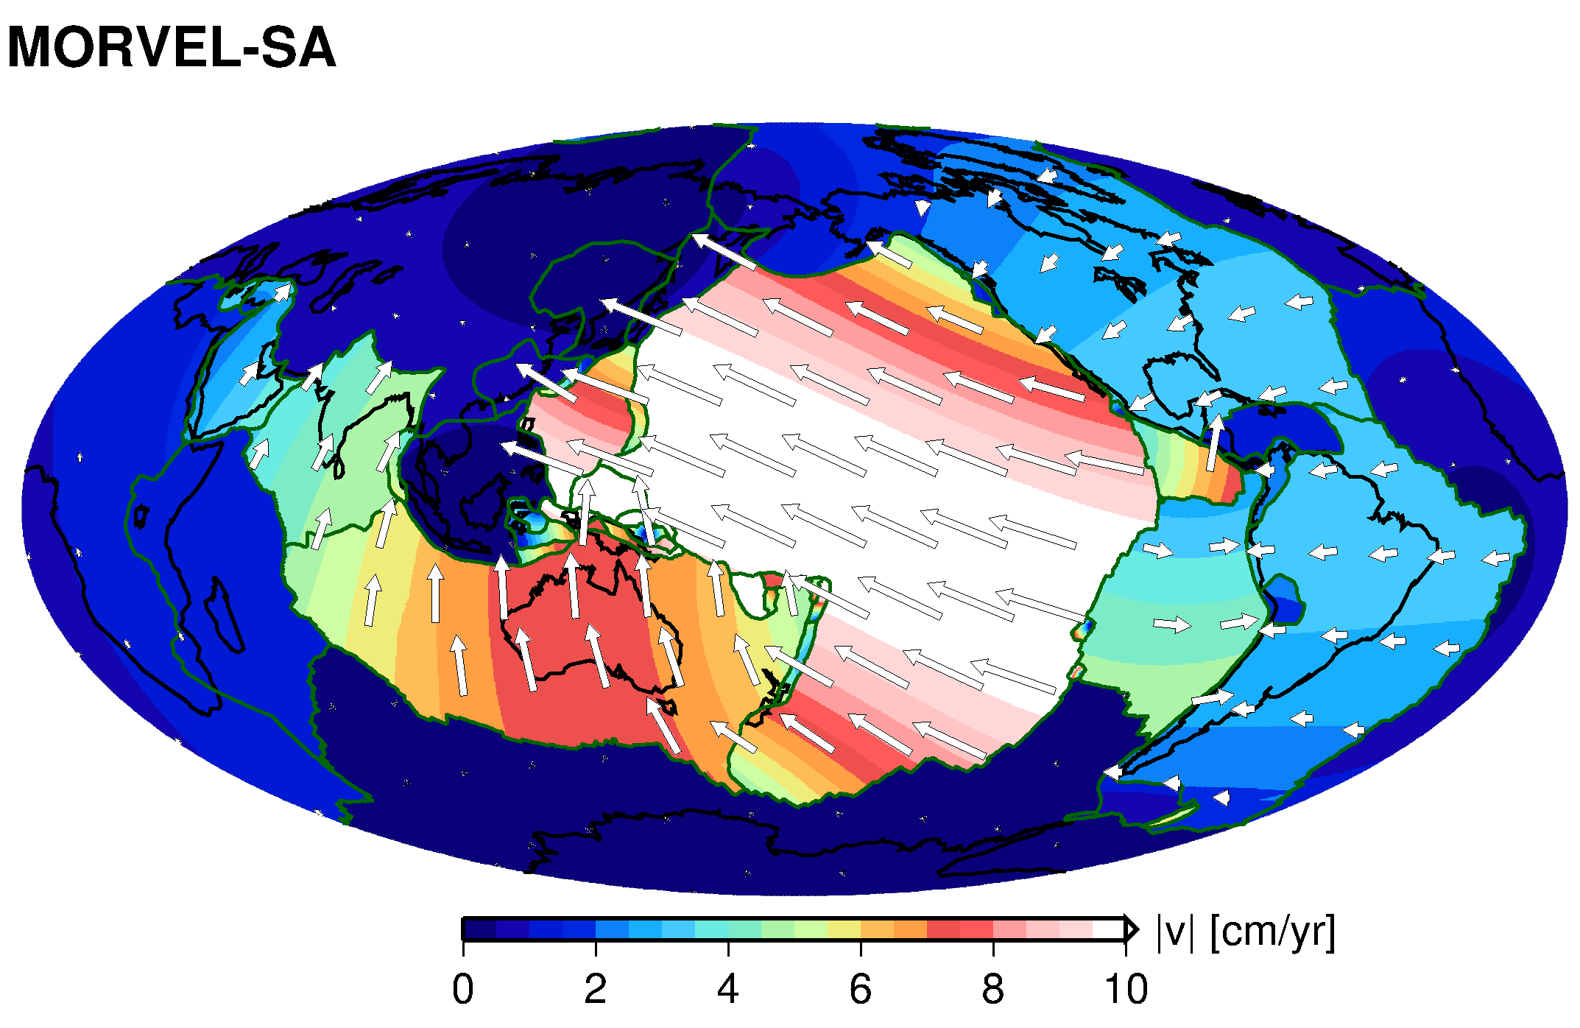
Plate motions

Slide 29
Plate tectonic theory
The lithosphere is made up of a mosaic of moving plates – segments of a spherical shell
Plates are rigid except near their boundaries, where relative motions between plates occur
New plate can be created at divergent boundaries and destroyed at convergent boundaries
Total plate area is conserved (no Earth expansion!)‏

Slide 30
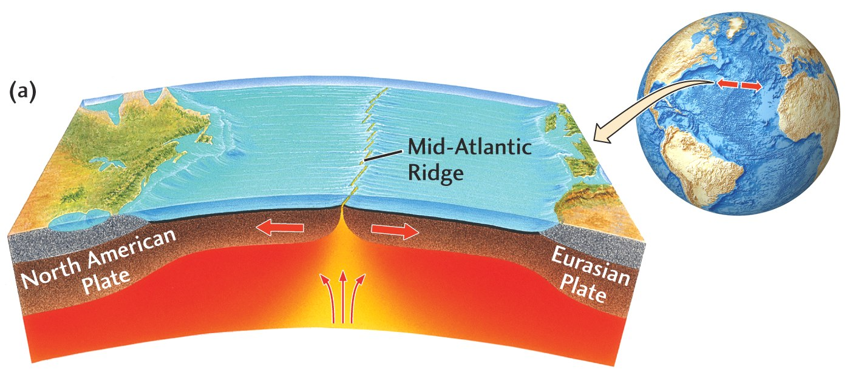
Oceanic spreading centers
(creation of seafloor)

Slide 31
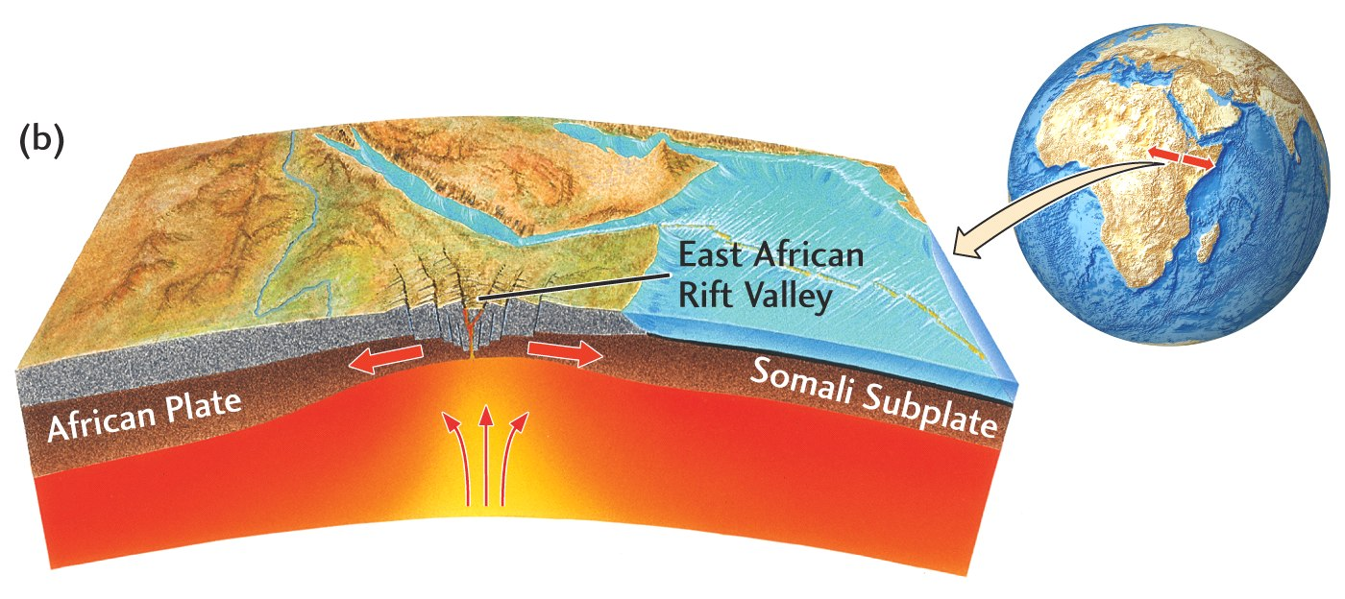
Intracontinental rift

Slide 32
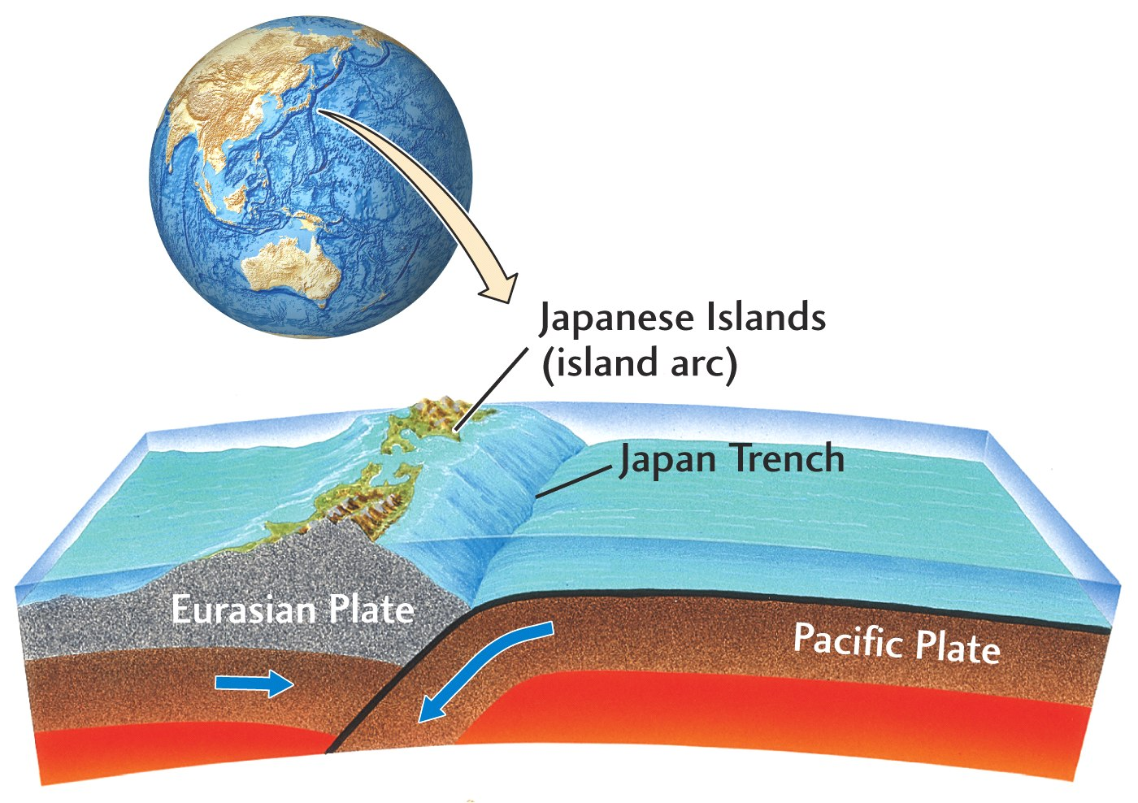
Ocean-ocean subduction
(destruction of seafloor I)

Slide 33
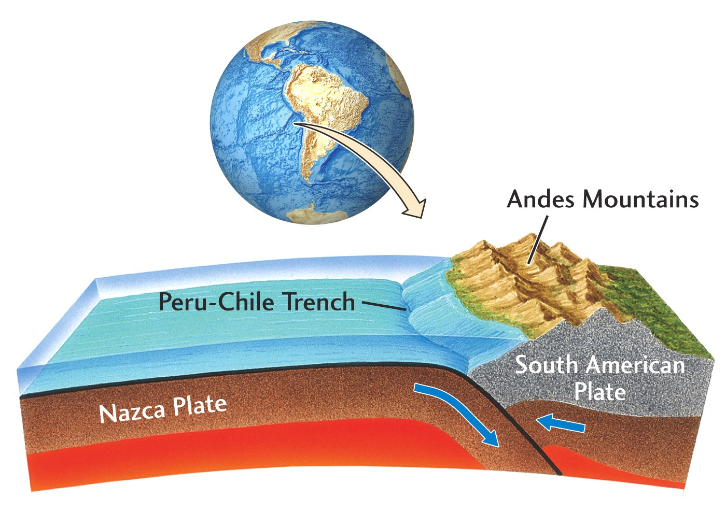
Ocean-continent subduction
(destruction of seafloor II)

Slide 34
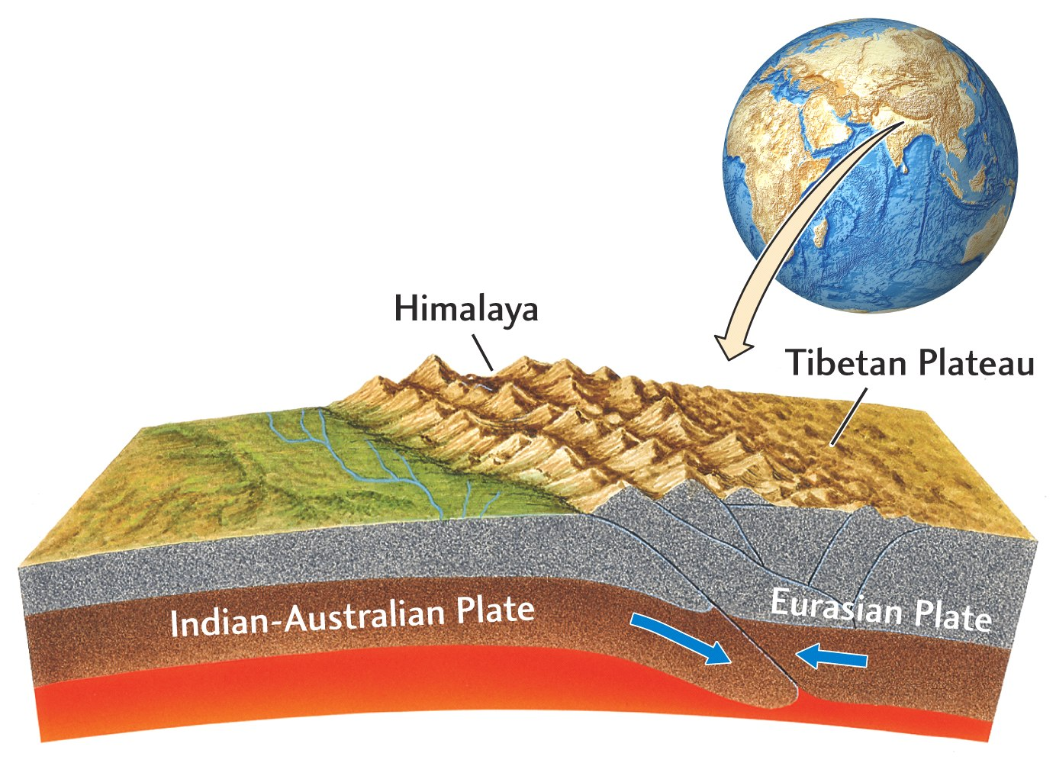
Continent-continent collision

Slide 35
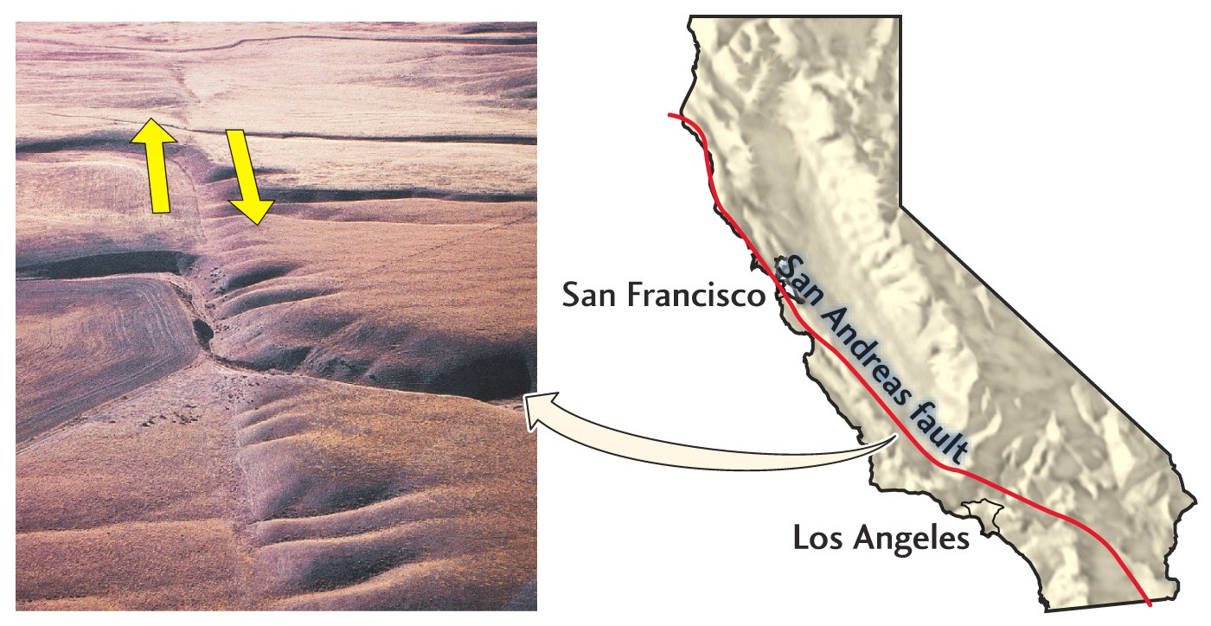
Continental transform fault

Slide 36
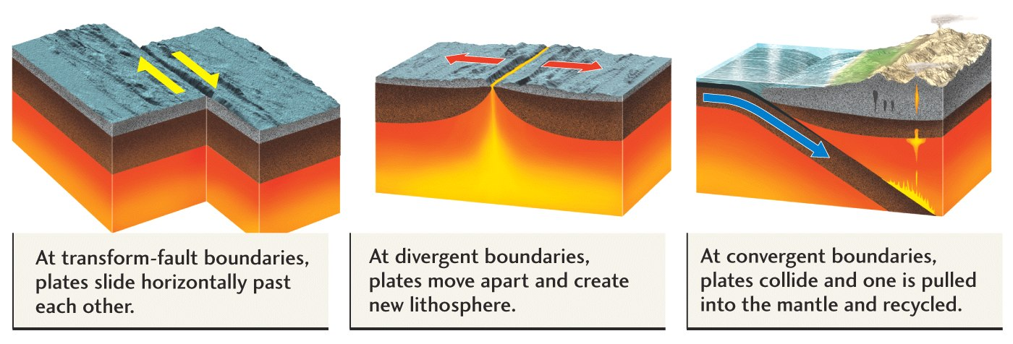
Types of plate boundaries relate to types of earthquakes

Slide 37
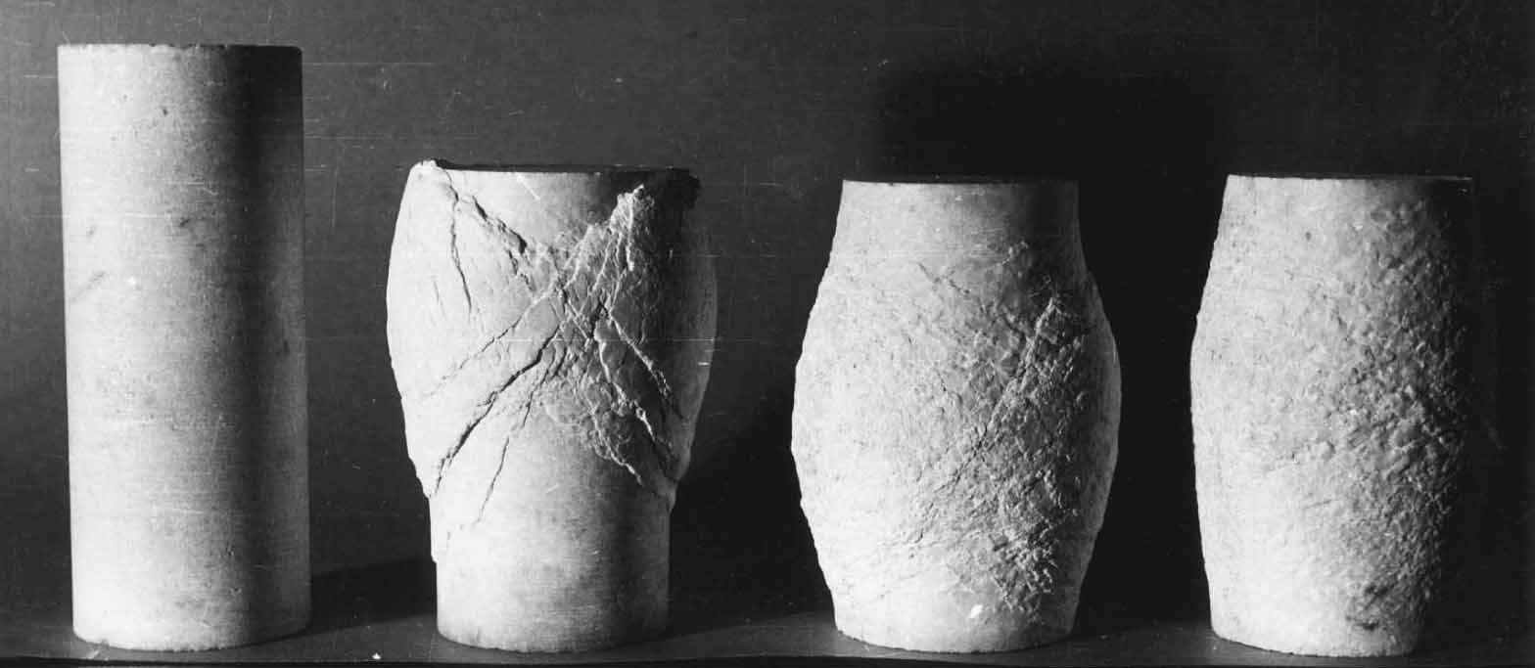
Why do the plates move?
Rocks don’t just break – they can flow
Ductile/creeping
(fluid) deformation
Brittle deformation
Increase in temperature

Slide 38
Subduction zones have the largest earthquakes because more room for faults before it gets too hot to break

Slide 39
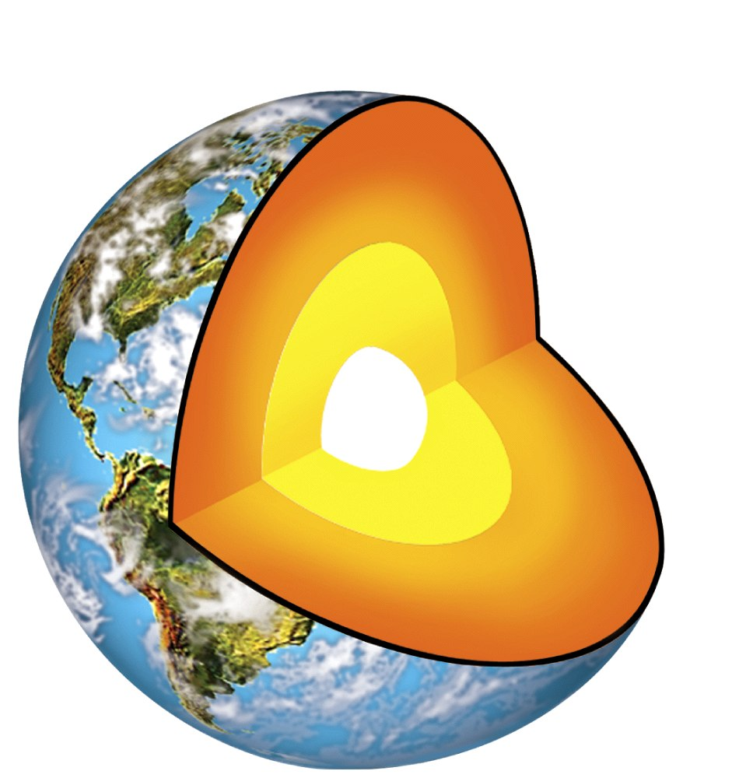
Why do the plates move? The mantle behaves like a fluid on long timescales
Mantle is heated from below and within (radiogenic elements)
Iron
core
silicate mantle
Doring (2020)

Slide 40
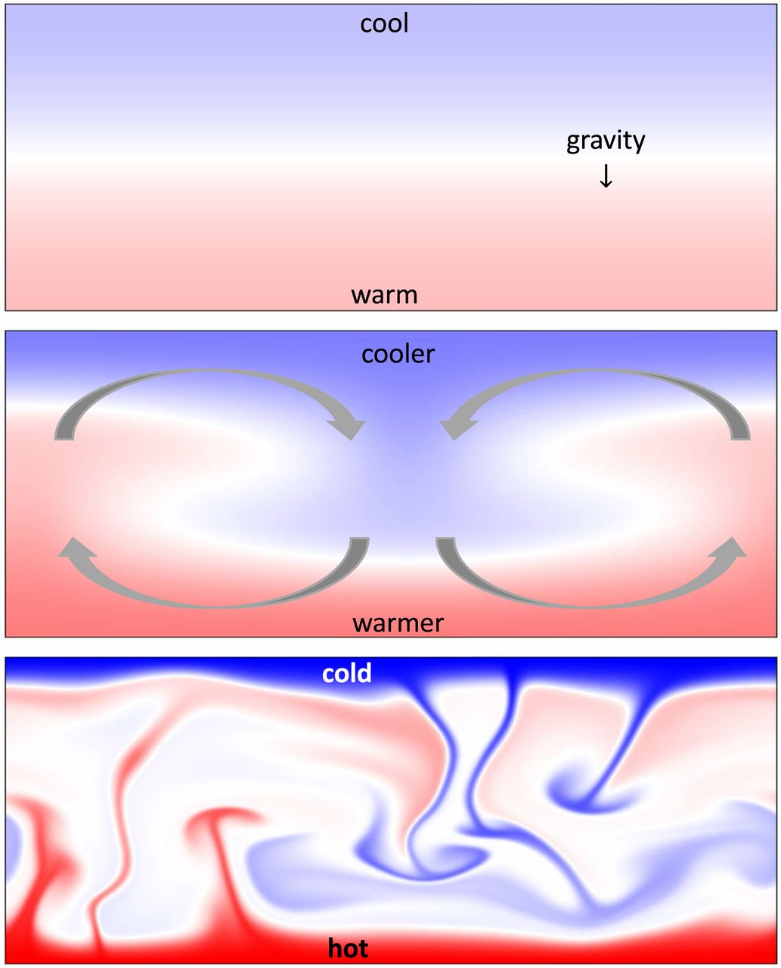
Why do the plates move? The mantle behaves like a fluid on long timescales
Heat transport by convection for any fluid if Rayleigh number
Ra > 1,000
(depends on temperature contrast, strength, etc.)
Ra < 1,000
Ra ~ 1,000
Ra > 1,000
Doring (2020)

Slide 41
Rayleigh number (Earth mantle) ~ 10⁷
Therefore, the Earth’s mantle
(outer ~3000 km layer) must convect!

Slide 42
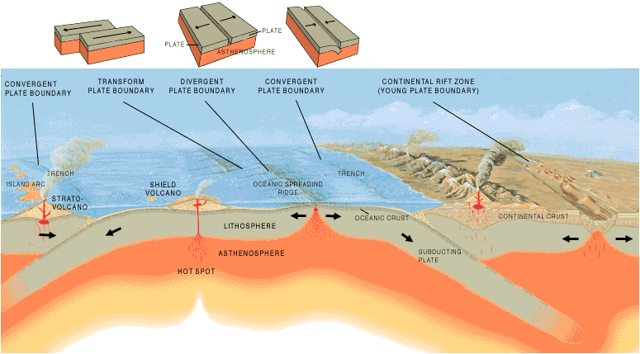
Mantle convection and tectonics
earthquakes

Slide 43
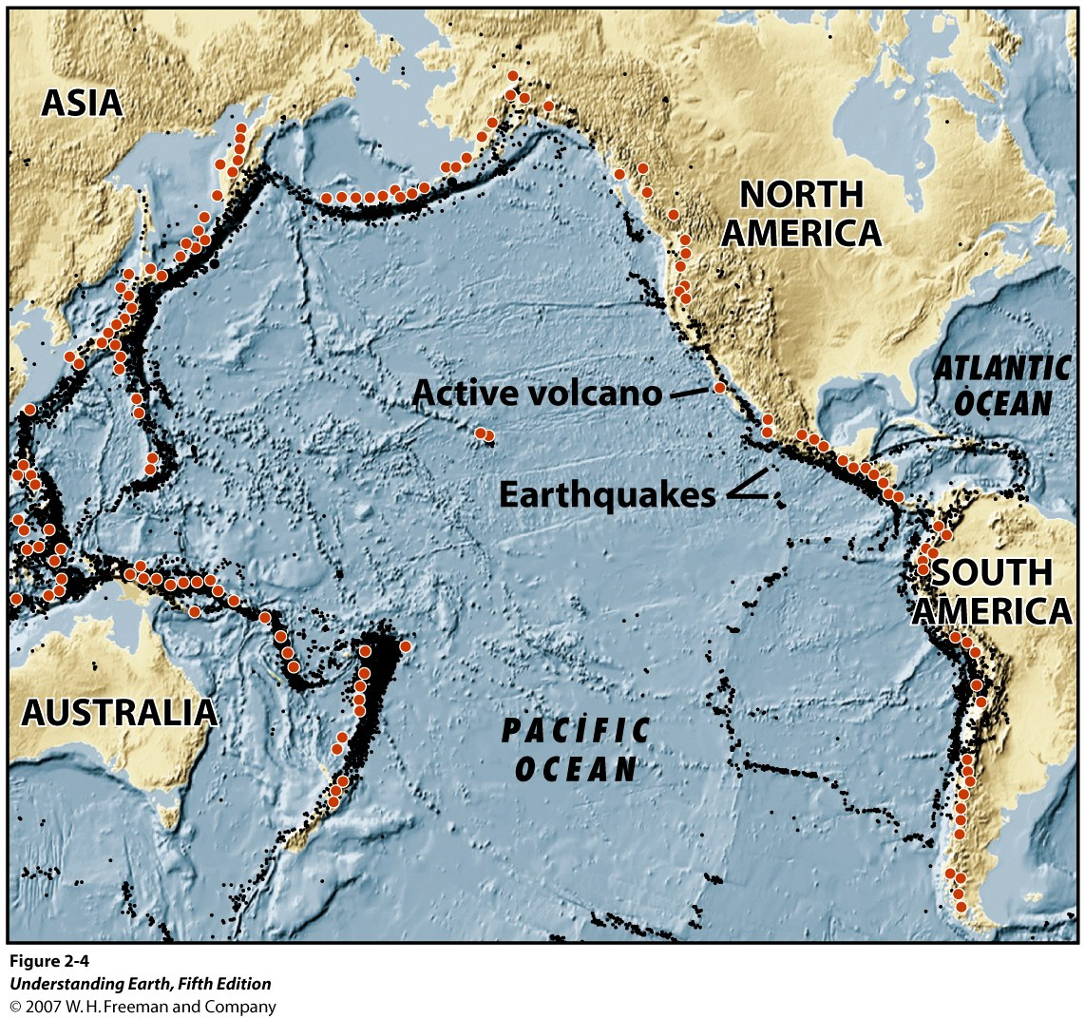
Plate boundaries and hazard

Slide 44
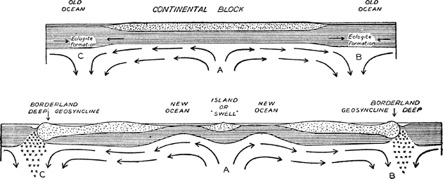
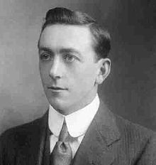
Holmes, 1928
It took the plate tectonic revolution triggered by the establishment
of seafloor spreading in the late 60ies to convince the establishment of continental drift, even though Holmes suggested convection as a driving force 7 years after Wegener.

