Slide 1


Regional Geodynamics
Thorsten W. Becker
Jackson School of Geosciences
The University of Texas at Austin
Internal Earth Doctoral Training
Barcelonette, France
October 15, 2019

Slide 2
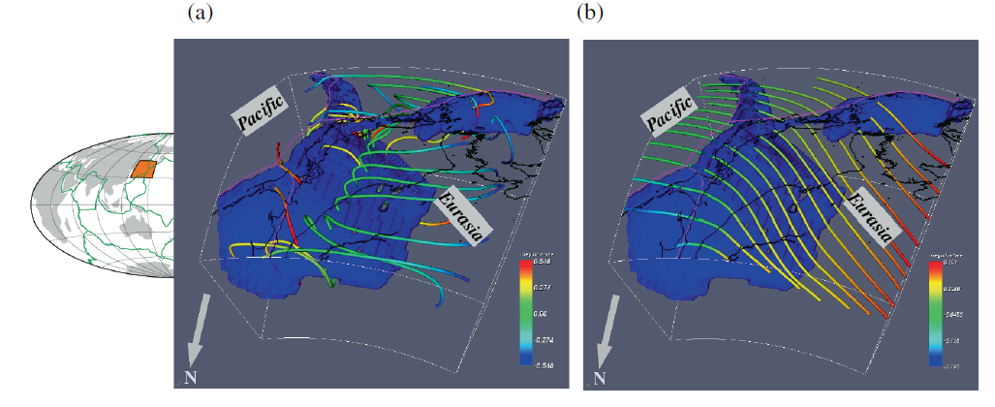
Stokes flow and the global mantle wind
Streamlines for regional flow model
Streamlines for global flow model
Becker & Faccenna (2009)

Slide 3
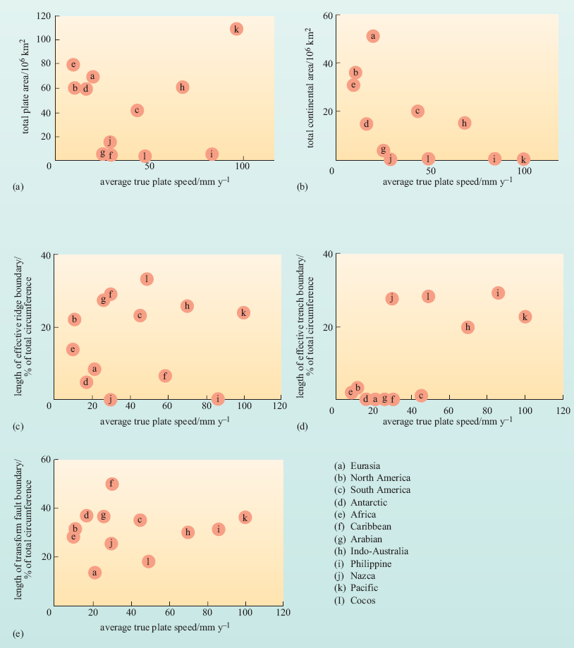
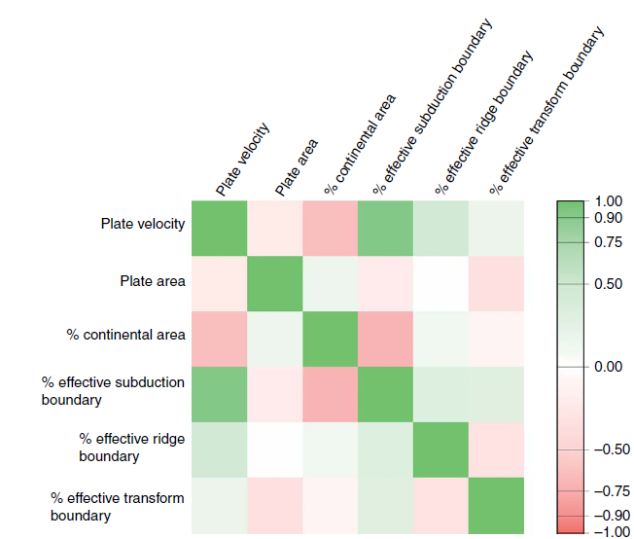
Slab pull drives ~70% of tectonics
length of trenches attached
Forsyth &
Uyeda (1975)
King (2008)
correlation

Slide 4
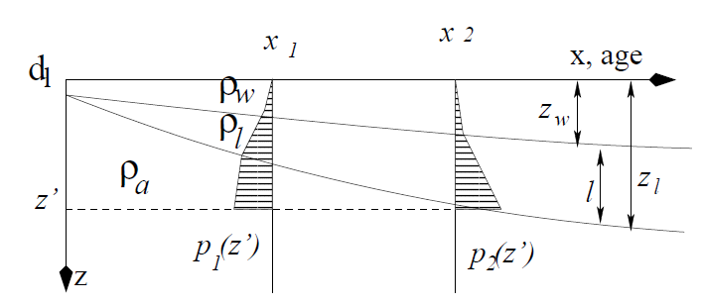



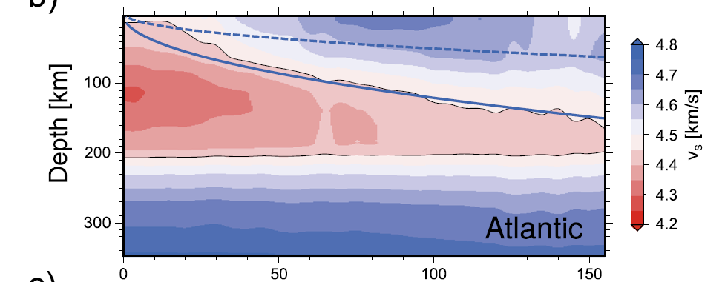
Lithospheric thickening
(AKA ridge push, oceanic GPE)
(from isostasy)
F_{RP} ~ 10¹² N/m

Slide 5
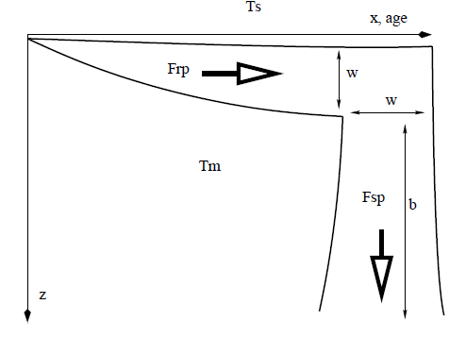

Subducting thermal boundary layer:
Slab pull >> Ridge push
F_{SP} ~ 10¹³ N/m

Slide 6
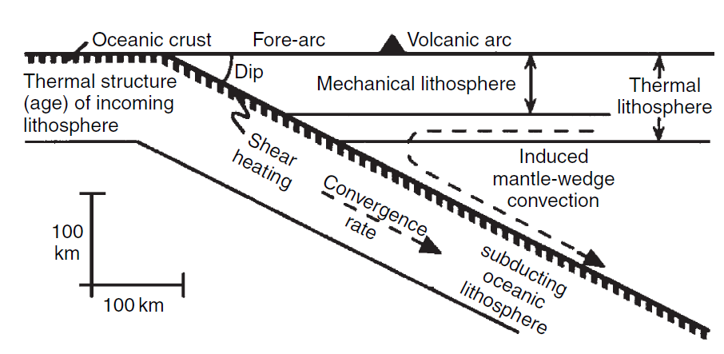
Thermo-kinematic models
Peacock (1996)

Slide 7
Subducting the boundary layer
van Keken (2003)

Slide 8
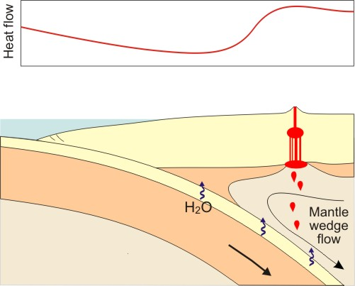
Young subducting plate
Old subducting plate
Importance to subduction margin:
Fault zone rheology and minerals
Metamorphism and fluids
Megathrust seismicity and volcanism
Cold
Forearc
Hot Arc
Back Arc
Serpentinized
Mantle wedge
70 ~ 80 km
~ 100 km
slide modified from K. Wang

Slide 9
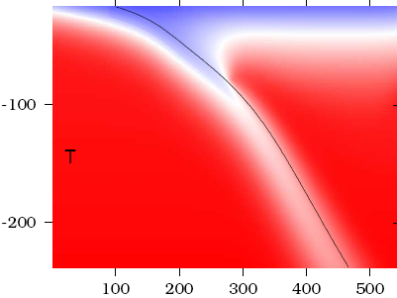
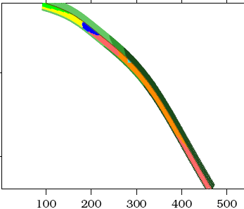
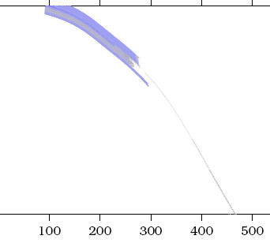


Predict petrology
Cascadia (young seafloor) – “hot”
temperature
rock facies
water carrying capacity
Slide courtesy of P. van Keken
T (C)
max H₂O (wt%)
Syracuse et al. (2010)

Slide 10
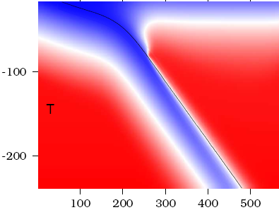
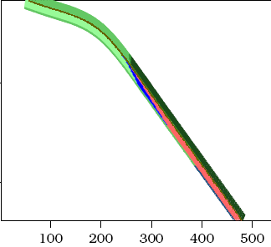
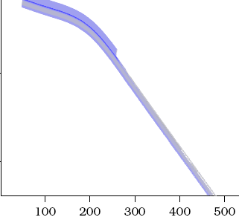
Predict petrology
Tohoku (old seafloor) – “cold”
temperature
rock facies
water carrying capacity
Slide courtesy of P. van Keken
T (C)
max H₂O (wt%)
Syracuse et al. (2010)

Slide 11
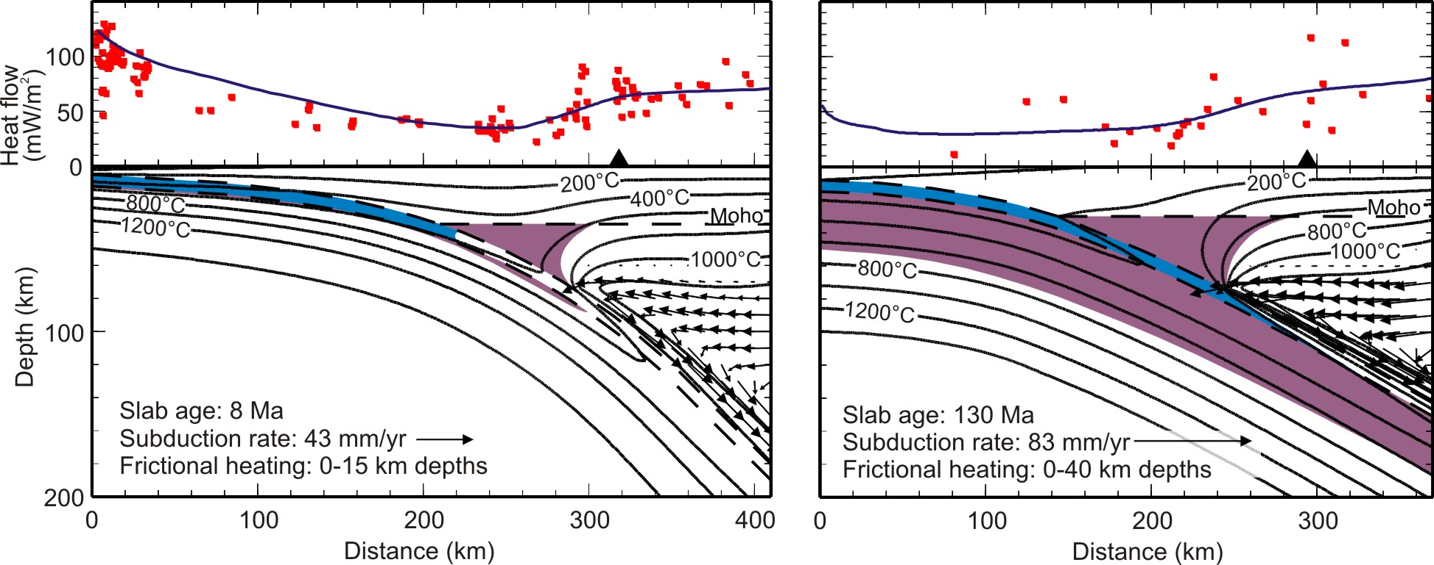
End-member young- and old-slab subduction zones
(Wada and Wang, 2009 G3; also Peacock, van Keken, Hacker, Syracuse, …)
N Cascadia
NE Japan
Blue:
Basaltic crust
Purple:
Serpentine stability
Less fluid in slab; shallow dehydration
More fluid in slab; deep dehydration
Less active arc volcanism (with exceptions)
Very active arc volcanism
Hydrated forearc mantle wedge corner
Dry forearc mantle wedge corner
slide modified from K. Wang

Slide 12
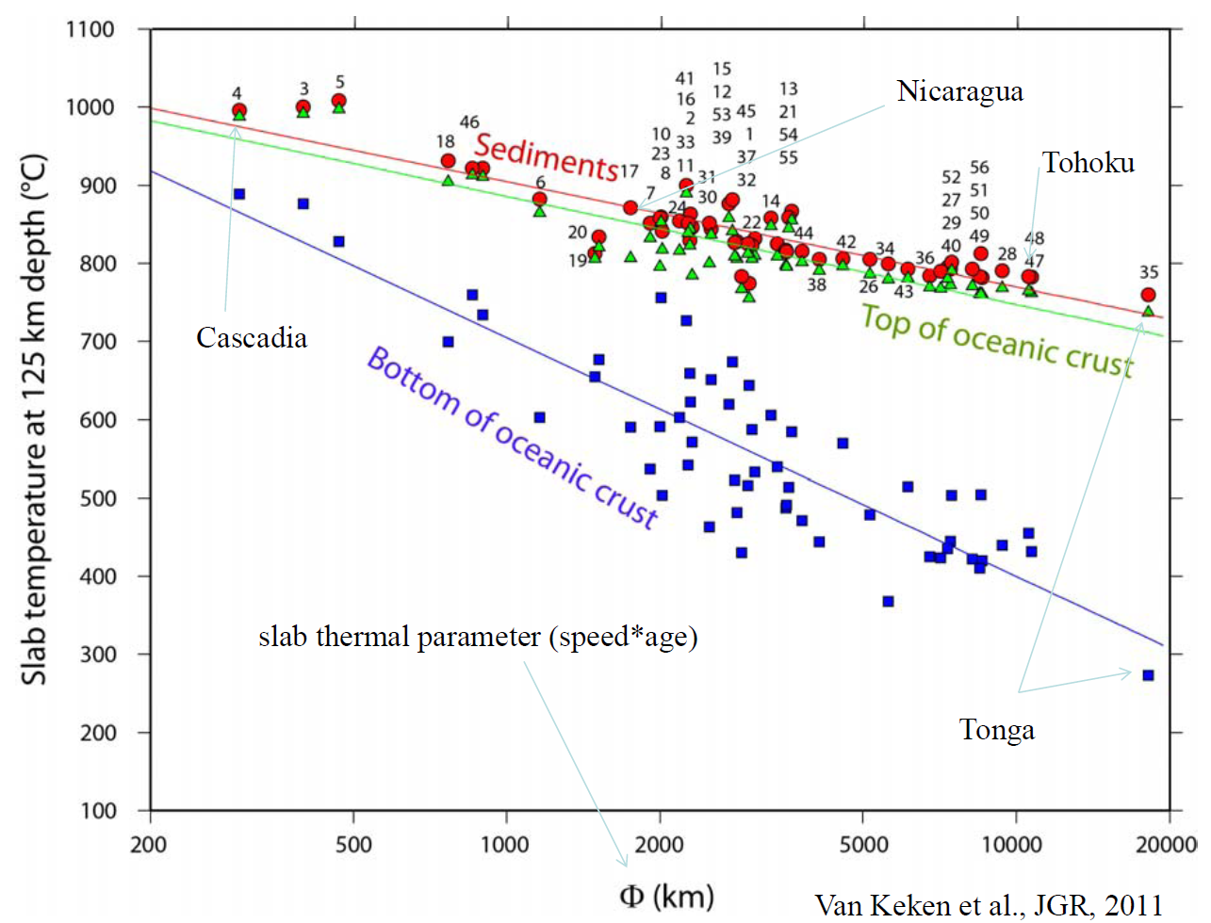
Thermal parameter
van Keken et al. (2011)

Slide 13
cf. Peclet number
van Keken et al. (2011)

Slide 14
Coupled models of wedge circulation
Cagnioncle et al. (2007)

Slide 15
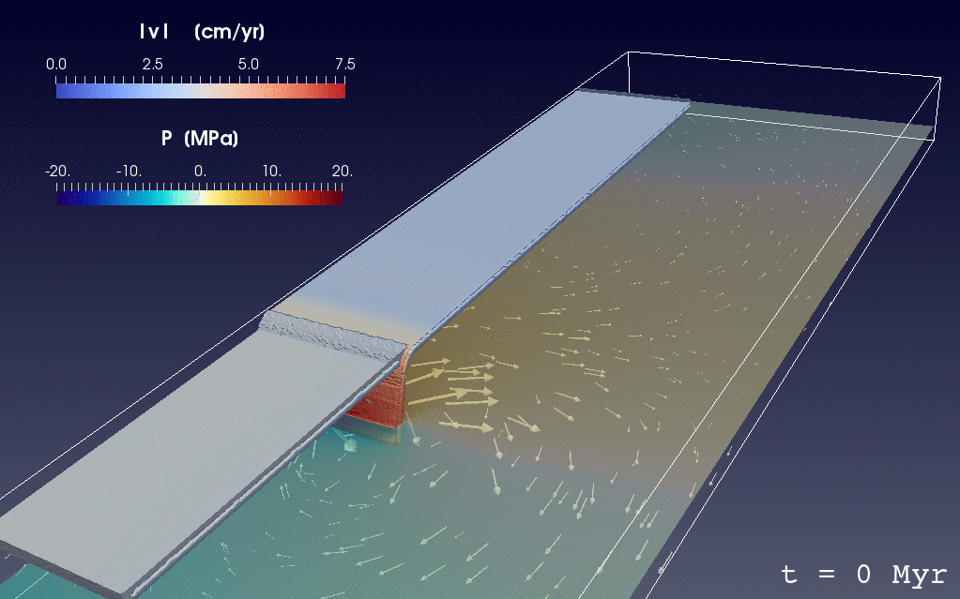
Regional self-consistent models
Holt et al. (2017)

Slide 16
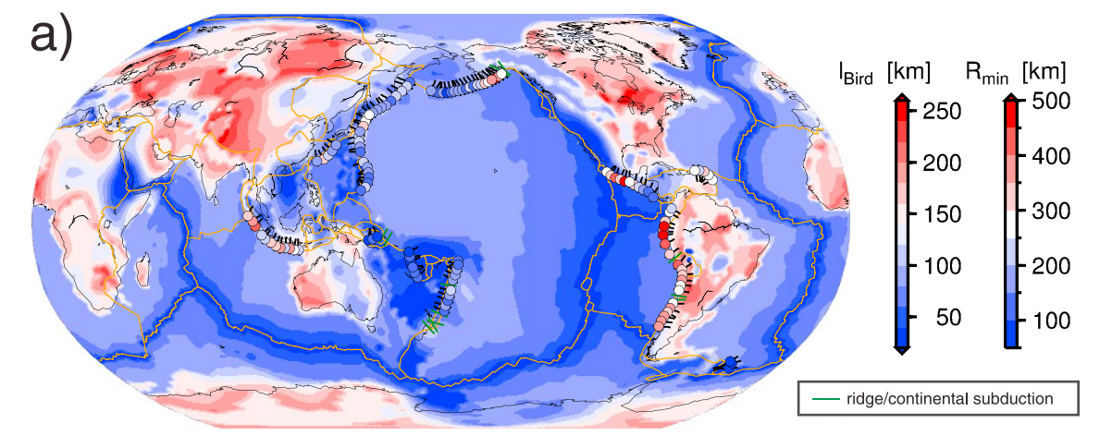
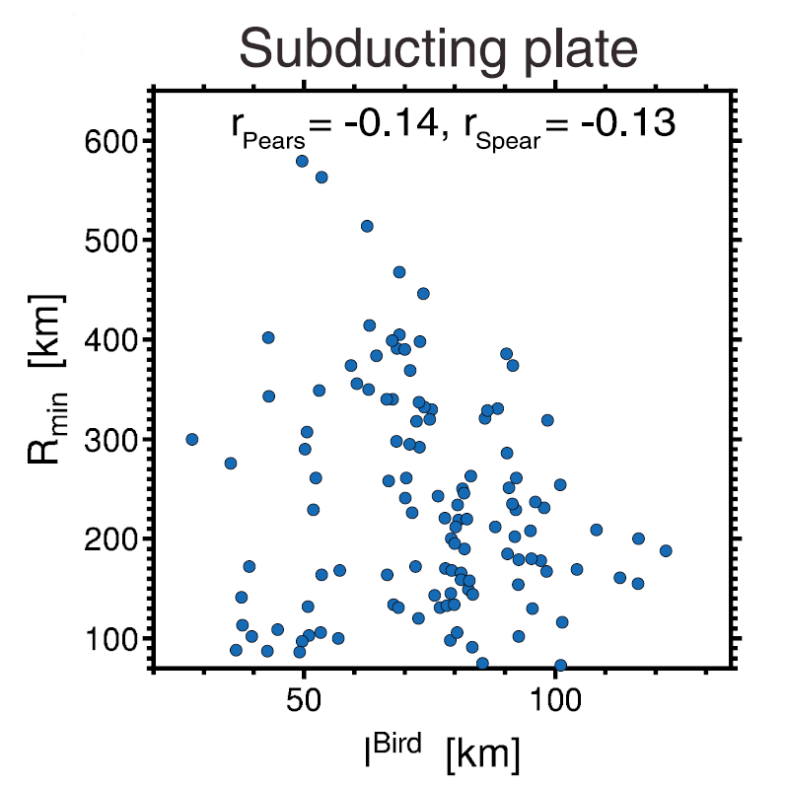
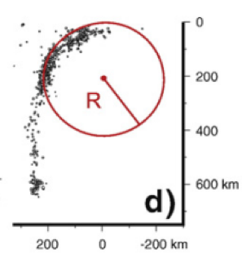
No subducting plate control on slab curvature
radius, R [km]
Lack of correlation between subducting plate thickness, h_{SP} and bending radius, R
(cf. Buffett & Heuret, 2011; Cruciani et al., 2005;
Fourel et al., 2014).
R [km]
Holt et al. (2015)
subducting plate thickness, h_{SP} [km]
Notes:
h ~ sqrt(kt)
Double subduction systems represetn
As mentioned earlier, a couple of locations where we think double subduction is important in producing enigmatic plate kinematic, past or present, are India-Eurasia and the Arcs just to the south of Japan.
We have shown that double subduction, with equivalent slab polarities, may be able to cause the anomalously high rates of pre-collision plate convergence between india and eurasia of ~15 cm/yr.

Slide 17
Slab geometry responds to dynamics:
Overriding plate thickness
Visco-plastic slab more strongly affected by lifting force (F_{ΔP}) associated with overriding plate, weak bending stresses
bending radius, R [km]
Overriding plate thickness [km]
F_{ΔP}
thin OP
thick OP
Holt et al. (2015)
Notes:
Double subduction systems represetn
As mentioned earlier, a couple of locations where we think double subduction is important in producing enigmatic plate kinematic, past or present, are India-Eurasia and the Arcs just to the south of Japan.
We have shown that double subduction, with equivalent slab polarities, may be able to cause the anomalously high rates of pre-collision plate convergence between india and eurasia of ~15 cm/yr.

Slide 18
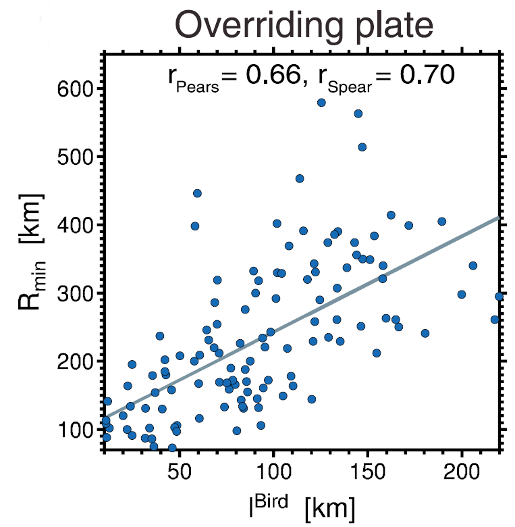
Overriding plate control on slab curvature
radius, R [km]
Lack of correlation between h_{SP} and R
Strong positive correlation between overriding plate thickness h_{OP} and radius R
Holt et al. (2015)
overriding plate thickness, h_{OP} [km]
Notes:
h ~ sqrt(kt)
Double subduction systems represetn
As mentioned earlier, a couple of locations where we think double subduction is important in producing enigmatic plate kinematic, past or present, are India-Eurasia and the Arcs just to the south of Japan.
We have shown that double subduction, with equivalent slab polarities, may be able to cause the anomalously high rates of pre-collision plate convergence between india and eurasia of ~15 cm/yr.

Slide 19
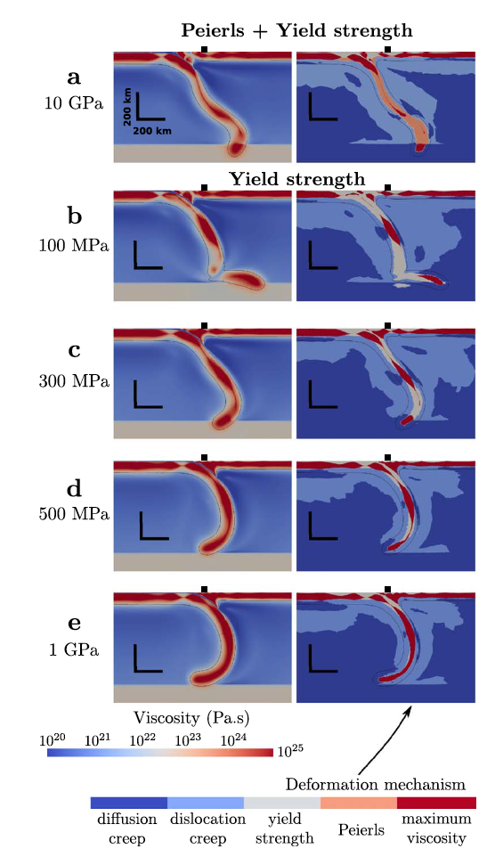
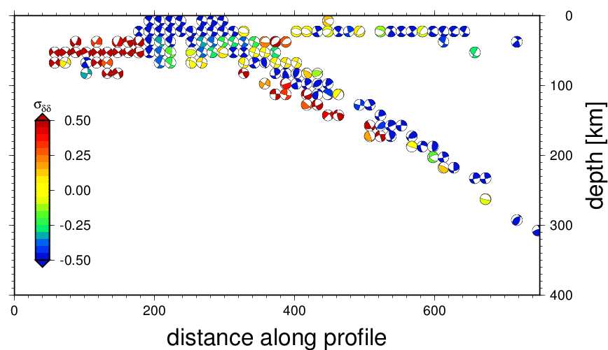
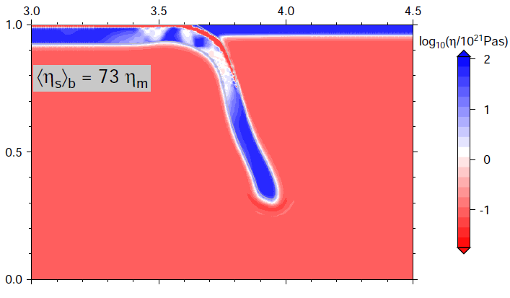
Subduction
with plastic
rheology
significant oceanic plate viscosity reduction, perhaps η_{slab}~200 η_{upper mantle}
Holt et al. (2015)
Garel et al. (2014)
cf. Čižcova et al. (2002); Billen and Hirth (2003)

Slide 20
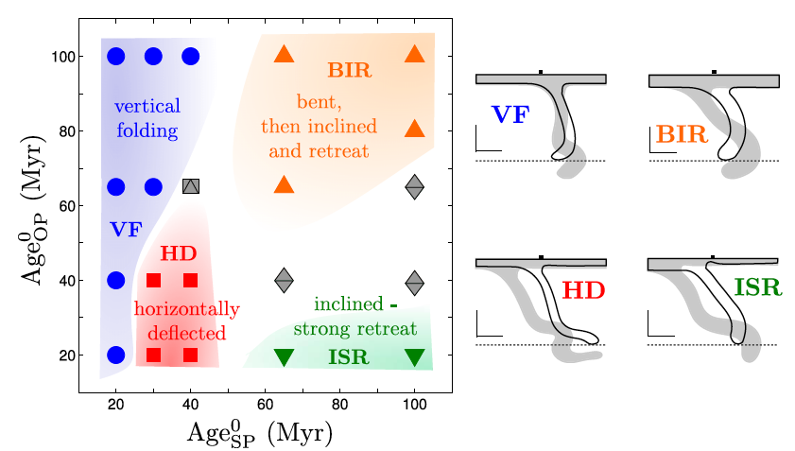
Regime diagrams for trench motions and ponding
for visco-plastic slabs with overriding plate
~overriding plate thickness
~subducting plate thickness
Garel et al. (2014)

Slide 21
buoyancy force
viscous drag
modified from Conrad and Hager (1999)
Notes:
21

Slide 22
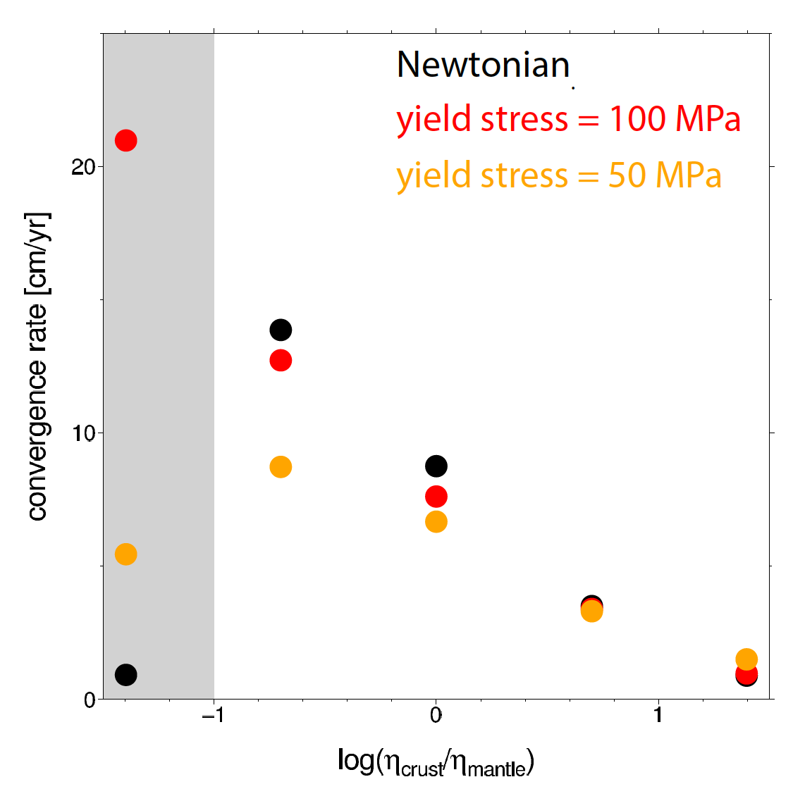
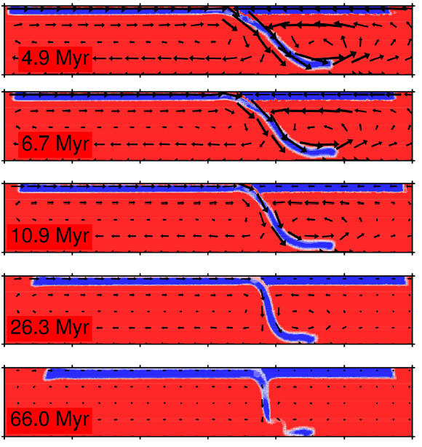
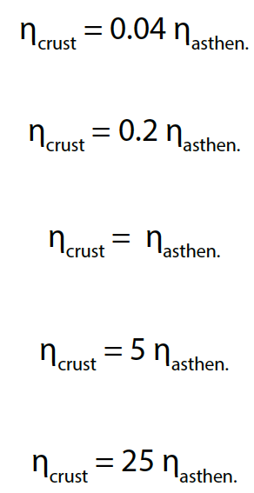
Role of crust for plate speeds
σ_{y} = 100 MPa
cf. King & Hager (1990)

Slide 23
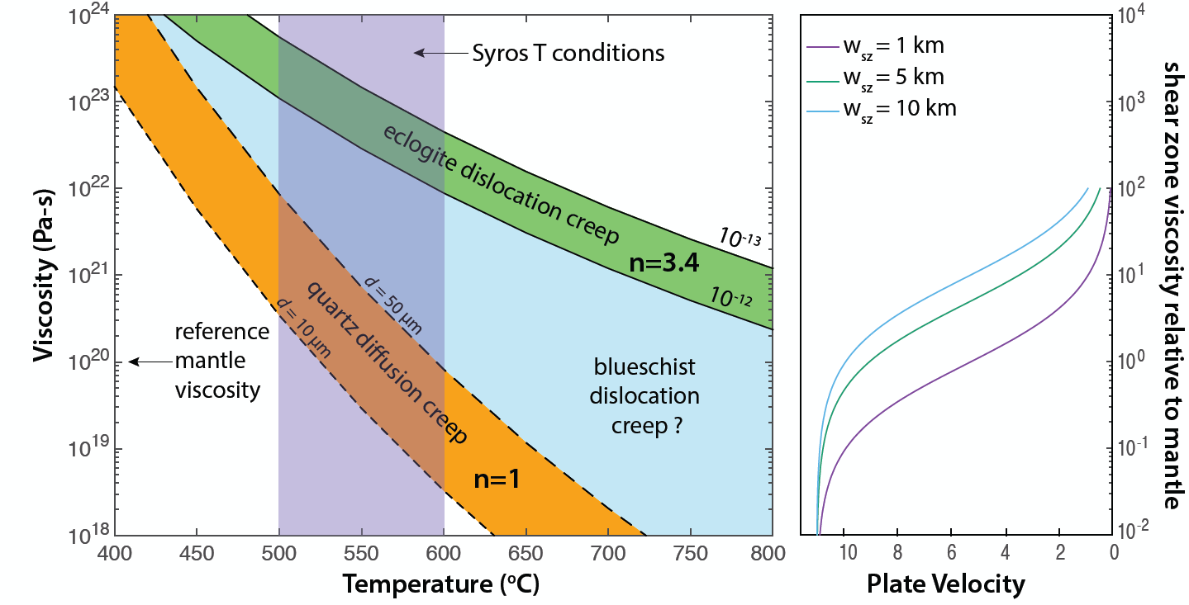
Interface (i.e. geology) control on plate velocities (continental erosion, long term cycles)?
slabs with eclogite
sediment lubricated
Behr and Becker (2018)

Slide 24
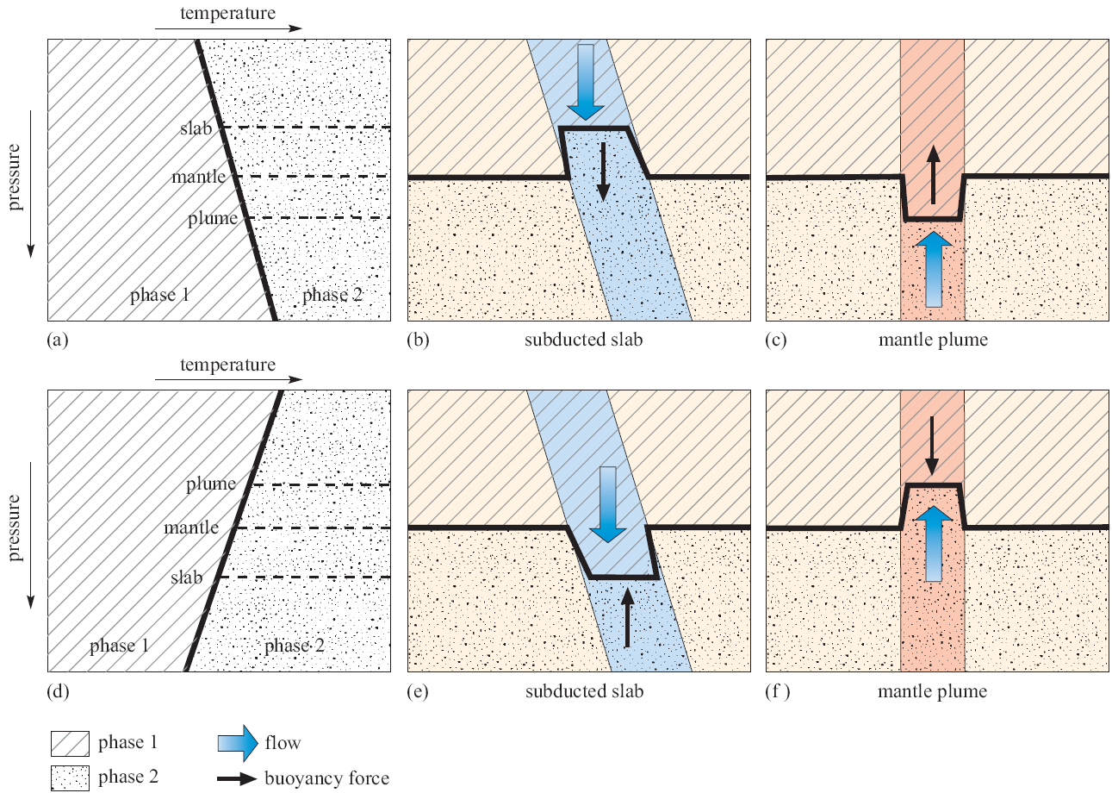
Deeper slab dynamics: upper mantle phase transitions
positive Clapeyron
slope at 410 km
(ol-wd)
~negative Clapeyron
slope at 660 km
(ri-br)

Slide 25
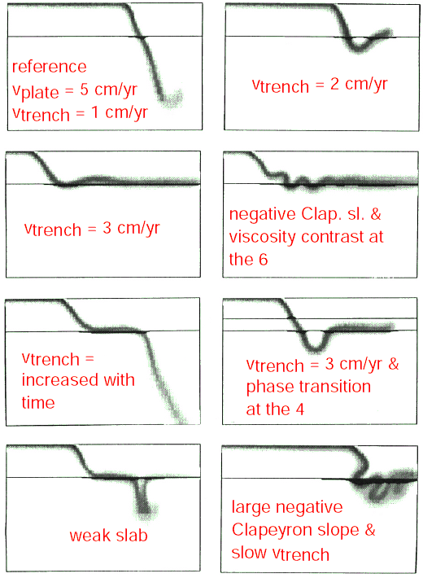
Range of slab morphologies: trench rollback and phase change
Christensen (1996)

Slide 26
Feedback between rollback and deep dynamics affects interface stress
weak slab η’ = 100
strong slab η’ = 2,000
Holt et al. (2015)

Slide 27
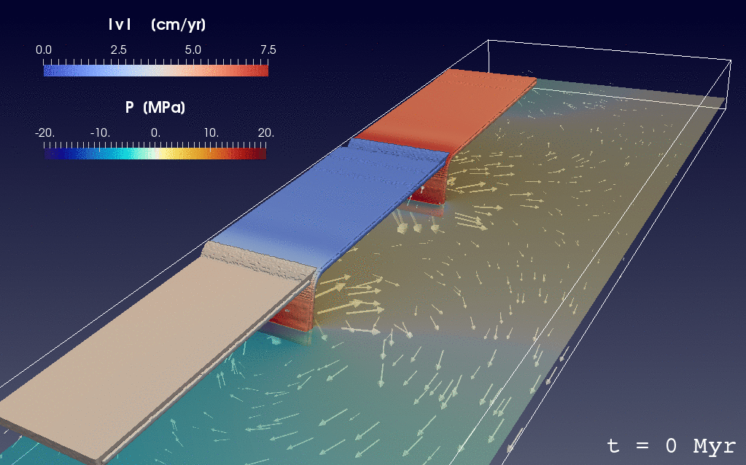
Slab-slab interactions
Holt et al. (2017)

Slide 28
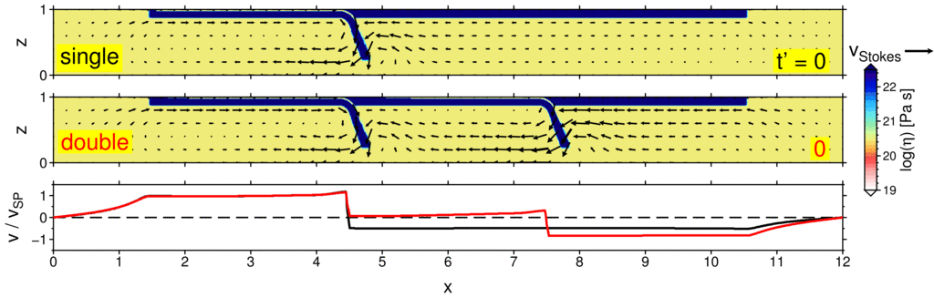
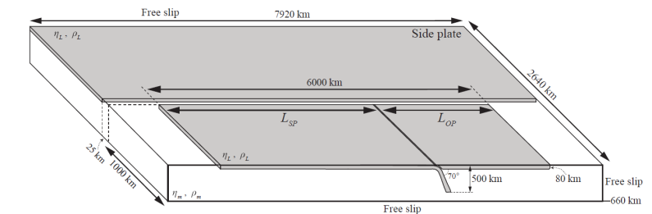
Trench motions for slab – slab interactions
horizontal plate velocity
1 + 1 ~ 2
Holt et al. (2017)
Notes:
28

Slide 29
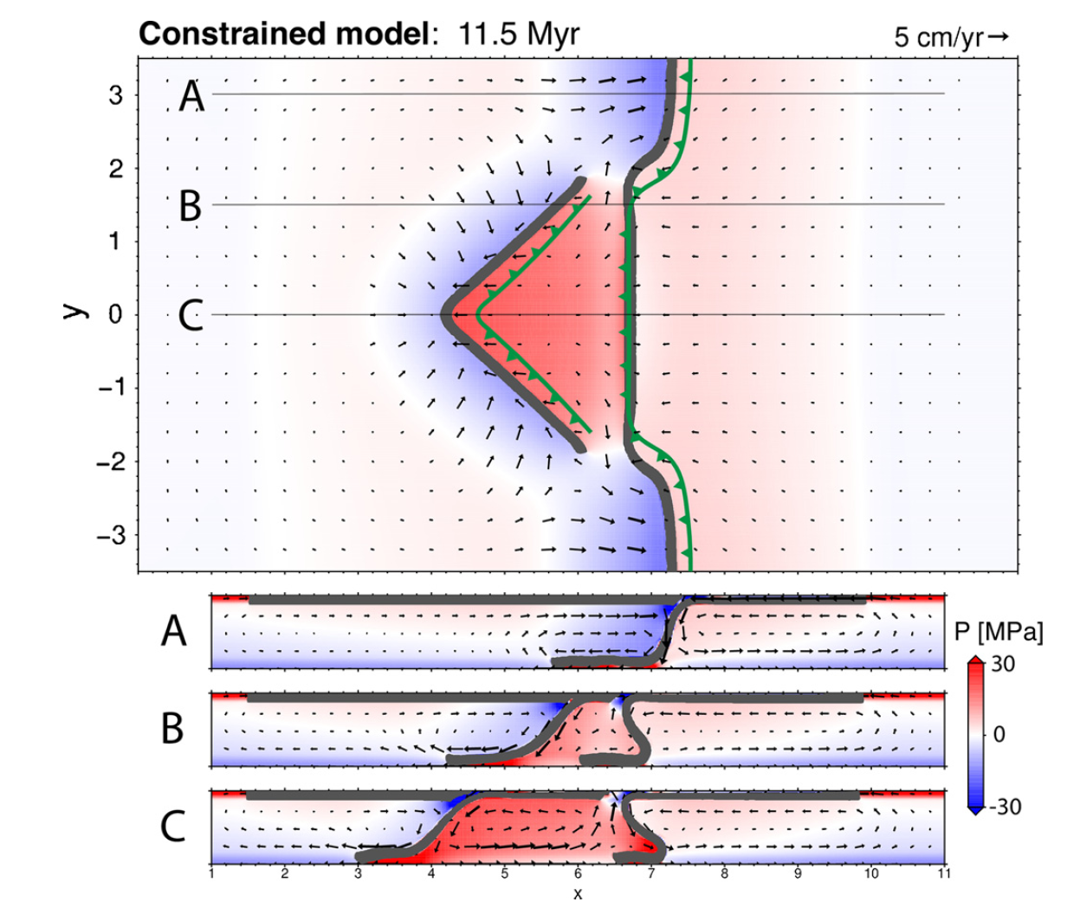
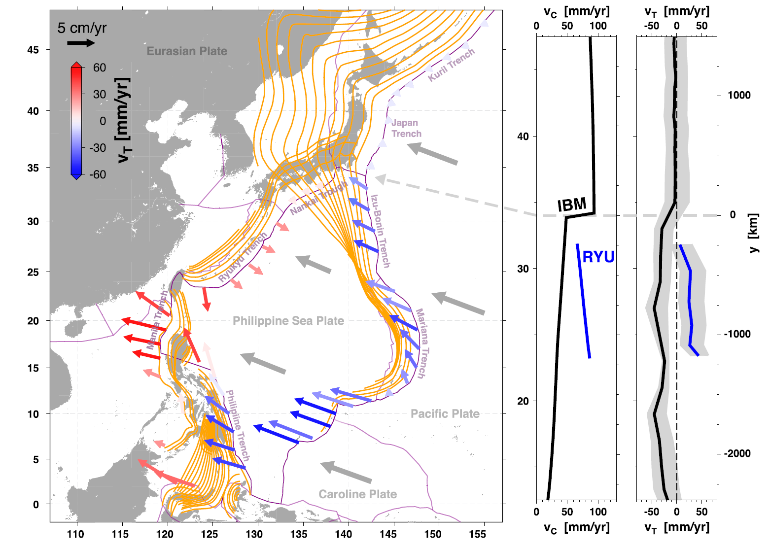
Pressure
variations
affect
slab
dynamics
pressure
for idealized
Philippine Sea
plate setting –
3D upper mantle
models
Holt et al. (2018)

Slide 30


advance
retreat
Holt et al. (2017, 2018)

Slide 31
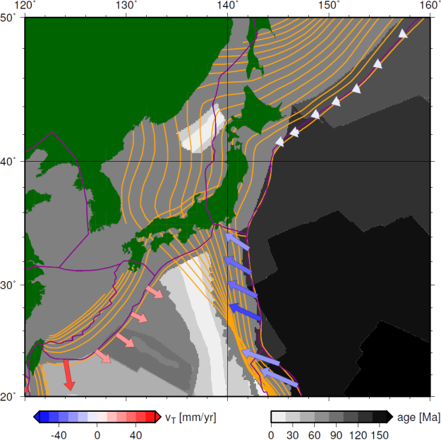
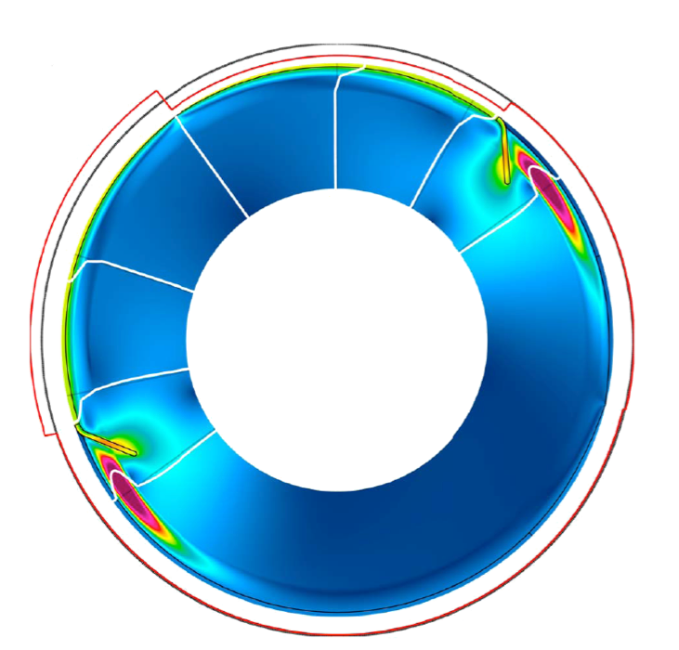
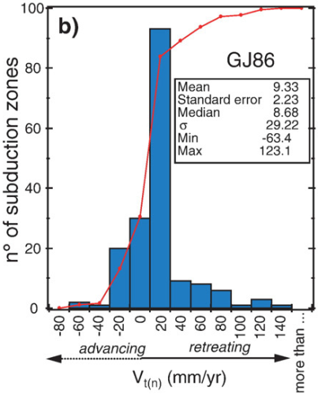
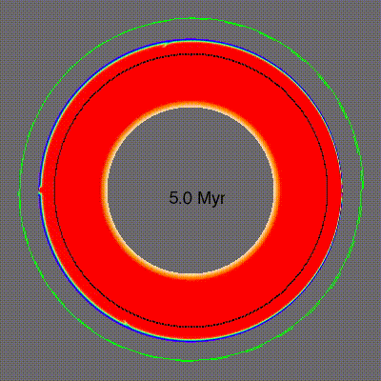
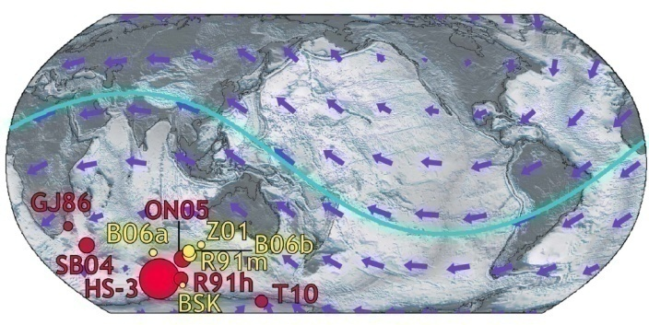
Global interactions:
Trench motions and reference frames
rollback
advance
Becker et al. (2015)
Funiciello et al. (2008)
Zhong and Gurnis (1995)
Gerault et al. (2011)

Slide 32
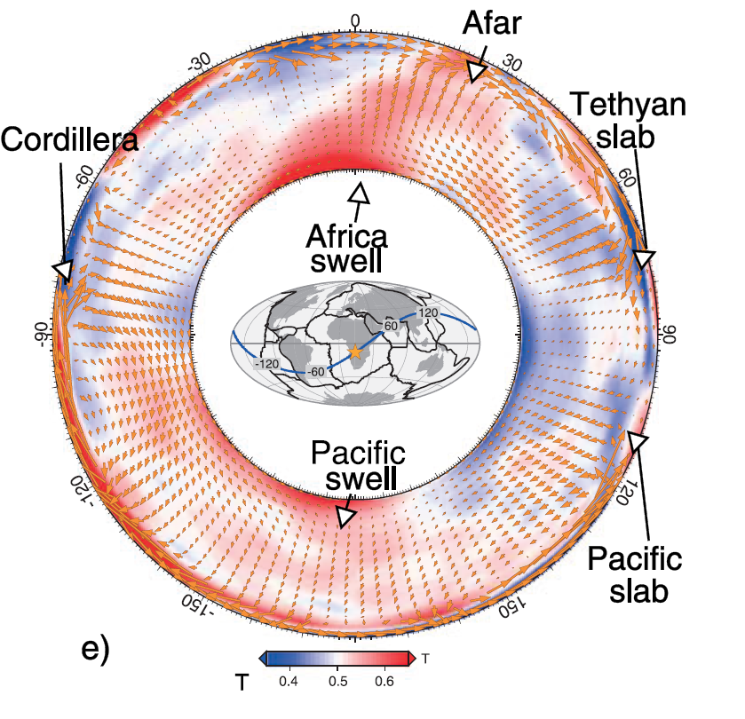
Global mantle
conveyor
belts
Faccenna et al. (2013)

Slide 33
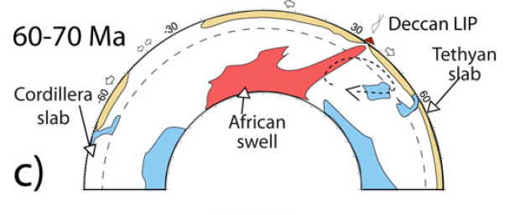
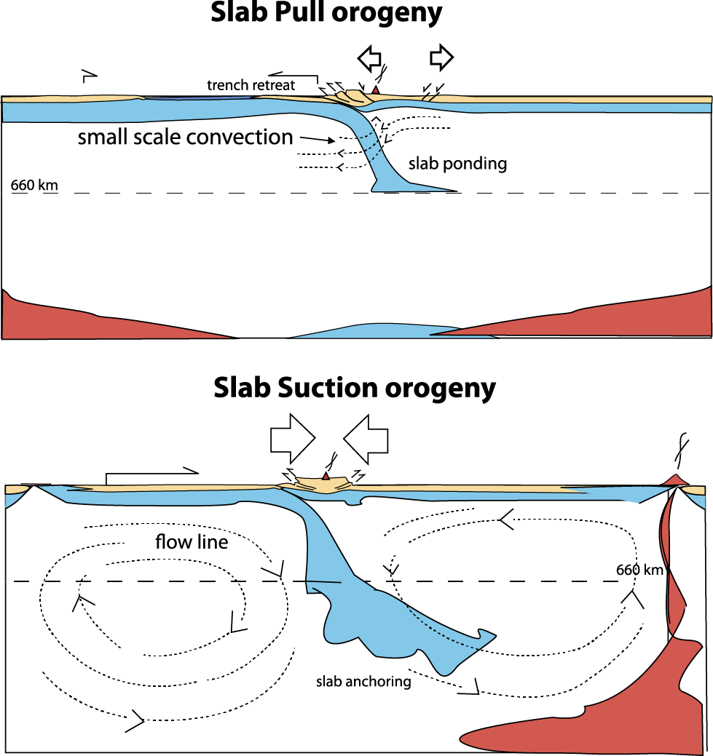
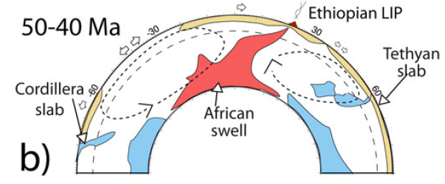
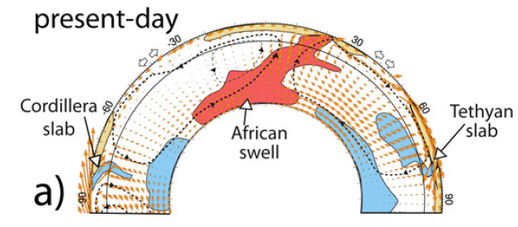
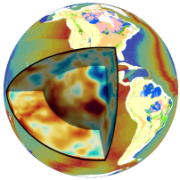
Tibetan orogeny linked to establishment of whole mantle convection cell
Faccenna et al. (2013, 2017)

Slide 34
Exploring the role of slab continental-keel interactions with seismic anisotropy
Lenardic et al. (2003)
Miller and Becker (2012)
Notes:
34
34

Slide 35
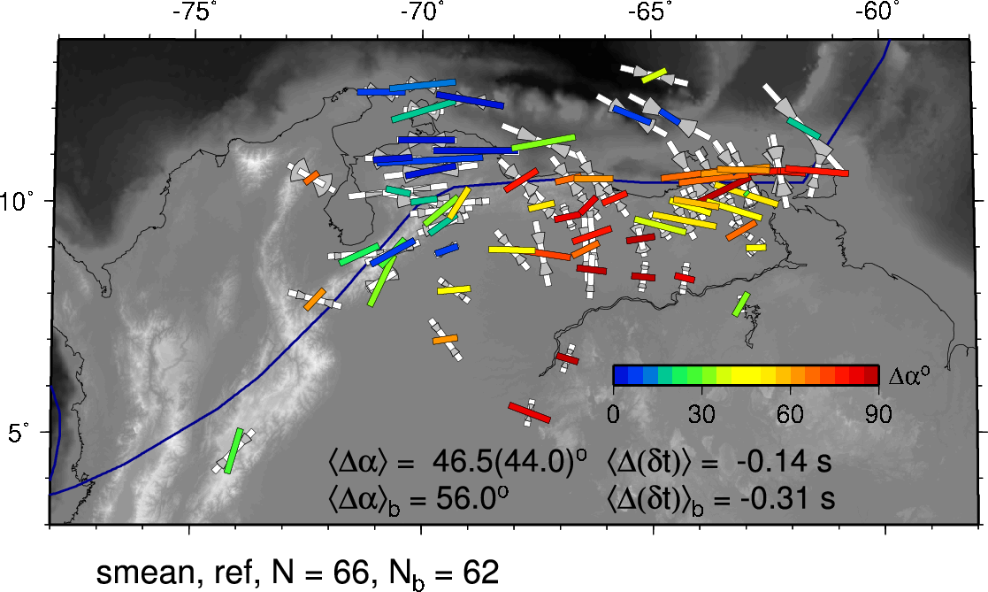
Exploring the role of continental keels
SKS splitting based on LPO from
global mantle flow models
good
bad
Colored bars: measurements colored by misfit
White bars: predictions from full waveform modeling,
wedges indicating back-azimuthal variation of δt, α
Miller and Becker (2012)
Notes:
35
35

Slide 36
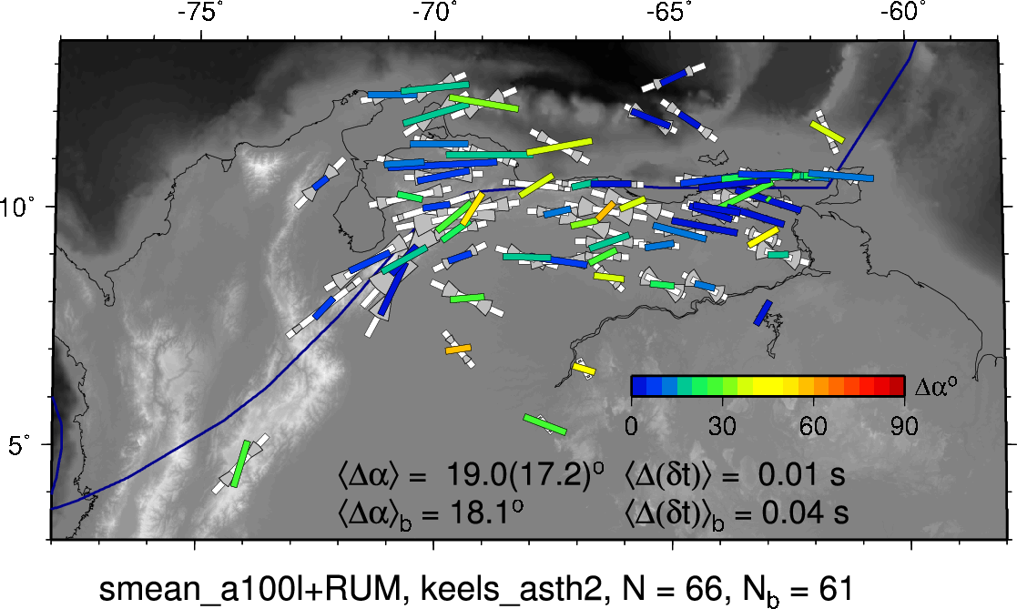
Splitting from slab model with
a weak asthenosphere and keel
good
bad
mean
angular
misfit
mean
delay time
misfit
Miller and Becker (2012)
Notes:
36

Slide 37
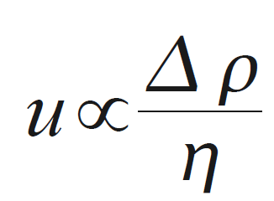


Inverse geodynamics:
Regional splitting azimuth misfit
bad
viscosity
models,
η
good
preferred
model
density models, Δρ
Miller and Becker (2012)
Notes:
37

Slide 38

Rheology
Constitutive law links dynamics with kinematics: $τ$, $\dot{τ}$ = f($ε, \dot{ε}$, …)
Kohlstedt et al. (1995)

Slide 39

The megathrust stick slip cycle
Earthquake cycle
Viscoelastic
Less viscous
Earthquake cycle
Viscoelastic
More viscous
Wang et al. (2012)

Slide 40

A few years About four decades Three centuries
Wang et al. (2012)
slide modified from K. Wang

Slide 41


slide modified from K. Wang
Sun et al. (2018)
T_{ref}
Reference time
50 km
Moment magnitude

Slide 42











Visco-elasticity
Elastic layer
Viscous layer
= η $\dot{ε}$
η = f(ε, τ, T, p, H₂0, C, d, …)
G
G
Timescale ~ viscosity / elastic modulus

Slide 43

Transient geodetic post-seismic response after M9 Tohoku-oki 2011
Hashima et al. (2016)
Freed et al. (2017)

Slide 44



Post-seismic transients as a probe for rheology
Becker (2006)
based on
Hirth and
Kohlstedt (2000)
η(p, T ) for upper mantle from laboratory creep laws
cf. Wu et al. (2015)
Freed et al. (2017)

Slide 45

Weakening of oceanic plate by Peierls creep, visco-plasticity?
Buffett and Becker (2012)
Freed et al. (2017)

Slide 46
Visco-elastic Rayleigh Taylor
Rates ~same, stresses different
Kaus and Becker (2008)

Slide 47
Role of rheology for subduction
Kaus et al. (2008)

Slide 48
Elastic core of plates
Burov (2011)

Slide 49

Trench motions for nonlinear mantle rheology
horizontal plate velocity
cf. Billen and Hirth (2003), Jadamec and Billen (2012)
Holt and Becker (2017)
Notes:
49

Slide 50

ambient mantle temperature
model time
geologic time since Archean
van Hunen et al. (2007)

Slide 51
Role of surface processes
(or free slip vs. free surface)
no erosion
fast erosion
Kaus et al. (2008)

Slide 52
Role of type of surface process
Ueda et al. (2015)

Slide 53


Verticals

Slide 54


Case history: Apennines
Inter-plate, very recent orogeny, little erosion
Sicily

Slide 55

Consider profile along strike
Faccenna et al. (2014)

Slide 56

Topography swath along profile
Median topography
within swath
Tyrrhenian slab
Seismicity profile
Faccenna et al. (2014)
Notes:
56

Slide 57


residual (anomalous) topography from Airy isostasy
from Moho model
Faccenna et al. (2014)
Notes:
57

Slide 58

inferred lithosphere
from perfect isostasy
S receiver function
Layer 1 and 2 LAB picks
Faccenna et al. (2014)
cf. Gvirtzman and Nur (2001)
Notes:
58

Slide 59

residual (anomalous) topography from Airy isostasy
“dynamic” topography due to mantle flow
seismic tomography profile
(Piromallo and Morelli, 2003)
Faccenna et al. (2014)
cf. Shaw and Pysklywec (2010)
Notes:
59

Slide 60

Uplift from geodesy
when corrected for GIA
with two different ice models
Faccenna et al. (2014)
Notes:
60

Slide 61


Faccenna et al. (2014)

Slide 62

Shallow mantle convection due to slab gap drives uplift and orogeny in the absence of tectonic forcing
Po plain subsidence and Apennines uplift active since slab break off at Pliocene-Pleistocene (~2 Ma)
Uplift rates of ~0.2 mm/yr from geodesy are consistent with building the Apennines in ~2 Ma
Steady-state topography (where erosion balances vertical rates) does not apply
cf. Wortel and Spakman (2000), Gvirtzman and Nur (2001), d’Agostini and McKenzie (1999), Shaw and Pysklywec (2010)
Faccenna et al. (2014)
Notes:
62

Slide 63

Case history: Atlas
Intra-plate weak zone, recent orogeny, little shortening, little erosion

Slide 64

Lithospheric structure and
seismic anisotropy
Orogeny over a preexisting lithospheric zone of weakness (along with delamination)?
Crustal and LAB constraints imply dynamic (mantle) support
Miller and Becker (2014)

Slide 65


qq
tangential component
seismograms
cf. Song and Helmberger (2007)
Sun et al. (submiited)
Sun et al. (2014)

Slide 66

data
synthetics
misfit for different models
Sun et al. (2014)

Slide 67

~350 K anomaly, maybe some partial melting
Using dry pyrolite parameterization following Goes et al. (2000)
Sun et al. (2014)

Slide 68

topography
residual
topography
dynamic
topography
Sun et al. (2014)

Slide 69
Fingerprinting topography
Combine
residual topography
dynamic topography
uplift
signatures

Slide 70

Case III: The western US
GPS based,
GIA corrected
Lau et al. (in prep)

Slide 71
Case IIIb: Cascadia
GPS based,
GIA corrected
Lau et al. (in prep)

Slide 72
Vertical megathrust deformation across temporal scales
Hashima and Sato (2017)

Slide 73
Visco-elastic megathrust cycle model
Hashima and Sato (2017)

Slide 74

h
mantle flow induced topography and uplift
Becker et al. (2015)

Slide 75
Additional slides

Slide 76




Dynamic topography: “plume” case
$$h$$
dh/dt µ Dr²
η ∝ τ ∝ Δρ
dynamic topography h ∝ with density (temperature anomaly), Δρ (here = ΔT)
Stokes' sphere
velocity/stress:
Notes:
  Often, we infer equivalent topography from
  σ_{zz} pushing on a free slip surface
  this works remarkably well in most cases (l ≪ L)
v ∝ Δρ/η
τ ∝ Δρ
dh/dt µ h⁻¹
Notes:
Queste sono alcune semplici leggi di scala per una palla in risalita nel mantello viscose (equazione di stokes). Il contrasto di densità è dato dalla differemza di temperatura delta T. la topo dinamica e la velocità di sollevamento sono linearmente legate a deltaT mentre la velocità è inversamente proiporzonale alla viscosità del mezzo.
76

Slide 77




Dynamic topography: “plume” case
$$h, \dot{h}$$
$\dot{h}$∝ Δρ²
h ∝ τ ∝ Δρ
dynamic topography h ∝ with density (temperature) anomaly, Δρ (here = ΔT)
v ∝ Δρ/η
$h$ ∝ τ ∝ Δρ
$\dot{h }$ ∝ v h
∝ Δρ²/η
Note:
  Match topography and
  velocity, constrain
  both Δρ and η,
  match uplift, even better!
$\dot{h}$ ∝ η⁻¹
uplift rate, $\dot{h}$∝ inverse of viscosity, 1/η (and density anomaly squared)
Notes:
Queste sono alcune semplici leggi di scala per una palla in risalita nel mantello viscose (equazione di stokes). Il contrasto di densità è dato dalla differemza di temperatura delta T. la topo dinamica e la velocità di sollevamento sono linearmente legate a deltaT mentre la velocità è inversamente proiporzonale alla viscosità del mezzo.
77

Slide 78



Topography is about knowing the
structure and the history, and not so much LVVs
strong
no viscosity variations
viscosity variations
squishy
Burov et al. (2003)

Slide 79

Dehydration of the subducting slab
Crust (wet basalt)
Mantle
Young slab
Young slab
wt% bound H₂O
Old slab
Old slab
Phase diagram from Hacker et al. (2004)
Reactions from Schmidt and Poli (1998)
Wet solidus: (1) Schmidt and Poli (1998), (2) Grove et al. (2003)
slide modified from K. Wang

Slide 80
Stadler et al. (2010)
Jadamek &
Billen (2011)

Slide 81

from
K. Johnson

