Slide 1


Global Mantle
Circulation Modeling
Thorsten W. Becker
Jackson School of Geosciences
The University of Texas at Austin
Internal Earth Doctoral Training
Barcelonette, France
October 14, 2019

Slide 2
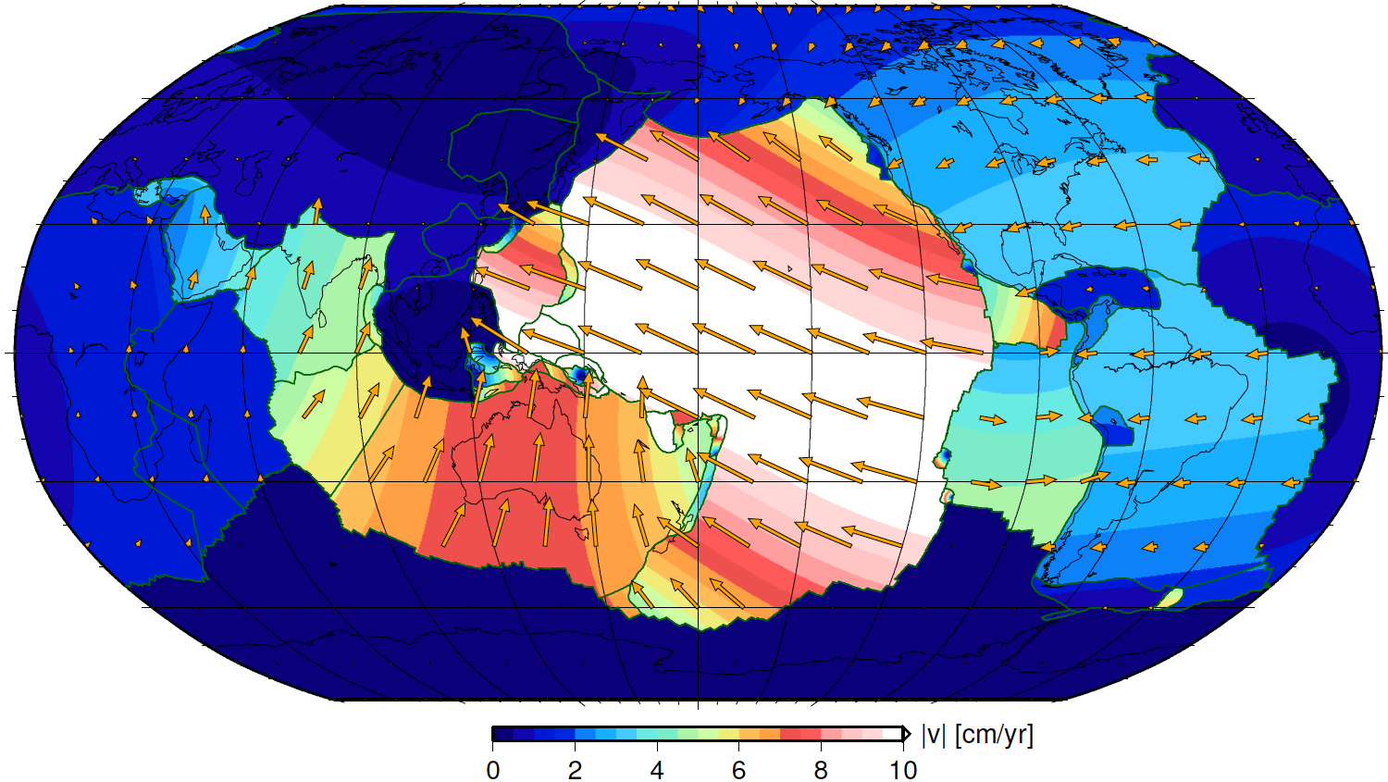
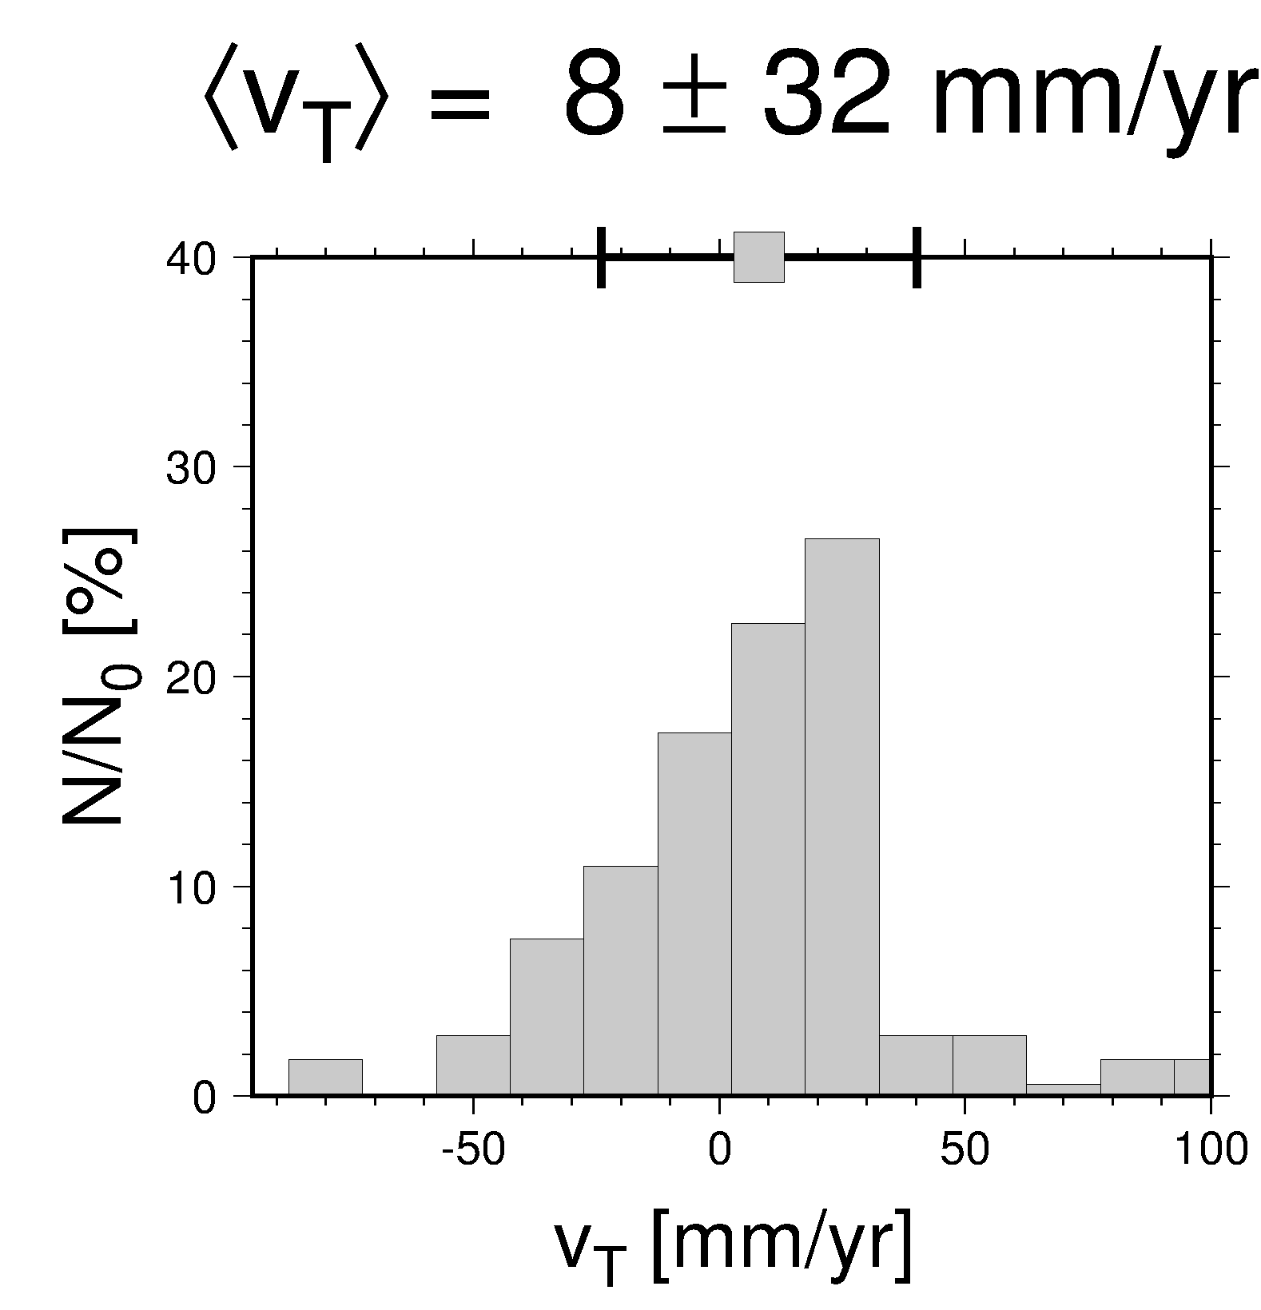
Plate kinematics
trench motions
|v_{T}| ~ 40% |v_{P}|
advance
rollback
MORVEL56 velocities by Argus et al. (2011) and trench motions from Heuret and Lallemand (2005) in spreading-aligned reference frame (Becker et al., 2015)

Slide 3
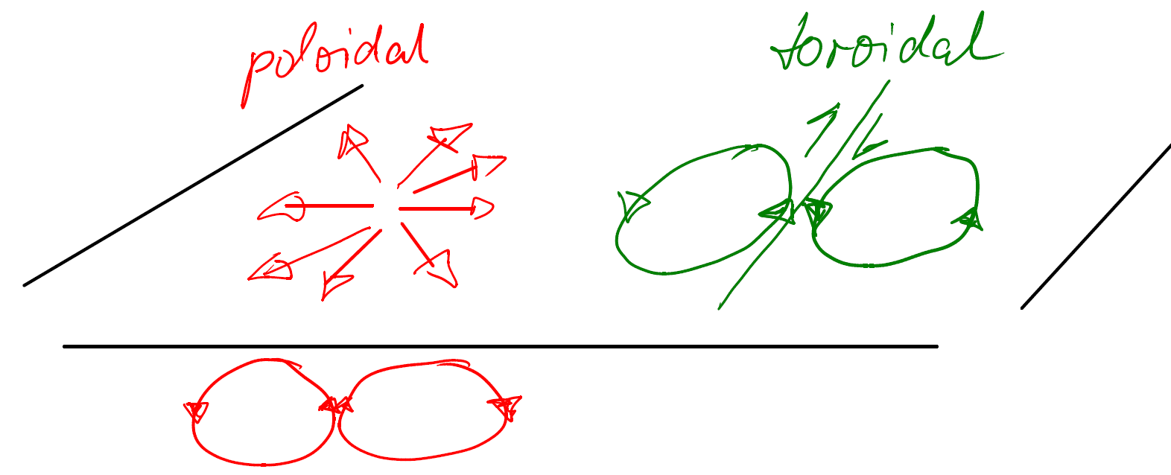

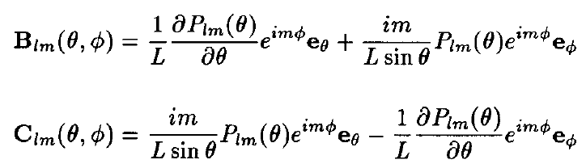
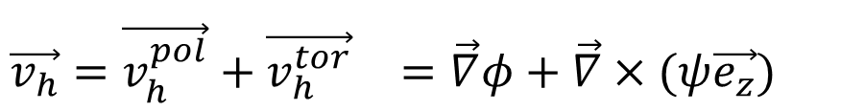
Helmholtz decomposition
into irrotational (poloidal) and
divergence free (toroidal) fields
$$\vec{v_{h}}={\vec{v_{h}^{pol}}+\vec{v_{h}^{tor}}}_{}^{}=\vec{∇}φ+\vec{∇}×(ψ{\vec{e_{z}}) }_{}$$
$$∇^{2}φ= \vec{∇}⋅\vec{v_{h}}; ∇^{2}ψ=\vec{∇}×({\vec{v_{h}}) }_{}$$
In vector spherical harmonics (use generalized spherical harmonics for orientational, 2φ):

Slide 4
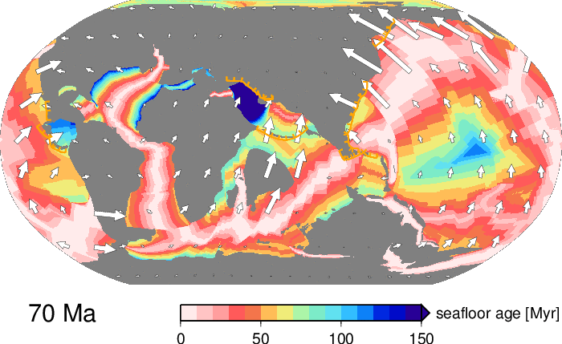
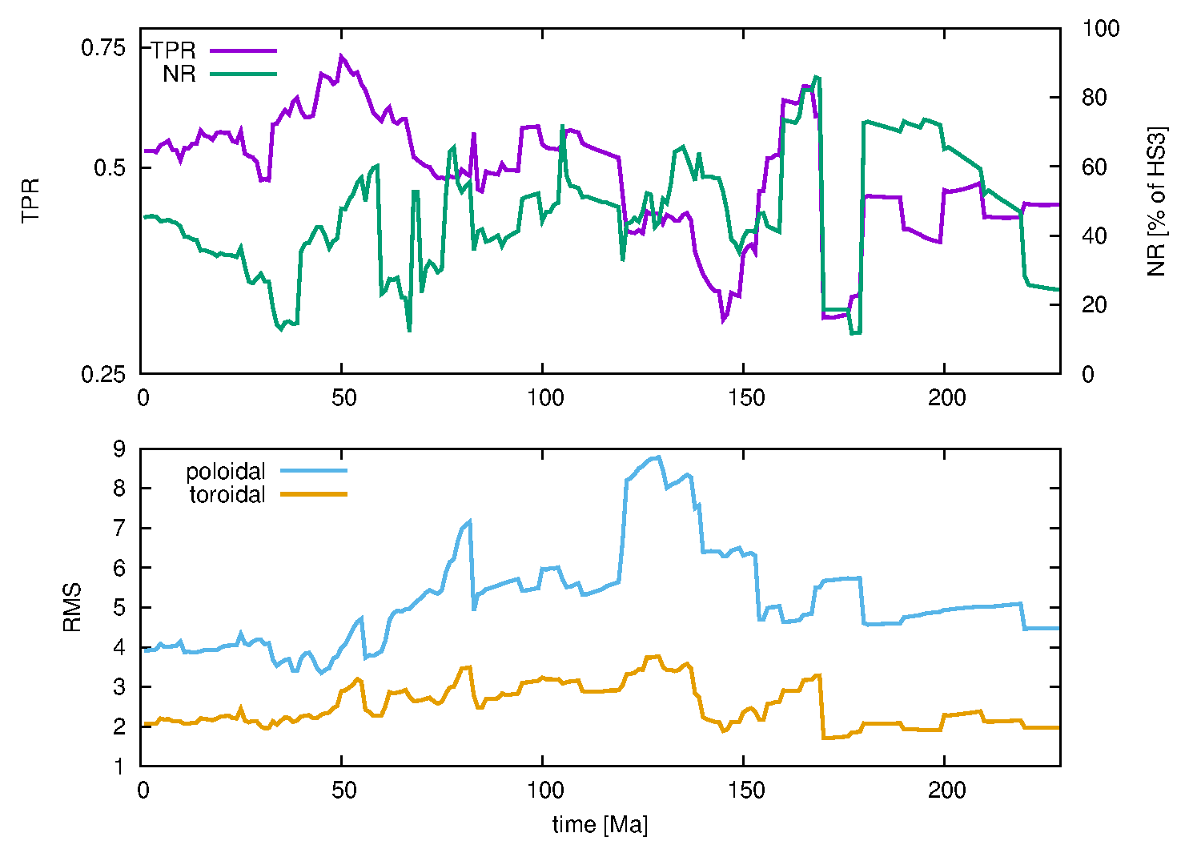
Mueller et al. (2016)
Time-evolution of plate
kinematic diagnostics
toroidal/poloidal ratio
net rotation

Slide 5
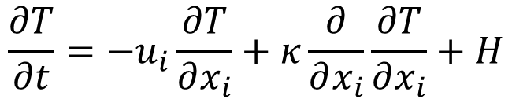
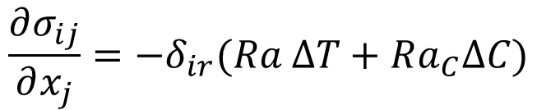
Mantle convection
  Energy equation introduces time-dependence
  Coupling between velocity and temperature introduces non-linearity
  Can time reverse advection, but not diffusion
$$\frac{∂σ_{ij}}{∂x_{j}}=−δ_{ir}(Ra ΔT+Ra_{C}ΔC)$$
force balance
(conservation of momentum)
constitutive law
(rheology)
$$σ_{ij}=−{Pδ}_{ir}+2η\left(\dot{ε}, ε,T,p,d,H_{2}O, C, …\right){\dot{ε}}_{ij}$$
conservation of
energy
$$\frac{∂T}{∂t}=−u_{i}\frac{∂T}{∂x_{i}}+κ\frac{∂}{∂x_{i}}\frac{∂T}{∂x_{i}}+H$$
Notes:
5

Slide 6
Mantle circulation
  Prescribe velocities and/or density structure
  Prescribe viscosity
  Arrive at instantaneous solution (laminar Stokes flow)
$$\frac{∂σ_{ij}}{∂x_{j}}=−δ_{ir}(Ra ΔT+Ra_{C}ΔC)$$
force balance
(conservation of momentum)
constitutive law
(rheology)
$$σ_{ij}=−{Pδ}_{ir}+2η\left(\dot{ε}, ε,T,p,d,H_{2}O, C, …\right){\dot{ε}}_{ij}$$
Can solve globally for RVVs in s on laptop,
LVVs in hours on supercomputer for ~1..20 km resolution
Notes:
6

Slide 7
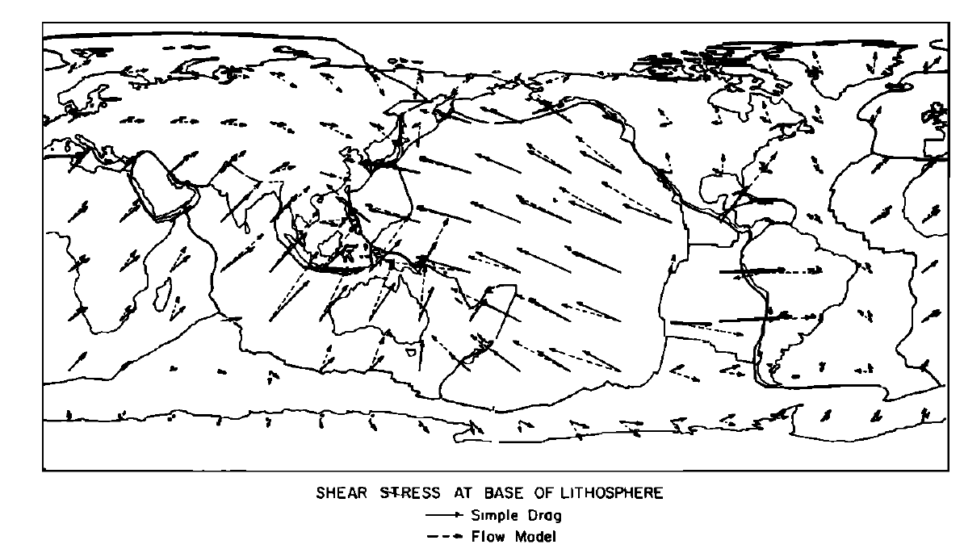

Global circulation models
$$τ=η \dot{ε}$$
Hager & O'Connell (1979)

Slide 8
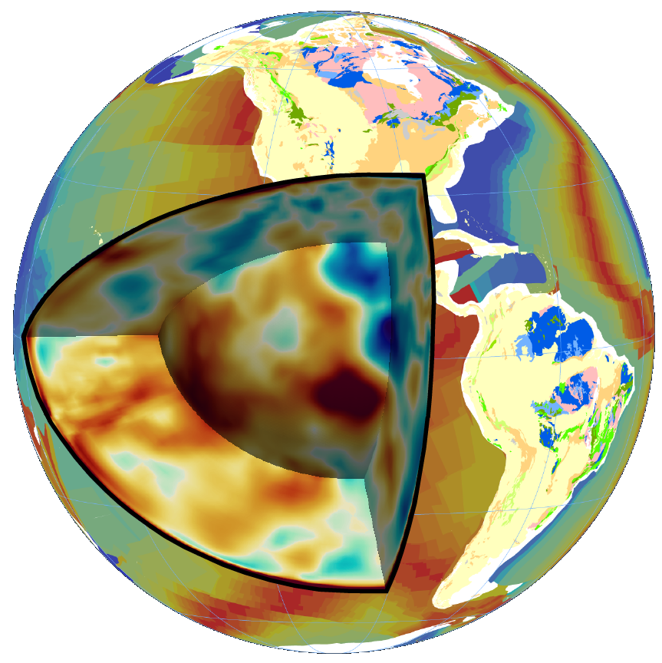
How do we build
a deep Earth
density model?

Slide 9
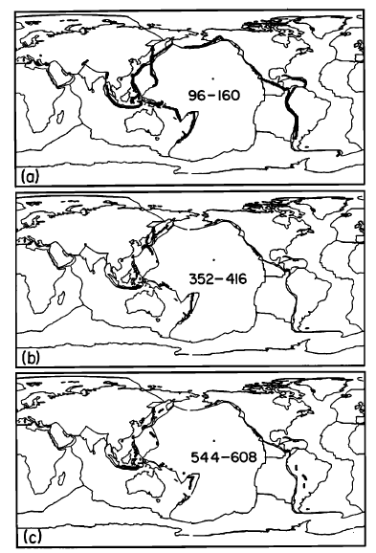
Upper mantle
slabs from
Wadati-Benioff
zones
Hager (1984)

Slide 10
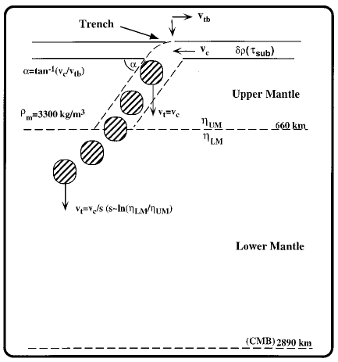
Mueller et al. (2016)
Stokeslets link subduction
history to mantle structure
Ricard et al. (1993); Lithgow-Bertelloni et al. (1993, 1998)

Slide 11
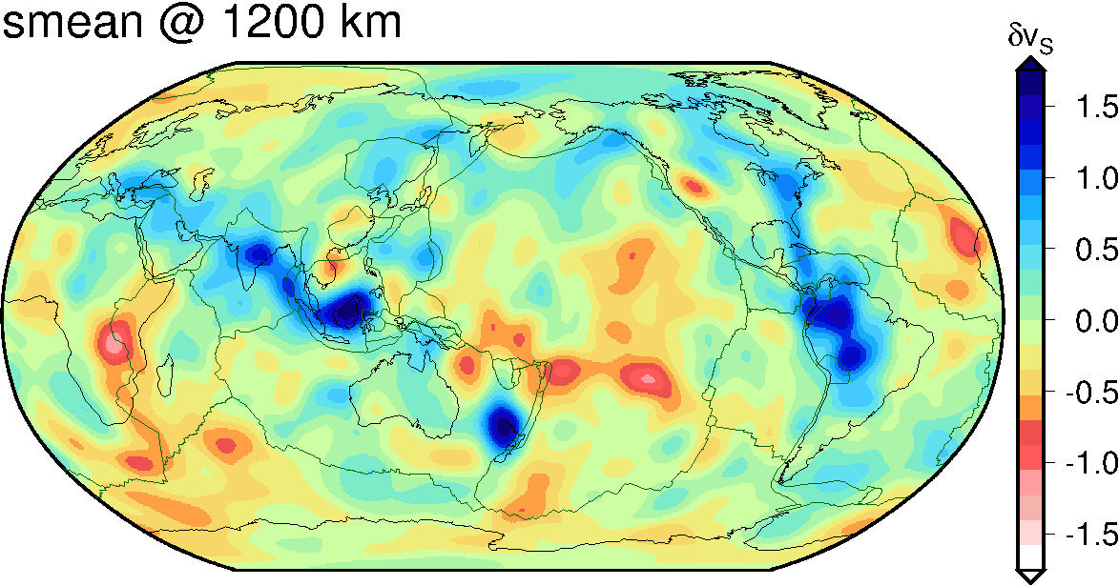
Slabs in global seismic tomography models
[%]
Becker and Boschi (2002)
S wave models provide poor image of slabs in upper mantle
P wave models poor outside subduction zones in upper mantle

Slide 12
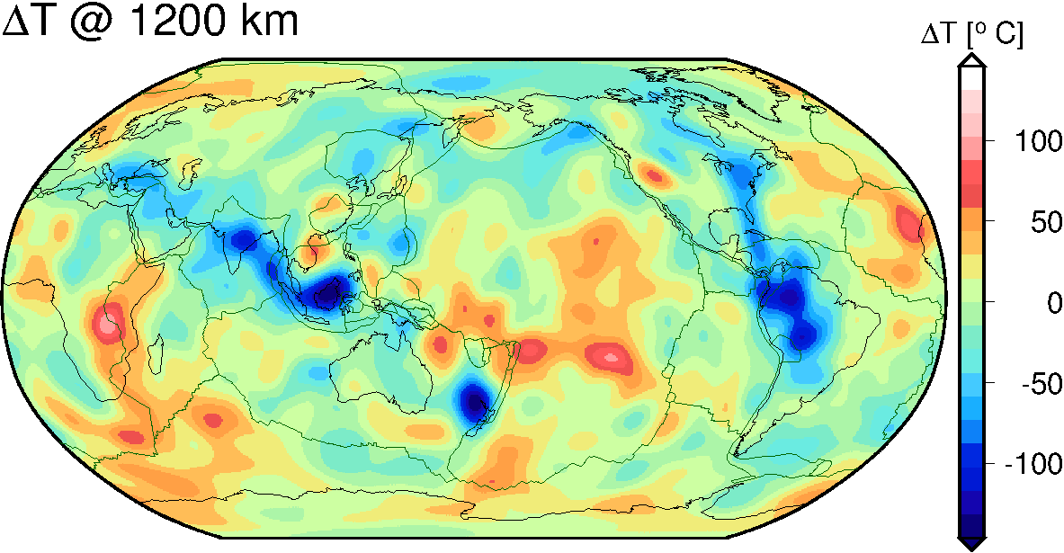
Convert to density (temperature) anomalies
Use mineral physics to convert velocity into temperature (density) anomalies

Slide 13
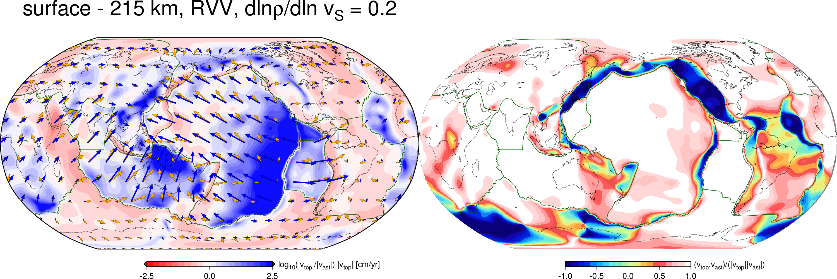
Plate motions != shear in upper mantle
Surface vs. asthenospheric velocities
from global flow model
Surface vs. asthenospheric
velocity directions
mantle leading plate ⬅
➔ plate leading mantle
opposite
same
direction
plate motions and density from tomography effects included
cf. Hager and O’Connell (1981)

Slide 14
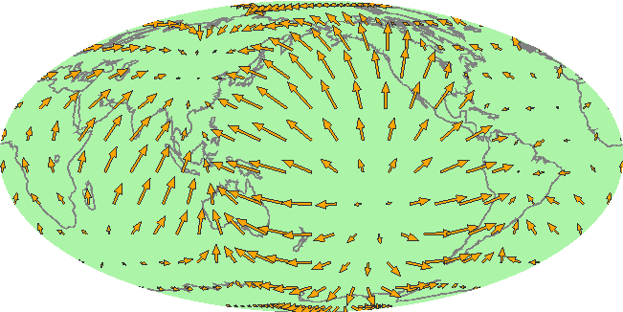
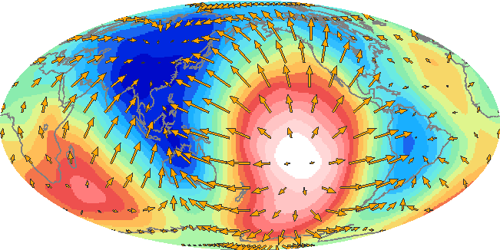
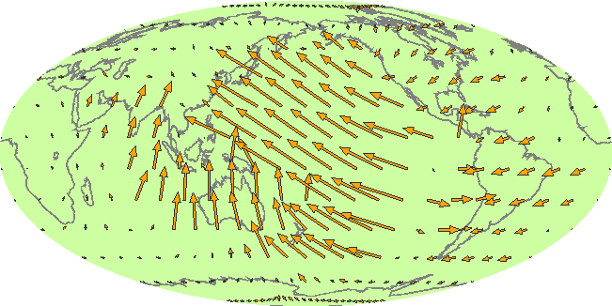
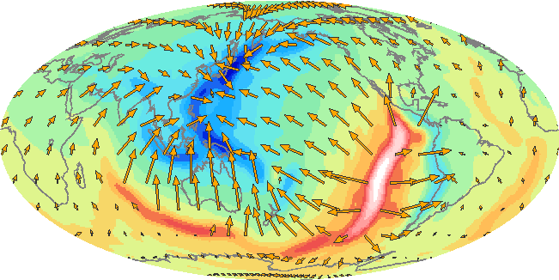
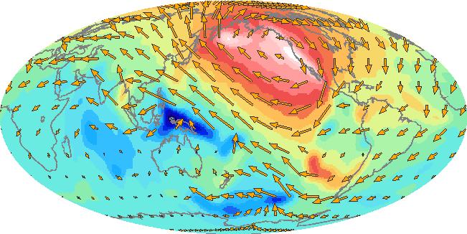
Predicting plate motions – free slip surface
Flow model with only radial viscosity variations
Poloidal component
No toroidal flow without lateral viscosity variations (no PT coupling)
Strain-rates not very plate-like
Observed plate velocities in hot spot reference frame
Poloidal component
Toroidal component
Sources and sinks
Strike slip motion, spin
O'Connell et al. (1991); Ricard et al. (1991); Ribe (1993); Forte & Peltier (1993); Thoraval & Richards (1997); Moucha et al. (2008); Ghosh et al. (2009)

Slide 15
Predicting plate motions with weak zones
Observed plate motions
Velocity model
  Prescribe weak plate boundaries
  Compute plate drag coupling and driving torques
  Solve for Euler vectors for rigid plates
Correlations good, but oceanic plates move as fast as continental ones
Modeled plate motions
Ricard & Vigny (1989)
Ricard & Vigny (1989); Lithgow-Bertelloni & Richards (1998); Becker & O'Connell (2001);
Conrad & Lithgow-Bertelloni (2002); Becker (2006); van Summeren et al. (2010; Alisic et al. (2014)

Slide 16
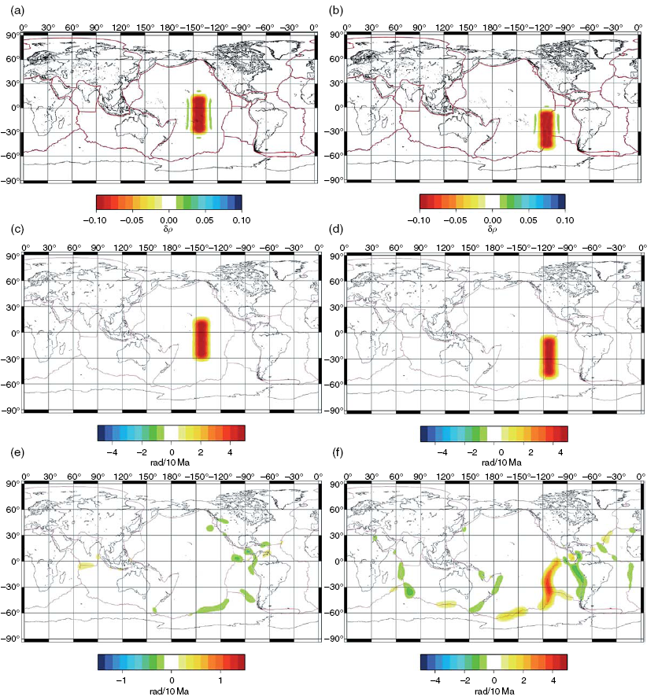
Two density
sources
Slow (“plume”) anomalies
Divergence of free slip
computation
Free-slip solution
for poloidal flow
“Plate” solution
for poloidal flow
Divergence of plate
coupled computation
Forte (2008, 2015)

Slide 17
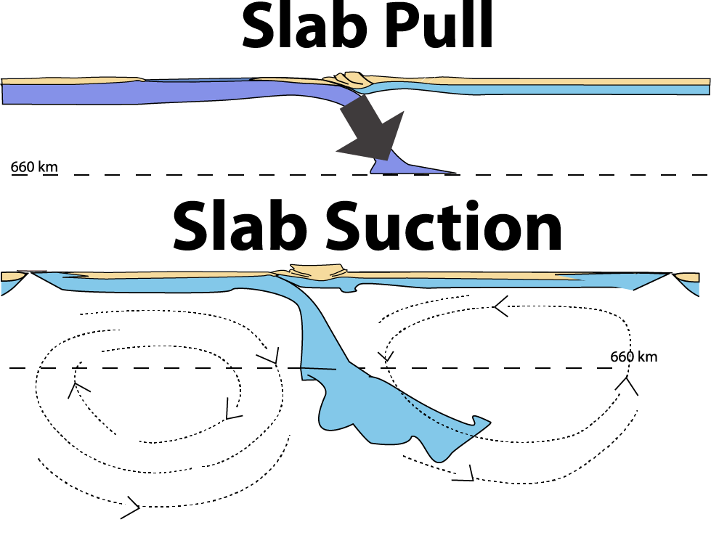
Plate driving forces
Asymmetric, strong slab
Symmetric, weak slab
cf. Conrad and Lithgow-Bertelloni (2002)

Slide 18
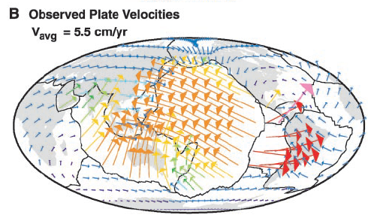
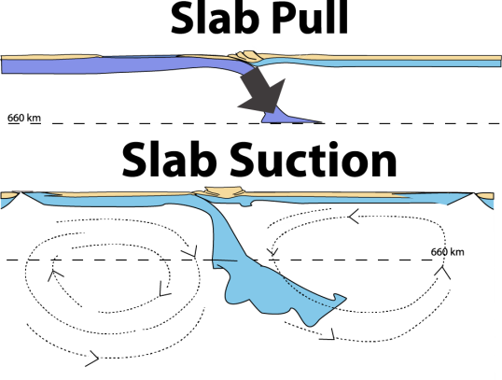
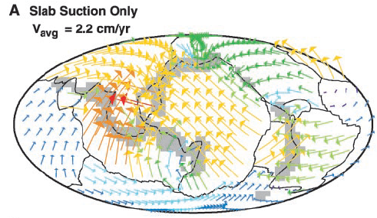
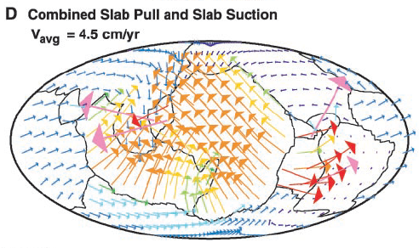

Plate speed vs. slab suction / slab pull
Conrad and Lithgow-Bertelloni (2002)

Slide 19
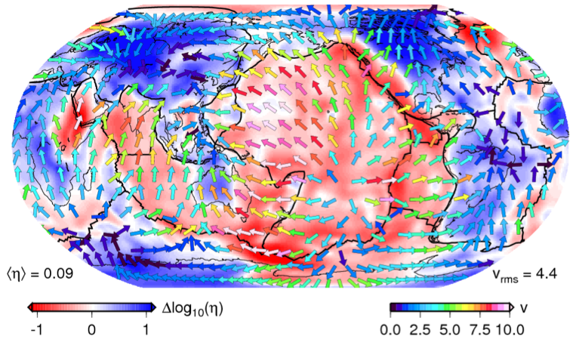
Plate speed vs. asthenospheric viscosity
viscosity and
velocity at 250 km
cf. Ricard et al. (1993); Zhong (2000)
Becker (2006)

Slide 20
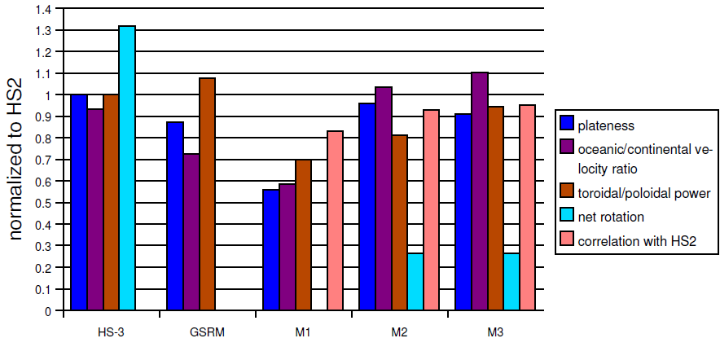
Prediction of plate scores with LVVs
tectonic
models
geodynamic
models
new hotspot
ref. frame
(HS3)
geodesy
model
(GSRM)
viscosity
depth
dependent
viscosity
temp.
dependent
dry
olivine
creep law
Becker (2006)

Slide 21
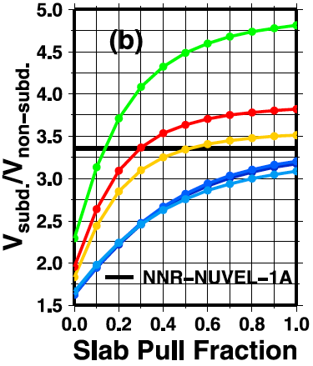


Asthenosphere vs. slab viscosity tradeoff
subducting/
non-subducting
plate speed
cf. Becker and O’Connell (2001); Conrad and Lithgow-Bertelloni (2002); Becker (2006)
van Summeren et al. (2012)

Slide 22
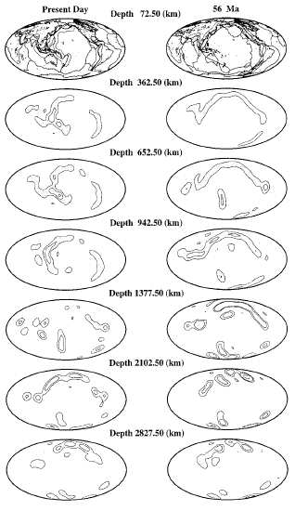
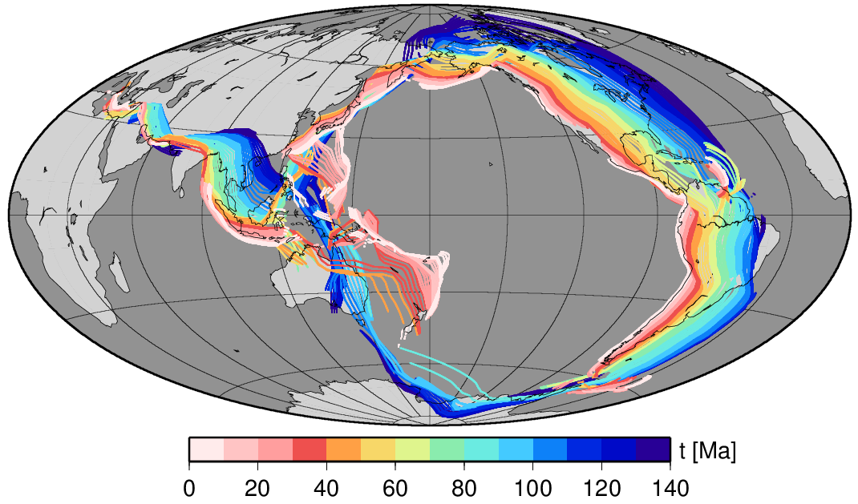
Mantle structure
as f(t) from subduction
Ricard et al. (1993); Lithgow-Bertelloni & Richards (1998);
Steinberger (2000); Spasojevich et al. (2009); Steinberger and Torsvik (2010)
Steinberger et al. (2014); Bower et al. (2015)

Slide 23
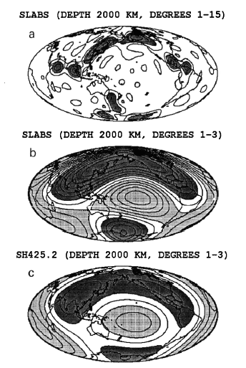
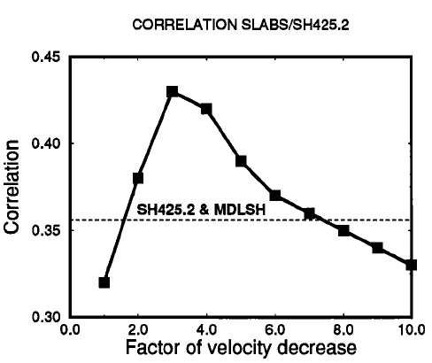
Correlation with tomography
Ricard et al. (1993)

Slide 24
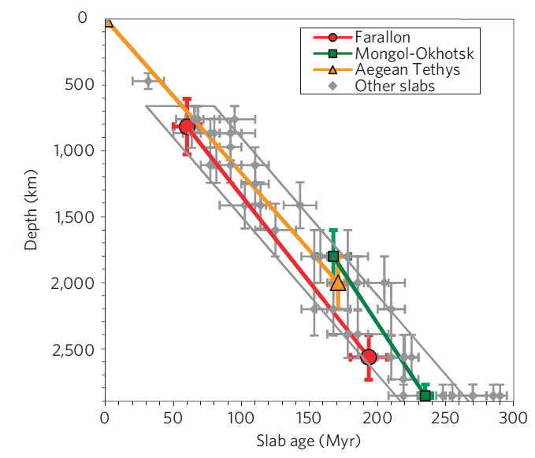
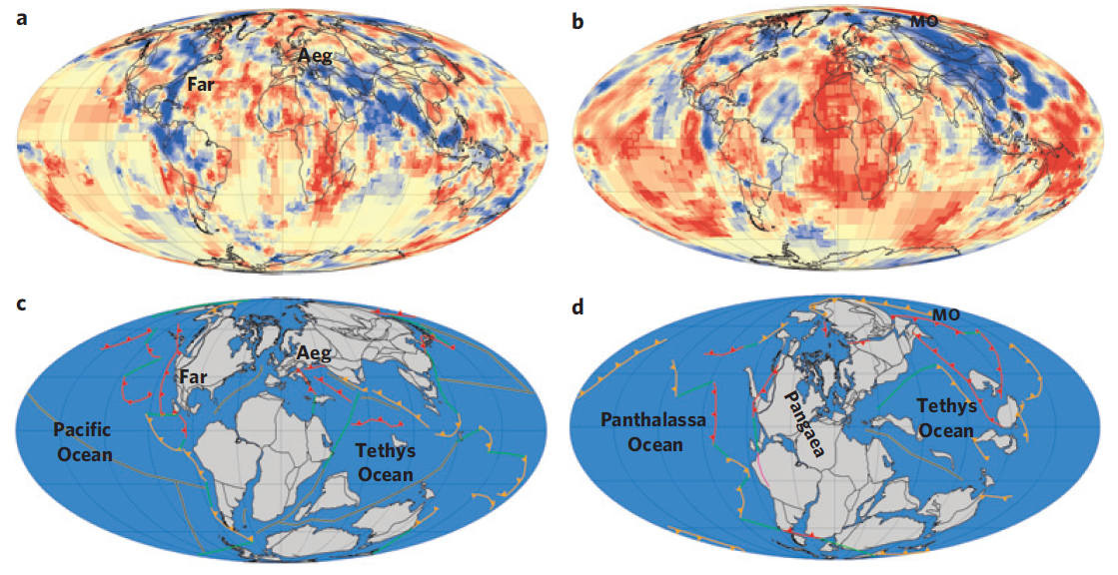
Possible reference frame for plate motions
250 Ma
van der Meer et al. (2009)

Slide 25
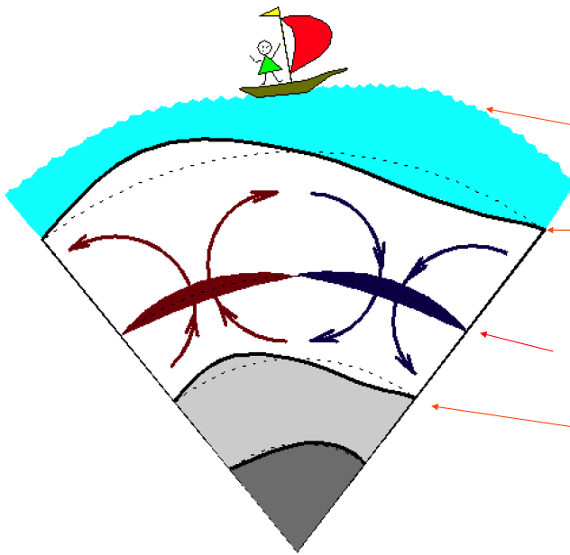
Geopotential and topography constraints
geoid
(-)
surface dynamic topography
(-)
(+)
load due to density anomaly
CMB topography
modified from Y. Ricard

Slide 26
Geoid
Non-elliptical geoid anomaly
Non-hydrostatic geoid anomaly

Slide 27
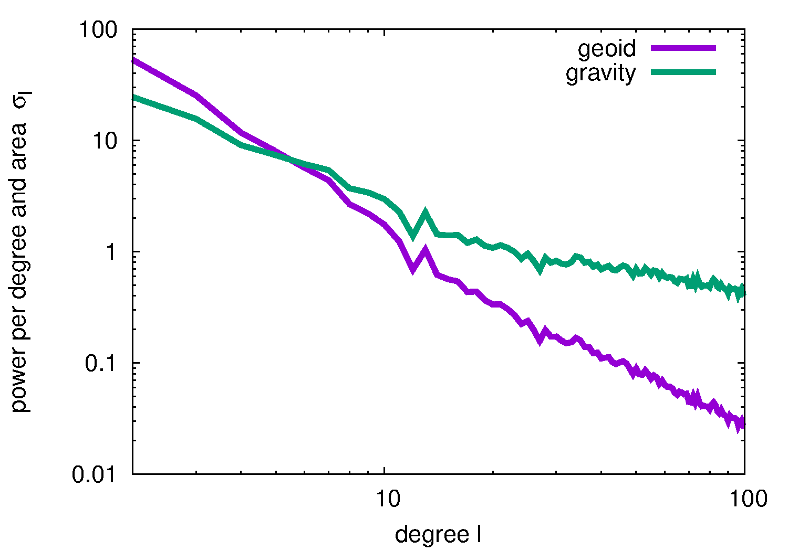


Slide 28
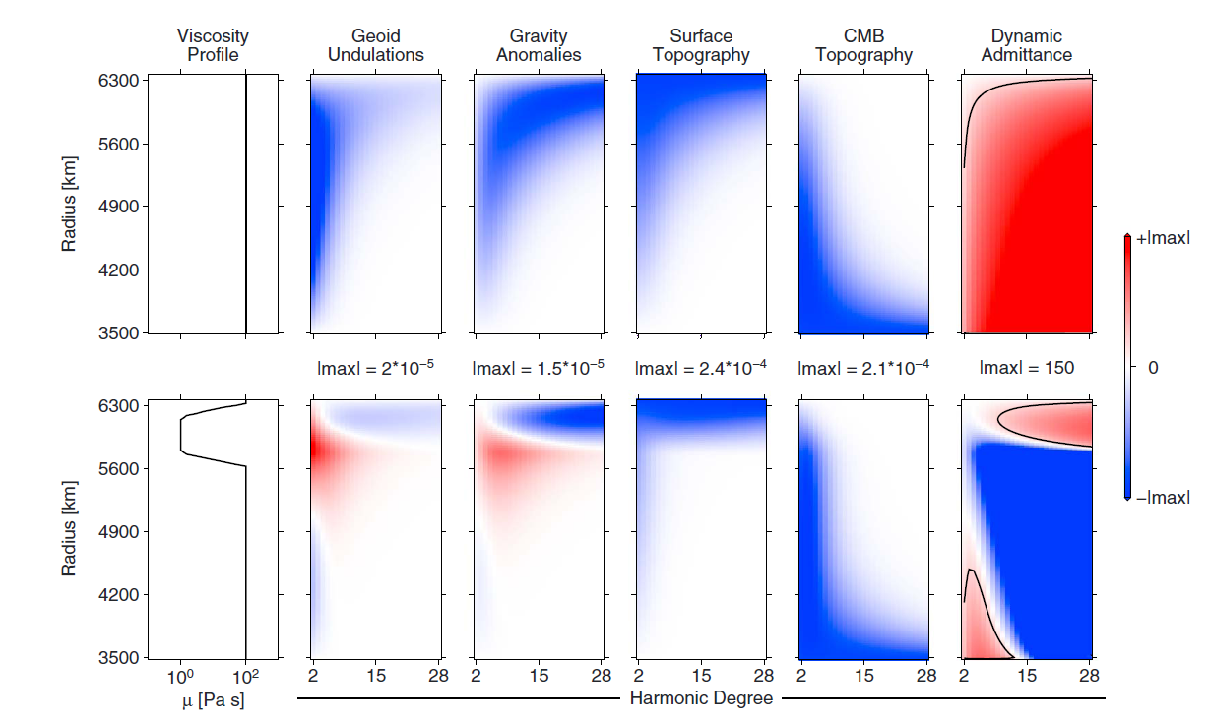
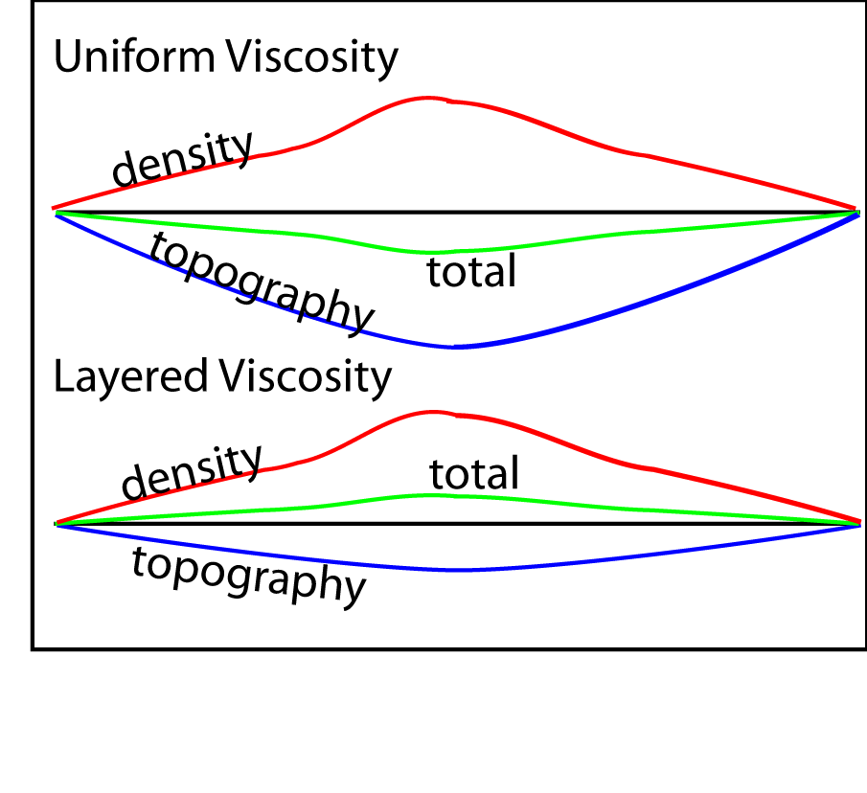
Let's fit the geoid:
Static effect of dense slablet
sketch from M. Billen's MYRES talk
cf. Hager & Richards (1984); Ricard (1984)

Slide 29
Combined static and dynamic
geoid effect of sinking slablet
sketch from M. Billen's MYRES talk
cf. Hager & Richards (1984); Ricard (1984)

Slide 30
Sensitivity kernels for homogeneous mantle
response to density
anomalies as f(z, l )
Colli et al. (2016), sketch from M. Billen
cf. Hager & Richards (1984); Ricard (1984)

Slide 31
Kernels for layered viscosity mantle
Layer 1
Layer 2
Colli et al. (2016), sketch from M. Billen cf. Hager & Richards (1984); Ricard (1984)

Slide 32
Dynamic topography and admittance kernels
admittance = surface topography/free-air gravity
Colli et al. (2016), sketch from M. Billen cf. Hager & Richards (1984); Ricard (1984)

Slide 33
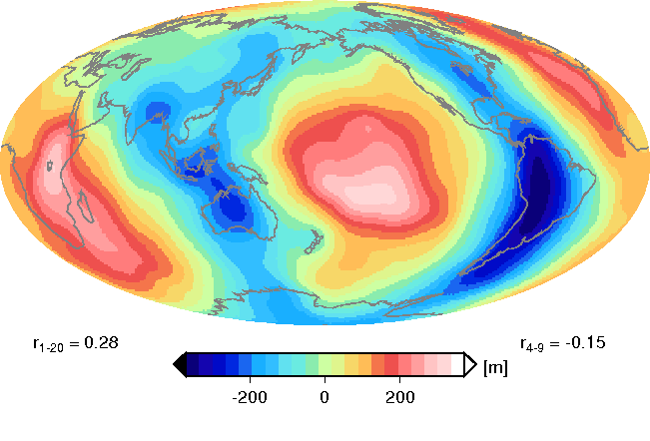
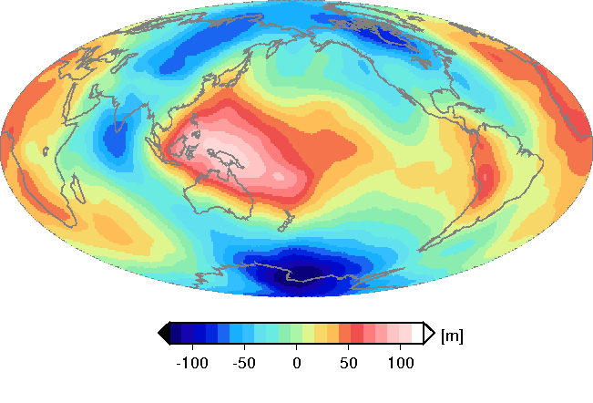
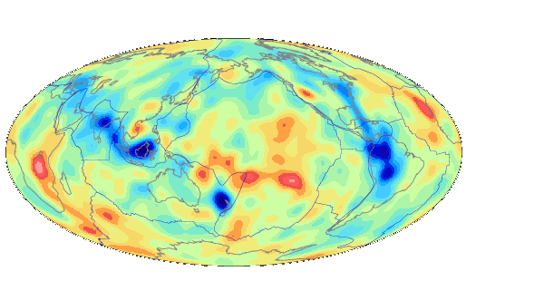
Geoid for tomography-driven flow
Isoviscous – free-slip surface boundary condition
geoid prediction
observed geoid
tomography @ 1200 km
Non-hydrostatic geoid

Slide 34
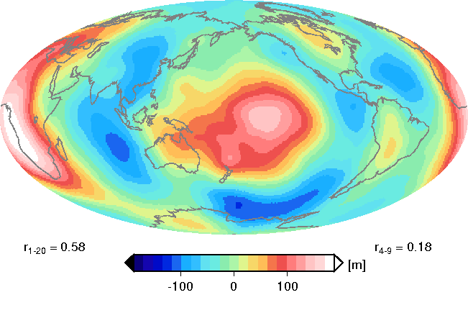
Geoid for tomography-driven flow
lower mantle viscosity increase
geoid prediction
observed geoid
tomography @ 1200 km
Non-hydrostatic geoid

Slide 35
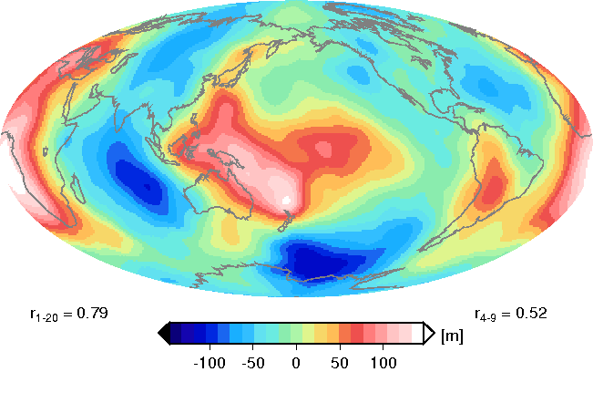
Geoid for tomography-driven flow
(cf. SEATREE/UGESCE)
Four-layer model with viscosity increase in lower mantle
geoid prediction
observed geoid
tomography @ 1200 km
Non-hydrostatic geoid

Slide 36
Surface topography

Slide 37





Isostasy
crust, ρ_{c}
l_{c}
L
mantle
lithosphere, ρ_{l}
l_{l}
ridge
reference
asthenosphere
ρ_{a}
Airy : ρ const. (~continents)
Pratt: l const. (~oceans)
p = const. @ compensation level
Notes:
37

Slide 38
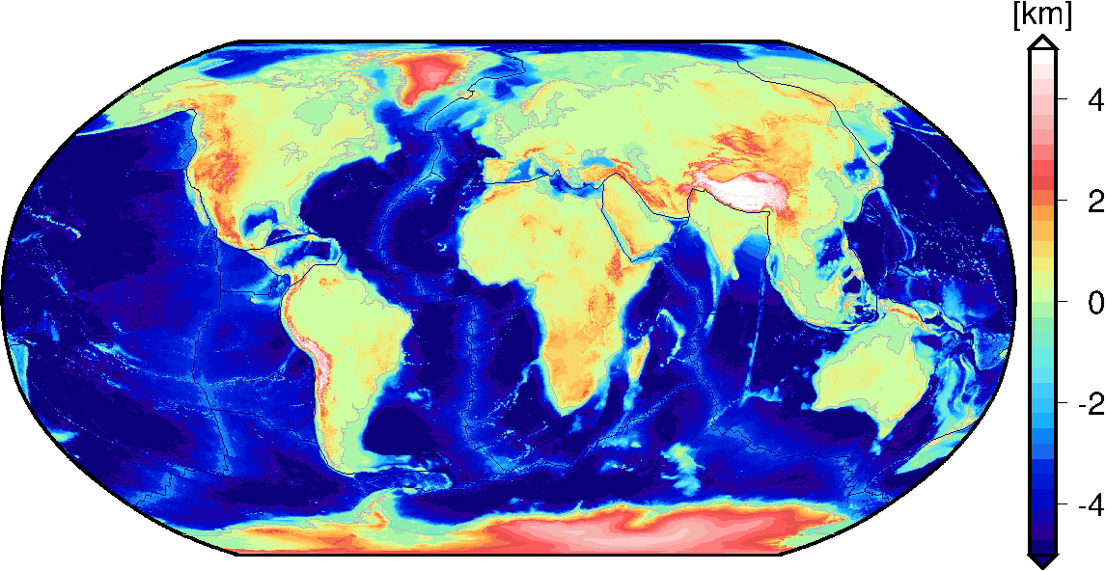
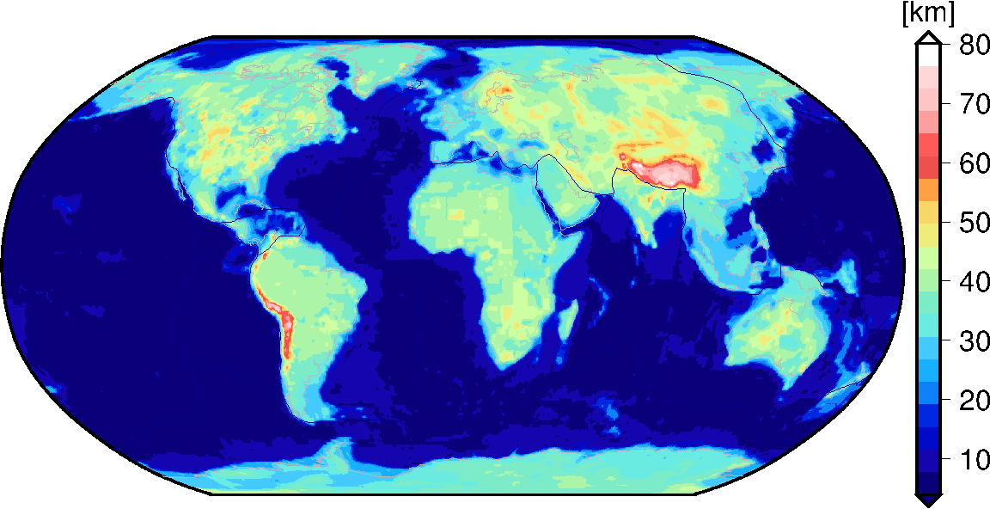
topography
crustal thickness
Note:
very uneven coverage.
active source best,
receiver functions next best thing
Laske et al. (2013)
Notes:
38
38
38
38
38

Slide 39
actual topography
observed topography [km]
crustal thickness
Laske et al. (2013)
effective crustal thickness [km]
Notes:
39
39
39
39
39

Slide 40
Residual (non-isostatic) topography
observed topography [km]
effective crustal thickness [km]
Notes:
40
40
40
40
40

Slide 41
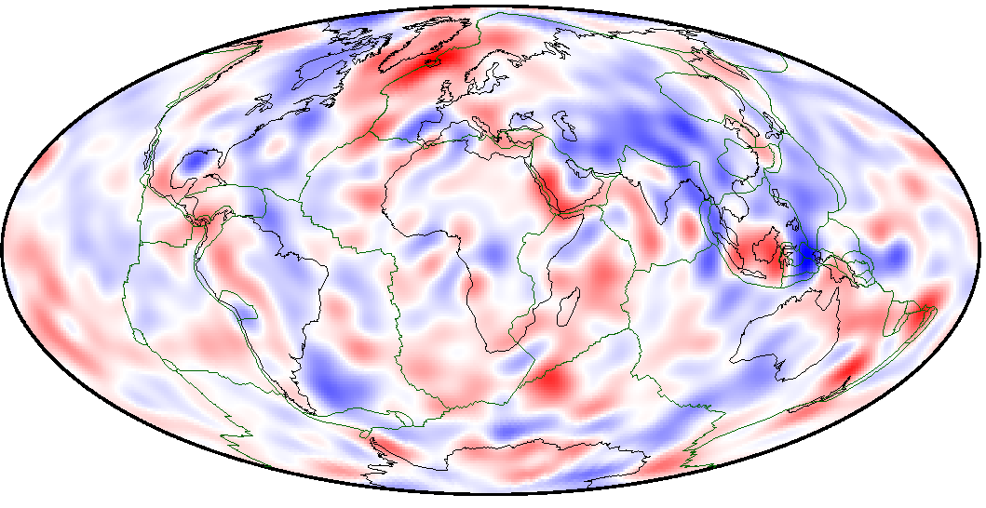
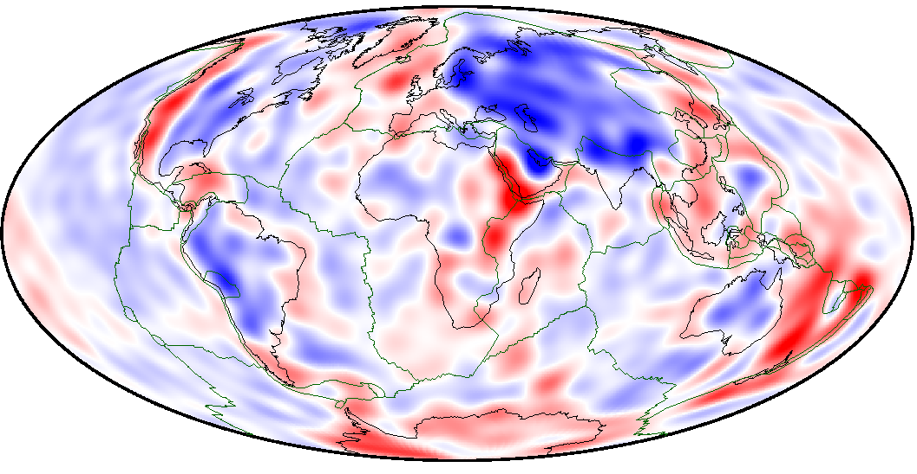
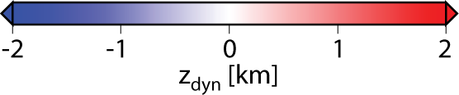
Hoggard et al. (2016)
Residual topography
models
crust for sparse, oceanic sites from active source,
corrected to ~plate model, continental areas from free-air
Steinberger (2016)
crust from CRUST1,
lithospheric model,
corrected for
half-space cooling

Slide 42


Match of dynamic topography from mantle
flow models to surface residual topography
with half-space cooling
without half-space cooling
Steinberger (2016)

Slide 43

Viscosity inversions (Monte Carlo approach)
based on geoid and dynamic topography
Panasyuk & Hager (2000)

Slide 44


Slab ponding and viscosity stratification in transition zone:
Mass transport over time across 660 unclear
cf. Fukao and Obayashi (2013)
Genetic algorithm inversion based on
geoid

Slide 45


Global, stochastic view on transition zone:
Radial correlation functions for seismic tomography models
Becker and Boschi (2011)
Boschi and Becker (2011)
cf. Puster and Jordan (1997),
Tackley (1998, 2002)

Slide 46
Query seismic data for discontinuity depth
Becker and Boschi (2011)
Boschi and Becker (2011)
cf. Puster and Jordan (1997),
Tackley (1998, 2002)

Slide 47


Upper mantle seismic anisotropy as a constraint:
Lattice Preferred Orientation of sheared olivine
Long and Becker (2010)
Here, focus on azimuthal anisotropy, but radial anisotropy underused.

Slide 48


SA APM vs. surface wave anisotropy at 200 km
Long and Becker (2010)
fast azimuth of tomography
model (absolute plate motions)
angular misfit
good
bad
absolute plate motions (APM) are overall aligned with fast axes from anisotropy in the asthenosphere, but there are some non-physical deviations
Becker et al. (2014, 2015)

Slide 49


Can we do better?
Castelnau et al. (2009)
Spreading aligned APM
LPO from mantle flow
fast azimuth of tomography
model (absolute plate motions)
fast azimuth of tomography
model (LPO from flow)
good
bad
More intuitive misfit patterns for LPO? Reorientation of fabrics, different LPO types?
Becker et al. (2014, 2015)

Slide 50

LPO from flow slightly better model than APM on global scales
NNR APM
SA APM
bad
good
average oceanic
plate misfit
Becker et al. (2003, 2015)

Slide 51
Disruption of plate shear as f(viscosity)
SL2013SV
asthenosphere
uber-asthenosphere
YB13SV
Becker (2017)

Slide 52
Match to plate velocities and anisotropy
consistent
best fit
sweet spot of oceanic asthenosphere being weaker than upper mantle, but not too weak
∃trade-off between thickness and strength
consistent
best fit
Becker (2017)

Slide 53
Earthquake constraints for slab and mantle viscosity
Alpert et al. (2010)
cf. Isacks and Molnar (1971)

Slide 54


Circulation model predictions for slab stresses
weak slab
strong slab
Alpert et al. (2010), cf. Vassiliou and Hager (1988), Alisic et al. (2010)

Slide 55

Summed gCMTs (in-slab projection)
Bailey et al. (2012)
compression extension

Slide 56

Predictions from global flow model with viscosity increase
cf. Vassiliou and Hager (1998), Billen and Gurnis (2003), Alisic et al. (2010), Alpert et al. (2010)
Bailey et al. (2012)
compression extension

Slide 57

Correlation: Advected slabs vs. tomography
Becker & Boschi (2002)
Lithgow-Bertelloni & Richards (1998); Steinberger (2000); Bunge & Grand (2000); Spasojevic & Gurnis (2009); Steinberger et al. (2010)

Slide 58
Geodynamic modeling update:
Convected slabs and plumes vs. tomography
cf. Steinberger et al. (2010)
Mao and Zhong (2019)

Slide 59


What about plumes?
Steinberger and O'Connell (1998)
Steinberger and Arntretter (2006)
Boschi et al. (2007, 2008)

Slide 60

Advected plumes vs. tomography
(Steinberger flow model conduits)
Note: Correlation with moving plumes better than with slabs
Boschi et al. (2007, 2008)

Slide 61




Input
Output
Is it resolution?
An a priori mantle model
increase
in CMB
heat flow
more
plumes
← depth

Slide 62

Input
Output
Resolving power of
global seismic tomography
← depth
Note: can resolve structure up to degree ~15
Nataf & Ricard (1993); Megnin et al. (1997); Boschi (2003); Ritsema et al. (2007)

Slide 63

Inter tomography-model correlation
Note: data and theory matter
Auer (2016)

Slide 64

Plate kinematics, slab rheology, and transition zone dynamics
Bower et al. (2014)

Slide 65

reconstructed seafloor age
hot temperature
isosurface
dense chemical
piles
time
Olson et al. (2016)
cf. McNamara and Zhong (2005) and many others
Seton et al. (2012)

Slide 66

reconstructed seafloor age
magnetic field
strength (B_{r}(CMB))
CMB heat flow
time
Seton et al. (2012)
Olson (2016)

Slide 67




Inversions for lateral viscosity variations
inverse
temperature
dependence
of viscosity
Yang and Gurnis (2016)

Slide 68




BEAMs stabilizing conveyor belts?
cf. Manga (1996), Becker et al. (1999)
Ballmer et al. (2017)
Notes:
68

Slide 69
Additional slides

Slide 70

Power of CMTs (F-Net)
dip of Wadati-Benioff
(double) seismicity
compression extension
along-dip normal strain
from Kostrov summation
Becker (in prep), cf. Wei et el. (2017)

Slide 71



Rigid plate motions for weak boundaries
Note: Can construct plate motion
interaction matrix P, for any LVVs
cf. Ricard and Vigny (1989), Forte (1993), van Summeren et al. (2010)

Slide 72


Plate motion models ~work
plate motions
mantle flow model prediction
Faccenna et al. (2013)
e.g. Ricard and Vigny (1989); Lithgow-Bertelloni and Richards (1998); Becker and O’Connell (2001); Ghosh et al. (2010); Forte (2015)

Slide 73
Davies et al. (2019)

Slide 74





Plate boundaries
matter...
cf. Ricard and Vigny (1989), Forte (1993),
King and Hager (1990), Gable et al. (1991), Han and Gurnis (1999)
Alisic et al. (2012)

Slide 75


How to convert
tomography
to density
anomalies?
I. Take it from mineral
physics and
composition from…
Stixrude and Jeanloz (2009)

Slide 76



II. Best-fit scaling
and composition as
inverse problems
cf. Simmons et al. (2008, 2010),
Soldati et al. (2014), Forte et al. (2015)

Slide 77

Adding edge forces to basal shear from flow
Correlation between model and
observed plate motions
Slab models
S wave models
P wave models
Ridge push/
GPE
Slab pull
Slab suction
Becker & O'Connell (2001)
Ricard & Vigny (1989); Lithgow-Bertelloni & Richards (1998); Zhong et al. (2000); Becker & O'Connell (2001); Conrad & Lithgow-Bertelloni (2002); Becker (2006)

Slide 78

Becker & O'Connell (2001)

Slide 79

Becker and O'Connell (2001)

Slide 80

Gravitational potential energy
Becker and O'Connell (2001)

Slide 81

Becker and O'Connell (2001)

Slide 82

Geodynamic reference
LPOs from mantle flow matches different seismological models
Convergence in structure mapped by surface wave inversions for azimuthal anisotropy
different seismological models

Slide 83


Use anisotropy to explore:
Tests for decoupling layer
reference viscosity model
black sticks = tomography model
white sticks = model prediction
decoupling viscosity model
Becker et al. (2003)

Slide 84

Becker et al. (2014), using SL2013SV

Slide 85

using Debayle et al.'s (2015) model

Slide 86

What about time dependence?
average global
misfit
Mueller et al. (2016)
Becker et al. (2003)
good
bad

Slide 87

Asthenosphere LPO from plate-driven flow
150 km
ξ_{c} = 0.75
SL2013SVA model

Slide 88

Asthenosphere LPO from plate-driven flow from 60 Ma reconstruction
150 km
Mueller et al. (2016)
ξ_{c} = 0.75
cf. Becker et al. (2006)

Slide 89

Lithosphere compared to LPO from steady-state, plate-driven flow
50 km
ξ_{c} = 1.5
SL2013SVA model

Slide 90

Lithosphere compared to LPO from plate-driven flow from 60 Ma reconstruction I
50 km
Mueller et al. (2016)
ξ_{c} = 1.5
cf. Nishimura & Forsyth (1989), Smith et al. (2004)
Debayle & Ricard (2015), Becker et al. (2015)

Slide 91

Lithosphere compared to LPO from plate-driven flow from 60 Ma reconstruction II
50 km
Seton et al. (2012)
ξ_{c} = 1.5

Slide 92

Oceanic domain
misfit for steady-state
and time-variable
plate induced flow
M16: Mueller et al. (2016)
S12: Seton et al. (2012)
bad
good
average global
misfit

Slide 93



Correlation with observed geoid
Geoid and
LVVs
0 < L < 20
Geoid
Free slip surface
Four layer viscosity (not optimized)
SMEAN tomography
Surface velocities with
viscosity in background
Observed geoid

Slide 94


Geoid and
LVVs
Geoid
Free slip surface
Weak zones, stiff keels
Surface velocities with
viscosity in background
Observed geoid

Slide 95

Yield stress control
100 MPa
150 MPa
200 MPa
250 MPa
Mallard et al. (2016)
cf. Tackley (2000a,2000), Richards et al. (2001),
van Heck and Tackley (2008), Foley and Becker (2009)
But: effect of asthenosphere, internal vs. bottom heating, Ra #,
continents, and damage/memory

