Slide 1


An introduction to
Mantle Convection
Thorsten W. Becker
Jackson School of Geosciences
The University of Texas at Austin
Internal Earth Doctoral Training
Barcelonette, France
October 14, 2019

Slide 2

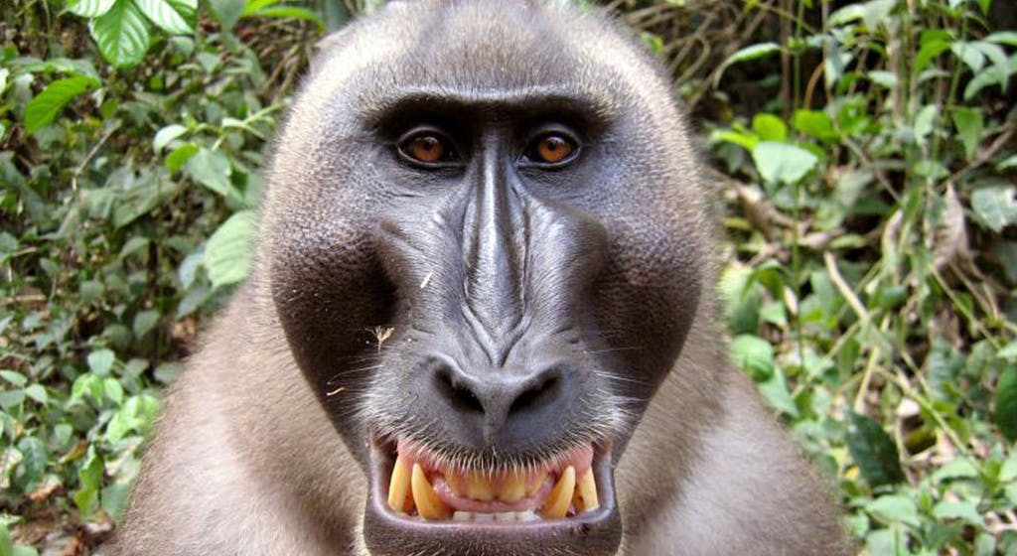
Continuum approximation

Slide 3
Heat transport: Conduction
Heat flux
[q] = W/m²

Slide 4
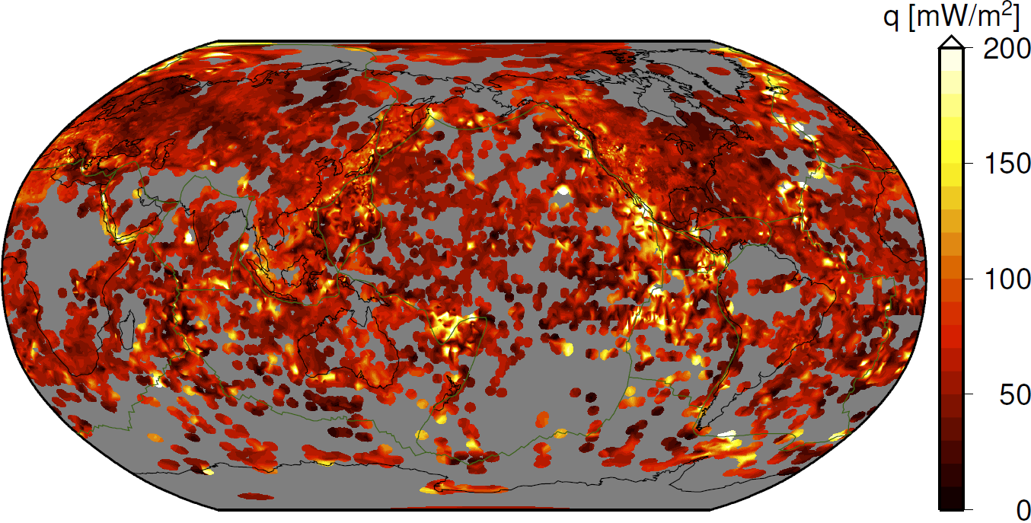
Heat flow measurements

Slide 5
Heat budgets
Oceans
q _{average} = 94 mW/m², corrected for hydrothermal circulation
Total ~32·10¹² W
(~60% area, ~70% heat)
Continents
q _{average} = 65 mW/m²
Total 14·10¹² W
(~40% area, ~30% heat)
Total surface heat loss
~46 TW
10 - 15% from crust
85 - 90% from mantle

Slide 6
Conservation of energy

Slide 7
Change of heat budgets in test volume

Slide 8
Heat budgets

Slide 9
Heat budgets

Slide 10

Internal and gradient change
$$mc_{p}\frac{∂T}{∂t}=HAδz+\frac{∂}{∂z}k\frac{∂T}{∂z}δzA$$

Slide 11

Internal and gradient change
$$mc_{p}\frac{∂T}{∂t}=HAδz+\frac{∂}{∂z}k\frac{∂T}{∂z}δzA$$
$${ρc}_{p}\frac{∂T}{∂t}=H+\frac{∂}{∂z}k\frac{∂T}{∂z}$$

Slide 12
Internal and gradient change
$$mc_{p}\frac{∂T}{∂t}=HAδz+\frac{∂}{∂z}k\frac{∂T}{∂z}δzA$$

Slide 13
Conduction equation
thermal diffusivity (~10⁻⁶ m²/s)

Slide 14
Steady-state in 1-D
0

Slide 15
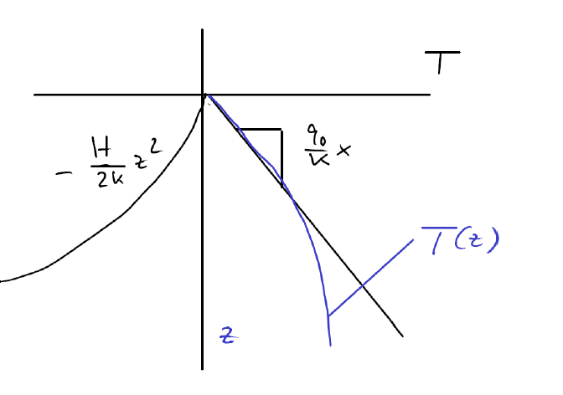
Crustal geotherms

Slide 16
Jaupart et al. (2007)

Slide 17
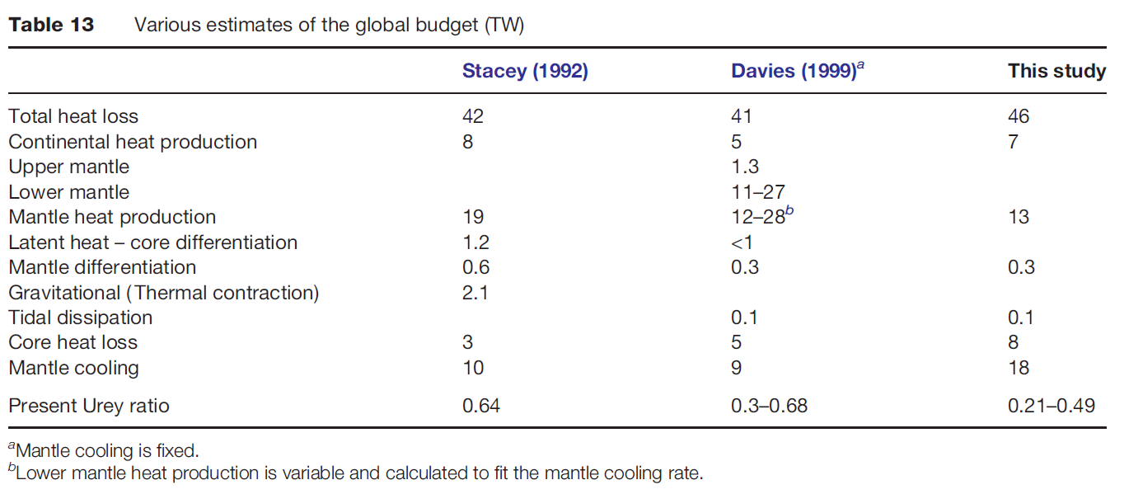
Jaupart et al. (2007)

Slide 18
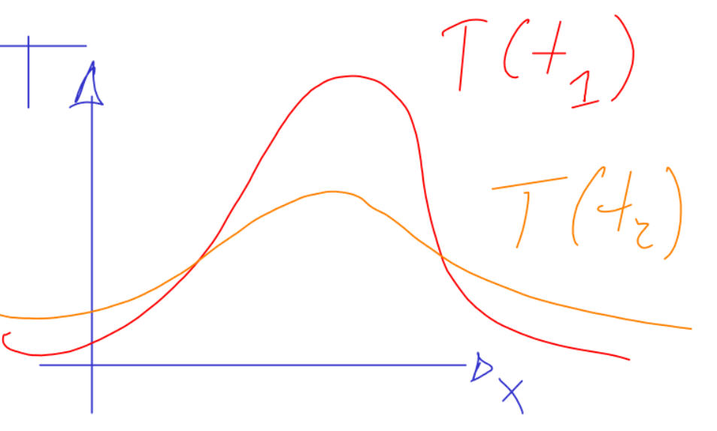
Time-dependence: Diffusion

Slide 19
Half-space cooling

Slide 20
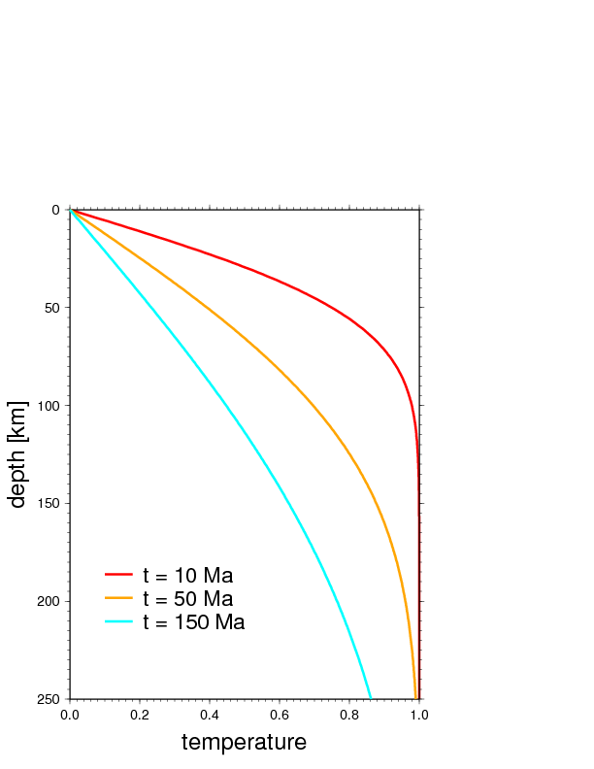
Half-space cooling

Slide 21

Half-space cooling
z_{T}
z_{T}
$$η_{T}={erf}^{−1}{(0.9)}$$

Slide 22
Diffusive scaling
[κ] = m²/s
l_{diff} ~ (t_{c}κ)^{1/2}
t_{diff} ~ (l_{c})²/κ

Slide 23
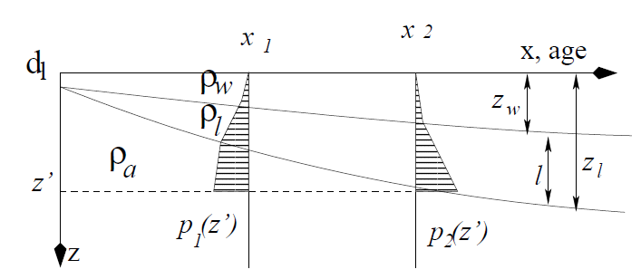
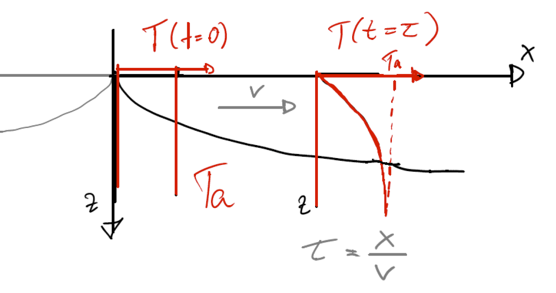
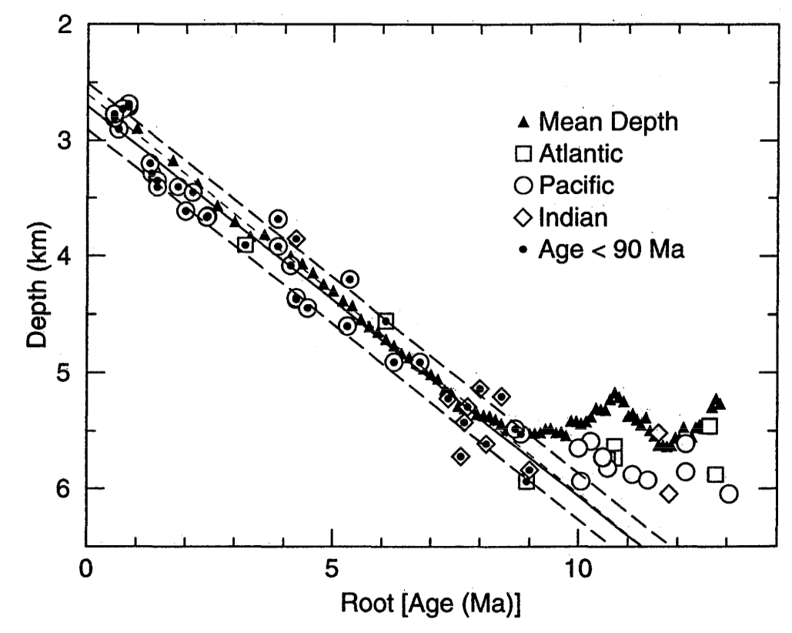

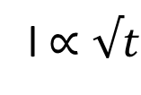
Half-space cooling applied to seafloor spreading
t = x/v
l $∝√t$
$$z_{w}∝√t$$
from isostasy
Carlson and Johnson (1994)

Slide 24
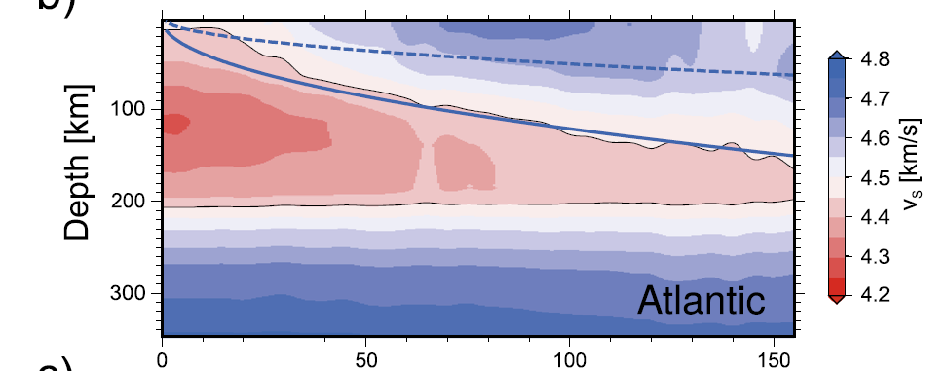
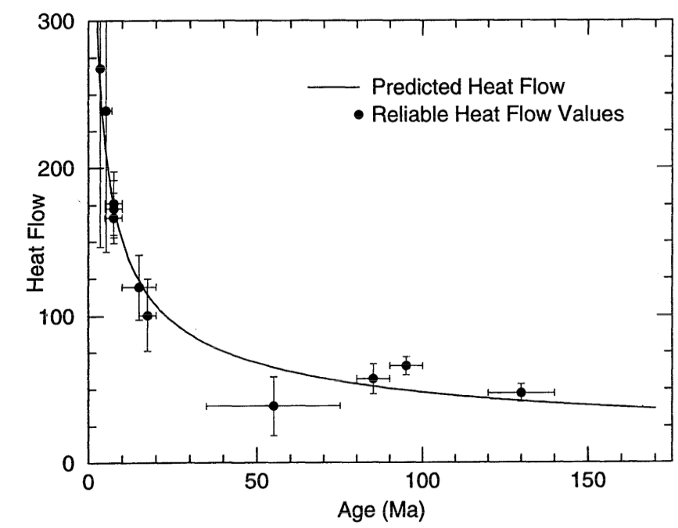
Half-space cooling ~explains
oceanic lithosphere
Auer et al. (2015)
Carlson and Johnson (1994)

Slide 25
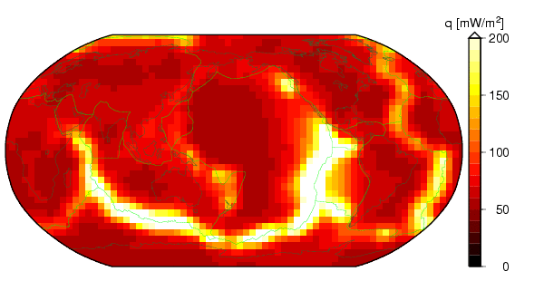
Global heat flow

Slide 26
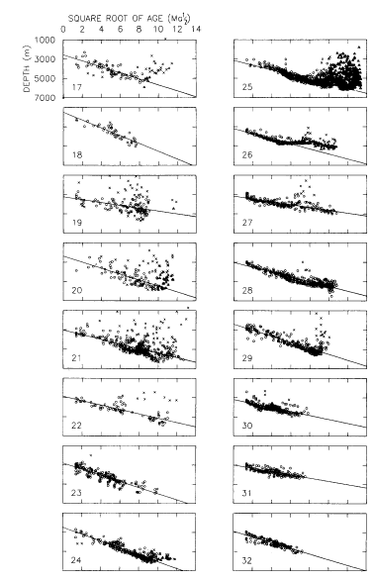
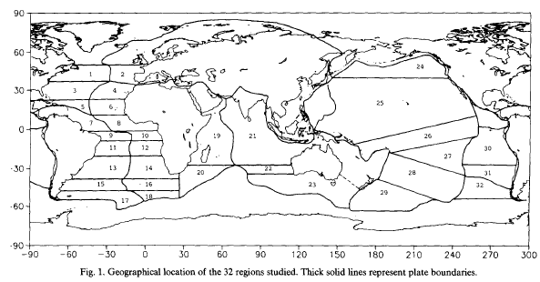
Regional deviations from
half-space cooling
Marty & Casenave (1989)

Slide 27
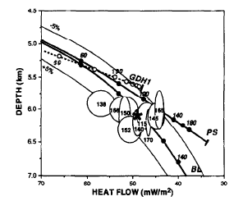
Reheating “explains” anomalously shallow and high heat flux sites in Pacific
Nagihara et al. (1989)

Slide 28
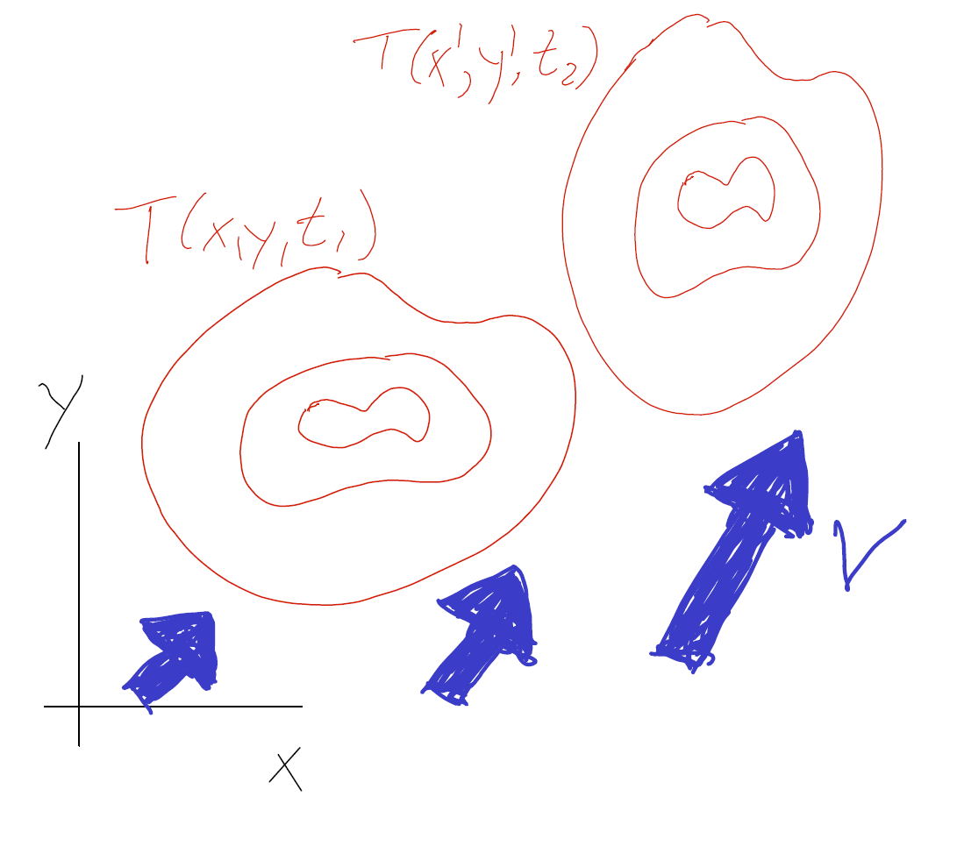
Allow for fluid motion

Slide 29
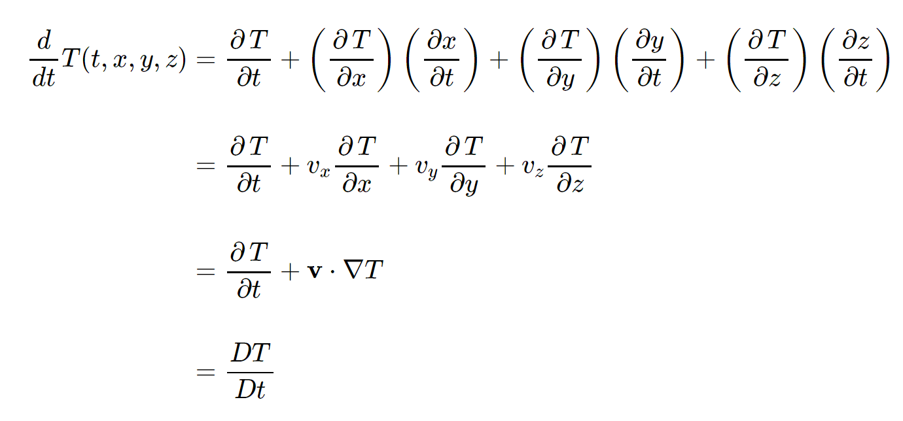
Eulerian (fixed reference frame) derivative

Slide 30
Eulerian derivative

Slide 31
Material derivative

Slide 32
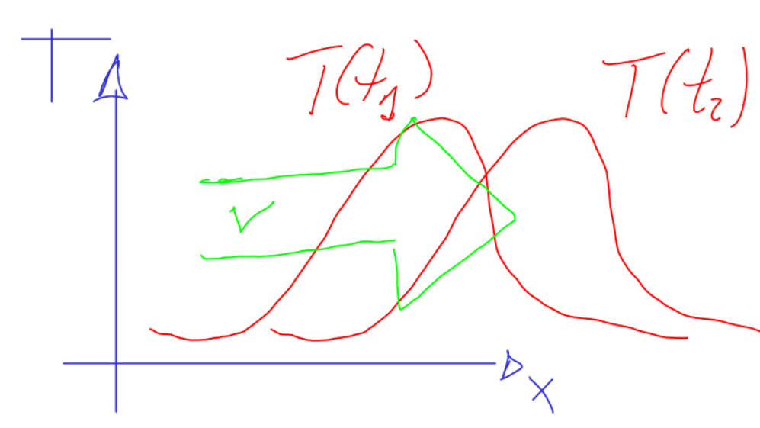
Convection: Advective and diffusive transport of heat
advection
diffusion
assume no heat
production for simplicity
time

Slide 33
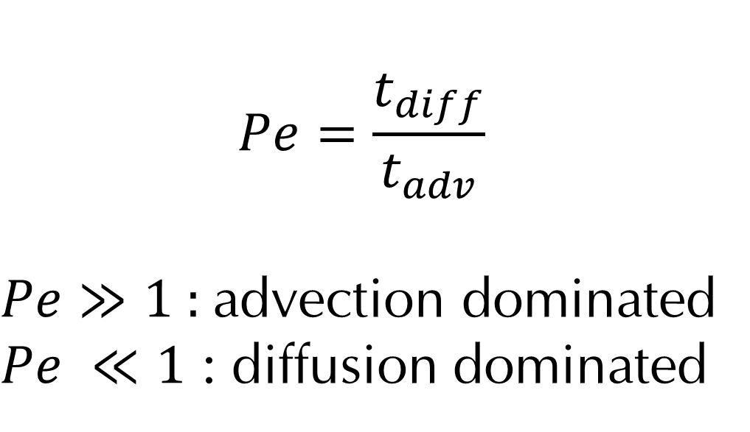
Peclet number describes importance of advection
$$Pe=\frac{t_{diff}}{t_{adv}}$$
$Pe≫1$: advection dominated
$Pe ≪1$ : diffusion dominated

Slide 34
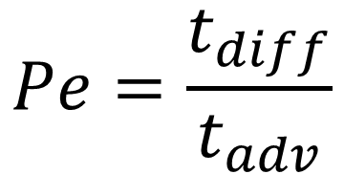

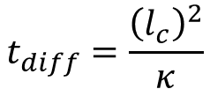
$$Pe=\frac{t_{diff}}{t_{adv}}$$
$$t_{diff}=\frac{{\left(l_{c}\right)}^{2}}{κ}$$
$$t_{adv}=\frac{l_{c}}{v}$$

Slide 35
Conservation equations
f = something/volume
F = flux = change of something per time per area
H = production (of something per volume per time)

Slide 36
Conservation: Gauss Theorem

Slide 37
Conservation: inertial reference frame and Gauss Theorem

Slide 38
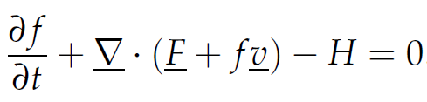
Volume independence

Slide 39

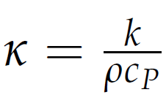
I) Conservation of energy

Slide 40

II) Conservation of mass
Incompressible

Slide 41


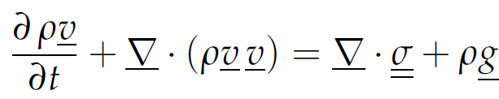
III) Conservation of momentum

Slide 42
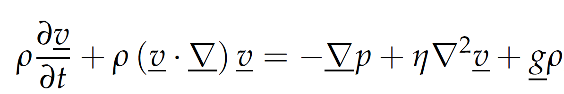
Conservation of momentum: Incompressible fluid
Navier-Stokes equation

Slide 43
Conservation of momentum:
Stokes equation
0
pressure
gradient
viscous
dissipation
body
force

Slide 44
Dense sphere sinking in fluid
static force balance: F_{drag} = F_{gravity}
F_{drag} = area × stress
F_{gravity} = mass × gravitational acceleration (g)
a
Δρ
η_{m}
v_{S}

Slide 45
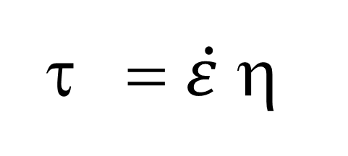
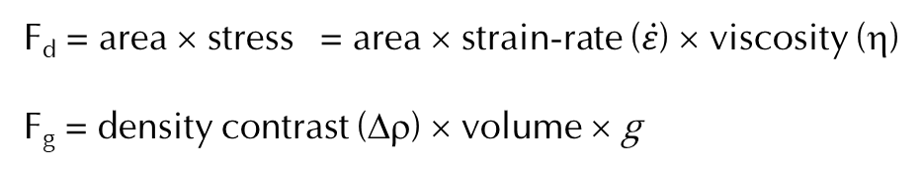
= $\dot{ε}$η
Constitutive law for fluid
F_{d} = area × stress = area × strain-rate ($\dot{ε}$) × viscosity (η)
F_{g} = density contrast (Δρ) × volume × g
a
Δρ
η_{m}
v_{S}

Slide 46
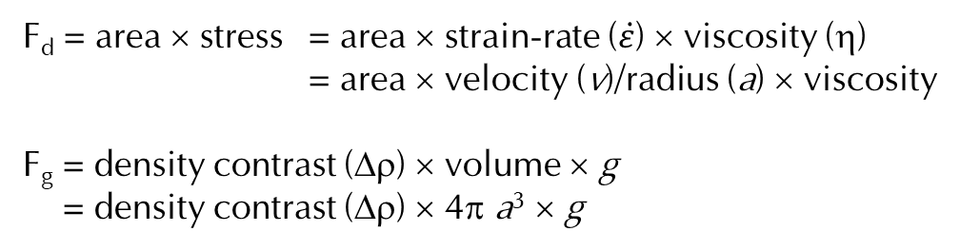
F_{d} = area × stress = area × strain-rate ($\dot{ε}$) × viscosity (η)
= area × velocity (v)/radius (a) × viscosity
F_{g} = density contrast (Δρ) × volume × g
= density contrast (Δρ) × 4π a³ × g
a
Δρ
η_{m}
v_{S}

Slide 47
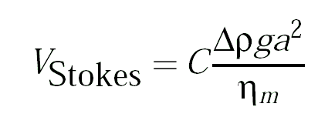
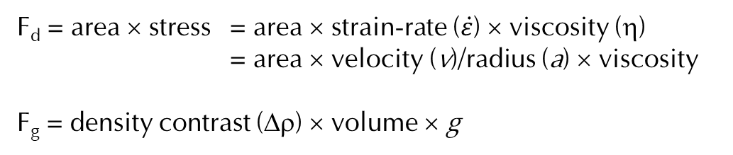
Stokes scaling
F_{d} = area × stress = area × strain-rate ($\dot{ε}$) × viscosity (η)
= area × velocity (v)/radius (a) × viscosity
F_{g} = density contrast (Δρ) × volume × g
a
Δρ
~
η_{m}
v_{S}

Slide 48
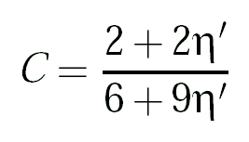
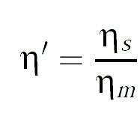
Stokes sinker velocity
a
Δρ
η_{m}
  A needle, as opposed to sphere, will sink with 0.5...2 v_{Stokes}
v_{S}

Slide 49
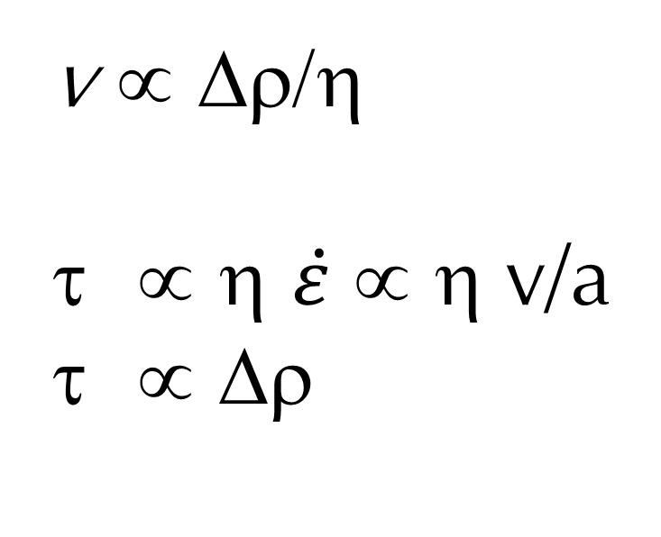
Flow stresses scale with density anomaly
v ∝ Δρ/η
∝ η $\dot{ε}$ ∝ η v/a
∝ Δρ

Slide 50
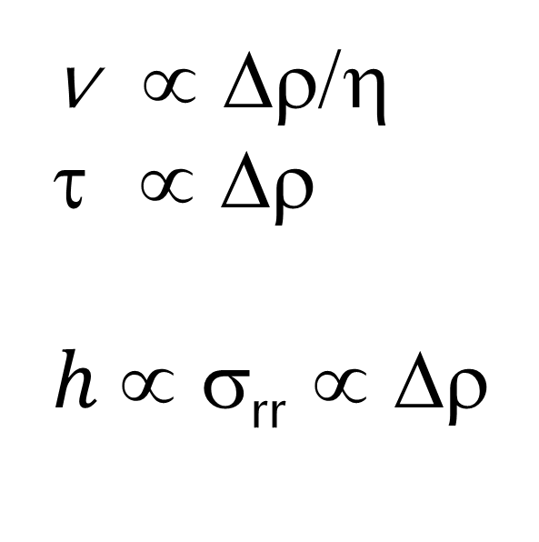
Density-driven dynamic topography h
h
v ∝ Δρ/η
∝ Δρ
$h$∝ σ_{rr} ∝ Δρ
σ_{rr}

Slide 51
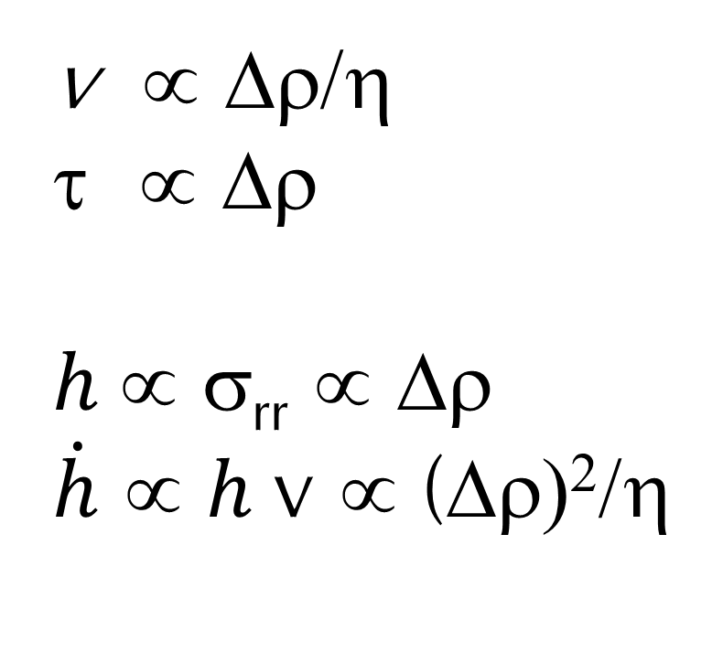
Topography and uplift rates
h
v ∝ Δρ/η
∝ Δρ
$h$∝ σ_{rr} ∝ Δρ
$\dot{h}$ ∝ $h$v ∝ (Δρ)²/η

Slide 52
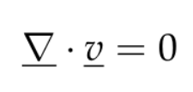
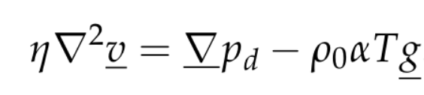
Mantle convection

Slide 53
Peclet number and thermal Stokes sinker
Δρ = ΔTαρ₀
ΔΤ
l_{c} = a
η_{m}
v_{S}

Slide 54
Rayleigh number: vigor of convection
for fluid heated from below
Δρ = ΔTαρ₀

Slide 55
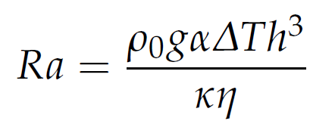
Rayleigh
Taylor
Instability

Slide 56
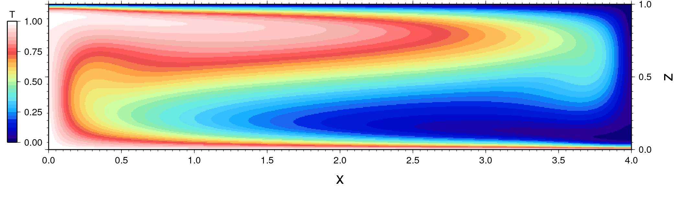
Finite amplitude
Rayleigh Benard convection @ Ra = 10⁵

Slide 57
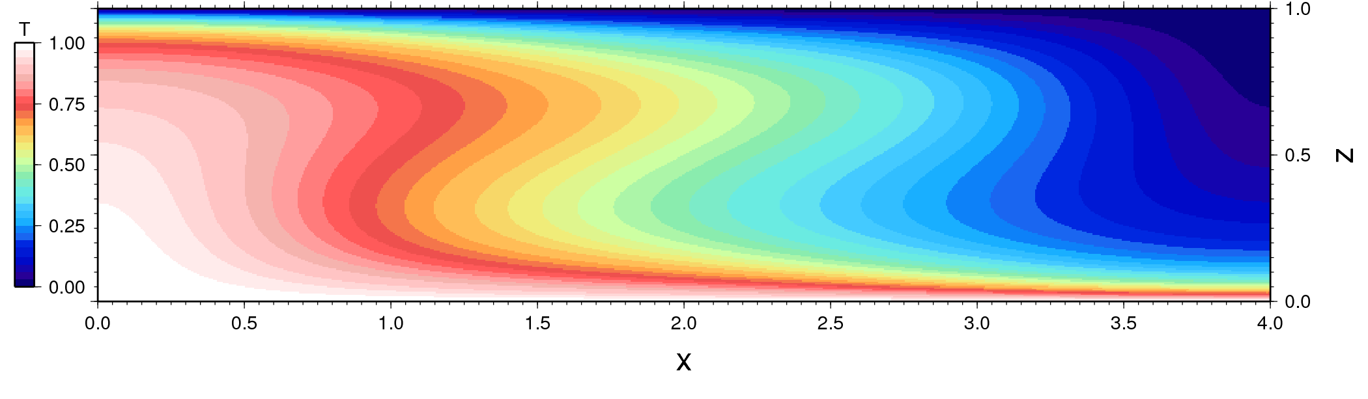
Ra = 10⁶

Slide 58

Ra = 10⁷

Slide 59
Computation by Allen McNamara

Slide 60
Finite amplitude boundary layer model
Oxburgh & Turcotte (1968)

Slide 61
Nusselt number: ratio of convective to conductive heat transport
aspect ratio
Oxburgh & Turcotte (1968)

Slide 62
Oxburgh & Turcotte (1968)

Slide 63
Numerical vs. scaling

Slide 64
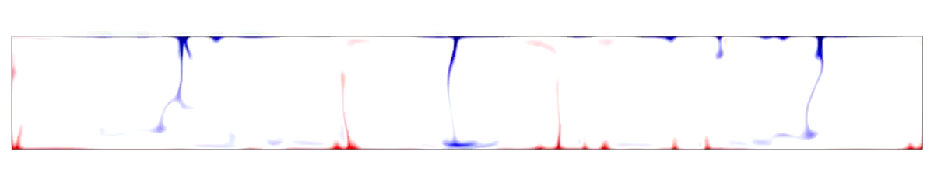
Ra = 10⁷, η’ = 0 η’ = viscosity contrast between hot and cold
computation by Allen McNamara

Slide 65
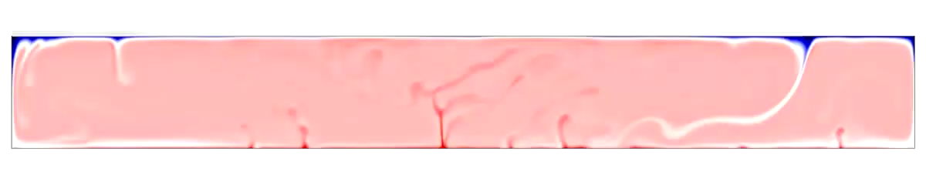
Ra = 10⁷, η’ = 1,000 η’ = viscosity contrast between hot and cold
computation by Allen McNamara

Slide 66

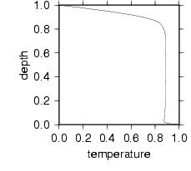
Ra = 10⁷, η’ = 100,000
η’ = viscosity contrast between hot and cold
computation by Allen McNamara

Slide 67
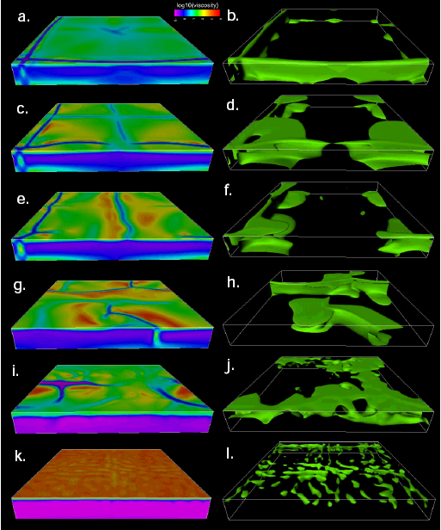
Plates: η(T) and σ_{y}
yield stress
Tackley (2000a)

Slide 68
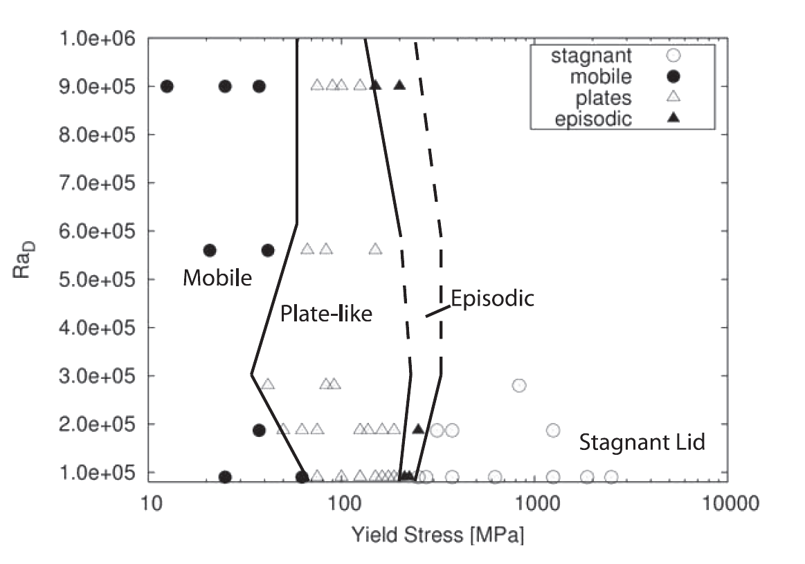
Visco-plastic yielding models make ~plates and slabs
Foley and Becker (2009), cf. van Heck and Tackley (2008)

Slide 69
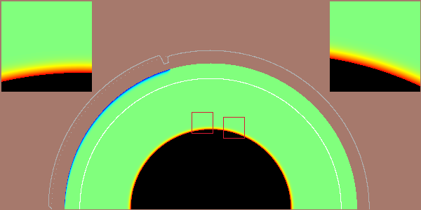
Phase transitions
Tan et al. (2003)

Slide 70
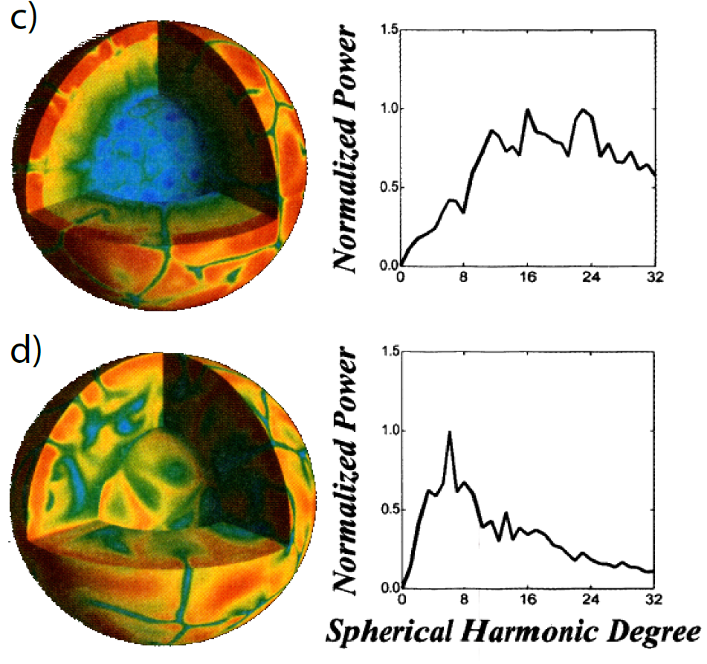
Effect of internal heating
phase change
high viscosity lower mantle
Bunge et al. (1997)

Slide 71
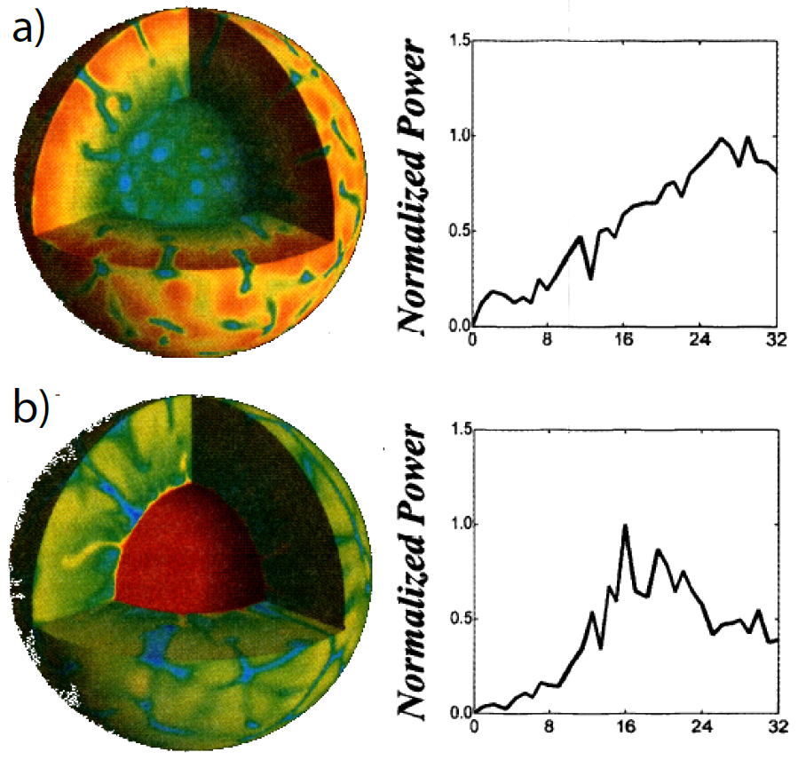
internally heated
bottom heating ~35%
Bunge et al. (1997)

Slide 72
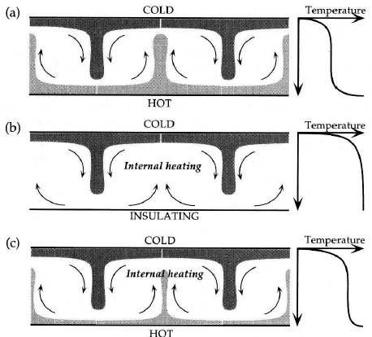
Davies

Slide 73



The geotherm: Mantle adiabat
Increase in temperature due to adiabatic compression
$$\left(\frac{ΔT}{ΔP}\right)={\left(\frac{ΔV}{ΔS}\right)}_{p}$$
Heat produced: ΔQ=VρC_{P}ΔT=TΔS
Change in volume: ΔV = αVΔT
In a hydrostatic fluid dp=ρgdz
adiabatic gradient with depth
$$\left(\frac{ΔT}{ΔP}\right)=\frac{αT}{ρC_{p}}$$
$${\left(\frac{∂T}{∂z}\right)}_{ad}=\frac{αgT}{C_{p}}$$

Slide 74



Estimating adiabatic temperatures
Gruneisen parameter
dimensionless
~ constant in mantle
$${\left(\frac{∂T}{∂P}\right)}_{ad}=\frac{γT}{K_{s}}$$
$${\left(\frac{∂T}{∂z}\right)}_{ad}=\frac{γgT}{φ}$$
Bulk modulus
(incompressibility)
K_{S} = ρ[∂P/∂ρ]_{S} = V[∂P/∂V]_{S}
$$\frac{dT}{T}=γ\frac{dρ}{ρ}$$
Seismic parameter
(bulk sound velocity²)
φ = K_{S}/ρ = V_{P}²-(4/3)V_{S}²
T=T₀(ρ / ρ₀)^{γ}
T₀ from T_{melt} basalts (mantle), iron (core)

Slide 75


Slide 76
van Thienen et al. (2003)

Slide 77

van Thienen et al. (2003)
Jaupart et al. (2007)

Slide 78

Hernlund et al.
In Jaupart et al. 2007

Slide 79


Lowrie (1997) after Stacey

Slide 80

Temperature anomalies

Slide 81

Thermo-chemical heterogeneity
McNamara & Garnero

Slide 82
Additional slides

Slide 83


Slide 84


Ra = 10⁷, η’ = 1,000, Η = 0
Ra = 10⁷, η’ = 1,000, Η = 20
Ra = 10⁷, η’ = 1,000, Η = 40
computation by Allen McNamara

Slide 85
Rayleigh Benard problem

Slide 86

Ra = 10⁷, η’ = 1,000, η_{lm}= 50
computation by Allen McNamara

Slide 87
Rayleigh Benard problem

Slide 88
Rayleigh Benard problem: Small amplitude

Slide 93

Rheology
Constitutive law links dynamics with kinematics: $τ$, $\dot{τ}$ = f($ε, \dot{ε}$, …)
Kohlstedt et al. (1995)

Slide 94
Elasticity
τ = G ε

Slide 95
τ = G ε
PREM
(do not
use)
ε = Δl/l
= 30 GPa × 5 m/100 km
Δτ = 1.5 MPa

Slide 96
Brittle/plastic failure

Slide 97
Mohr-
Coulomb theory

Slide 98
Byerlee stress limit: pore pressure factor λ

Slide 99
Dynamic mantle flow models:
forces due to density anomalies
stress tensor
body forces
e.g. buoyancy
Static force balance (conservation of momentum) in any continuum

Slide 100
Constitutive law for an incompressible, Newtonian fluid
dynamic
pressure
Newtonian
viscosity
conservation of mass
2 x strain-rate

Slide 101
Mantle is in the Stokes flow regime
Constitutive law for an incompressible, Newtonian fluid
Stokes equation for constant viscosity (neglect inertia, laminar)
buoyancy force
dynamic
pressure
gradient
viscous drag

